Slide 1
Dye-sensitized
Solar cell
2002-11971 박준모
2002-12009 배세영

Slide 2
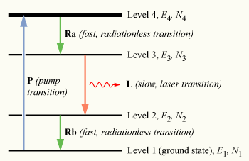
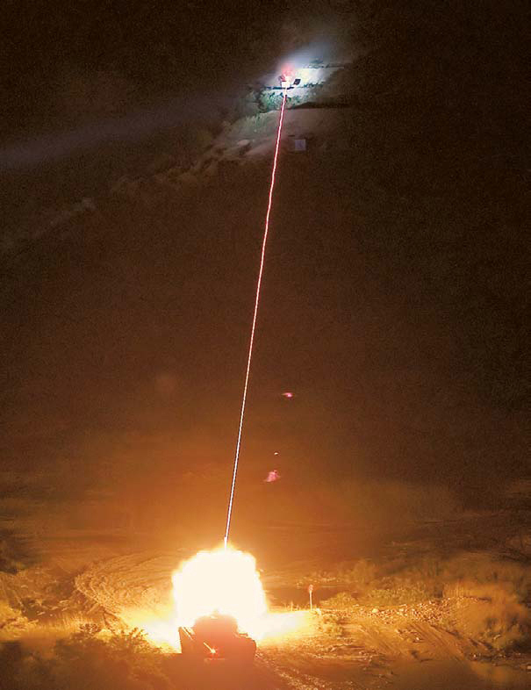
How did we get this topic?
Is there any reverse process?

Slide 3
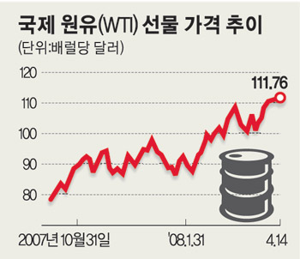
Necessity of SOLAR CELL
Limit of Natural Source
Increasing the price of oil
Solution for problems the we face

Slide 4
History of SOLAR CELL

Slide 5
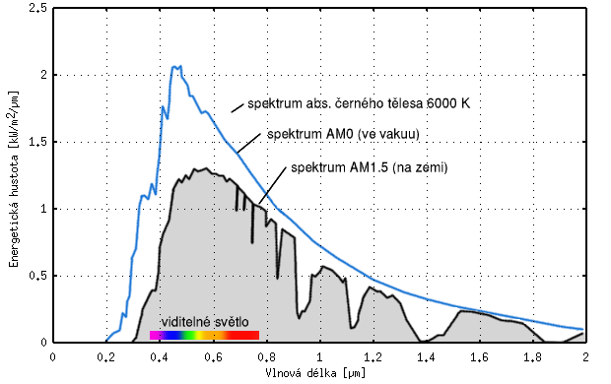
The Spectrum of Solar Energy

Slide 6
From now on, we are going to focus on DYE-SENSITIZED SOLAR CELL

Slide 7
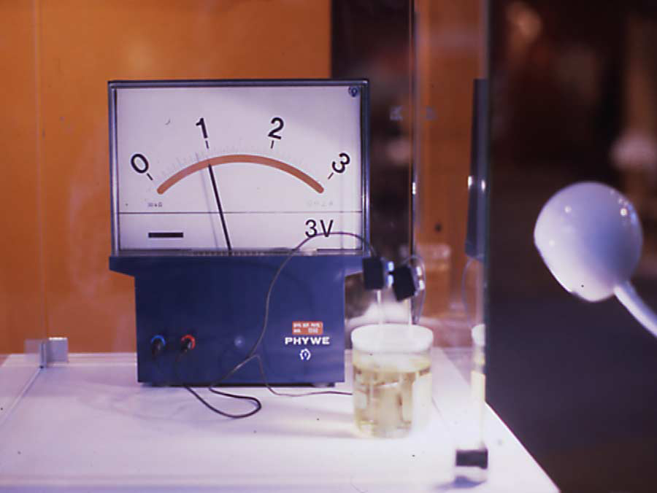
Why DSC?
Very low cost fabrication
Attractive features that
facilitate market entry
Good for everyone

Slide 8
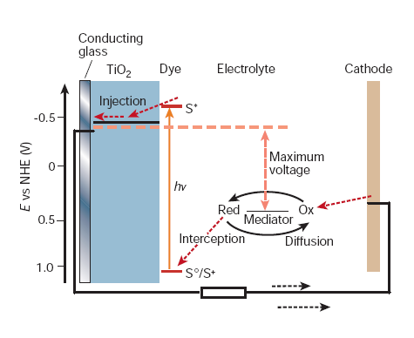
DSC Structure(overall)
Oxide
Semiconductor
Dye Sensitizer
Electrolyte

Slide 9
DSC Operation
-S+/S → S+/S*
-Electron injection to
conduction band of TiO₂
-e⁻ to counter electrode
via external load
-I₃⁻ + 2e⁻ → 2I⁻
-2I⁻ → I₃⁻ + 2e⁻ (to dye)

Slide 10
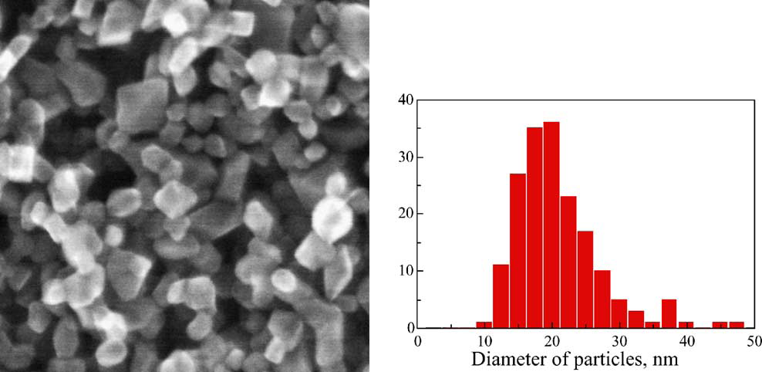
Material for DSC(Oxide Semiconductor)
Wide Band gap
Nanoporous structure
Low cost, non-toxic, biocompatible
Low porosity
M.Gratzel, Dye-sensitized solar cells,2003

Slide 11
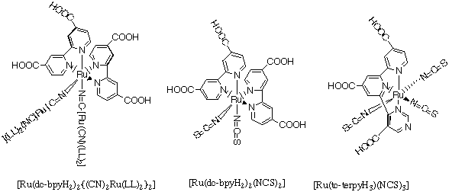
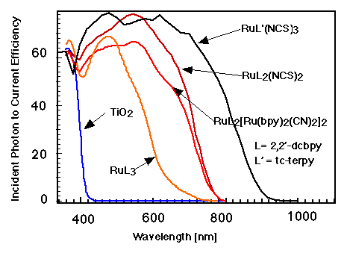
Material for DSC(Dye Sensitizer)
-Concrete bonding to TiO2
-Absorption of whole region of visible rays
-Should be stable optically and thermally

Slide 12
Material for DSC(Electrolyte)
Reduction & Oxidation
Provide electron to DYE
Platinum( Catalyst ) – related to the speed of electron while luminescence

Slide 13
Current Issue( Nanowire DSC)
Advantage
  -Rapid collection of
  carriers
  -Uniform electrolyte
  contact
Disadvantage
  -Surface area up to 1/5
  -Low efficiency(1.5% at
  full Sun)

Slide 14
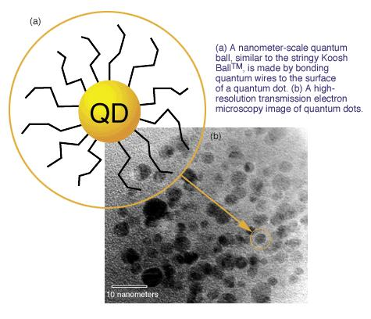
Current Issue(Quantum dot)
Zero-dimension structure
The absorption can be
adjusted by changing the
particle size
High extinction coefficient

Slide 15
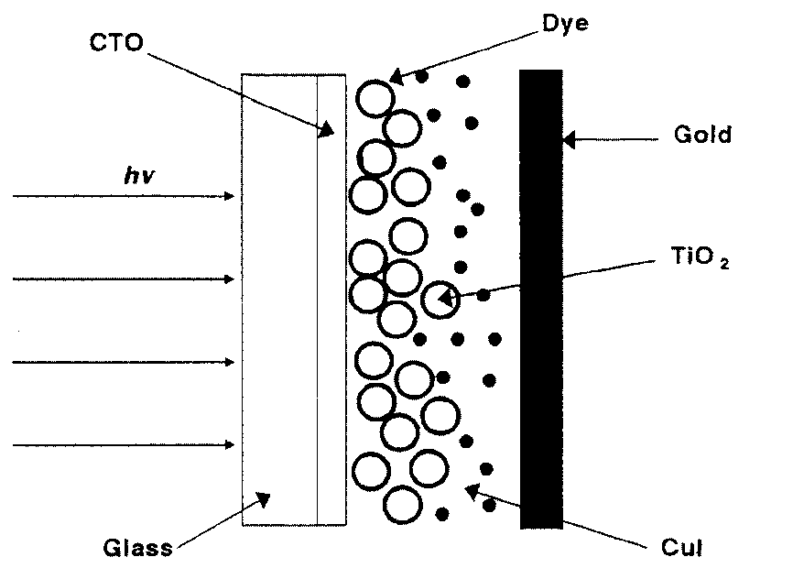
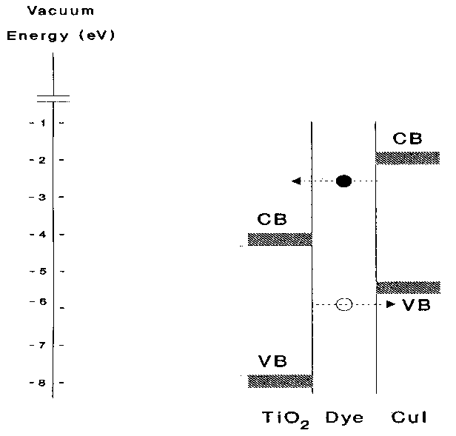
Current Issue(solid-state DSC)
-Liquid electrolyte →
transparent p-type
Semiconductor
-n-type TiO2 Dye p-type CuI
-Carrier Separation
D + hv → D*
D* → D⁺ + e⁻ (to CB of TiO2)
D⁺ → D + h⁺ (to VB of CuI)
-Low efficiency (4.6% at full
Sun)

Slide 16
Advantage of DSC
Insensitive to angle of incident
Low cost
Durability, Flexiblity
Able to produce transparently
→ Able to produce multi-layer cells
→ Improve the efficiency in same area

Slide 17
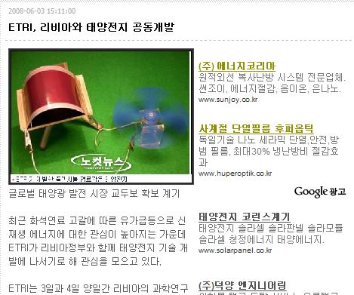
The present DSC technology in KOREA
KIST, ETRI, KERI
Able to mass produce 1st and 2nd generation SOLAR CELL
Lack of an infrastructure to produce 3rd generation SOLAR CELL

Slide 18
THE END
Thank you for your patience

