Slide 1
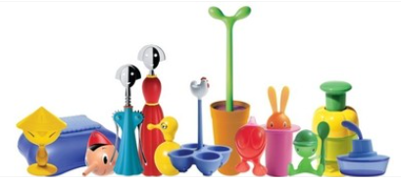
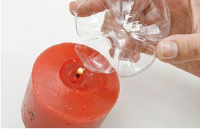
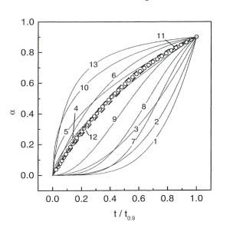
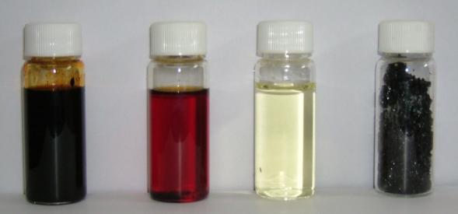
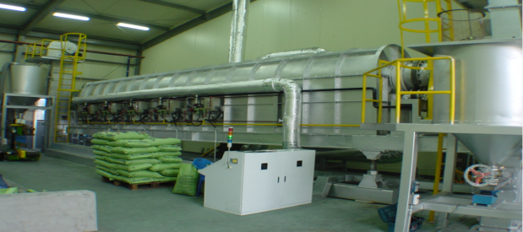
Polymer Pyrolysis
2014. 9. 23. SNU Presentation
Seungdo KIM, Professor/Director
Pyrolysis Research Laboratory
Hallym University

Slide 2
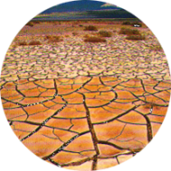
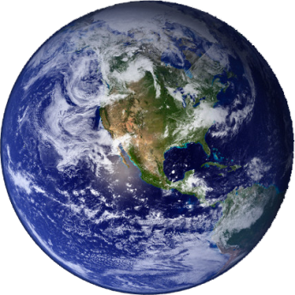
Contents
1. Introduction of Pyrolysis
2. Pyrolysis Mechanisms
3. Pyrolysis Kinetics
4. Pyrolysis Reactor Design

Slide 3
1. Introduction

Slide 4
Introduction: Definition of pyrolysis
Pyrolysis = Pyro + Lysis
Thermal cracking of polymers
into smaller molecules
Reverse Reaction
Polymerization

Slide 5
Introduction: Basic Principles
Attacking the weakest bond
Related to bond dissociation energy
C-C, C-H, C-O, C-Cl
More thermal energy input yields lower molecular weight compounds
Crashing walnut with hammer!

Slide 6
Introduction: Conceptual Reaction
Gases
(CH₄, C₂H₆)
No oxygen
Reduction
Endothermic
400~700℃
Polymers
Liquids
(Gasoline, Diesel)
Solids
(Carbon black,
Activated Carbon)
Energy Input

Slide 7
Design Target of Pyrolysis Reaction
Minimization of Energy Input
Maximization of Valuable by-products

Slide 8
2. Pyrolysis Mechanisms

Slide 9
Why pyrolysis mechanism is important?
Pyrolysis mechanism can elucidate PATHWAY to Valuable Products
Pyrolysis
Desirable Products
Polymers
Undesirable Products

Slide 10
Why pyrolysis mechanism is important?

Slide 11
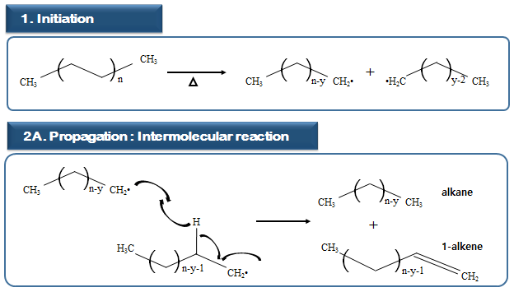
Pyrolytic Degradation Pathways of Polyethylene

Slide 12
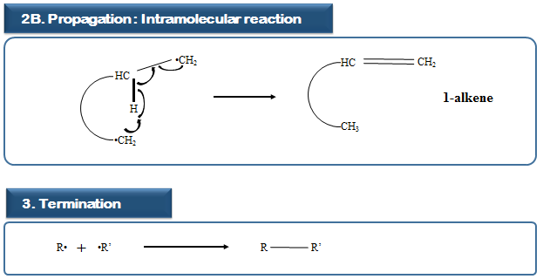
Pyrolytic Degradation Pathways of Polyethylene

Slide 13
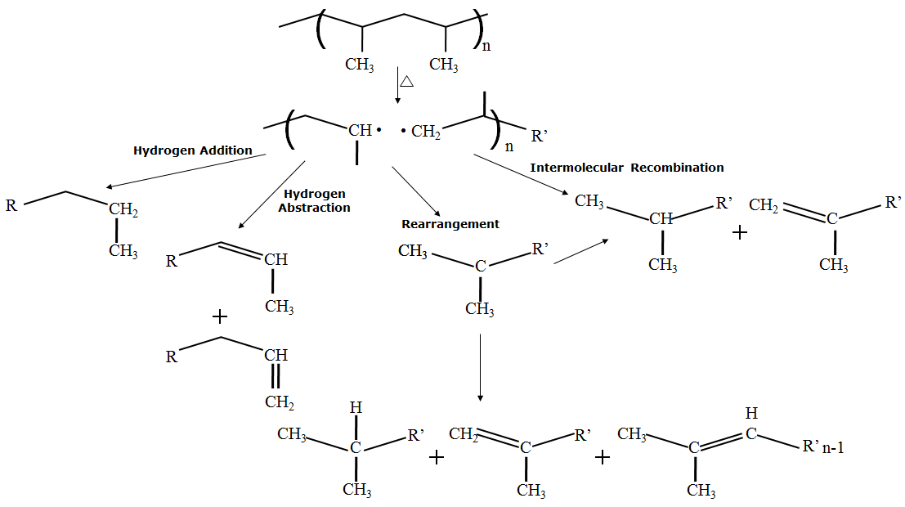
Pyrolytic Degradation Pathways of Polypropylene

Slide 14
3. Pyrolysis Kinetics

Slide 15
Why pyrolysis kinetics is important?
Pyrolysis kinetics can elucidate 1) how fast the reaction is completed and 2) how the production rate of desirable products can be increased
Desirable Products
k_{d}
Polymers
Maximization of k_{d}
k_{u}
Undesirable Products

Slide 16
Pyrolysis Kinetic Models
MODEL I
MODEL II
K₃₁
Gas
K₃₂
Gas
K₄₁
K₄₂
Organic
Wastes
Liquid
Organic
Wastes
Int
Liquid
K₂₁
K₅₁
K₅₂
Solid
Solid
K₁₁
K₂₂

Slide 17
Pyrolysis Kinetic Models
MODEL III
K₄₂
Liquid
K₂₁
Int
Organic
Wastes
K₅₂
Solid
K₃₁
Gas
K₁₁
K₂₂

Slide 18
Pyrolysis Kinetic Models
MODEL IV
K₃₂
Gas
K₂₁
Int
Organic
Wastes
K₄₂
Liquid
K₅₁
Solid
K₁₁
K₂₂

Slide 19
Pyrolysis Kinetic Models
MODEL V
K₄₂
Gas
K₂₁
Int
Organic
Wastes
K₅₂
Solid
K₃₁
Liquid
K₁₁
K₂₂

Slide 20
Pyrolysis Kinetic Model of Thermoplastics
Gas
Molten
State
Plastics
Liquid

Slide 21
Pyrolysis Kinetic Equation
Kinetic Triplet
Arrhenius Parameters

Slide 22
Pyrolysis Kinetic Equation
A Unique Thermal Reaction can be characterized by one set of Kinetic Triplet
Incorrect reaction model can mislead the Arrhenius Parameters as well

Slide 23
Example: Polypropylene
What is the reaction model commonly
used for the pyrolysis of Polypropylene?

Slide 24
Question
Is Reaction Order Function appropriate for representing the pyrolysis reaction model of Polypropylene?

Slide 25
Evidences
Discrepancy of Activation Energy Values between Model-fitting and Model-free method
The reaction order function is usually applicable for homogeneous gas-phase kinetics, but the thermal degradation of polymers is accounted for by heterogeneous solid state mechanisms

Slide 26
Activation Energy Values derived from model-fitting and model-free Methods
Methods |  | n | E (kJ․mol-1)
Model-fitting Methods | Freeman-Carroll
 | at 5 K/min
 |  | 1.57 | 338.15
 | at 10 K/min
 |  | 1.69 | 346.63
 | at 20 K/min | 1.38 | 290.13
 | average | 1.55 | 324.97
 | Catterjee-Conrad
 | at 5 K/min |  | 340.90
 | at 10 K/min |  | 351.16
 | at 20 K/min |  | 293.65
 | average |  | 328.57
 | Coats-Redfern
 | at 5 K/min |  | 316.71
 | at 10 K/min |  | 315.62
 | at 20 K/min |  | 321.02
 | average |  | 317.78
Model-free Methods | Friedman |  | 189.18
 | Kissinger |  | 183.62
 | Ozawa |  | 186.75
Discrepancy of
E values

Slide 27
How to identify Kinetic Triplet
How to Identify the Pyrolysis Reaction Model of PP and its Arrhenius Parameters
Kinetic Triplet

Slide 28
How to identify Kinetic Triplet
Procedures Estimating Kinetic Triplet
1st Stage
Determining Reaction Model
2nd Stage
Determining Reaction Constants
at various isothermal temperatures
3rd Stage
Estimating Arrhenius Parameters

Slide 29
How to derive g(a)
Derivation of
Kinetic equation
Integrating the kinetic equation
where

Slide 30
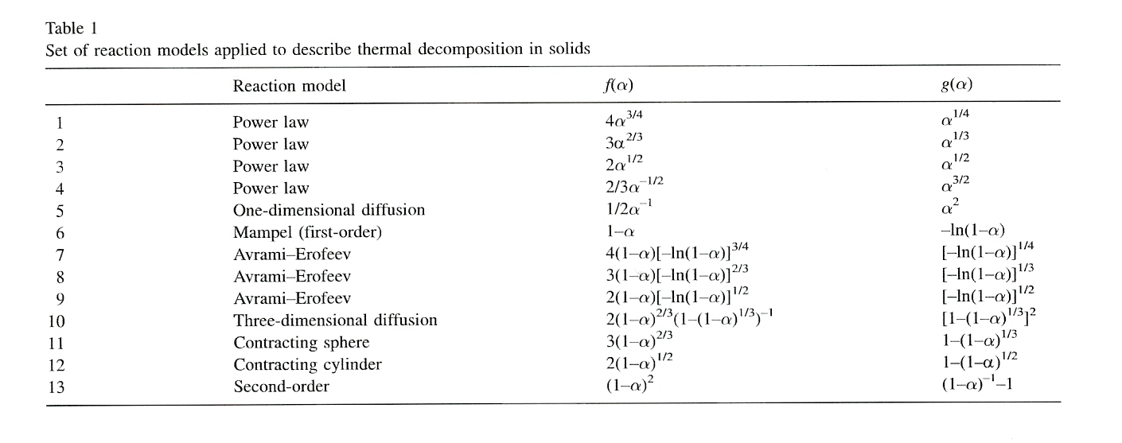
Theoretical 13 models of RTPs
Reaction Models

Slide 31
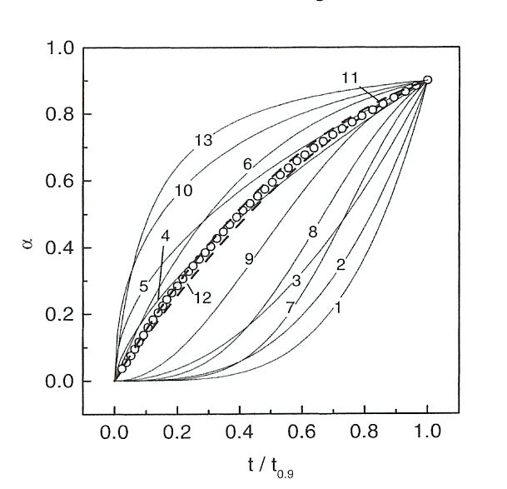
Procedures deriving Theoretical RTPs for 13 models
Procedures deriving Reduced Time Plots
Developing the following Relationship
Substituting serial numbers(0.1, 0.2 etc)
into α in the model equations and then
determining
Determining the reduced time from
4. Developing the reduced time vs. α

Slide 32
How to determine pyrolysis reaction model of polymers
Fitting practices of experimental
RTP to theoretical RTPs
Best-fit of an experimental RTP
to a theoretical RTP

Slide 33
Estimation of Arrhenius Parameters
Determination of Arrhenius Parameters
Estimating the reaction constants at various isothermal conditions
Estimating A and E from Arrhenius Plot

Slide 34
How to obtain Isothermal Kinetic Data
RTP requires decomposition pattern of polymers with time under isothermal conditions
Most previous studies have used commercial TGA that allowed
thermal decomposition that occurred during the course of
the temperature rise to the target temperatures
Target Temperature
Temp
Undesirable decomposition happens
during the temperature rise
Time

Slide 35
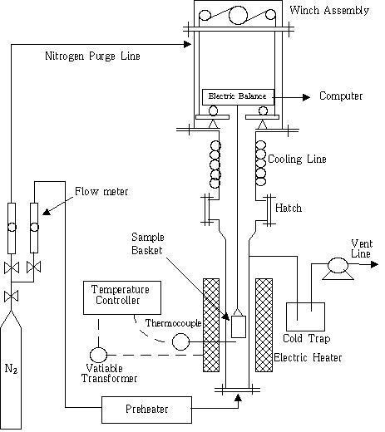
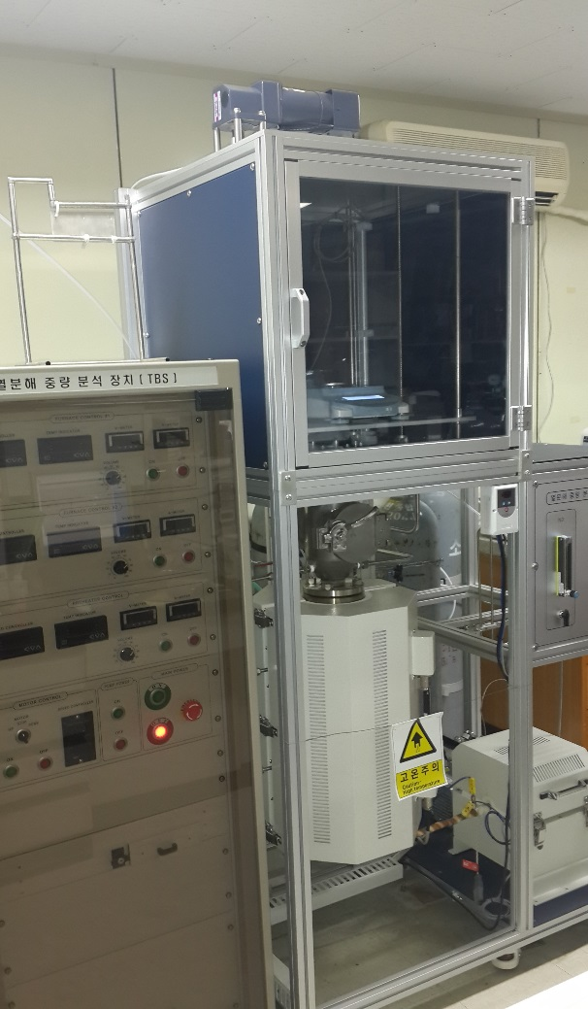
Thermobalance operated under pure static conditions
Weight Detection Part
Sample Loading Part
Pyrolysis Reactor

Slide 36
Pyroltic Decomposition of PP under Dynamic Conditions(678~738K)`
Lower Temperatures
Higher Temperatures

Slide 37
Reaction model of PP
Variation of Reaction Model with Reaction Temperature(R2→A2)

Slide 38
Estimation of Reaction Constant (k): PP
Lower Temperatures
Higher Temperatures

Slide 39
Pyrolysis Reaction Model of PP
Lower Temperature Zones (650~700K)
Contracting Cylinder Model
E = 155 kJ/mol, lnA = 24.6 (A: min⁻¹)
Higher Temperature Zones (>700K)
Avrami-Erofeev Model
E = 115 kJ/mol, lnA = 19.4 (A: min⁻¹)

Slide 40
Verification
Model-free methods
Isothermal data
Non-isothermal data
Model-fitting methods
Differential
Integral

Slide 41
Model-free method using isothermal data
Compiling kinetic data at various isothermal operating temperatures
Developing a set of isoconversional data (α=0.1, 0.2, 0.3, …)
Determining activation energy from the slope of the following equation:

Slide 42
Model-free methods using non-isothermal data
Friedman method
Kissinger method
Ozawa method
Revised Ozawa method

Slide 43
Activation energy(KJ/mol) values of PP
Lower temperature regions
Higher temperature regions
Model-fitting method
using Isothermal Data
(This study)
140 112
Model-free method
using Isothermal Data
103 71
Model-free method
using Non-isothermal Data
118
Lower conversion regions
Higher conversion regions
Model-fitting method
using Non-isothermal Data
112 83

Slide 44
Activation energy(KJ/mol) values of PP

Slide 45
Low Temeratures: Contracting-cylinder model
Isotropic shrinkage of melt
Evolution of volatiles at the surface
Solid State
Heat is applied
Liquid State

Slide 46
Higher Temperatures: Avrami-Erofeev model
Bubble Nucleation is responsible for a major pyrolysis mechanism at higher temperatures
There may be a critical temperature where the highest molecular size of fragments is small enough to be vaporized, thus triggering the explosive generation of volatiles
At the critical concentration of volatiles, bubbles may begin to nucleate
Liquid State

Slide 47
Implication
Rate of bubble nucleation appears to be limited by
the kinetics of heat, momentum or mass transfer
and thermodynamic properties of melt

Slide 48
4. Pyrolysis Reactor Design

Slide 49
Step for Effective Reactor Design
Investigating Pyrolysis Mechanism
Determining REACTION PATHWAY
Estimating Pyrolysis Kinetic Model and Kinetics (Chemical Kinetics)
Determining REACTION TIME
Controlling REACTION PARAMTERS
Determining Scale-up Factors
Determining Temperature and Pressure Profiles of Reactor
Determining Reaction Rate and Time

Slide 50
Thank You !

