Slide 1
Seoul National University Seminar
Gasification Technology of Solid wastes
November 11. 2014
KOLON GLOBAL Corp., R&D department
KWAK YEON HO

Slide 2
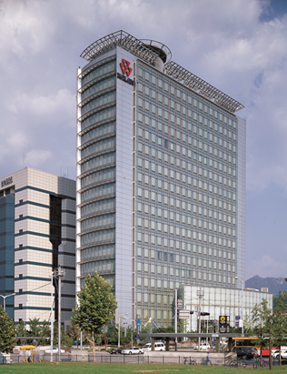
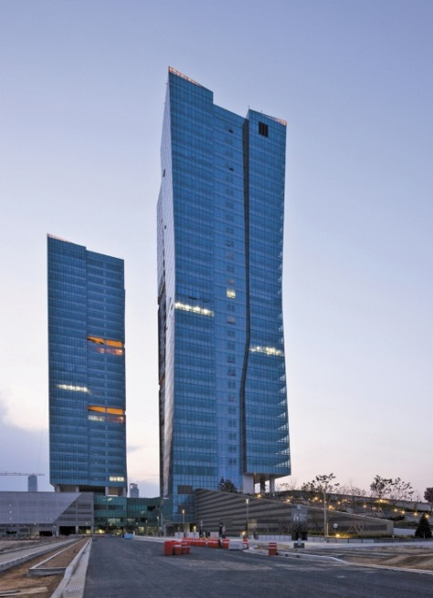
1. Introduction of KOLONGLOBAL
[Overview]
▶ KOLON GLOBAL CORPORATION
▶ Address
- KOLON TOWER (Main building) 11 kolon-ro
Gwacheon-si, Gyeonggi-do, Korea
- Song-Do Technopark IT Center 32 Song-Do science-ro
YeonSu-Gu, Incheon, Korea
▶ Employee : 2,500 people
▶ Revenue : 3 Billion Dollars (2013)
[Gwacheon]
[Songdo]
KOLON GROUP
Established in 1954
Over 12,000 employees with 36 Subsidiaries
Sales Revenue US$ 11 Billion (2013)

Slide 3

1. Introduction of KOLONGLOBAL
[History of Company]
IT
✓
1990
KOLON Communication and Information
[Merger]
Merger-Launched in Dec.2011
✓
[Name Changed]
[Name Changed]
Trading
1954
Kaemyeong Corporation formed
1979
KOLON
Trading Corporation
2001
KOLON
International
2006
KOLON I’Net
✓
[Merger]
Motors
1987
(Established)
KOLON Motors
2005
KOLON
Glotech
2011
(Spin-off)
KOLON B&S
Sports & HealthCare
✓
1984
(Established)
KOLON SPOREX
[Merger]
[Name Changed]
Construction
✓
1960
(Established)
Hyupwha Industry
1978
KOLON General Construction
2000
KOLON E&C
Engineering
✓
1977(Established) KOLON Engineering

Slide 4
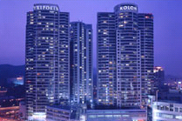
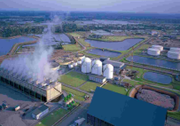
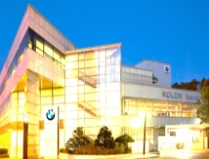

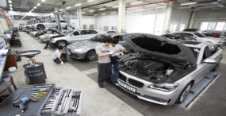

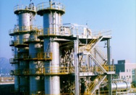
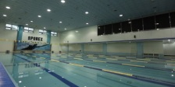
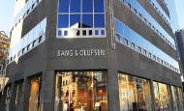

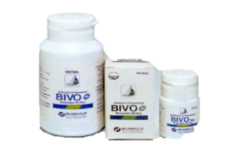
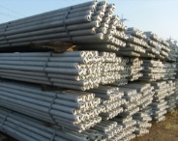
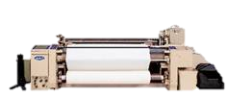
1. Introduction of KOLONGLOBAL
[Business Area]
Construction
- Construction, Development, EPC & O&M
- Power plant, Environmental plant
- New regeneration energy
- Overseas
Auto distribution
- BMW Dealing (No.1 in domestic)
A/S Factory
BMW Rental, Lease
BPS service
MINI, R/R, BMW Motorrad
Portfolio
Trading Service
- Steel
- Energy, Heavy chemistry
- Fashion, Leisure, Fiber
- General products
Health care
- Sport center (KOLON Sporex)
- Lifestyle Business (Bang&Olufsen)

Slide 5
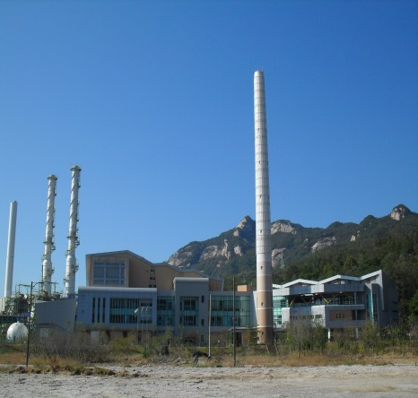
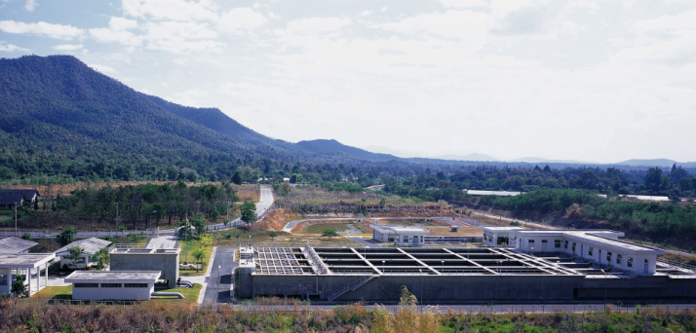
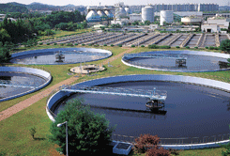
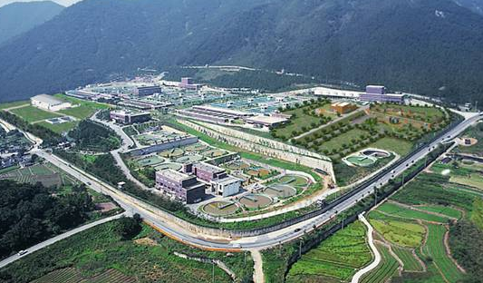
1. Introduction of KOLONGLOBAL
[Environment Business Area]
Future Environmental Technology for Human
Base on environment friendly technologies and abilities, KGC provides total solution for all environmental facilities from EPC to O&M.
Our sewage water treatment technology is selected as new
environmental technology and we’re endeavoring to improve
high water treatment facilities business.
Namyang-Ju Incinerators
Chiang Mai in Thailand
Water Supply Facility
Business Brief
Deoksan Water Purification Plant
Water treatment
Waste treatment(Incineration, Sanitary landfill)
Waste to Energy
Recovery works, etc.
Daejeon Sewage Treatment Plant
Green technology for the future

Slide 6
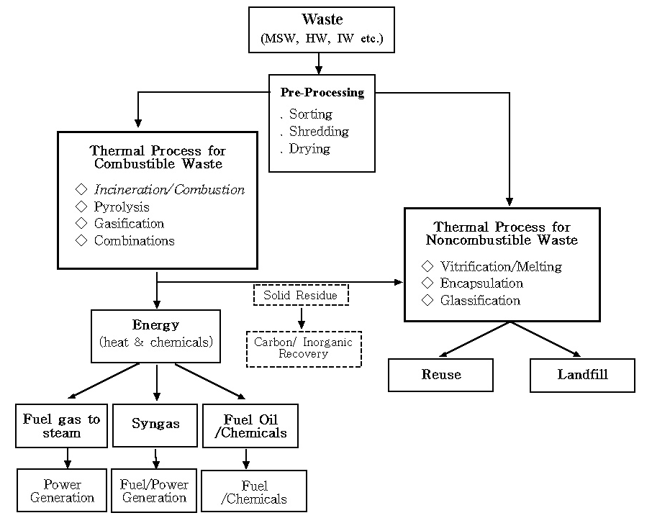

2. What is Gasification?
Thermal treatment technology of wastes

Slide 7
2. What is Gasification?
Thermal Conversion Processes : Combustion, Gasification, Pyrolysis
Thermal Process
Excess Air
Partial Air
No Air
Combustion
Gasification
Pyrolysis
Heat
Ash
Syn gas
Ash
Liquid
Gas, Char
Gasification
공급원료
Combustion
Partial combustion reaction
CO, CH₄
C
CO₂
Complete combustion reaction
H₂, H₂O
H
H₂O
NOx
N
NOx
SOx
S
SOx
O₂
O
O₂

Slide 8
2. What is Gasification?
Thermal Conversion Processes : Combustion, Gasification, Pyrolysis
Air-fuel ratio, %
Combustion zone
Gasification zone
Pyrolysis zone

Slide 9
2. What is Gasification?
Purpose : To convert wastes or low-value fuels to higher value energies
Boiler
Air, O₂, Steam
Electricity
Heat
Coal (Char)
Waste
Biomass
Residual Oil
Energy = Heat
+ Chemicals
Turbine
Gasifier
Temp. : 700~1,500℃
Engine
Syngas
Fuel Cell
Methanol
CO, H₂, CH₄
DME
Inorganic matters
F-T
Synthesis
Ammonia
Hydrogen
SNG
The feedstock is prepared and fed into a gasifier with the reactants
Combustible gas called syngas is produced
These gases are available to produce the electricity or heat after gas cleaning
They can also be used for the production of chemicals

Slide 10
2. What is Gasification?
Main gasification reaction and gas composition
Combustion reactions,
C + 1/2O₂ ↔ CO
C + O₂ ↔ CO₂
H₂ + 1/2O₂ ↔ H₂O
Boudouard reaction,
C + CO₂ ↔ 2CO
Water gas reaction,
C + H₂O ↔ CO + H₂
Methanation reaction,
C + 2H₂ ↔ CH₄
CO shift reaction,
CO + H₂O ↔ CO₂ + H₂
Steam methane reforming reaction
CH₄ + H₂O ↔ CO + 3H₂
Syngas
Composition (Vol %)
Waste
H₂
CO
CO₂
CH₄
H₂O
H₂S
N₂
NH₃+HCN
25 - 30
30 - 60
5 - 15
0 - 5
2 - 20
0.2 - 1
0.2 - 1
0 - 0.3
Oxygen
Steam
Ash / Slag / PM / Tar
8/21

Slide 11
3. Why is Gasification?
Advantages of Gasification in compare to incineration
Environmental standpoint
  low SOx / NOx emissions(reducing atmosphere)
  Dioxin compounds are not formed during gasification
  Reduction of CO2 emissions
  (Exhaust gas is much less than its of combustion)
Energy standpoint
  Possible to a various applications(Power/Heat/Chemicals/Oil)
  Power efficiency is high
By-product utilization standpoint
  Reuse of slag as construction materials

Slide 12
3. Why is Gasification?
Reduction effect of greenhouse gas according to waste to energy types
Classification | Reduction of greenhouse gas (TC/ton) | Reduction of others (TC/ton) | Total (TC/ton)
Incineration (No heat recovery) | 0 | - | 0
Incineration (With Heat recovery) | 0.19 | - | 0.19
SRF (Solid refused fuel) | 0.21 | - | 0.21
Gasification | 0.27 | 0.4 | 0.67

Slide 13
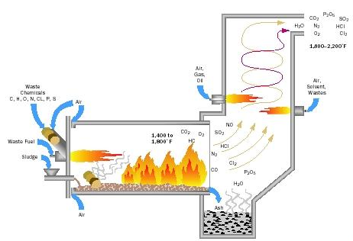

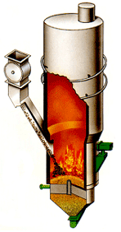



4. What do we develop?
Development of gasifier
type | Fixed bed | Fluid bed | Rotary kiln
Advantage | Simple of gasifier | High heat transfer Large scale upgrading | High syngas quality (indirect heating)
Disadvantage | Limited capacity | Low syngas quality (high air injection) | Low heat transfer

Slide 14
4. What do you develop?
Development of gas cleanup system
Contaminant | Examples | Problems | Cleanup method
Particles | Ash, char, fluid bed material | Erosion | Filtration, scrubbing
Alkali Metals | Sodium and potassium compounds | Hot corrosion | Cooling, condensation, filtration, adsorption
Fuel nitrogen | Mainly NH₃ and HCN | NOx formation | Scrubbing, SCR
Tars | Refractory aromatics | Clog filters, difficult to burn, deposit internally | Tar cracking, Tar removal
Sulfur, Chlorine | H₂S, HCl | Corrosion, emissions | Lime or dolomite scrubbing or absorption

Slide 15
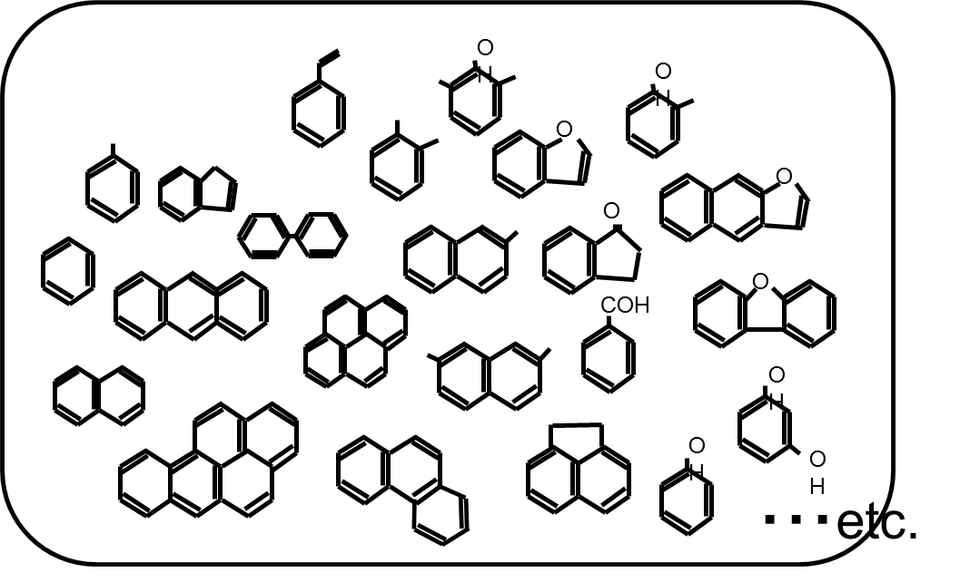
4. What do you develop?
Development of gas cleanup system
Structure of tar
As complex aromatic compounds are connected with many benzene rings, tar is very difficult
to remove completely.
The tar is present in the gaseous state at a high temperature.
However, tar is changed in a limy liquid when cooled.
This can cause the damage to the engine or turbine equipment

Slide 16
4. What do you develop?
Development of gas cleanup system
Tar removal method
Physical removal method
Steam reforming method
To directly remove the tar
Filter
Scrubber
Adsorption
Low cost
Low removal efficiency
Reduction of syngas heating value
Tar was converted into syngas by a thermochemical conversion
Steam of a high temperature
High value syngas
High removal efficiency
High cost

Slide 17






4. What do you develop?
Development of gas engine
Test of gas engine
Generator
LPG (5.4LPM)
RPM : 3200 rev/min
Air
Emcoder
Tank
Engine
Taco meter
MFC
MFC
MFC
MFC
MFC
MFC
Sensor
LPG (3.3LPM)+CO₂(2.1LPM)
MFC manager
Power Meter
RPM : 1800 rev/min
H₂
CO
CO₂
N₂
LPG
LPG (5.4LPM)
DAQ system
the gas engine for LNG was generally developed
Heating value of syngas is very lower than its of LNG (1,500kcal/Nm3)
When heating value of syngas is low, techniques for controlling the mechanical characteristics of engine is needed.

Slide 18
5. Our research
Research Project
Project Title | Eco-STAR Project : Center for Waste Eco-Energy and non-CO₂ Green House Grasses
Research Title | Development of energy conversion technology from waste through application of pre-treatment & gasification
Total Research Period | 2008. 2.1~2012. 12.31 (4 year 10 month)
Total Research fund | 8.2 billion won
Major Research Institute | KOLON E&C
Participating firm | KOLON E&C, EFMC, KOREA DISTRICT HEATING CORP, SUDOKWON Landfill Site Management Corp., SEOHUNG EN-TECH LTD., U SENTECH
Consignment research institution | Korea Testing Laboratory, THE UNIVERSITY OF SEOUL

Slide 19
5. Our research
Objectives
Concept : E³ TECHNOLOGY
Eco – friendly : Developing technologies to minimize contaminants
Energy efficient : Maximizing recovery of energy by increasing gasification conversion rate
Economic : Saving cost of facilities and operation by integration and localization
Application in full-scale plant
Developing energy conversion system from waste by pretreatment / gasification / energy recovery technologies

Slide 20
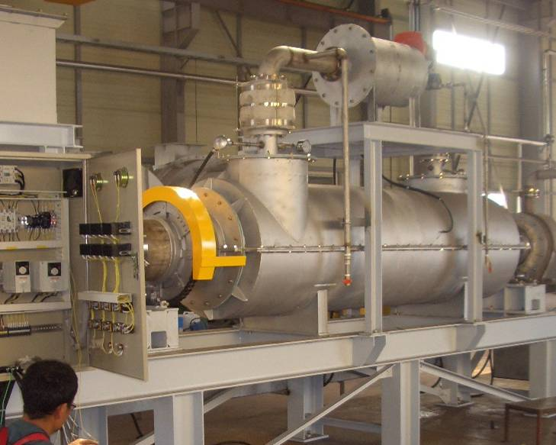
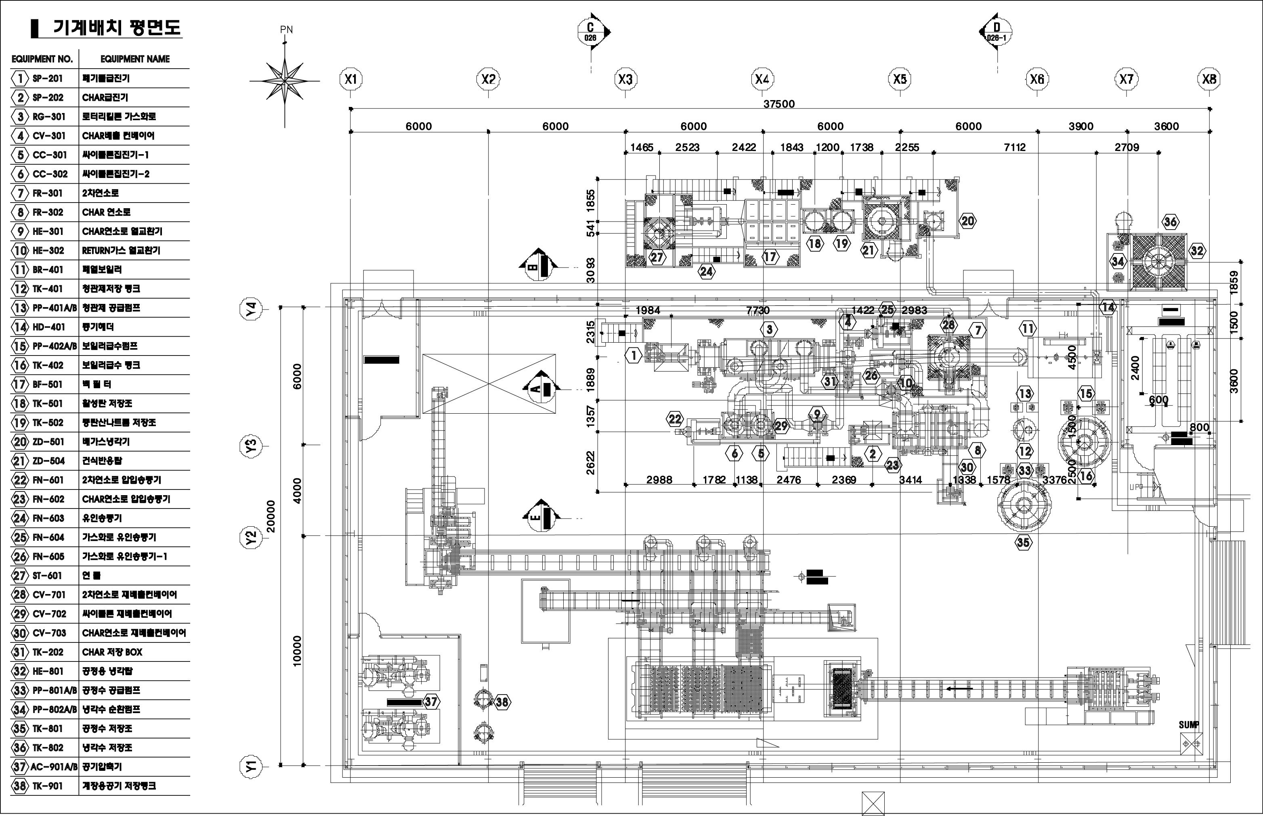
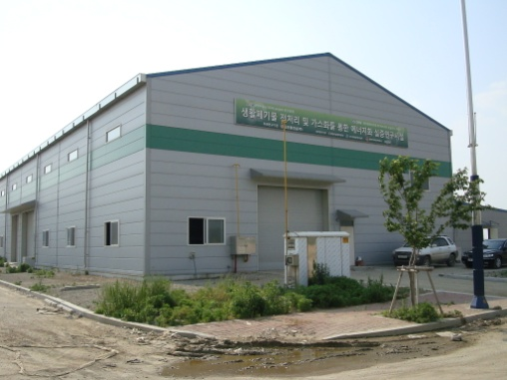
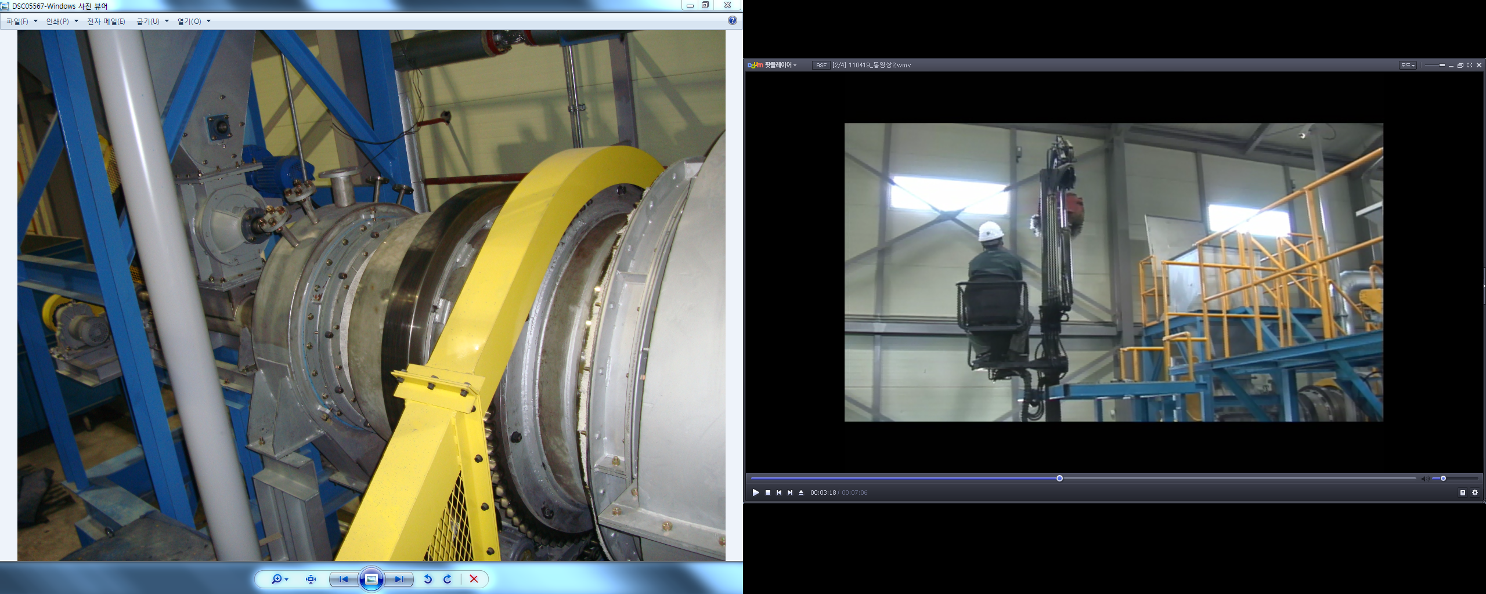
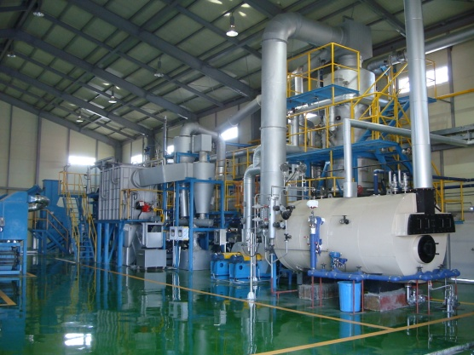
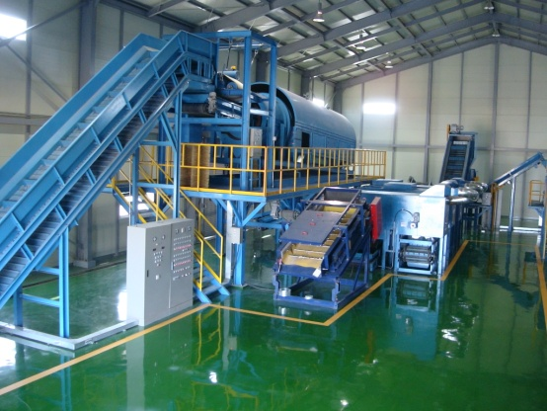
5. Our research
Research history
2008
Research project launched(2008)
2009
2010
Prototype manufacture and test(20kg/hr) (2009)
Plant design(5t/d)(2010)
Construction of building
(2010)
2011
2012
Manufacture of gasification
facility(2011. 05)
Manufacture of pre-treatment facility(2010)
Operating and test(~2012)

Slide 21
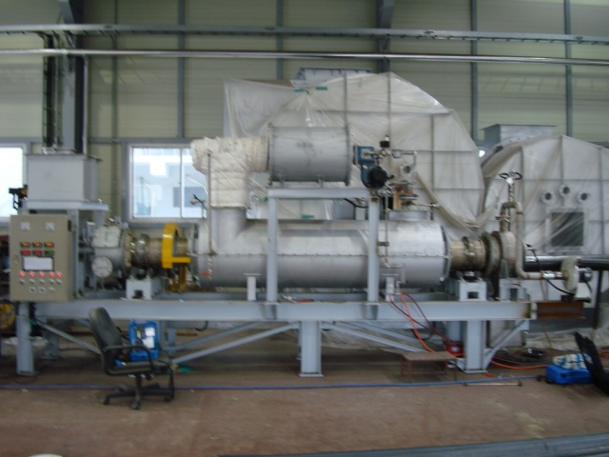
5. Our research
Prototype rotary kiln gasifier(20kg/hr)

Slide 22
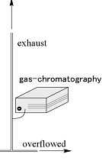

5. Our research
Testing procedure in a rotary kiln gasifier
RDF
Exhaust gas
LPG Burner
Stack
Inlet
Outlet
Syn gas
Flare stack
Gas sampling
TC1
TC2
TC3
Feeding rate : 15-17kg/hr
TC1 temperature : 630 – 790 C
Air ratio : 0.05 – 0.15
Char box
Cold trap
Micro GC

Slide 23
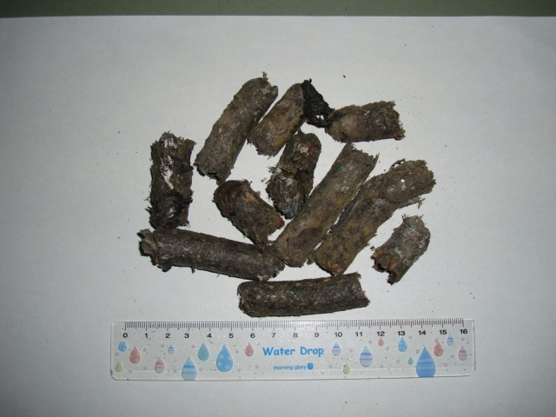
5. Our research
Sample used in this Test
Proximate analysis (wt%) |  | Ultimate analysis (wt%)
Moisture | 9.0 | C | 40.63
Volatile matter | 53.0 | H | 5.74
Fixed carbon | 11.5 | O | 23.97
Ash | 25.8 | N | 1.33
High Heating value | 3,850 | S | 0.01
(kcal/kg) |  | * Dry basis, **Wet basis
Pelletized RDF

Slide 24
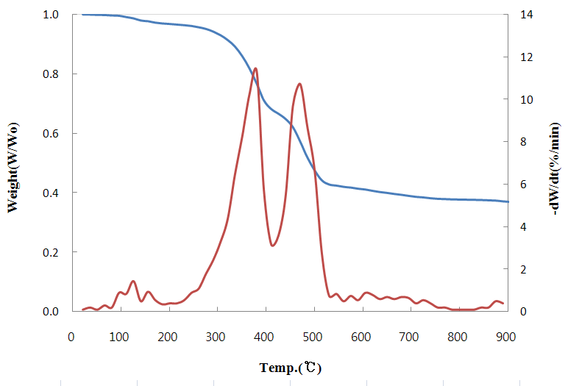
5. Our research
TG and DTG curves of Sample
Feedstock
: RDF(dried and crushed)
Sample weight
: 10 mg
Setting temperature
: 30C/min to 900°C
Carrier gas : N2
2nd stage pyrolysis
1st(300-410°C) : Paper, Wood, Food waste, Textile
2nd(420-510°C) : Rubber, Plastics

Slide 25
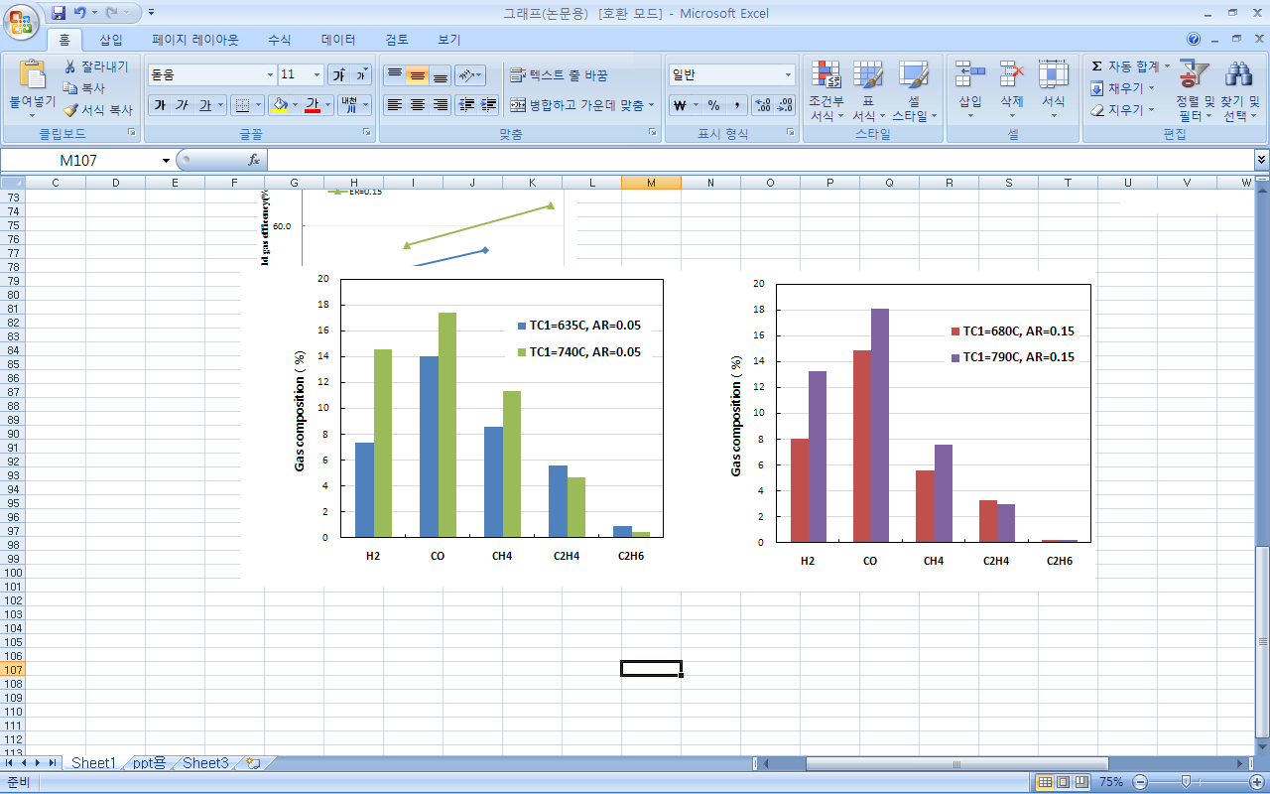
5. Our research
Result of gasification experiment - gas composition
Air ratio=0.15
Air ratio=0.05
Hydrocarbons were converted into CO or CO₂ by oxidation reaction as AR increased

Slide 26
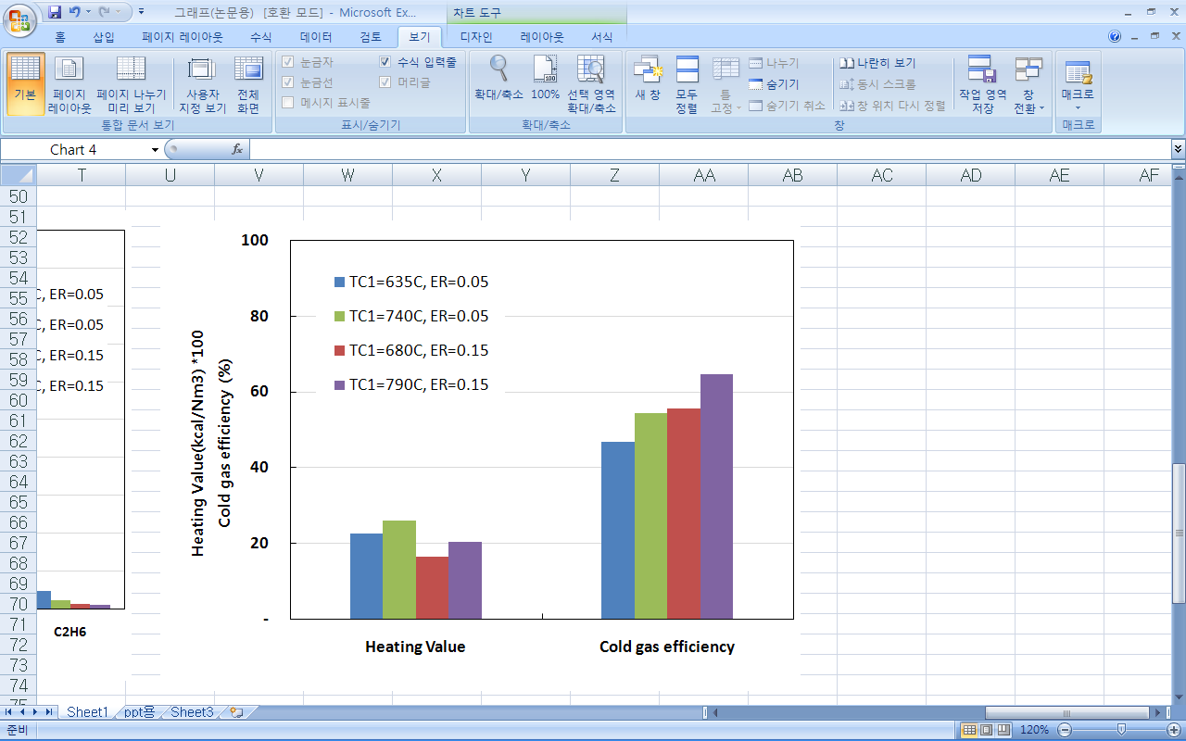
5. Our research
Result of gasification experiment
– Heating value & Cold gas efficiency
Heating value(kcal/Nm3)
=Σ(Heating value of each gas * content)
Cold gas efficiency(%)
Heating value in product gas[kcal/hr]
Heating value in RDF[kcal/hr]
Minimum heating value for the energy
from gas engine
: 1300-1,500kcal/Nm3
Cold gas efficiency at high temperature
: 60-70%
An efficient energy generation appears to be possible through results obtained in this experiment

Slide 27
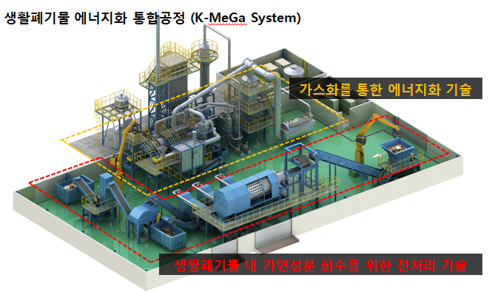
5. Our research
Pilot plant
K-MeGa system(Kolon Mechanical & Gasification system)
Waste : Municipal Solid Wastes
Facilities : Pre-treatment + gasification
Capacity : 5 ton/day
Construction costs : 2.1 billion won
Pre-treatment system
Gasification system

Slide 28
6. Our research
The video to explain
K-MeGa system

Slide 29
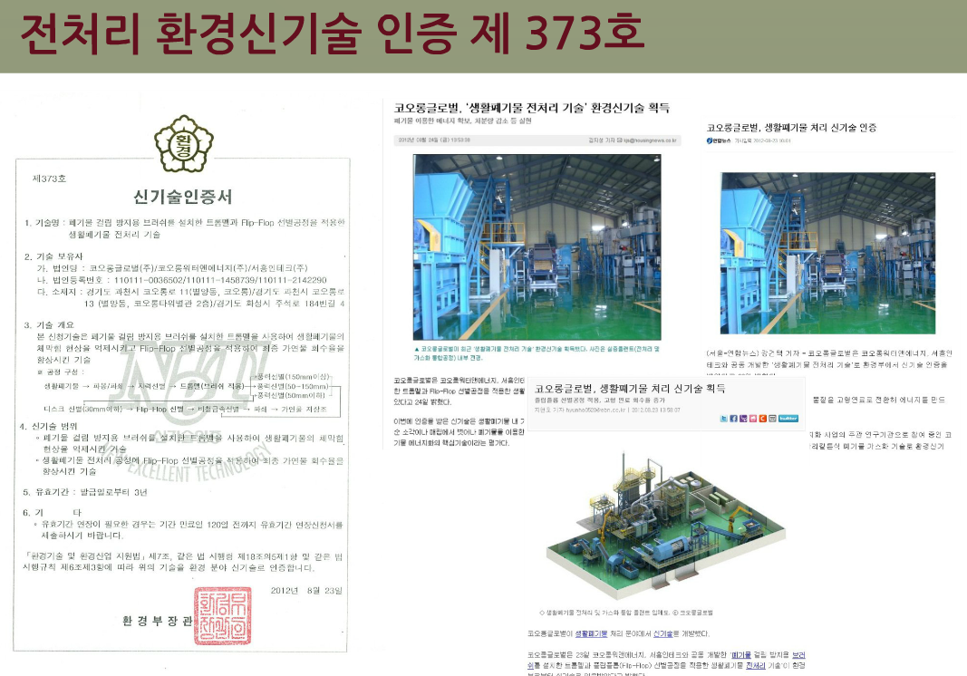
5. Our research
Research result
Certification on environment new technology

Slide 30
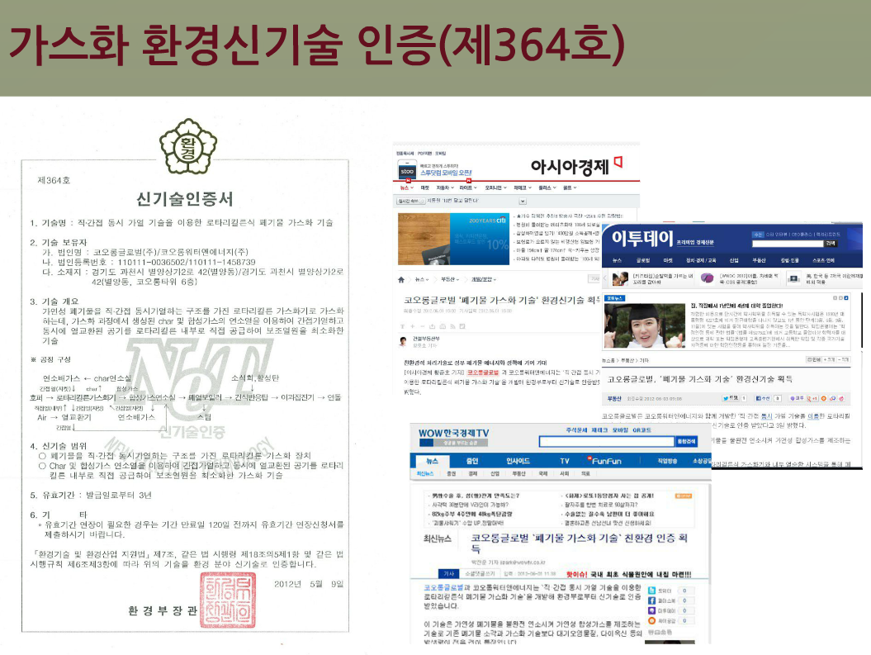
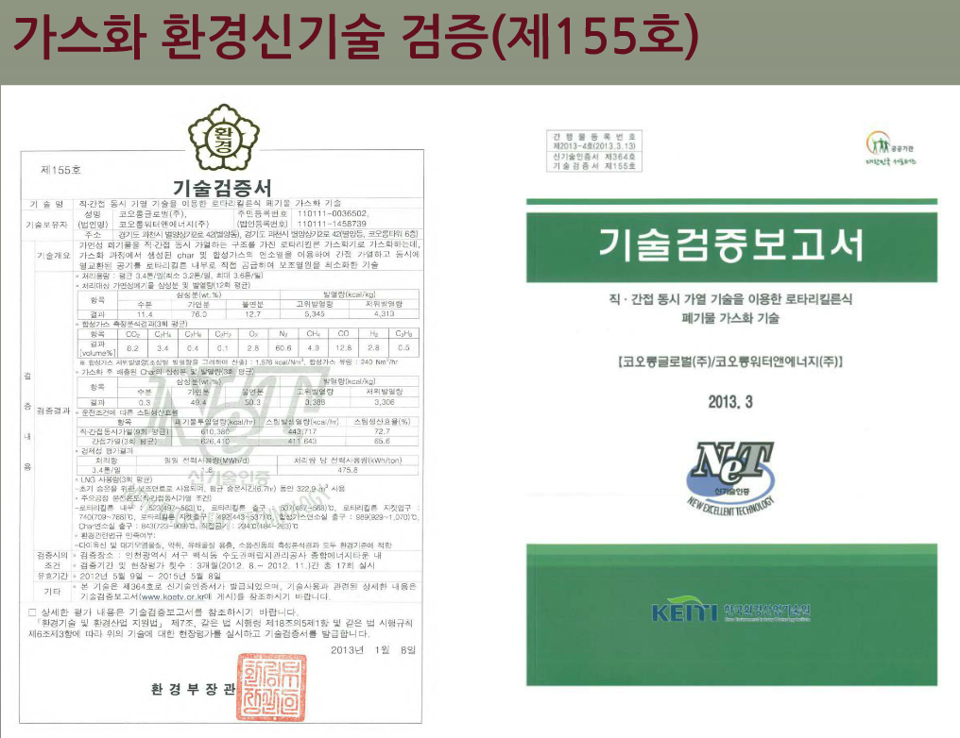
5. Our research
Research result
Certification on environment new technology

Slide 31
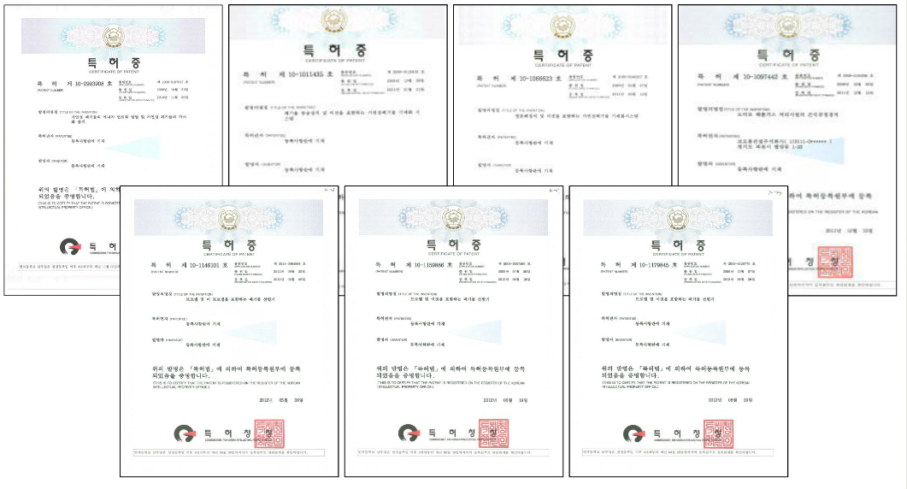
5. Our research
Research result
Patent application : 36, Patent registration : 12

Slide 32
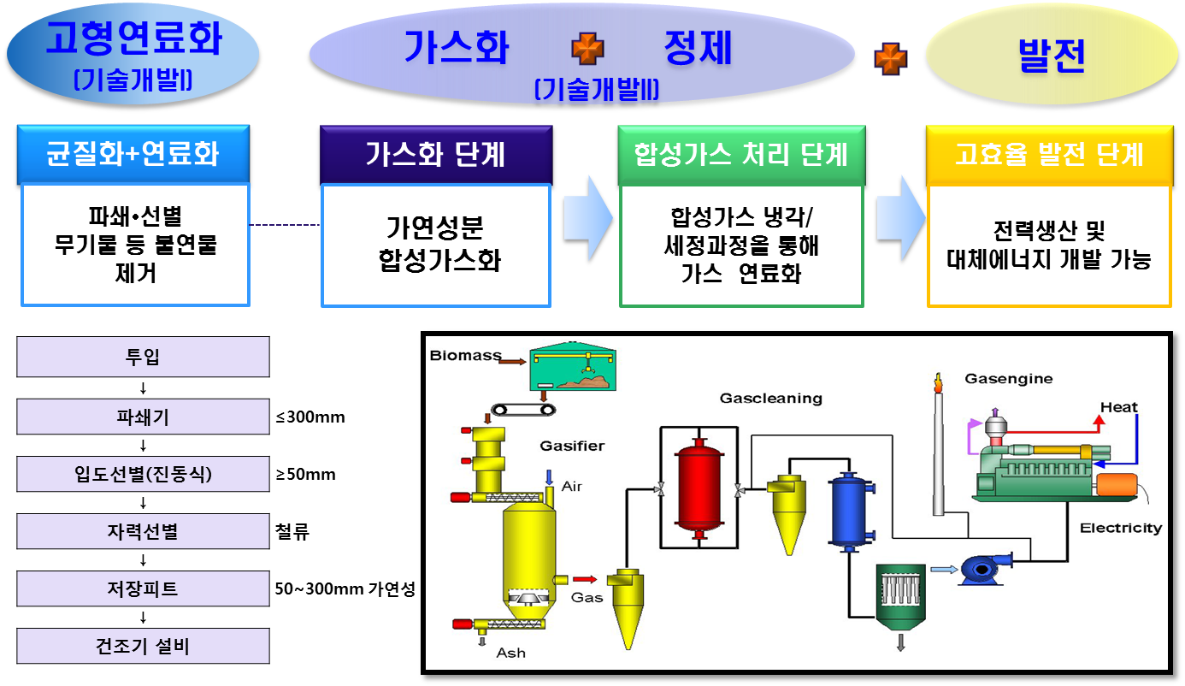
6. Our further research _ commercial plant development PJT
Overview
Research period : 2013 ~2019(during 9 years)
Research fund : 68 billion won
PJT Scale : SRF 120ton/day, gasification & power 80ton/day
Gasifier type : Fixed bed
Site : Yeosu city
Research institute : Samho, Kolon, Advanced tech. Institute
Meaning
The first full scale commercial plant in Korea
The next-generation technology alternating incineration

Slide 33
Thank you for your attention

