Slide 1
Seoul National University
Department of Civil & Environmental Engineering
Waste to Energy Projects
Reuse-Wastewater & Sludge
Gabriel MUTTO
Samsung C&T-Water & Environment Engineering Team December 2014

Slide 2
Career path
Experience:
  3 years in water analysis laboratory and 17 years involved in different water treatment projects acting with several roles as Project Manager, Design Engineer and Process Engineer
Positions Held:
  April 2014– till date: Deputy General Manager, Samsung C&T, Water & Envorinment
  January 2012– April 2014: Engineering Director Veolia Argentina
  June 2007- September 2012: Applications Director Veolia Argentina
  July 2005-June 2007: Process & Design Engineer Degrémont Argentina
  May 2003-July 2005: Process Engineer and Engineering Manager Degrémont Korea
  May 2002-May 2003: Design Engineer Degrémont Chili (off shore office Degrémont France)
  May 1997-May 2002: Process Engineer, Project Manager, Star Up Engineer and Design Engineer Degrémont Argentina

Slide 3
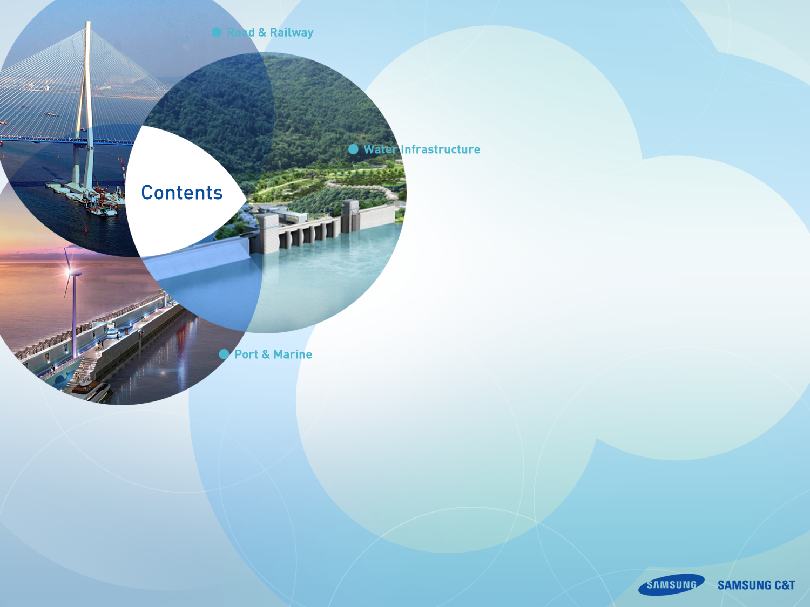
1. Samsung group
2. Samsung C&T Corporation
3. Civil Infraestructure Biz Unit
4. Reuse case studies

Slide 4
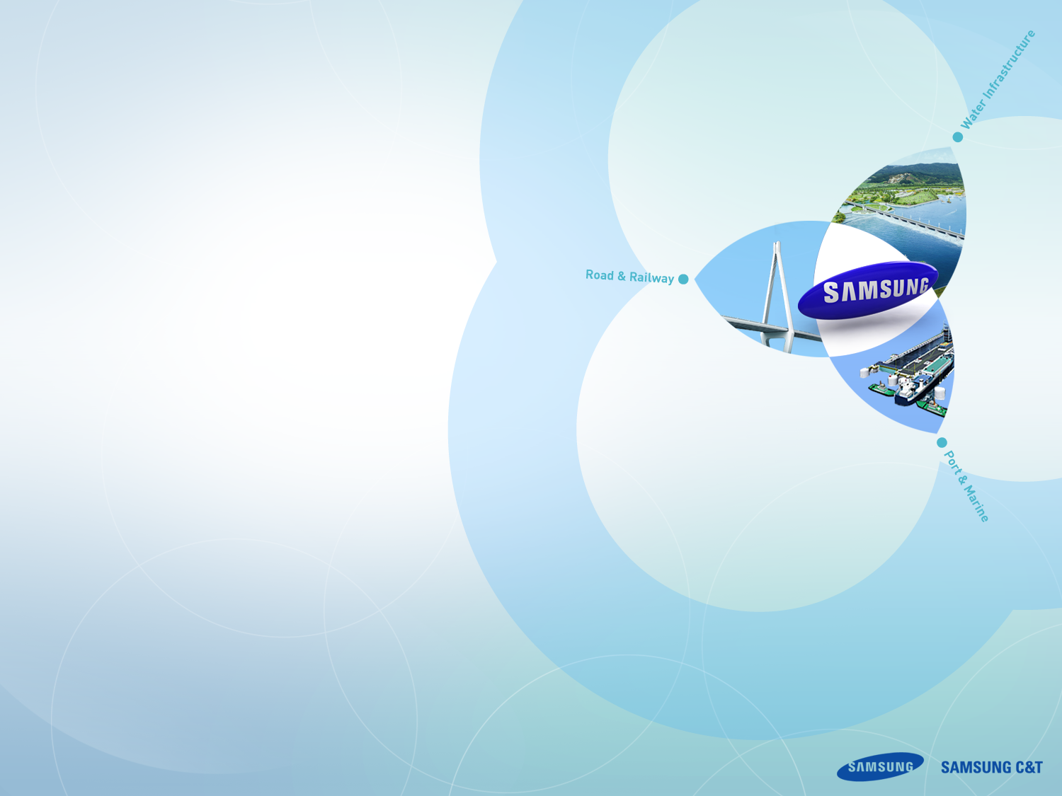
1. Samsung Group

Slide 5

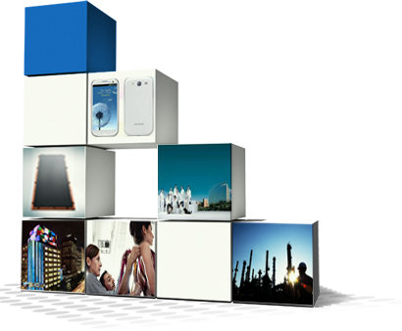


Affiliated Companies
30 Affiliates are commercially and legally independent,
but unified by sharing one Single Philosophy under Samsung Group
Electronics Industry (6)
Financial Services (6)
Others (10)
Samsung Electronics
Samsung Electro-Mechanics
Samsung SDI
Samsung SDS
Samsung Display
Samsung Corning Advanced Glass
Samsung Life Insurance
Samsung Fire & Marine Insurance
Samsung Card
Samsung Securities
Samsung Investment Trust Management
Samsung Venture Investment
Cheil Industries
Samsung Everland
The Shilla Hotels & Resorts
Cheil Worldwide
S1 Corporation
Samsung Medical Center
Samsung Economics Research Institute
Samsung Bioepis
Samsung Biologics
Samsung Welstory
Engineering & Constructions (3)
Samsung C&T Corporation
Samsung Engineering
Samsung Heavy Industries
Chemical Industry (5)
Co-work & Synergy Effect
Samsung Total Petrochemicals
Samsung Petrochemicals
Samsung Fine Chemicals
Samsung BP Chemicals
Samsung Techwin

Slide 6
2. Samsung C&T Corporation

Slide 7
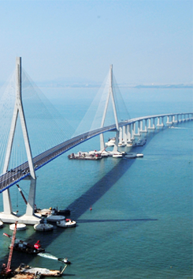
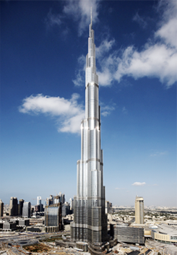
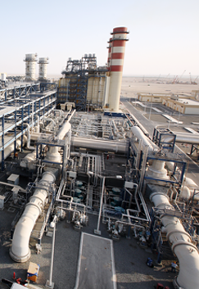
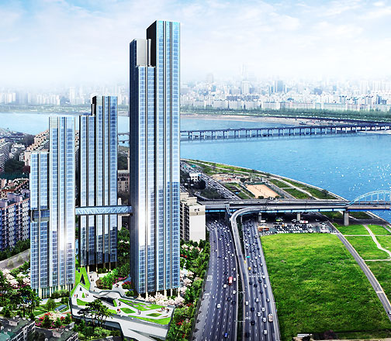
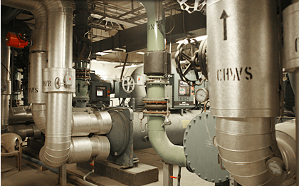
Organization
Chief Executive Officer
Mr. Chi-Hun Choi
Corporate Support
Q-HSE
Strategy
& Innovation
Human
Resources
R&D Center
Finance
& Accounting
Risk
Management
Global Marketing
Procurement
Civil
Building
Plant
Housing
M&E
Road, Bridge & Tunnel
Metro & Railway
Port & Marine
Water Resources
Mining
High-Rise, Mixed-Use
Hi-Tech
Healthcare, Aviation
Sports Facilities
Power Generation
Nuclear Power Plant
Energy Storage
Industrial Plant
Residential Complex
Urban Development
Civil Infra. M&E
Building/Housing M&E
Industrial Facility M&E
Incheon Grand Bridge (2009)
Burj-Khalifa (2010)
Qurayyah IPP (2014)
Housing Supply
Delhi Subway (2013~)
21.27km
828m
4,000MW
217,000Units
15.5km

Slide 8
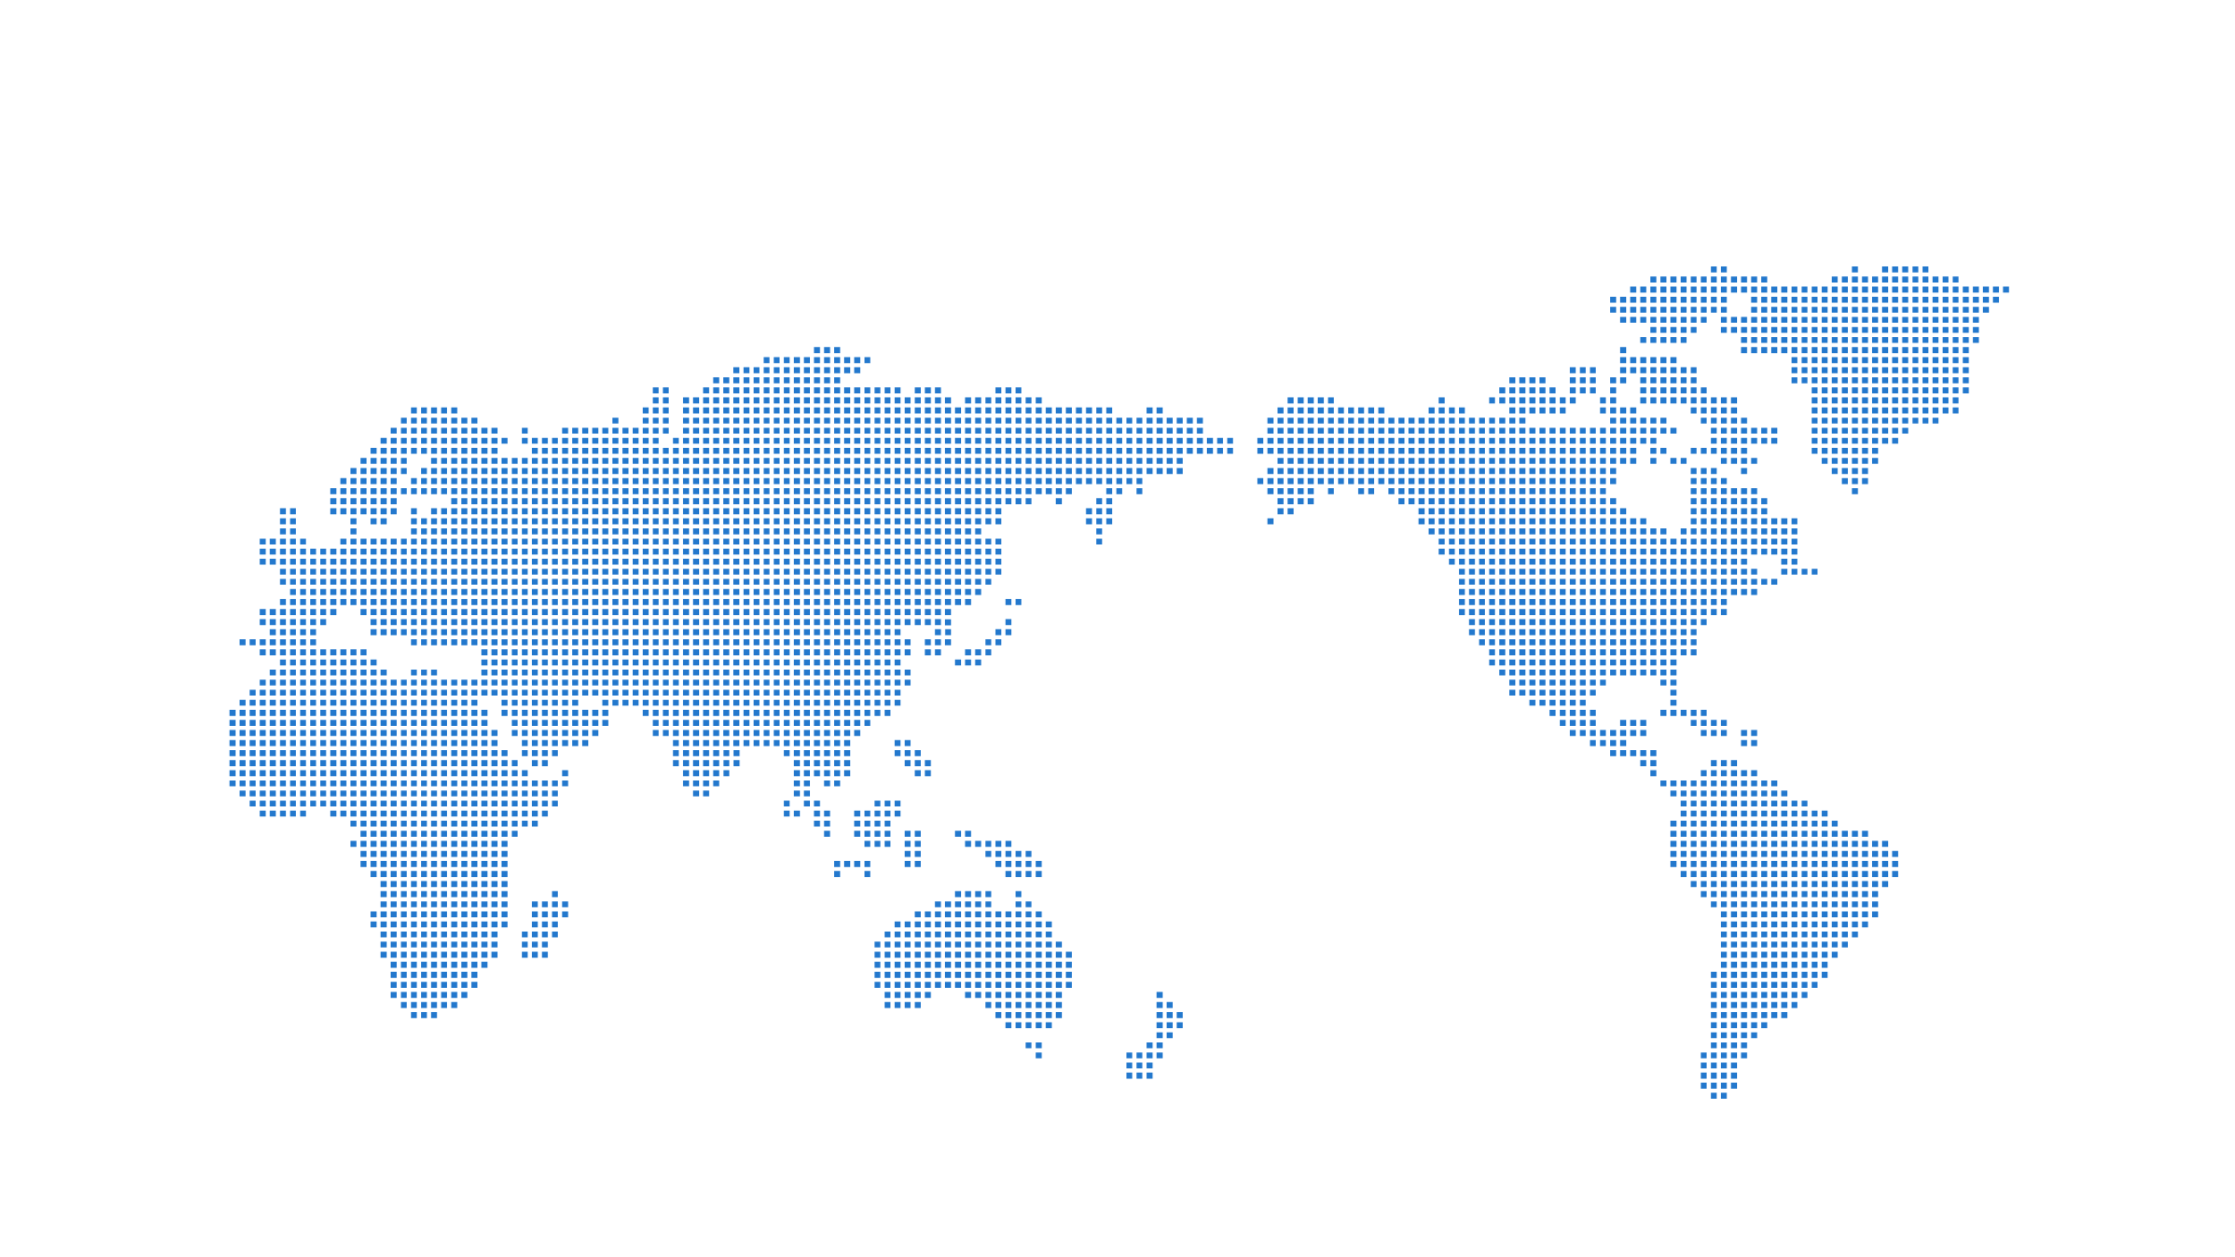

Global Operations
36 Global Offices in 26 Countries
10,665 Manpower
HQ: 3,173 / Global Offices: 406 / Sites: 7,086
Regional HQ: 3 / Local Subsidiary: 15 / Branch: 18
Russia
Canada
UK
Hungary
Mongolia
Turkey
Korea
USA ECA
Algeria
Kuwait
China
(HQ)
Morocco
Qatar
Japan
(Engineering & Construction Americas)
Egypt
KSA
India
Hong
Kong
USA SECAI
Taiwan
SINGAPORE
Malaysia
(Southeast Asia RHQ)
Indonesia
UAE
Australia
Brazil
(Middle East RHQ)
Chile
Headquarter
Regional Headquarter
Local Subsidiary
Branch

Slide 9
3. Civil Infrastructure
Business Unit

Slide 10
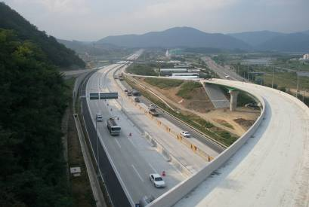
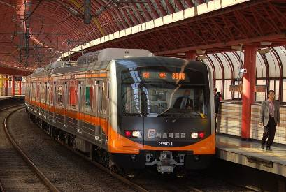
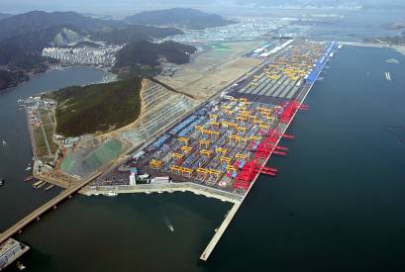
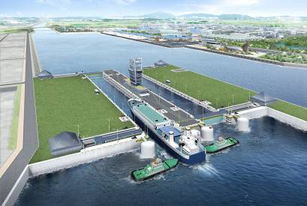

Business Unit Overview
Road
&
Bridge
Bridge & Tunnel
Highway & Roadway
Underground Expressway
Total solution provider in all areas
of the construction business –
financing, planning, design,
procurement, construction, and O&M
Metro
&
Railway
High Speed Railway
LRT / MRT
Freight
Mining Infrastructure
Port
&
Marine
Wharf / Breakwater / Jetty
Dock / Dredging / Reclamation
Offshore (Wind Farm, Pipeline)
Mining Infrastructure
Dam / Hydropower Plant
Water & Wastewater Treatment
Sewer & Water Tunnel
Soil Remediation
Water
&
Environment
F/S
F/S
F/S
F/S
F/S
EPC
Financing
O&M

Slide 11

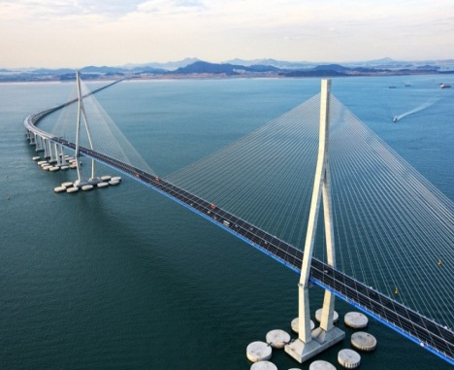
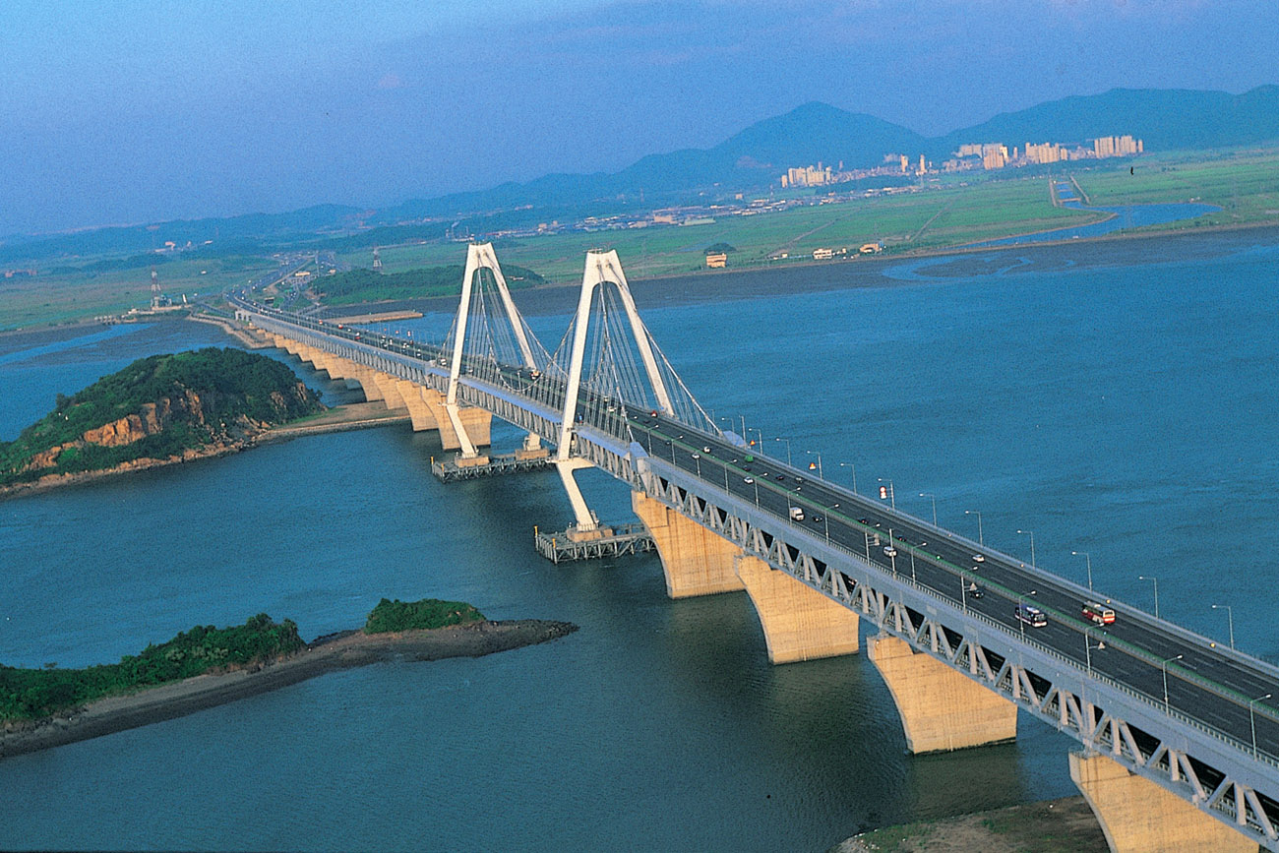
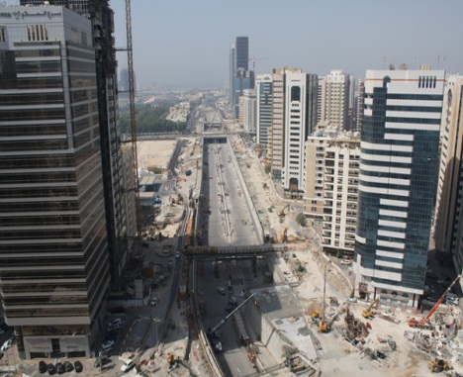
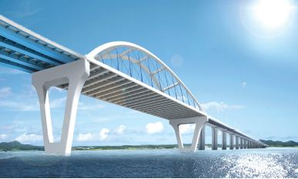
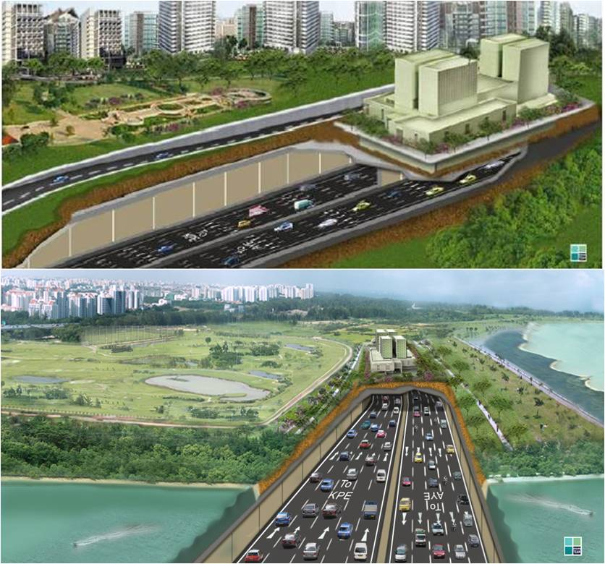
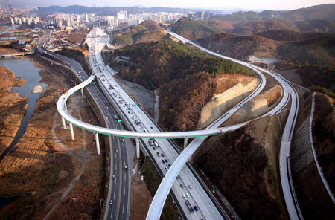
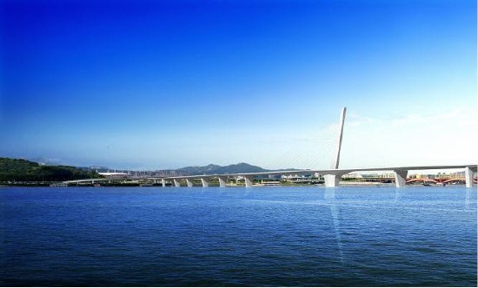
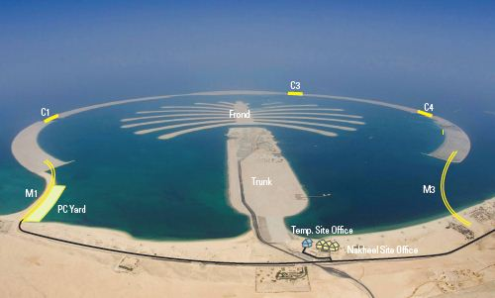
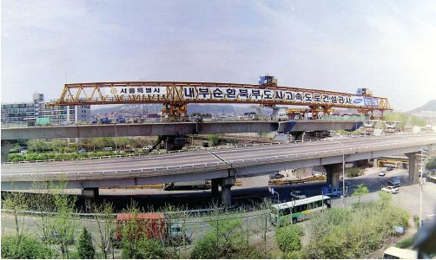
Project Competency – Bridge & Road
On-going
Mersey Gateway Bridge
Incheon Grand Bridge
Young-Jong Bridge
Al Salam St., UAE
On-going
Gun-Jang Bridge
Wando Bridge
MCE C486, Singapore
Busan-Ulsan Expressway
On-going
World Cup Bridge
Palm Jebel Ali, UAE
MCE C483, Singapore
Bukbu Arterial Road

Slide 12
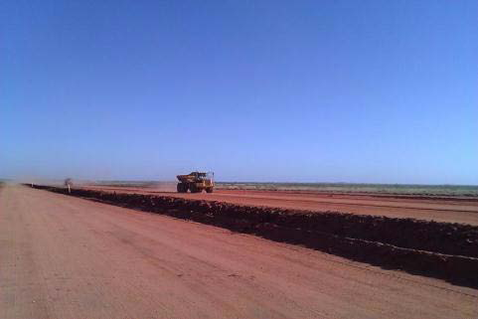
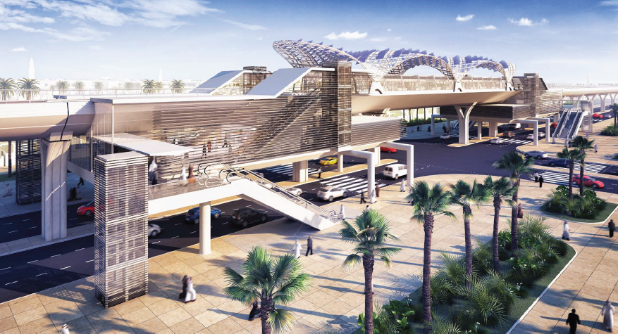
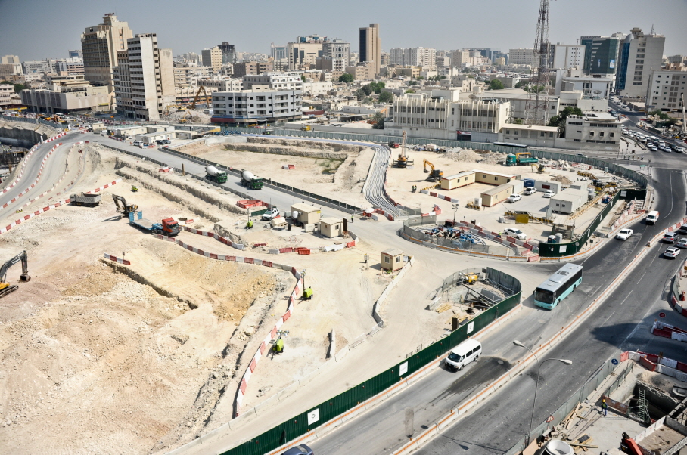
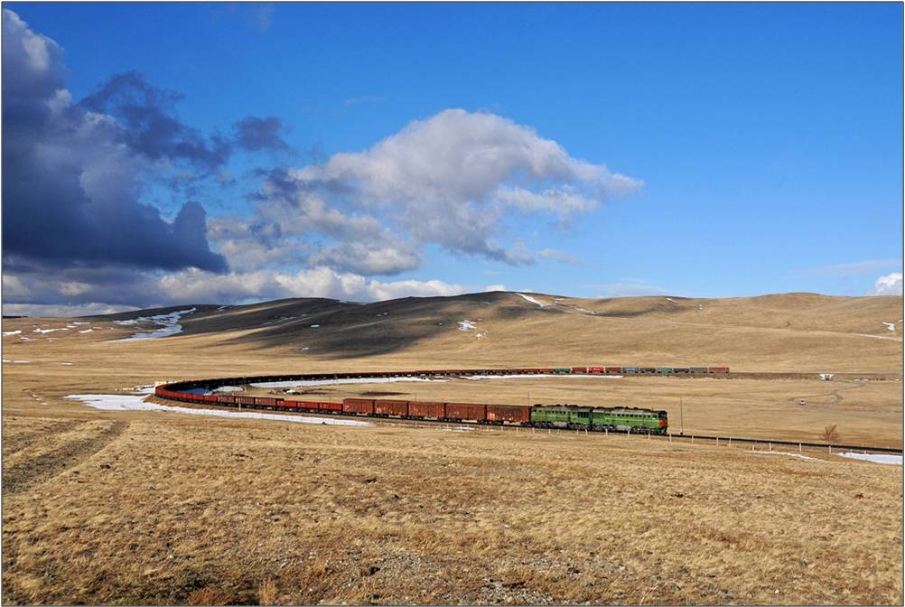
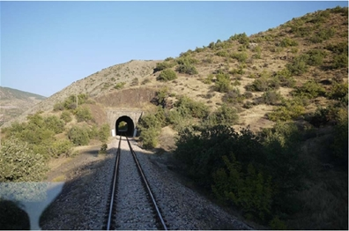
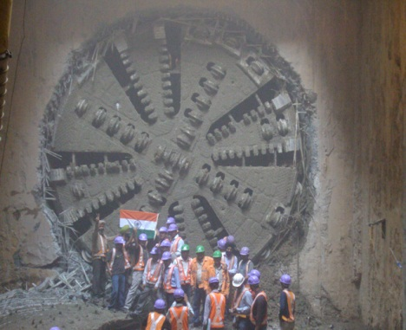
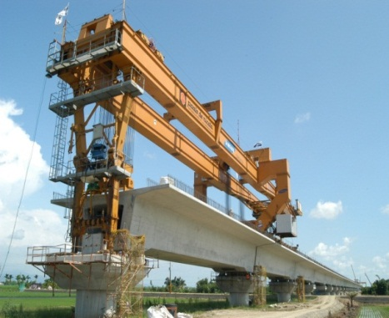
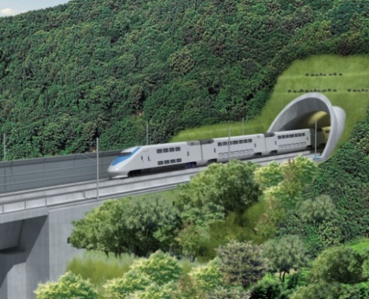
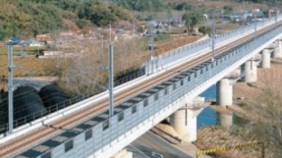
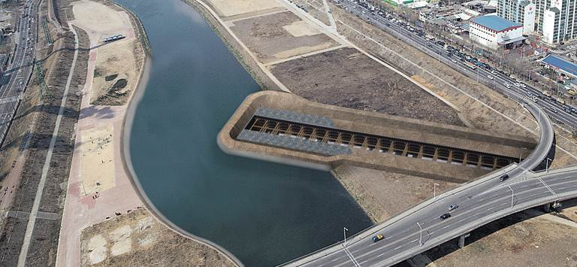
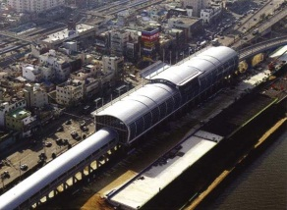
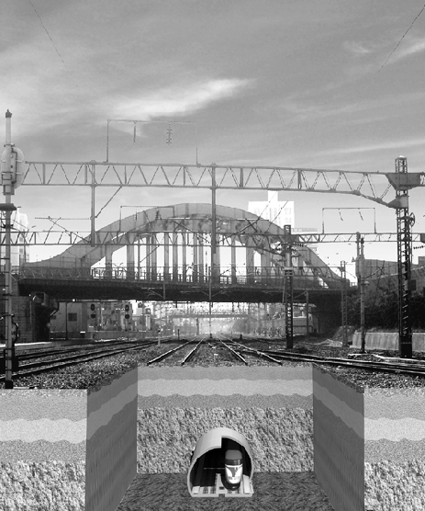
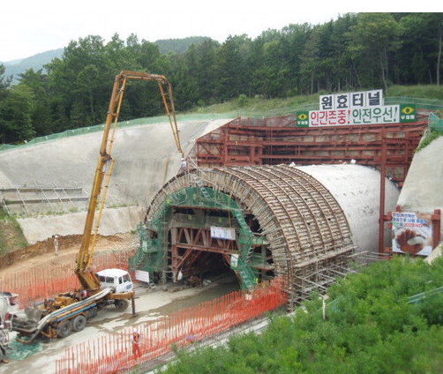
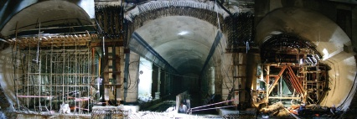
Project Competency – Metro & Railway
On-going
On-going
On-going
On-going
Roy Hill, Australia
Riyadh Metro, KSA
Doha Metro, Qatar
UHG-GS Railroad, Mongolia
On-going
Delhi Metro, AMELC1 , India
Taiwan HSR, C280
Kyungbu HSR, 7-2/10-1
Relocation of Kalekoy Railway,
Turkey
Daejeon Metro 103
Busan
Metro 311
Seoul Metro 907
Kyungbu HSR, 14-3
Kyungbu HSE, 13-3

Slide 13
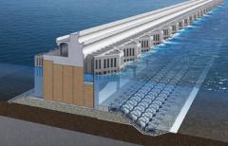
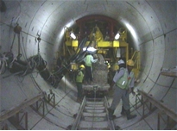
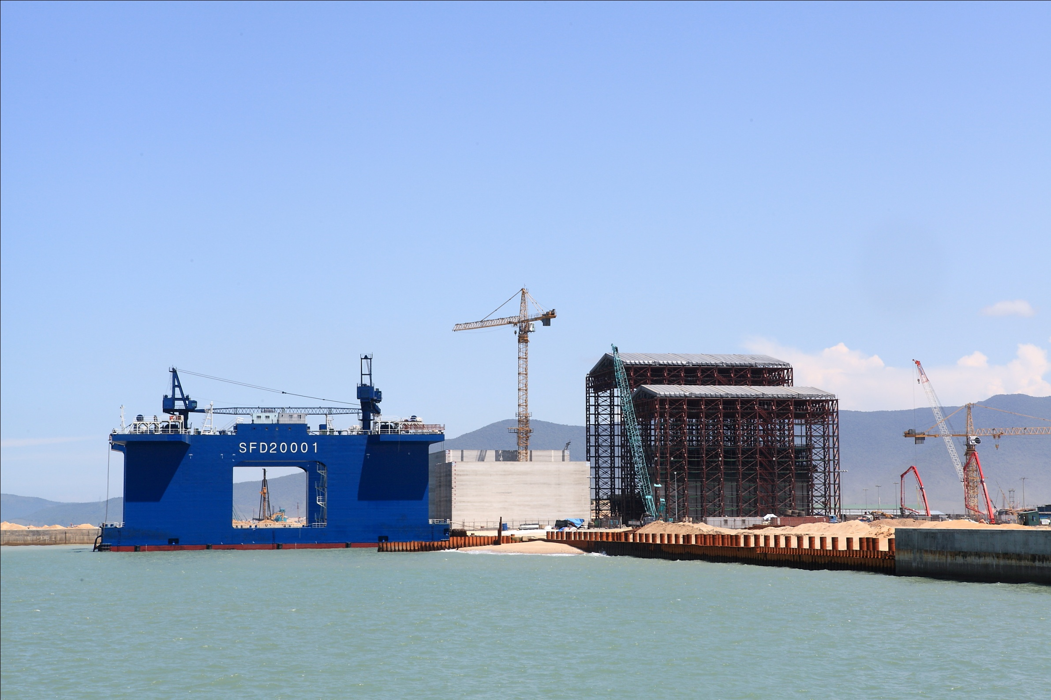
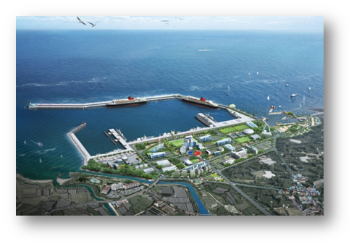
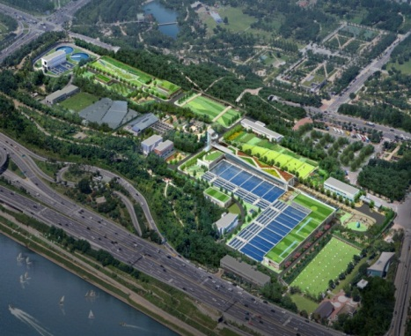
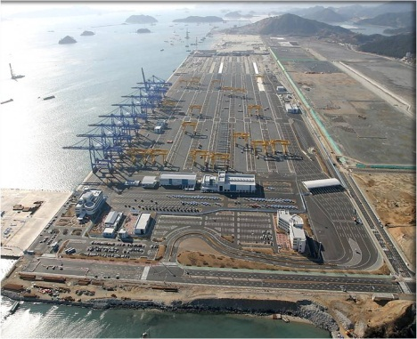
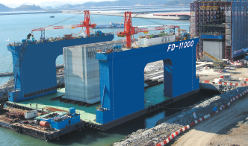
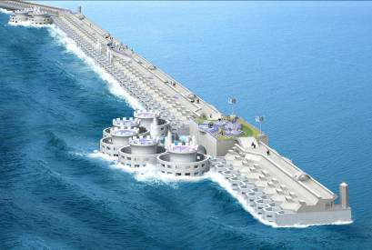
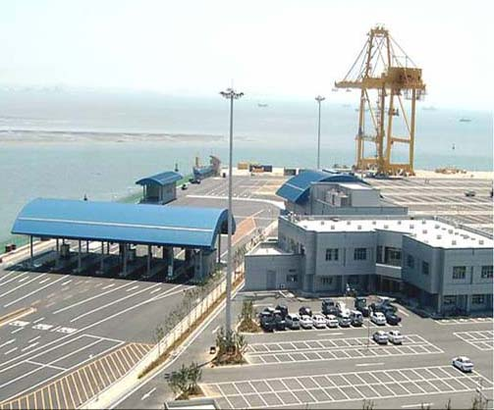
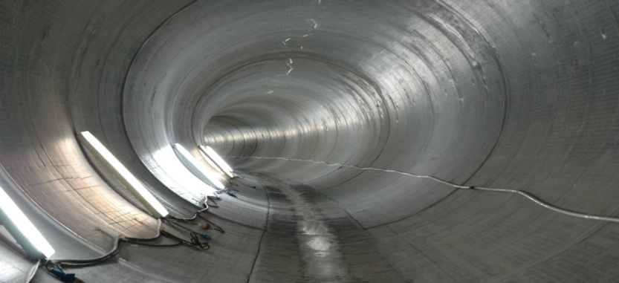
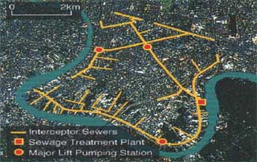
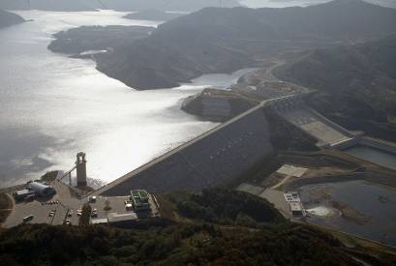
Projects –
Project Competency – Port & Marine / Water
On-going
On-going
On-going
On-going
Son Duong Port, Vietnam
Jeju Naval Base(Caisson)
DTS T01, UAE
Dookdo Purification Facility
Busan New Port
Ulsan New Port (Caisson)
Ulsan North Breakwater
Incheon South Port
DTSS T-04, Singapore
Kyung-in Ara Canal
Wastewater Treat, Thailand
Yong-dam Multi Dam

Slide 14
4. Waste to Energy

Slide 15
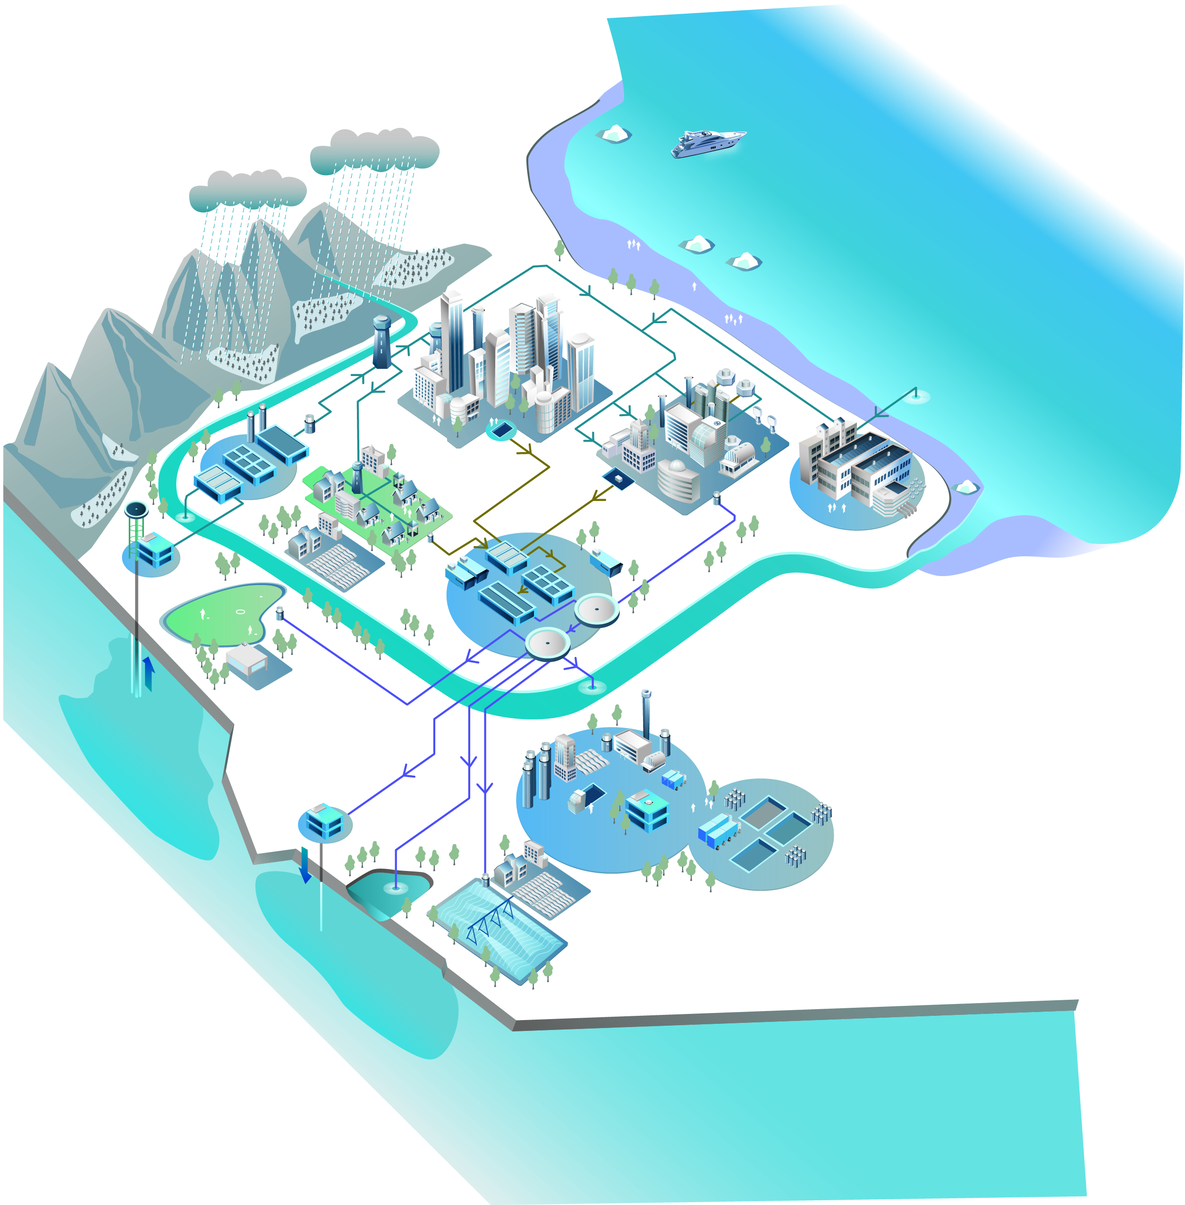
Water Infraestructure
A better urban life
The world is facing climate change that threatens the supply and management of water resources.
Hence, the most vital duty in the water sector is the securing of a clean water supply and promoting
renewable energy generation.
Infrastructure
Dam / Hydropower
Drainage tunnel system
Industrial wastewater treatment plant
River development
Water supply network
Soil remediation
Water treatment plant
Sewer network
Reservoir
Wastewater treatment plant / Re-use plant

Slide 16


Waste to Energy-Savings in treatment
Savings in treatment
Minimize process energy consumption
  High efficiency equipment
  Diffusers
  Blowers
Process control
  PLC and Scada
  Control optimization
Process improvement
  Cutting edge technologies
  Optimal efficiency with lower energy consumption
  Optimal sludge generation and handling scheme
Savings in treatment
Generating energy
Waste 2 Energy
By products
Reuse

Slide 17
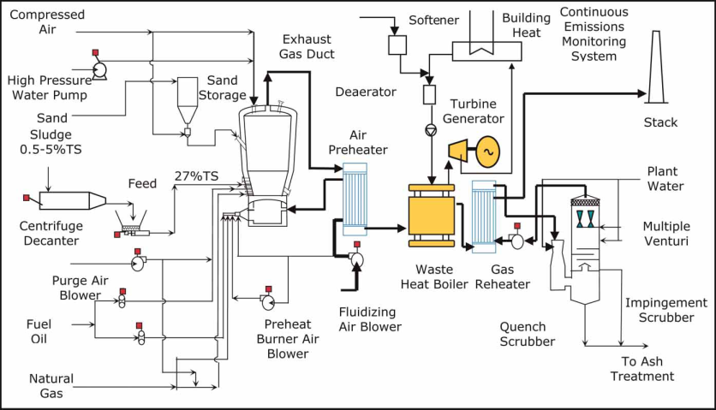
Savings in treatment-High efficiency equipments
Fluid bed incineration
Thermal processes used in sludge disposal have become more attractive as process improvements have been introduced, such as power generation and efficient heat recovery.
Sustainable management is the main driver.
Fluid bed furnaces, especially the hot windbox (HWB) fluid bed, could operate without the use of any auxiliary fuel.
The reduction in fossil fuel consumption as well as the ability to produce electrical energy from a renewable source not only offsets the net carbon footprint of the treatment
facility but can also qualify for carbon credits if and when such provisions are available for this treatment district.

Slide 18
Savings in treatment-High efficiency equipments
Fluid bed incineration-Case Studies-Degremont Technologies Infilco
The electrical consumption per dry ton is less at Duffin Creek than at Lakeview, because at Duffin Creek the steam generated is used in a single stage turbine to drive the fluidizing air blower to eliminate energy demand from the 600 HP motor.
At Southerly, the steam produced is sent to a turbine generator to produce 1,225 kWh of electricity to satisfy Southerly’s electrical needs for the incineration plant with a surplus of 20 kWh.
 | Lakeview | Duffin Creek | Southerly
Sludge loading per line, Dry ton/h | 4.17 | 4.37 | 3.79
Electrical kWh consumption per line | 967 | 845 | 1205
Electrical consumption per dry ton, kW | 232 | 215 | 289
Electricity production, kWh | 0 | 0 | 1225
Net electricity production, kWh | 0 | 0 | 20

Slide 19






Organica FCR Reactor Is The “Heart of the Solution”
Savings in treatment-Process improvements
Plants on the supporting mesh
Walkway and plant supporting rack
3000+
species
Activated
sludge in suspension
Root zone (up to 1.5m) as fixed film carrier
800 species
3-5 kg
of biomass /m³
12-18 kg of biomass /m³
Engineered
supporting media
Fine bubble aeration
Notes:
At the heart of this system are these reactors.
This is the time to inquire whether the listeners are familiar with the basics of biological wastewater treatment in general. Except for the professionals they are generally not. In this case give a two minute „crash course” into the essence of biological treatment. It goes like this: lets take this glass of tea (better have one at hand ☺). It was produced by pouring hot water over the tea leaves and the hot water dissolved all the „goodies” that makes the tea desirable into the water. Thus we can say that the tea is organic matter dissolved in water. Now the question is that if my tea gets cold and I dump it in the sink and thus it becomes wastewater, how do we separate the two again?
What they have been doing in the past decades in all biological treatment plants is this: they take the tea, put it in a vessel and pour a lot of hungry bacteria along with it. They also add aeration just like the one you would use in your aquarium at home (this is to make sure that the bacteria can breath while they eat). The aeration will keep the bacteria is constant suspension. There are very precise mathematical formulae that tell you how many bacteria will eat how much tea stuff out of the water over how long a period of time. Once the bacteria is finished eating all the available food they move the whole mixture in another vessel (a clarifier) and let the well fed bacteria settle at the bottom which leave the clean water on the top. All biological treatment processes employ the same principal including our system. What is the difference?
The reactors are made of steel or concrete (whatever the local economy can produce most efficiently), have fine bubble aeration at the bottom (just as in any traditional technology) and have suspended „activated sludge ”(hungry bacteria if you will) as in traditional solutions. What is new that a few centimeters under the water surface there is a grid on which plants are placed. The root system of these plants dangle into the water 1-1,5 m. In addition, we put several thousand species into the reactor! So, one important difference is that we use a much larger variety of species than in traditional systems
An important note: while the plants are the most visible parts of the system, it’s not the plants that treat the water!! Instead, the plants with their extensive root system provide the habitat for a complex ecosystem that is thriving on the waste stream!

Slide 20

Series Of Food Chain Reactor Zones
Savings in treatment-Process improvements
The biological process takes place in a series of cascade reactors, with standard pretreatment at
the beginning, and phase separation (via Organica Disc Filters or Secondary Clarifiers) and final
polishing at the end.
As water flows through from one reactor zone to the next, different ecologies will grow and adapt to
the conditions in each stage. This configuration allows the “food chain effect” to develop, as higher
level organisms become predators for the simpler organisms.
The result is enhanced removal efficiency and resiliency, while utilizing less energy and producing
less sludge.
19

Slide 21




Savings in treatment-Process improvements
Microbial fuel cell
Organica’s Food-Chain-Reactor (FCR) is a complete wastewater
treatment solution incorporated into a compact, single structure.
Plants are selected for their root structure, root mass and their ability to
withstand the conditions in various reactors. Only locally available
species are used, plants are never transported across borders. Plant
maintenance comprises of simple gardening practices that can be
performed by ordinary wastewater plant operators, no special skills are
required.

Slide 22
Waste to Energy-Generating Energy
Generating Energy
Biogas
  Generating Biogas
  Optimum Biogas generation
Biological fuel cell
Savings in treatment
Generating energy
Waste 2 Energy
By products
Reuse

Slide 23

Generating Energy-Optimum biogas generation
Needs : Sludge volume Reduction & Producing energy from sludge
Solution: Anaerobic digestion enhanced by TH (Thermal Hydrolysis)
High temperature (165°C), pressure (10 bar) and retention time (>30’) allows to ”crack” long
chain molecules
Effects :
  Solubilisation of organic matter previously not accessible for digestion
  Pathogen destruction
  Disintegrates cell structure/organic materials and dissolves naturally occurring cell polymers
  (exopolymeric substances- EPS), a form of protein, into an easily digestible feed for anaerobic
  digestion

Slide 24


Generating Energy-Optimum biogas generation
Principle THP + MAD (Mesophilic Anaerobic Digestion) Exelys Biothelys® Veolia
1) Improving sludge biodegradability by THP
  150-165°C and 6-9 bar
  20-30min
  on concentrated sludge > 16% dryness
  batch or continuous
2) Treating the hydrolyzed sludge by MAD,
  producing more biogas and reducing DS
  15 days HRT
  37-41°C
Digestion – Lysis – Digestion
23
Notes:
23

Slide 25

Advantages of thermal hydrolysis
Generating Energy-Optimum biogas generation
Provide higher VM removal and higher biogas production
Hygienisation (EPA class A)
Dewatering (better dryness)
  Biological sludge: from 21-22% to 28-35% by centrifuge
  High final digested sludge volume reduction
sludge viscosity Improvement (digester can operate at higher concentration)
Volume of digester following TH reduced by 2-3
High sludge quality: odorless, easy storage
No foaming in digester observed
Biogas production increase (+30%)
Sludge to disposal decrease (-35%)
OR
The capacity of the Digester increase (up to 50%)
AND
Complete hygiénisation of sludge
And efficient, reliable and robust solution
24
Notes:
24

Slide 26
Generating Energy-Optimum biogas generation
Conventional
2927 Nm3/d
CHP: 273kWe
MAD
4000 m3
50% VM rem
160 t/d
10tDS/d
25°C
25t/d, 25%
DLD
3723 Nm3/d
CHP: 347 kWe
160 t/d
10tDS/d
25°C
MAD
2400 m3
TMAD
920 m3
63% VM rem
12,5t/d, 34%
25
Notes:
25

Slide 27


Generating Energy-Generating biogas

Slide 28




Generating Energy-Generating biogas

Slide 29

Generating Energy-Biological fuel cell
Microbial fuel cell
Are bioreactors that can convert the chemical energy
present in organic compounds into chemical energy.
Producing electricity using microrganism was first reported
by Potter in 1911.
MFCs are devices that produce energy by the
biodegreation of organic matter using bacteria as catalysts.
Consist of anodic and cathodic chambers separated by a
proton exchange membrane (PEM). The oxidation of
organic matter occurs in the anodic chamber through
bacteria thet generate electron and protons. The electrons
are aborbed by anode and transported to the cathode
through an external circuit.
Protons cross the PEM and enter the cathodic chamber
where they combine with oxygen to form water.
There are several electrochemically active bacteria which
have the capability to transfer electrons from inside the cell
to the extracellular acceptors through c-type cytochromes
and microbial nanowires (flagella) present on their outer
membrane

Slide 30


Generating Energy-Biological fuel cell
Microbial fuel cell
MFCs play the dual duty of degrading effluents and generating power by the treatment of industrial and municipal
wastewater. There is a linear relationship between
the organic content of wastewater and the power output
of MFCs. The biological oxygen demand (BOD) is an
indication of the strength of wastewater, and the power
output of an MFC reflects the BOD of the wastewater,
making MFC a possible BOD sensor.
Therefore, MFCs can be used to reduce the COD of wastewater and simultaneously generate power.
fed with primary sludge the MFC reduced both organic and suspended solids, but the energy output was lower and the formation of methane gas dominated the total energy
Production.This led to the opinion that although it may be
challenging to use MFCs consuming primary sludge for energy production, it may find use in polishing the digested effluent from anaerobic digesters.
Also MFCs can be turned into a microbial electrolysis cell (MEC) by adding a small suplement electricity at the cathode to produce products such as hydrogen gas.

Slide 31

Generating Energy-Biological fuel cell
Bio-electrochemically assisted
microbial reactor
The BEAMR and MFC systems share many similar
characteristics, and therefore many findings for improving
electricity generation in MFCs should be applicable for
increasing hydrogen production in the BEAMR system.
Hydrogen production was examined using domestic
wastewater as the fuel in the BEAMR process, and
Evaluated system performance in terms of hydrogen
recovery, CE, and the effectiveness of treatment (BOD,
COD, and DOC removal).
The initial condition ranges for the wastewater were:
BOD, 86 to 270 mg/L; COD, 204 to 481 mg/L;
DOC, 56.8 to 90 mg/L. The average BOD
concentration (BOD5) at the end of a batch cycle was
4.5 mg/L with a maximum of 7.0 mg/L
and was not a function of the initial wastewater strength. Overall removals (graphite granule tests) were: BOD,
97 %; COD, 95;and DOC, 92.
It is reasonable to expect that domestic wastewater could be used to make hydrogen in the BEAMR process as
either acetate or wastewater can be used to generate electricity in an MFC.

Slide 32
Waste to energy-By products
By products
Sludge: Struvite, Fertilizer
Biopolymer
Savings in treatment
Generating energy
Waste 2 Energy
By products
Reuse

Slide 33





By products-Biopolymer
PHA
Polyhydroxyalkanoates (PHAs) are thermoplastic polymers
that are biodegradable and can be produced from renewable
resources.
The main subtrates used for the selective growth of PHA
storing organism and PHA production have been volatile
fatty acids (VFAs) since VFAs are efficiently converted into
PHAs, whereas carbohydrates are preferably stored as
polysaccharides.
For every ten tonnes of COD removed in a biological
wastewater treatment system one to four tonnes of biomass
is produced, in which contains bacteria that can store PHA
Alcaligenes latus loaded with PHA granules

Slide 34

By products-Biopolymer

Slide 35
Waste to energy-Reuse
Reuse
Agricultural
Industrial
Groundwater recharge
Recreational uses
Urban use
Savings in treatment
Generating energy
Waste 2 Energy
By products
Reuse

Slide 36
Reuse- Description
Energy efficiency and sustainability are key drivers of water reuse, which is why water reuse is so integral
to sustainable water management. The water-energy nexus recognizes that water and energy are mutually
dependent, energy production requires large volumes of water, and water infrastructure requires large
amounts of energy.
Sustainable development is development that meets the needs of the present without compromising the ability
of future generations to meet their own needs, therefore, sustainable water management can be defined as water
resource management that meets the needs of present and future generations.
Water reuse is integral to sustainable water management because it allows water to remain in the environment
and be preserved for future uses while meeting the water requirements of the present. Water and energy are
interconnected, and sustainable management of either resource requires consideration of the other. Water
reuse reduces energy use by eliminating additional potable water treatment and associated water conveyance
because reclaimed water typically offsets potable water use and is used locally.

Slide 37
Reuse-Definitions
De facto reuse: A situation where reuse of treated wastewater is, in fact, practiced but is not
officially recognized (e.g., a drinking water supply intake located downstream from a wastewater
treatment plant [WWTP] discharge point).
Direct potable reuse (DPR): The introduction of reclaimed water (with or without retention in an
engineered storage buffer) directly into a drinking water treatment plant, either collocated or
remote from the advanced wastewater treatment system.
Indirect potable reuse (IPR): Augmentation of a drinking water source (surface or groundwater)
with reclaimed water followed by an environmental buffer that precedes drinking water treatment.
Nonpotable reuse: All water reuse applications that do not involve potable reuse.
Potable reuse: Planned augmentation of a drinking water supply with reclaimed water.

Slide 38

Reuse & Management
Water Management
The cities face weakness in the traditional
practices of water management, which typically
focus on individual resources or utilities.
Dry weather stormwater represents low flows that
occur during non-peak events that may end up in
the wastewater collection system, and wet
weather stormwater represents higher flow
periods that generally end up as discharge to
receiving waters. Urban watersheds use more
receiving waters for their water supplies and
wastewater and stormwater into receiving waters.
Reduce the demand for freshwater are part of this
comprehensive management Approach, like
rather than viewing stormwater as a nuisance, it
should be considered an asset that is allowed to
recharge groundwater through best management
practices, such as the use of swales, porous
pavement, or cisterns.
Additionally, wastewater can be reused, providing
both environmental and water supply benefits

Slide 39

Reuse
Energy Management
Knowing than cities use around up to 5% of its total
energy consumption for drinking water and
wastewater systems, implementing best management
practices must be accompanied by optimal treatment
facilities in which energy audits are highly important.
Wastewater Treatment BPs
Variable Frequency drive applications-0.5 to 5 years
Optimize flow with controls-Variable
Optimize aeration system-3 to 7 years
Fine bubble aeration-Variable
Variable Blower air flow rate-3 years
Dissolved oxygen control-2 to 3 years
Final effluent recycling-2 to 3 years

Slide 40



Reuse & Applications
Water & Energy Management

Slide 41

Reuse & Applications and quality
Wastewater Reuse
Treated wastewater can achieved the
values shown in this chart and with the
a proper local wastewater management
energy consumption and water footprint
can be optimized.
 | Primary | Secondary | Tertiary
BOD | 19% | 74% | 5%
TSS | 40% | 55% | 4%
TOC | 21% | 64% | 8%
Ammonia-N | 5% | 52% | 1%
Phosphate-P | 16% | 28% | 54%
Iron | 11% | 59% | 22%

Slide 42


Reuse-Water quality needed
Irrigation quality
Boilers

Slide 43



Reuse & WTP
Microorganism removal
Filtration size-contaminants
Processes for WTP

Slide 44
4. Reuse case studies

Slide 45
Reuse-Case study-Aquapolo-Industry
Description
Solution
The State of São Paulo is the world’s seventh most
populous urban area.
The region contains nearly one-fourth of the country’s population but less than 2% of Brazil’s water.
The state government, recognizing the importance of
safeguarding drinking water for the region’s inhabitant,
issued regulations to restrict the industrial use of
potable water, forcing factories to look for ways to
reuse their wastewater, or obtain recycled water from another source.
Upon completion, this groundbreaking facility will free up enough drinking water to continuously supply a
population of 350,000 inhabitants, with the potential
capacity to reach 600,000.
Koch Membrane Systems (KMS) concluded
that membrane bioreactor (MBR) technology with a
Tertiary Membrane Bioreactor (TMBR) system was
the best solution for the new facility.
The Aquapolo facility employees KMS’PURON® MBR technology as well as MegaMagnum® reverse
osmosis (RO) membranes.
The initial 2012/2014 phase will produce 56,160 m3/
day (650 L/s) of reuse water, eventually reaching a
capacity of 86,400 m3/day.

Slide 46
Reuse-Case study-Aquapolo-Industry
Reuse solution
Challenges
Sixty-five percent of the plant output has already
been sold under a 34-year contract to Quattor, a
petrochemical company located within the Mauá
petrochemical complex—Aquapolo’s target market.
Other potential users are companies located along
the 10-mile steel pipeline being built to carry water to
the complex.
The recycled water used in industry for processes
such as cooling, making steam, and cleaning requires
removal of particular substances as well as a
reduction of suspended solids and conductivity.
The poor performance of the secondary clarifiers,
suffering regularly from bulking sludge, was a major
potential threat for any RO solution. Even the
installation of either sand filtration or direct
ultrafiltration (UF) would only move the problem
upstream, but never eradicate it.
Another point to address was the high ammonia level still present in the secondary effluent from the plant,
varying between 10 and 25 mg/L NH4-N. As the
current plant was only designed for carbonaceous
removal, nitrification was impaired because the
sludge retention time was too short, resulting in high
ammonia effluent values. RO technology alone will
not be able to meet strict reuse criteria of <1 mg/L
NH4-N year average. While RO remained an
essentialpart of the treatment process to reduce total dissolved solids and make the water clean enough for reuse, the RO system needed to be coupled with an
effective pretreatment system.

Slide 47




Reuse-Case study-Aquapolo-Industry
Process-PFD
 | Primary
Pre treatment | Disc Filter 400 micra
Bio recators | 3500 m3
Membrane cassettes | 63 units/1500 m2 each/94.500 m2
Flux | 25 l/m2.h
MLSS (Membrane tanks) | 5 to 8 g/l
MLSS (bio recators) | 6.4 g/l

Slide 48




Reuse-Case study-Aquapolo-Industry
Results

Slide 49

Reuse-Case study-Kuwait city-Agriculture
Description
Solution
Recover municipal wastewater from Kuwait City and the surrounding area. The consortium was
established to design, build, own, operate and
maintain a100 million gallon per day (mgd) (375,000 m3/day) wastewater treatment facility at Sulaibiya
Near Kuwait City. The Sulaibiya facility is the
world’s largest membrane-based water reclamation
facility. The reclaimed and desalinated water
from the Sulaibiya facility is used for non-potable
uses that impact the drinking water supply, by
blending with brackish water to better exploit existing
brackish water distribution facilities
A conventional biological wastewater treatment plant
(WWTP) treats the effluent to better than secondary
effluent quality.
The secondary effluent then flows to the water
reclamation plant, which uses ultrafiltration (UF) and
reverse osmosis (RO) to further treat the water for
reuse. Sludge from the wastewater treatment plant
is treated to allow for disposal by landfill, incineration,
or by composting.
The water reclamation plant is designed to treat
100 mgd (375,000 m3/day) of secondary effluent,
which is prefiltered with disk filters and then fed to the ultrafiltration system. UF product feeds a reverse
osmosis plant, and UF waste is recycled to the
WWTP. The UF system treats 100% ofthe flow after
biological treatment since the UF waste is recycled.
Hence, the feed to the RO system is also 100 mgd.
The RO plant is designed for 85% water recovery, so the expected production rate is 85 mgd.

Slide 50

Reuse-Case study-Kuwait city-Agriculture
Results
Process
The plant influent is typical domestic sewage.
The WWTP is designed to produce an effluent
with an average monthly value of less than 20 mg/l
BOD and 20 mg/l TSS.
The average total dissolved solids (TDS) in the feed
Is 1,280 mg/l, and the plant product is less than
100 mg/l, significantly better than World Health
Organization (WHO) potable water guidelines.
The effluent fed to the UF first passes through a disk
filter, after which a small amount of coagulant is added to coagulate fine particulates and possibly allow
some TOC removal to facilitate the operation of the
plant. The SDI of the UF product will be below 2, an
important criterion for the RO plant performance.
Previous experience treating secondary municipal effluent with UF has shown that SDI values of less than 1 are possible.
The salinity of the municipal effluent has an average
monthly value of 1,280 mg/l TDS, with a maximum
value of 3,014 mg/l. RO is used to desalinate the
water to 100 mg/l TDS, as well as provide a second
barrier to bacteria and viruses.
RO technology is well proven for desalinating
municipal effluent. The system consists of 42 identical skids in a 4:2:1 array. Approximately 21,000
membranes, provided by Toray of America, were
required for this project. The RO system is limited to
operating at 85% recovery by calcium phosphate
precipitation, which can frequently be the limiting
factor for water recovery in membrane systems
desalinating municipal effluent.

Slide 51
Reuse-Case study-Australia-Industry
Description
Solution
The Wynnum Advanced Wastewater treatment plant
is located south of the Brisbane River junction to the
sea in Moreton Bay. Abundant wildlife live in and
around Moreton Bay, which is like a lagoon because a series of off-shore barrier islands restrict the flow of
oceanic water.
In 2008, as part of the area’s sustainability efforts, an advanced wastewater treatment plant was built to
produce Class A+ recycled water for industrial
processes.
The water reclamation plant receives feed water from the upgraded wastewater treatment plant. Table 1 details the average feed water quality.The effluent water
is chloraminated (2-3 mg/L) (Cl2) and then directed to the balance tank, where it goes through 0.5 μm Amiad screens and two microfiltration units—the SDI of the MF filtrate is less than three 100% of the time. The pH is corrected with H2SO4, and then the water moves
through MF filtrate tanks, and an antiscalant dose
before being fed to RO units. The RO system consists of two identical units of 16:8 configurations and each pressure vessel houses seven elements 336 pieces
of BW30-400/34i-FR membranes are installed. The
units recover 75% with a total design capacity of
5.3 ML/d. From there, the RO permeate is sent to the degassing tower, breakpoint chlorinated and then
stored.
Produces 4,500 m3/d of high industrial grade Class A+ recycled water daily from municipal sewage.

Slide 52


Challenges
Process-PFD-Results

Slide 53

“Water is the driving force of all nature”
Biosphere
Food
Water
Energy
Energy can be produced
from food crops
Energy is used for
storing, cleaning and
transporting water
Food production
uses a lot of energy
Water is needed for
energy production
Water is needed for
food production
Food production
affects water availability

Slide 54


