Slide 1
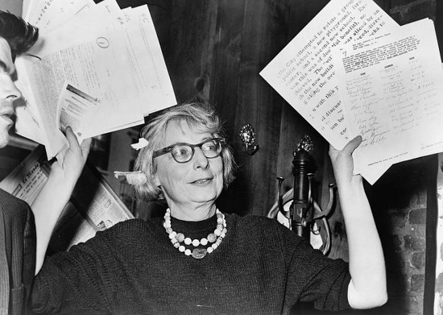
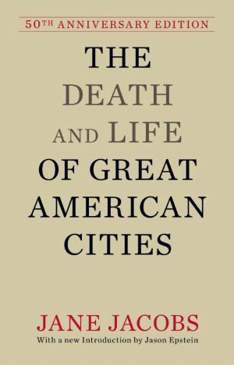
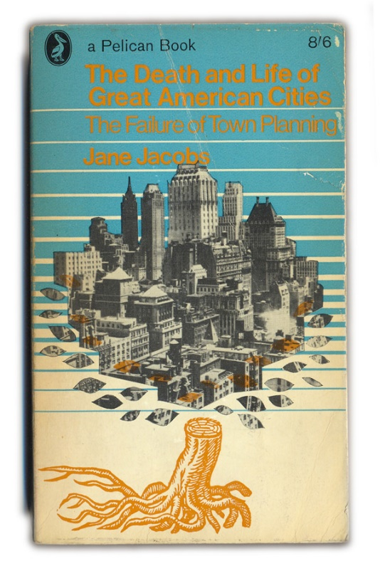
Advanced Urban Design (Urban Regeneration), 2015. 10. 08, Seoul National University
The Death and Life of Great American Cities
Written by:
Jane Jacobs
Presented by:
Junghwan Park
Master’s Course,
Urban Design Lab,
Department of Civil and Environmental Engineering,
Seoul National University

Slide 2
Table of Contents
Introduction
The Uses of Sidewalks: Safety
The Uses of Sidewalks: Contact
The Uses of Sidewalks: Assimilating Children
The Role of Parks
City Neighbourhoods

Slide 3
I. Introduction

Slide 4
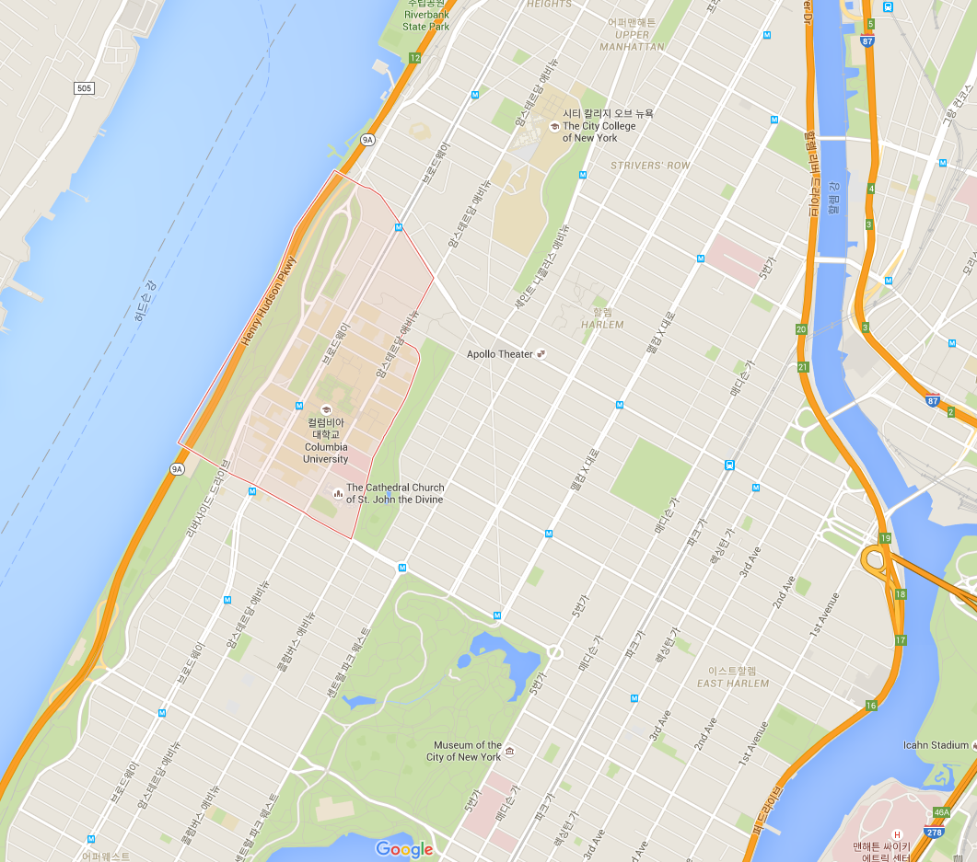
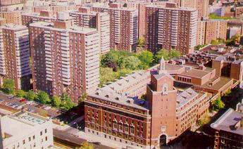
Introduction
“This book is an attack on current city planning and rebuilding”
“An attempt to introduce new principles of city planning and rebuilding”
- Jane Jacobs
Orthodox urban planning were helpless to stem decay in most American cities
Example: Morningside Heights, NYC

Slide 5
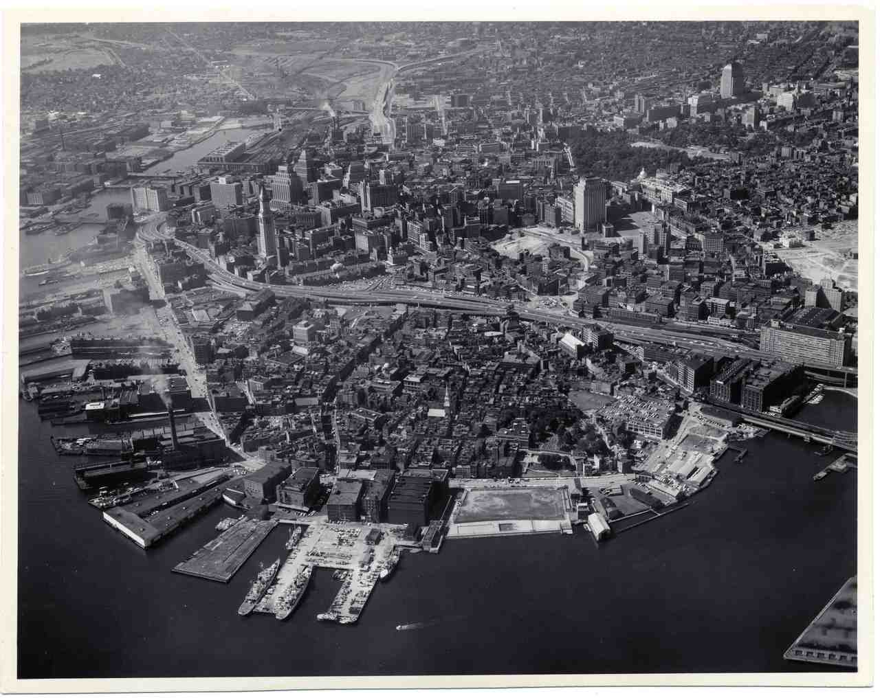
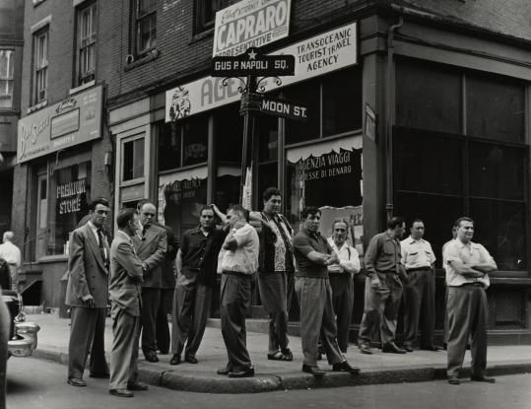
Introduction
“The simple needs of automobiles are more easily understood and satisfied than the complex needs of cities, and a growing number of planners and designers have come to believe that if they can only solve the problems of traffic, they will thereby have solved the major problem of cities.”
Example: North End, Boston
North End was a well-known in slum area near Boston harbor.
In 1950s, orthodox urban planners still regarded the area as slum, but Jacobs thought differently…

Slide 6
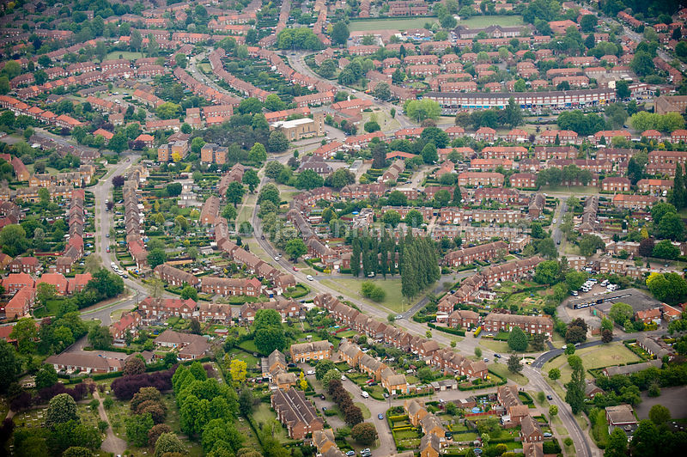
Review on Orthodox Urbanism
Brief review on orthodox urban planning theory
Sources of Orthodox Urbanism:
Garden Cities of Tomorrow, Ebenezer Howard.
The Culture of Cities Lewis Mumford.
Cities in Evolution, Sir Patrick Geddes.
Modern Housing, Catherine Bauer.
Toward New Towns for America, Clarence Stein.
Nothing Gained by Overcrowding, Sir Raymond Unwin.
The City of Tomorrow and Its Planning, Le Corbusier.
Criticism on Howard & Geddes
Howard tried to solve urban problems through running away from cities
He ignored many other aspects of big cities; diverse cultural activities, ways to maintain safety, political activities, exchange of thoughts
Geddes supported Howard’s idea through a logic drawn from natural resources.
Welwyn Garden City

Slide 7
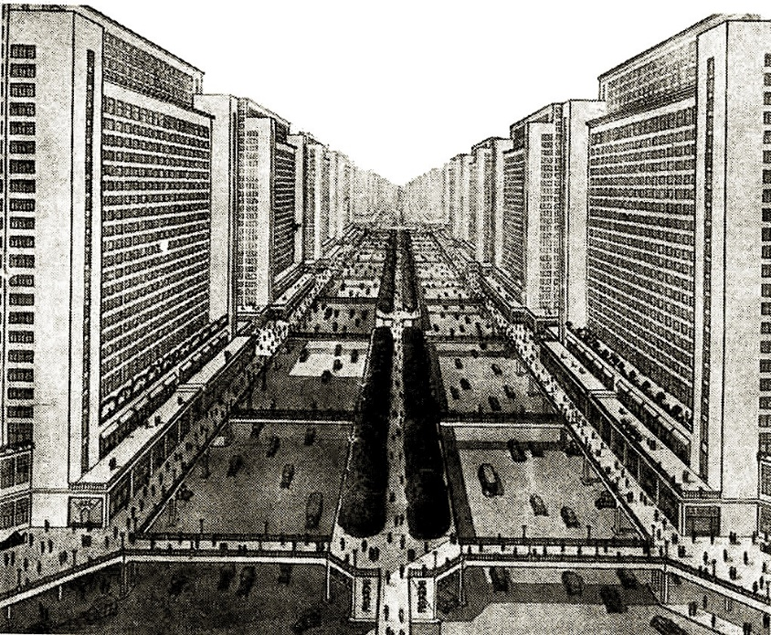
Review on Orthodox Urbanism
‘Decentrists’ in America (1920s)
Louis Mumford
Clarence Stein
Henry Wright
Catherine Bauer
Focused merely on the failures of great cities
Did not give efforts to understand the principles of great cities
Le Corbusier – Radiant City
The Decentrists were aghast at Le Corbusier’s idea, but ironically, the Radiant City directly came out from Garden City
‘Vertical Garden City’
A City for automobiles

Slide 8
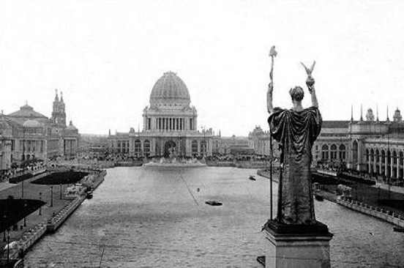
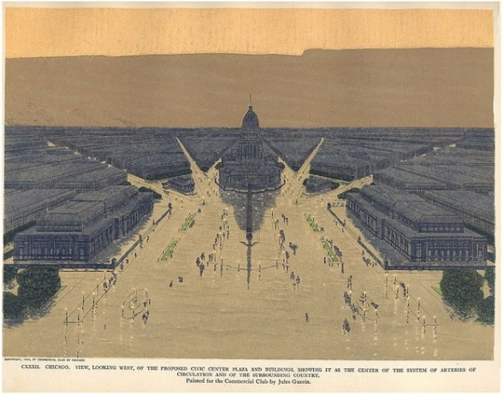
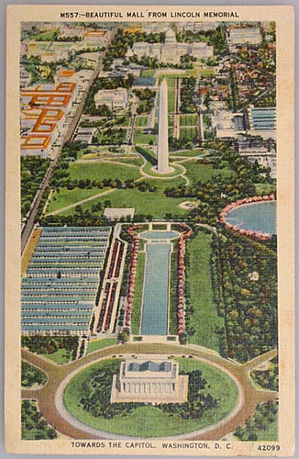
Review on Orthodox Urbanism
‘City Beautiful Movement’ – one other line of ancestry in orthodox planning
Daniel Burnham
The aim of the City Beautiful was the City Monumental
Gathering monuments into a central area
However, it failed in most cases
Decay in the central parts got faster, and people visited less and less
“Unstudied, unrespected, cities have served as sacrificial victims”

Slide 9
II. The Uses of Sidewalks: Safety

Slide 10
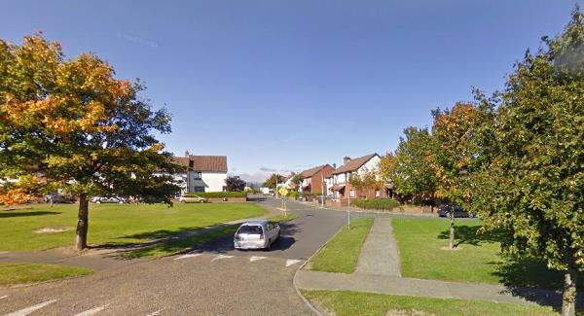
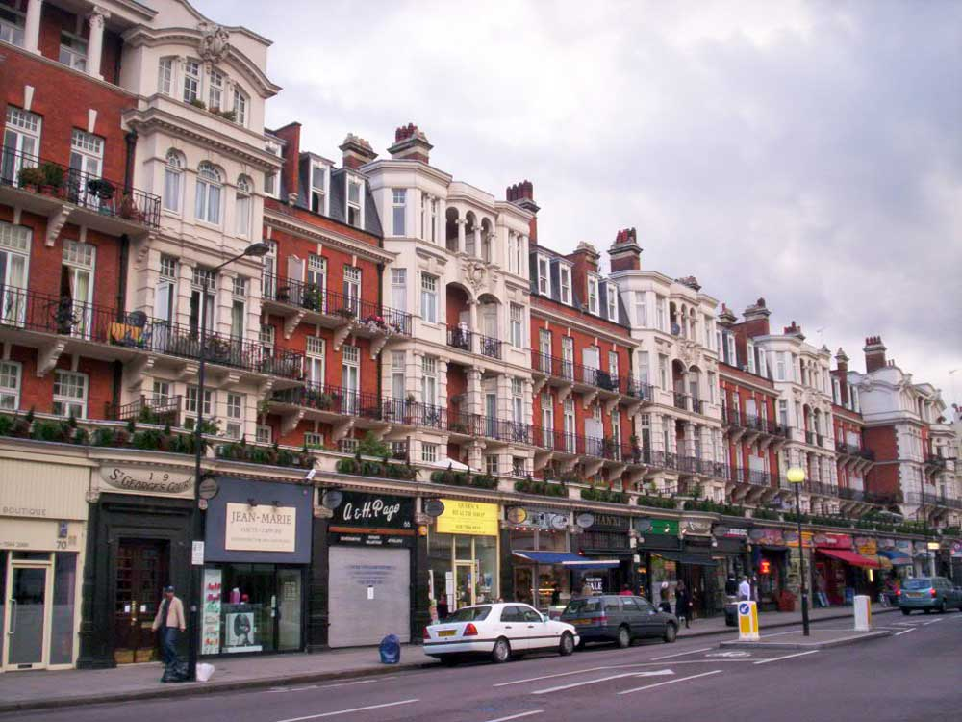
Streets
“Streets in cities serve many purposes besides carrying vehicles, and city sidewalks-the pedestrian parts of the streets-serve many purposes besides carrying pedestrians”
Street and their sidewalks are a city’s most vital organs
If streets of a city look interesting, the city looks interesting
More than that, if a city’s streets are safe from barbarism and fear, the city is thereby tolerably safe
Where does barbarism and fear happen the most?
-> probably more in ‘quiet residential areas’

Slide 11
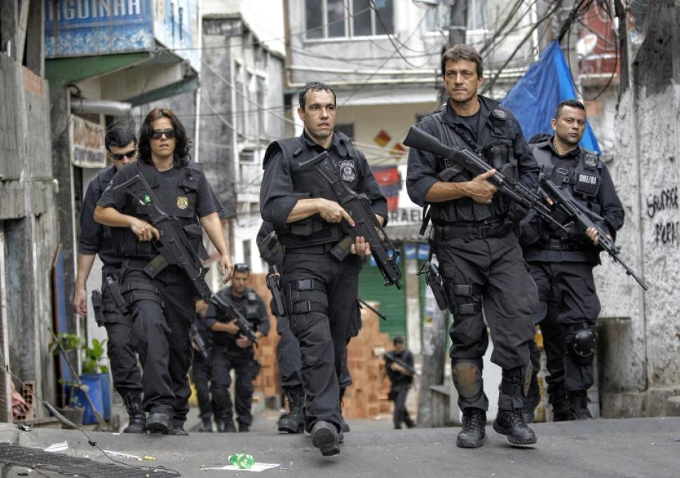
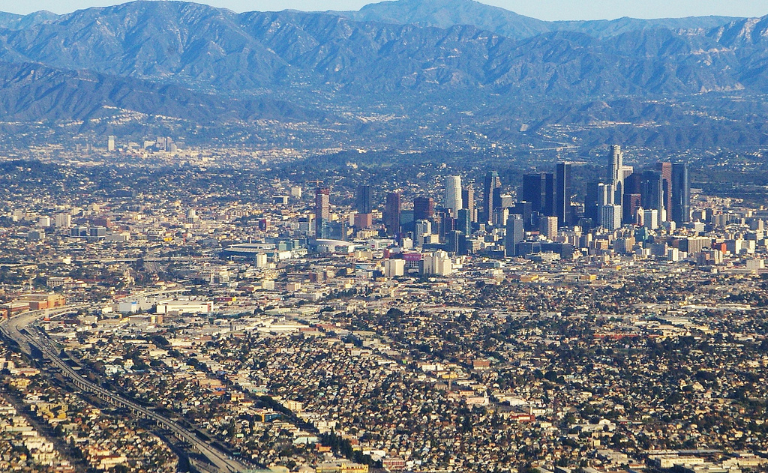
Safety in cities
Characteristics of security in cities
First, public peace of cities is not kept primarily by the police
peace is kept by an intricate, almost unconscious, network of voluntary controls and standards among the people themselves
Second, the problem of insecurity cannot be solved by spreading people out more thinly
If this worked, Los Angeles should be a very safe city because superficially Los Angeles is almost all surburban

Slide 12
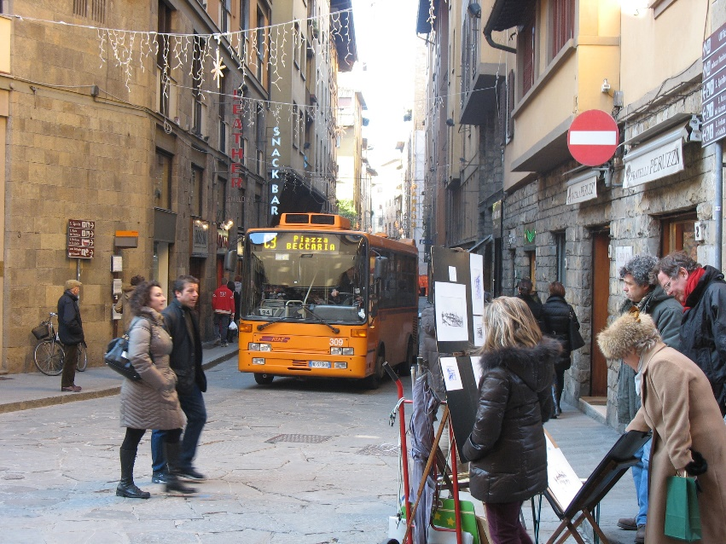
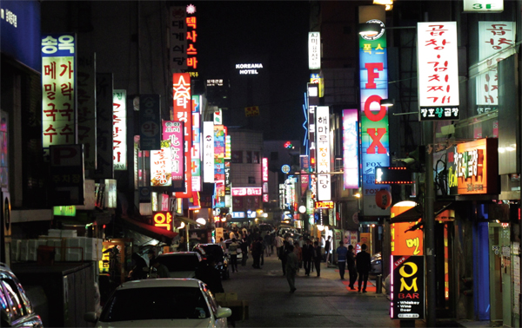
A city street’s main qualities
A city street equipped to handle strangers, and to make a safety asset, in itself, out of the presence of strangers, as the streets of successful city neighbourhoods always do, must have three main qualities:
First, there must be a clear demarcation between what is public space and what is private space
Second, there must be eyes upon the street, and the buildings must be oriented to the street
Third, the sidewalk must have users on it fairly continuously, to induce the people in buildings to watch the sidewalks in sufficient numbers.

Slide 13
Shops and public places
A substantial quantity of stores and other public places are required for such surveillance
First, they give people-both residents and strangers-concrete reasons for using the sidewalks on which these enterprises face
Second, they draw people along the sidewalks in nearby areas, thereby increasing the number of people walking in wider ranges
Third, storekeepers and other small businessmen are typically strong proponents of peace and order themselves
Fourth, the activity generated by people on errands, or people aiming for food or drink, is itself an attraction to still other people
“Most city planners and city architectural designers operate on the premise that city people seek the sight of emptiness, obvious order and quiet”

Slide 14
III. The Uses of Sidewalks: Contact

Slide 15
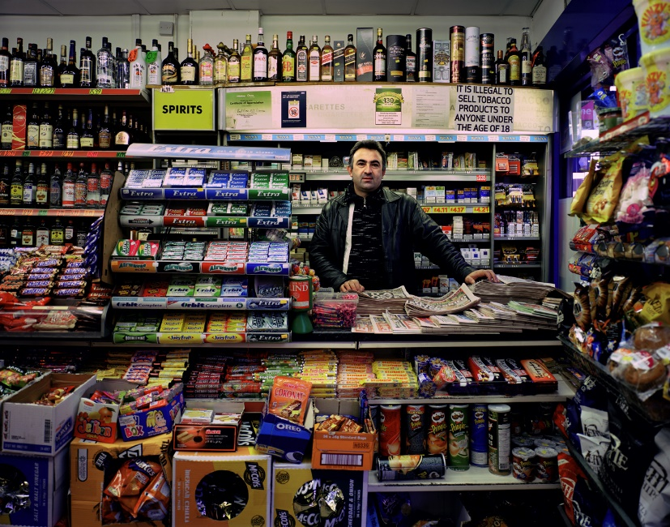
Contact
Contact on streets = trust between people = security and safety in city life
Privacy
Urge for contact
Sidewalk travel ensures that people know each other
Also, suspicion and fear of neighbors will make sidewalks unsafe
Shopkeepers are essential elements of contacts in neighbourhoods -> ‘public character’
If there are no shops/no street life, privacy can be encroached
In high-rise buildings, there are few chances to meet with neighbours

Slide 16
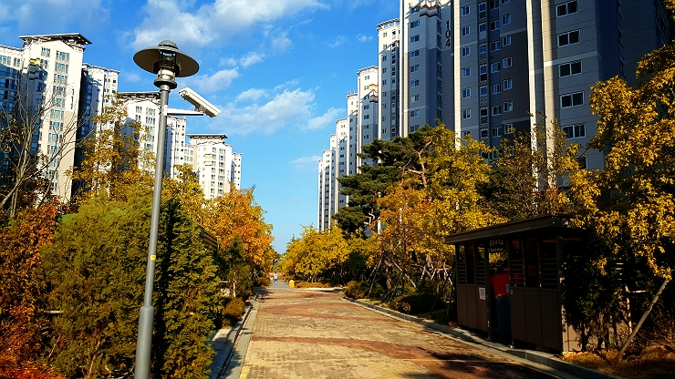
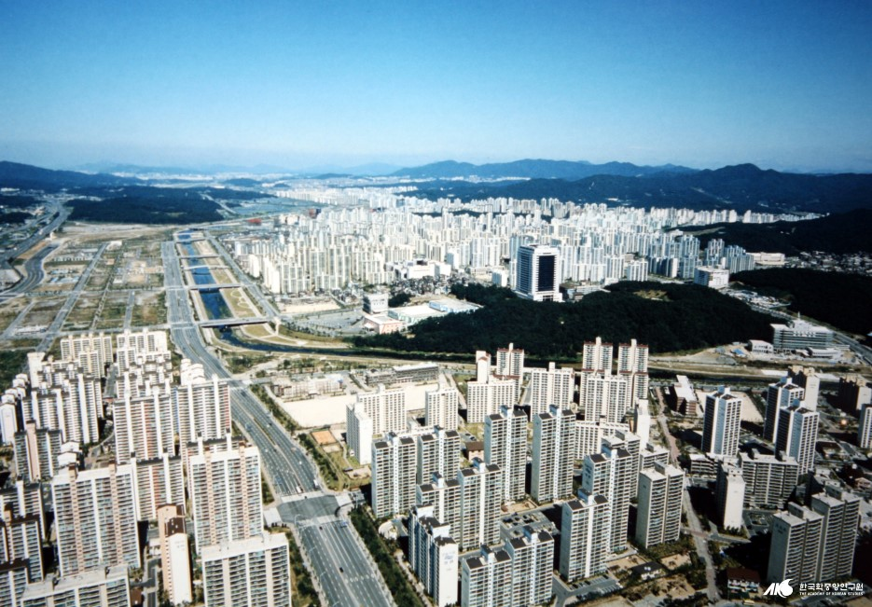
Korean case - apartments

Slide 17
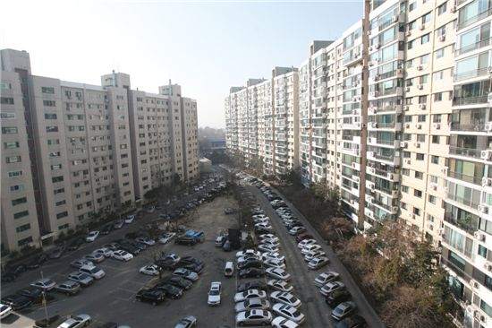
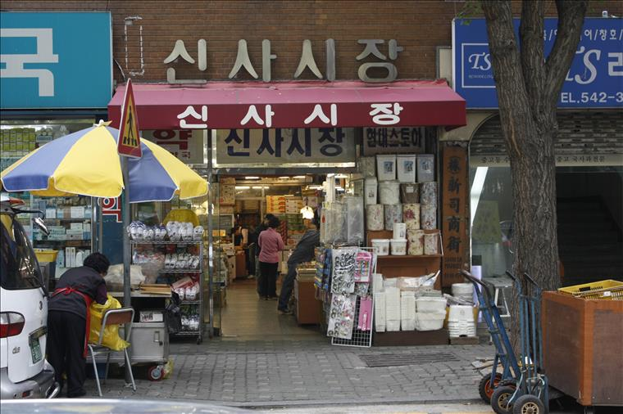
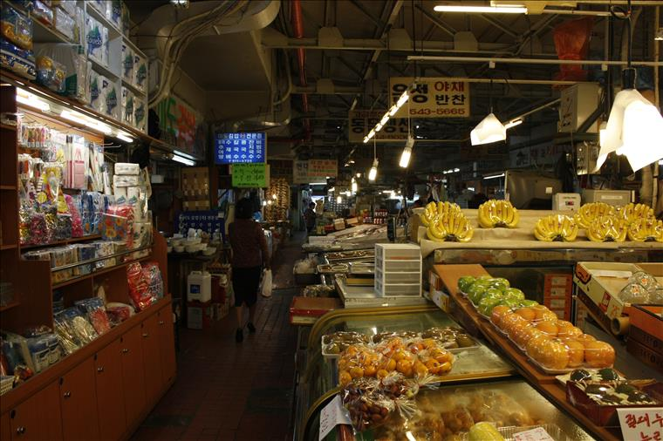
Korean case - apartments
Apgujeong Hyundai Apartment
Has a shopping street inside the residential complex

Slide 18
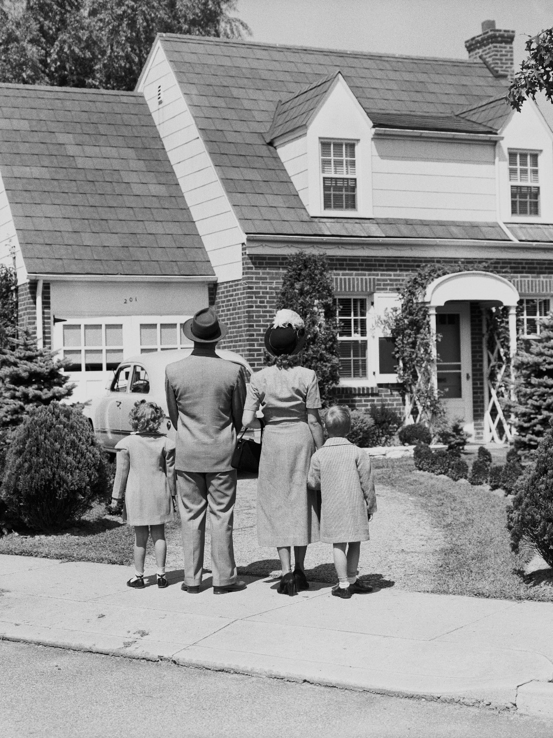
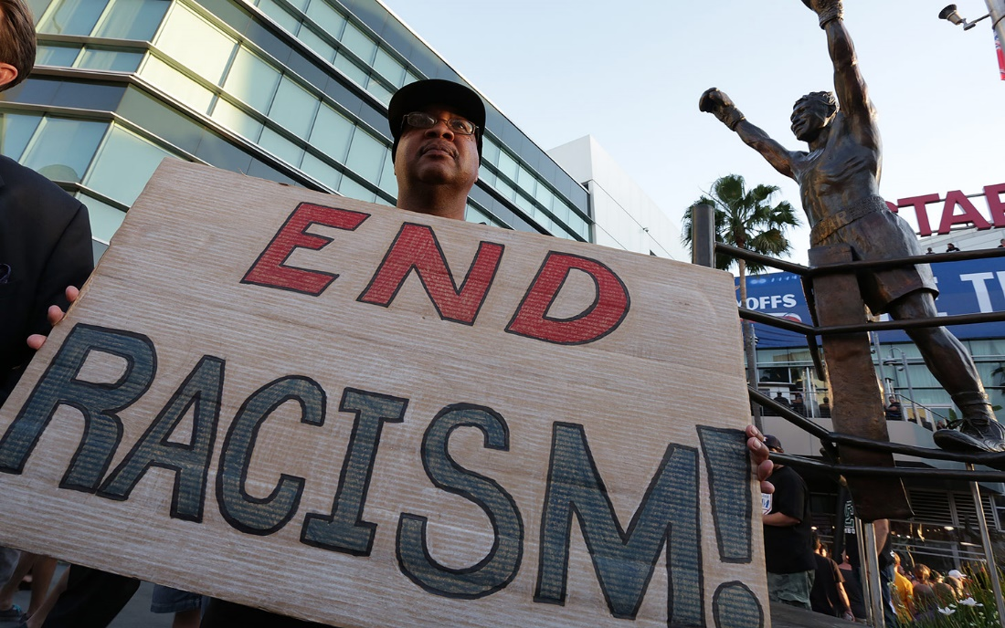
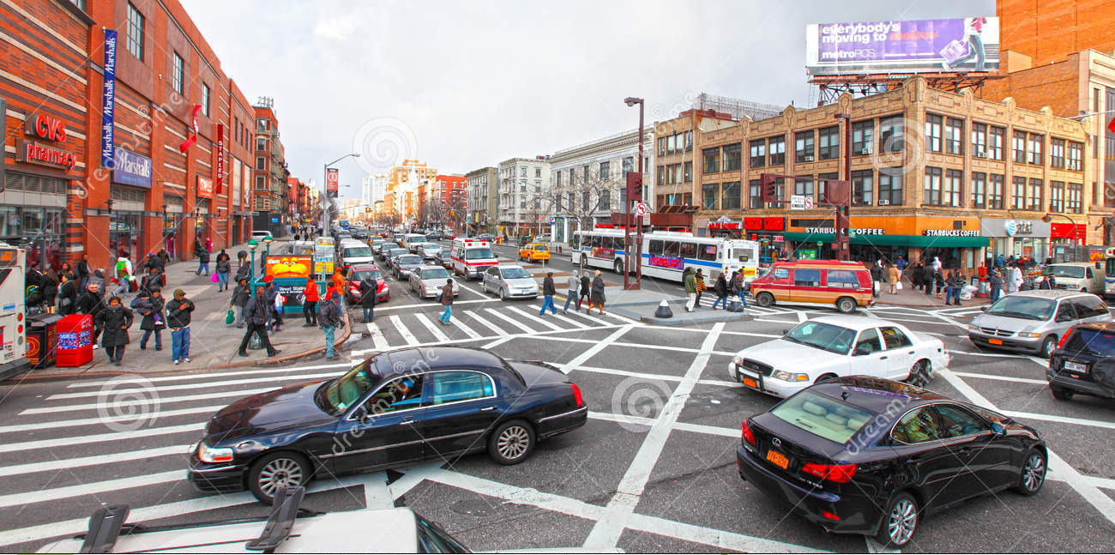
American case - Racism

Slide 19
IV. The Uses of Sidewalks: Assimilating Children

Slide 20
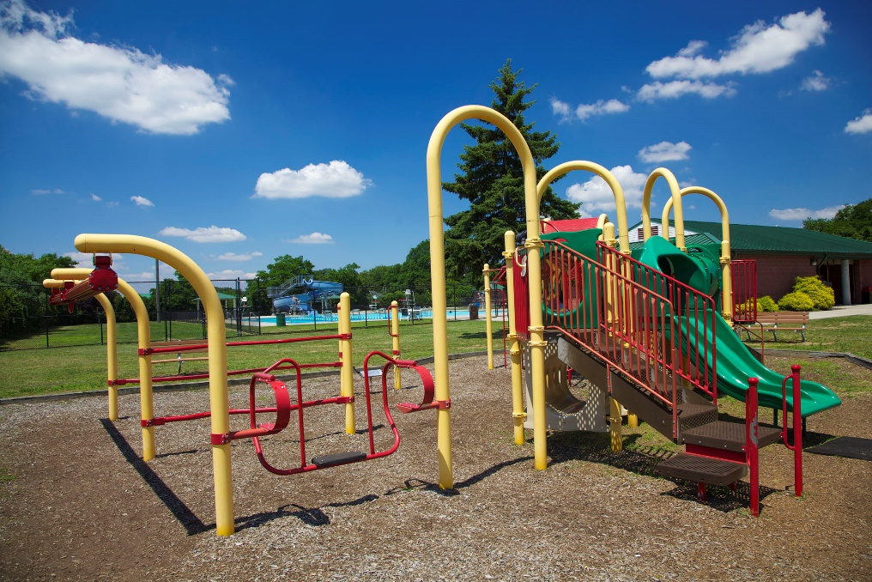
Children: where to play?
Old superstition on children
-> that streets are dangerous for children, and they can become delinquent in the streets
That’s why old planners wanted to send children to parks and playgrounds to play
However, in a survey in US,
- Juvenile crime rate ~ number of playgrounds and parks

Slide 21
Children: where to play?

Slide 22
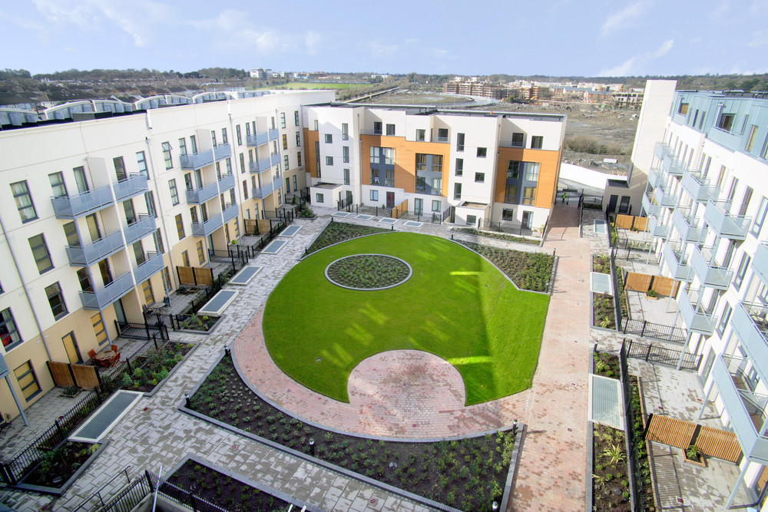
Children: where to play?

Slide 23
Children: where to play?
Adults are in the streets
Don’t separate where the adults and children stay

Slide 24
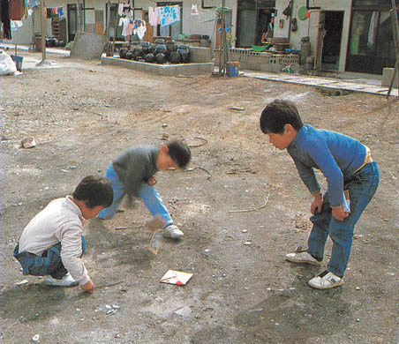
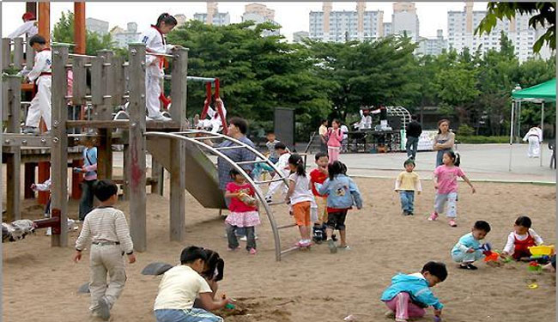
Children: where to play?
Furthermore, most children ‘prefer’ playing in the streets
Children like adventures and don’t want to stay in an artificially made playing-space

Slide 25
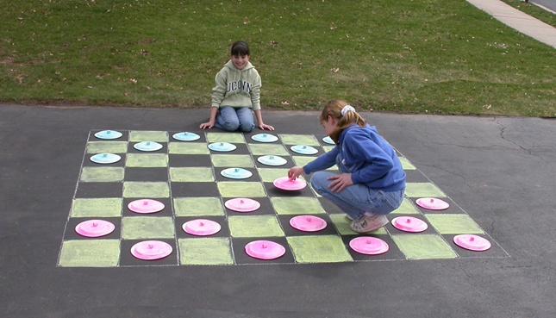
Design of sidewalks
Jacobs states that sidewalks of 30 to 35 feet in width are ideal, capable of accommodating any demands for general play, trees to shade the activity, pedestrian circulation, adult public life, and even loitering.
However, she admits that such width is a luxury in the era of the automobile, and finds solace that twenty-foot sidewalks - precluding rope jumping but still capable of lively mixed use - can still be found.
Even if it lacks proper width, a sidewalk can be a compelling place for children to congregate and develop if the location is convenient and the streets are interesting.

Slide 26
V. The Uses of Neighbourhood Parks

Slide 27
Characteristics of parks
Orthodox urbanism defines parks as "boons conferred on the deprived populations of cities."
Jacobs challenges the reader to invert this relationship, and "consider city parks deprived places that need the boon of life and appreciation conferred on them.“
City parks go through changes very easily, and in a short time
Jacobs says that people have too much trust in city parks, and expect lots of benefits from them such as economical gain through real estate price increase.
Parks are very delicate, and need to be managed carefully
-> A park is not an anchor, but it is affected by nearby environment

Slide 28
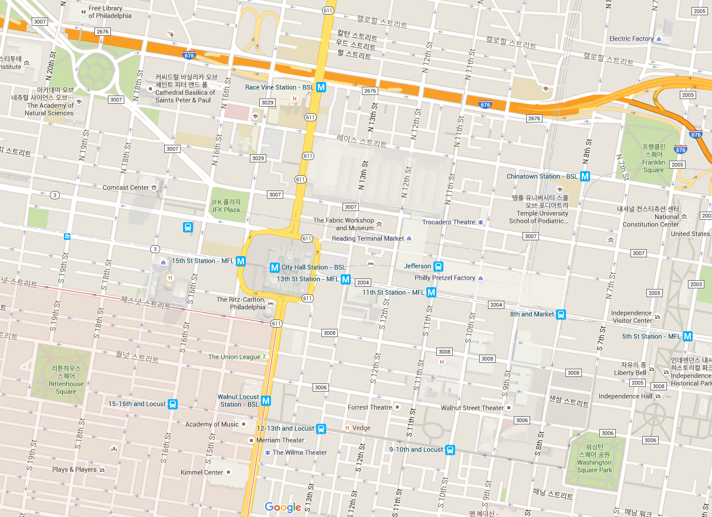
William Penn

Slide 29
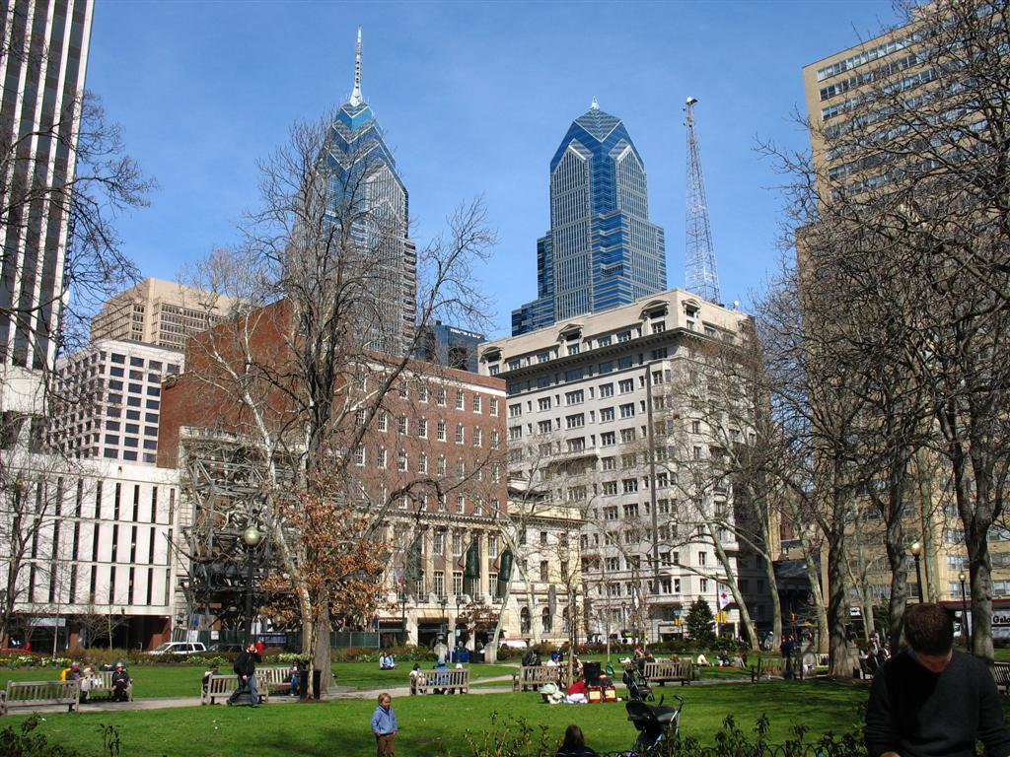
William Penn – (1) Rittenhouse Square

Slide 30
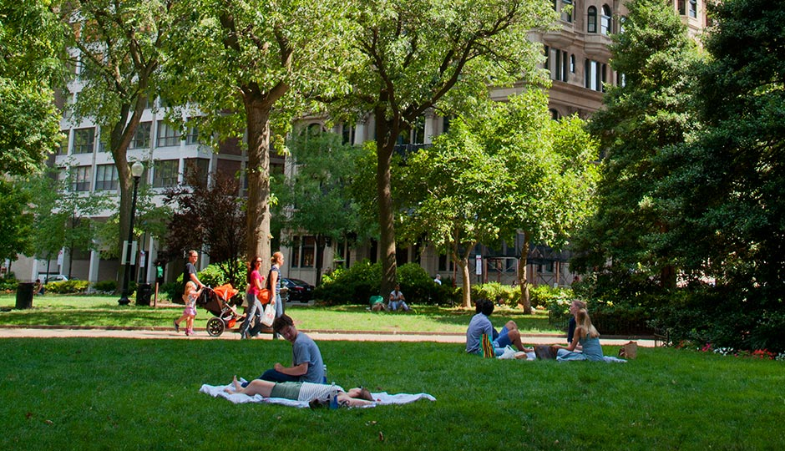
William Penn – (1) Rittenhouse Square

Slide 31
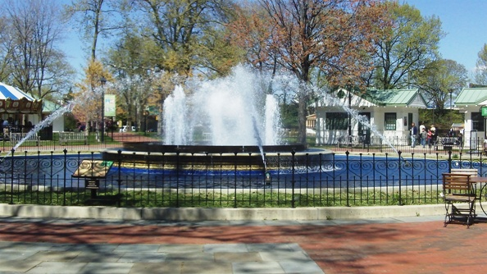
William Penn – (2) Franklin Square

Slide 32
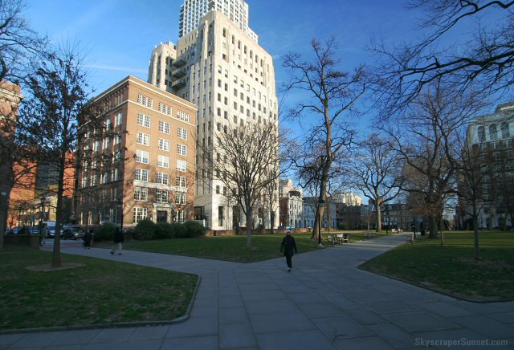
William Penn – (3) Washington Square

Slide 33
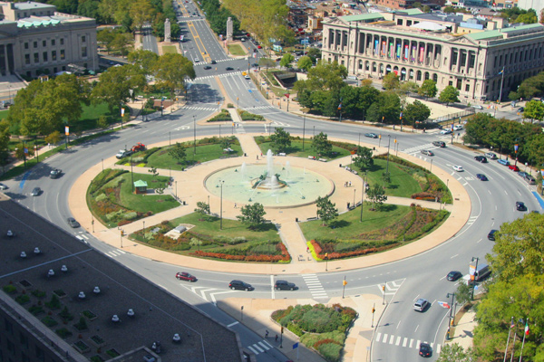
William Penn – (4) Logan Circle

Slide 34
Rittenhouse Square
Why was Rittenhouse Square successful?
-> Diverse background area
Restaurants
Art center
Music school
Military office
Apartment
Old pharmacy
Shops
Office
More usage
Various time of the day
Diversity
Residential -> Office -> Commercial -> Residential

Slide 35
Four tenets of good park design
Intricacy
Centering
Stimulating a variety of uses and repeat users
main crossroads, pausing point, or climax
Access to sunlight
Enclosure
Big shadows can hinder a park’s activity
the presence of buildings and a diversity of surroundings

Slide 36
VI. The Uses of City Neighbourhoods

Slide 37
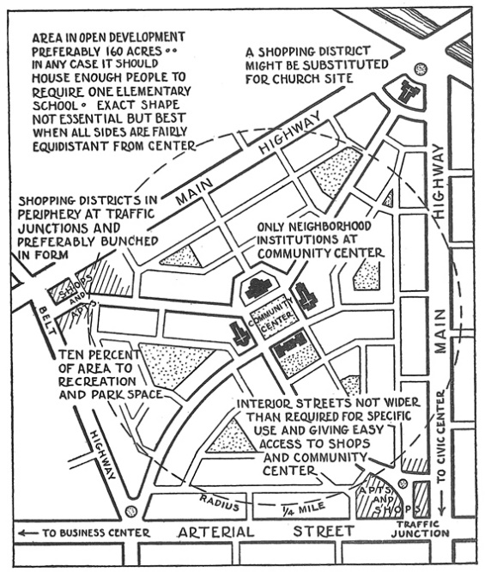
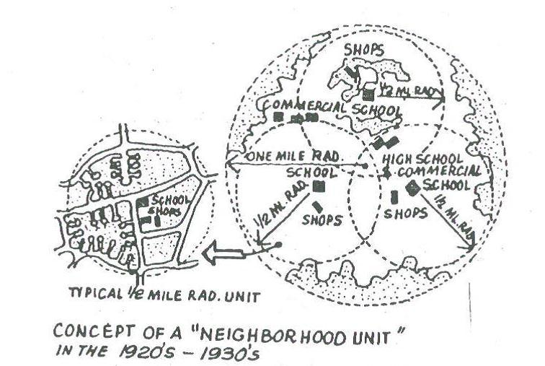
Orthodox conception of a city neighborhood
Orthodox conception of a city neighborhood is defined as a modular, insulated grouping of roughly 7000 residents, the estimated number of persons to populate an elementary school and support a neighborhood market and community center
Jacobs thought that a feature of a great city is the mobility of residents and fluidity of use across diverse areas of varying size and character, not modular fragmentation.

Slide 38
Jacobs’ alternative
City-level
“The city of New York as a whole is itself a neighborhood, the parent community from which public money flows, administrative and policy decisions are made, and conflicts of general welfare are resolved on behalf of districts. Civic associations and special interest groups - from opera societies to public unions - are often formed at the city level, creating like-minded communities of interest that coordinate local activities.”
Street-level
“Individual streets - such as Hudson Street in Greenwich Village - can also be characterized as neighborhoods. Street-level city neighborhoods, as argued elsewhere in the book, should aspire to have a sufficient frequency of commerce, general liveliness, use and interest so as to sustain public street life. They are not discrete units of fixed length, but economic and social continuities of all proximate street-level neighborhoods.”

Slide 39
Jacobs’ alternative
District-level
“the district of Greenwich Village is itself neighborhood, with a shared functional identity and common fabric. The primary purpose of the district neighborhood is to intermediate between the needs of the street-level neighborhoods and the resource allocation and policy decisions made at the city-level.”
Jacobs estimates the maximum effective size of a city district to be 200,000 people and 1.5 square miles, but prefers a functional definition over a spatial definition: "big enough to fight city hall, but not so big that street neighborhoods are unable to draw district attention and to count."
City-level
District-level
Street-level

Slide 40
Four pillars of effective city neighbourhood planning
To foster lively and interesting streets
To make the fabric of the streets as continuous a network as possible throughout a district of potential subcity size and power
To use parks, squares, and public buildings as part of the street fabric, intensifying the fabric's complexity and multiple uses rather than segregating different uses
To foster a functional identity at the district level

Slide 41
Thank You for Listening

