Slide 1
Just Art for a Just City: Public Art and Social Inclusion in Urban Regeneration
ADVANCED URBAN DESIGN,
CLARA ÁLVAREZ

Slide 2
Table of contents
Introduction
Effects of deindustrialization in Glasgow and Bilbao
The response to decline
Concluding remarks

Slide 3
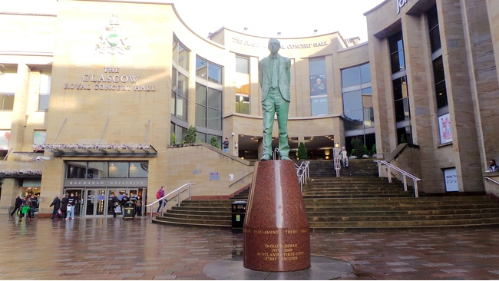
Statues of Glasgow: Donald Dewar
The statues commemorate largely forgotten political and military figures of the 19th century and are symptomatic of the ‘imposed monumentalism’ of the Victorian City. What Lefebvre warned of as the ability of «monumental buildings to mask the will to power and the arbitrariness of power beneath signs and surfaceswhich claim to express collective thought», is given added weight through the impress of time and habituation.

Slide 4
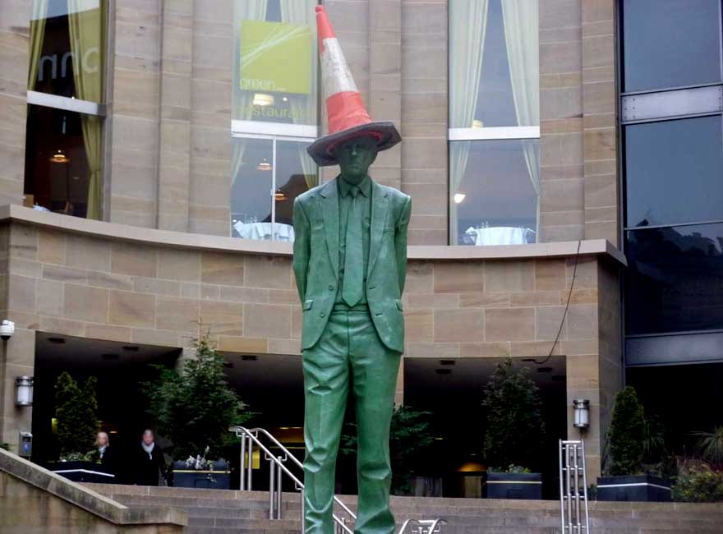
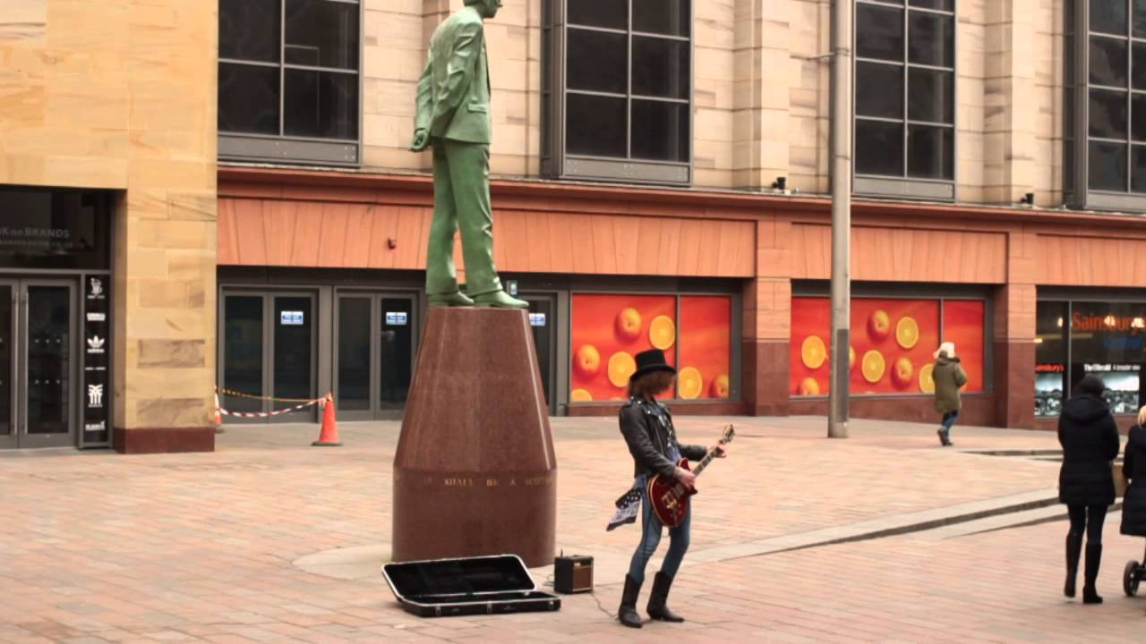
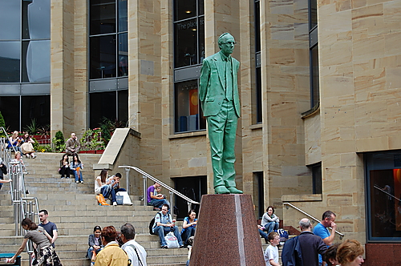
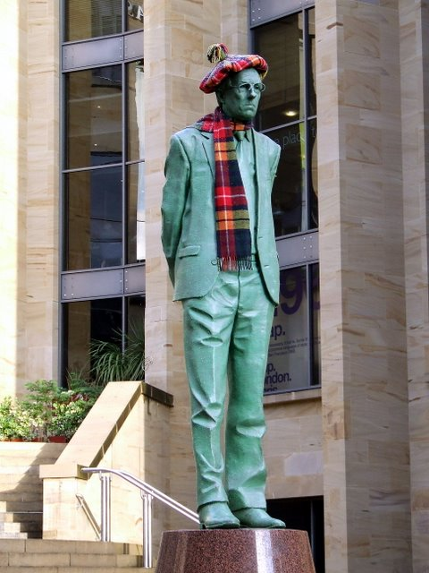

Slide 5
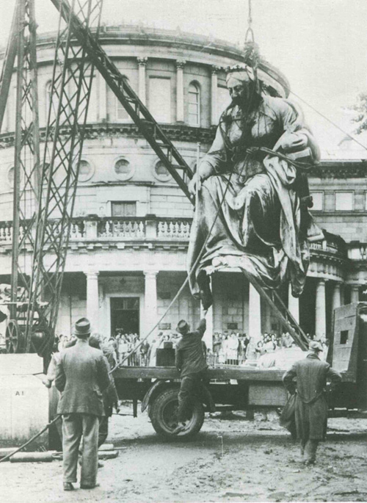
Statues of Dublin:
The unveiling (and removal) of Queen Victoria

Slide 6
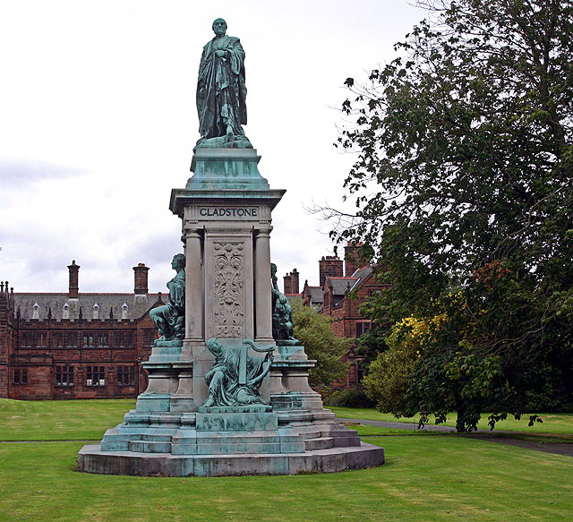
Gladstone statue in Hawarden, Wales

Slide 7
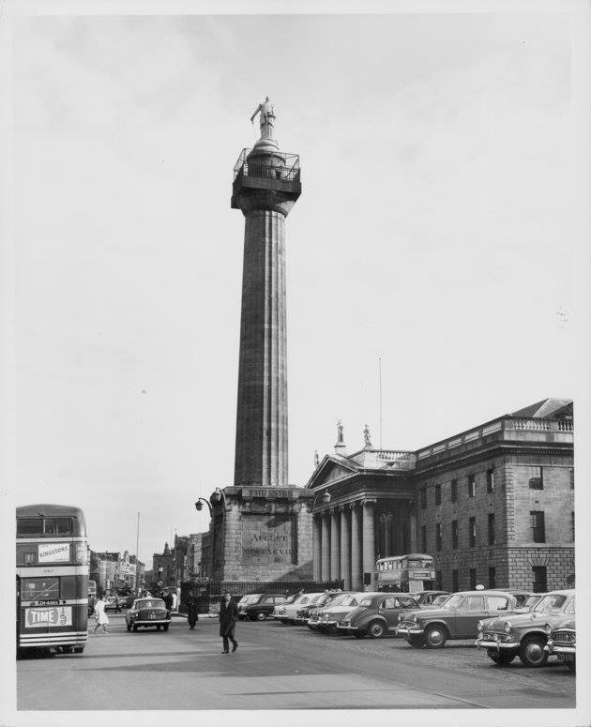
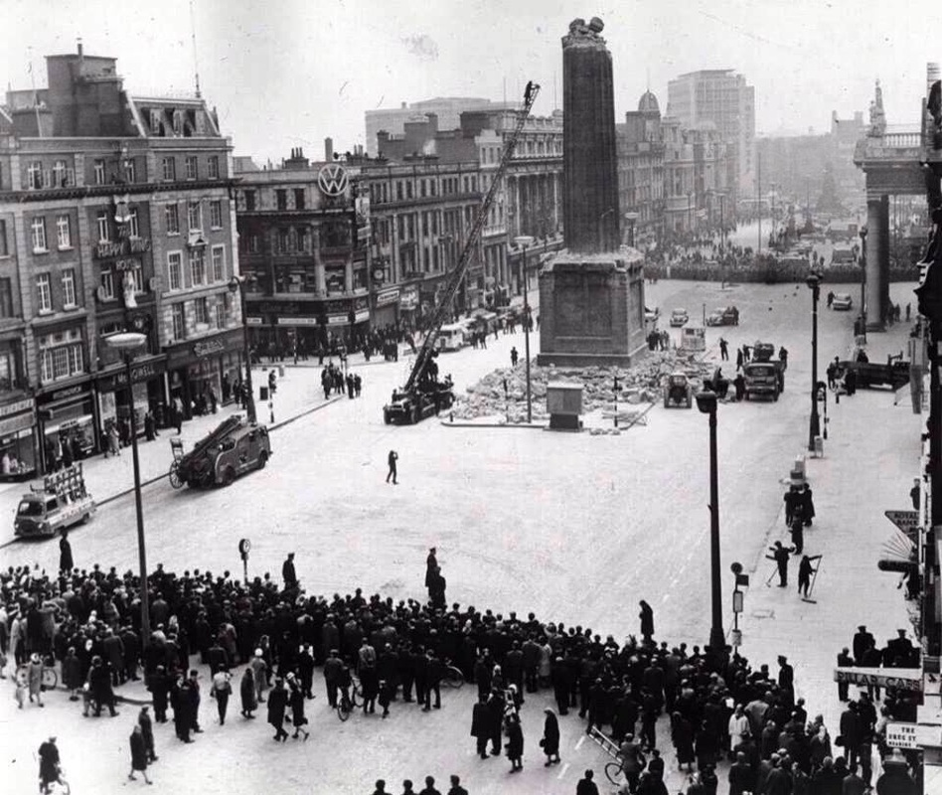
Nelson’s Pillar, Dublin “With the passage of time it became a popular meeting-place and viewing point… and a symbol of the city center that trascended any polittical connotations “ (Whelan, 2003)

Slide 8
Cultural planning immediately raises the question of ‘culture for whom?’ in which imposition and the favouting of particular interests are likely to engender reaction and resistance. To its practitioners, there may be a degree of inevitability here, particulary where the reimagineering of cities has become so focused arounf the winning of mega-events; the focused nature of such events may be incompatible with the ability to address the diverse set of preferences represented in the city.

Slide 9
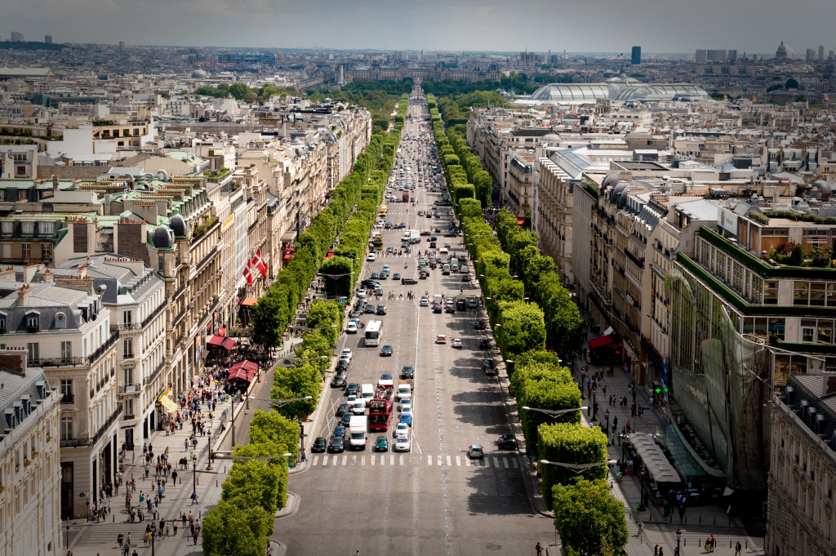
Avenue des Champs-Élysées. One of Haussmann’s wide tree-lined boulevards

Slide 10
Public Art is not simply art placed outside. It is art which has as its goal a desire to engage with its audiences and to create spaces- whether material, virtual or imagines- within which people can identify themselves, perhaps by creating a renewed reflection on community, on the uses of public spaces or on behaviour within them. Public Art, then, does not only have to be expressed visually, but it has to be with «urban environment» and «aura of quality», when it comes to urban regeneration.

Slide 11
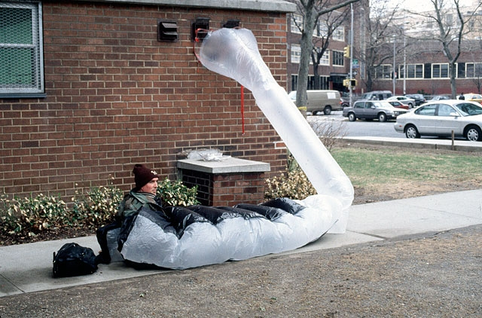
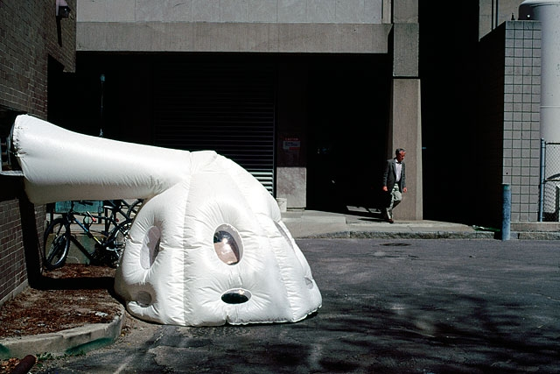
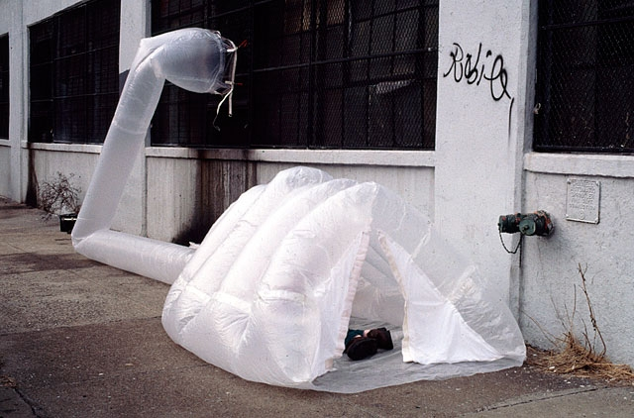
ParaSITE project, Michael Rakowitz, NYC, 2000

Slide 12
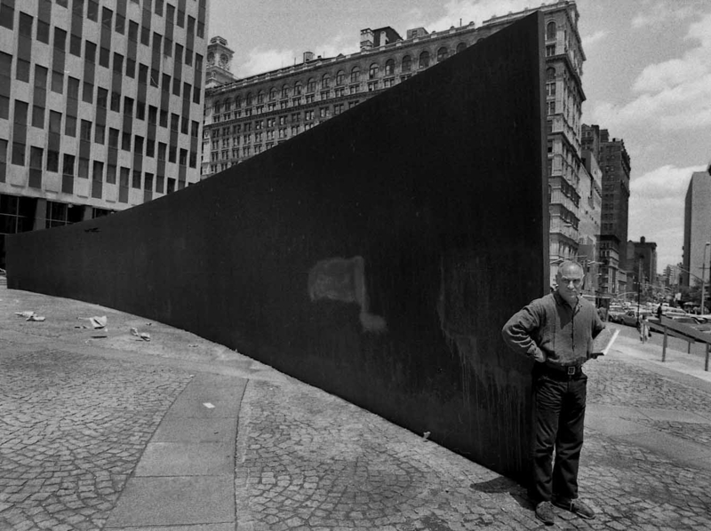
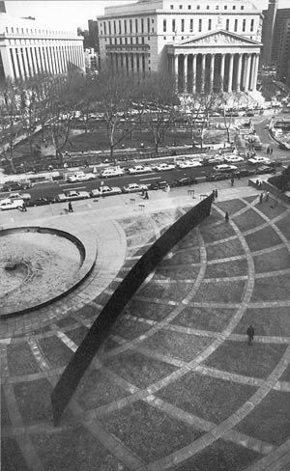
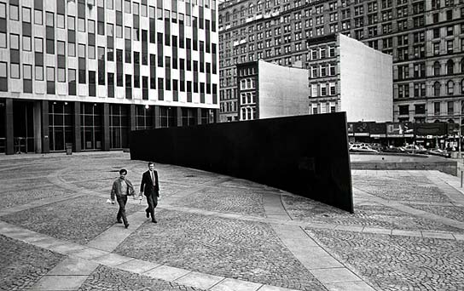
Tilted Arc, Richard Serra, Federal Plaza Manhattan, 1989

Slide 13
Nowadays, there often a spatial and temporal essentialism in defining community, and there is where Art has to act. Inclusive approaches to designing public art – work-shops,
Meetings and so on- can ensure ownership by those in that community and hence encourage care and lessen the likelihood of vandalism.
A weapon for political and cultural innovations that will continuosly redefine the city

Slide 14
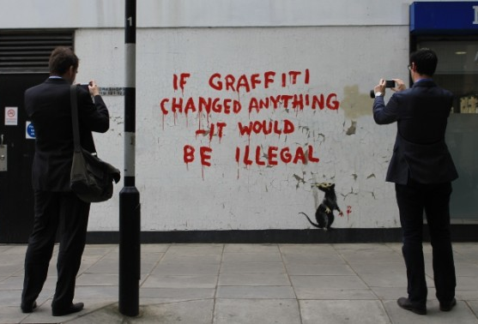
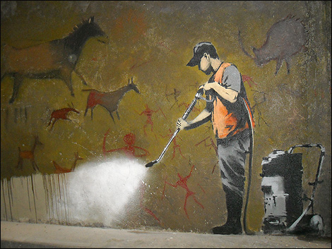
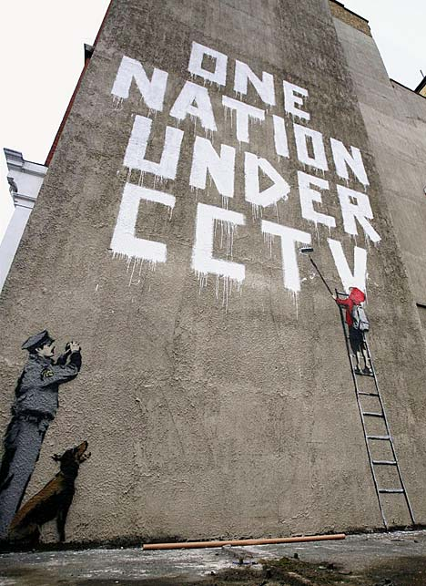
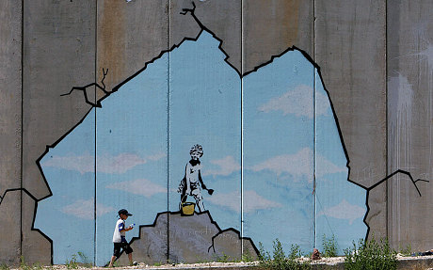
Banksy Art pieces

Slide 15
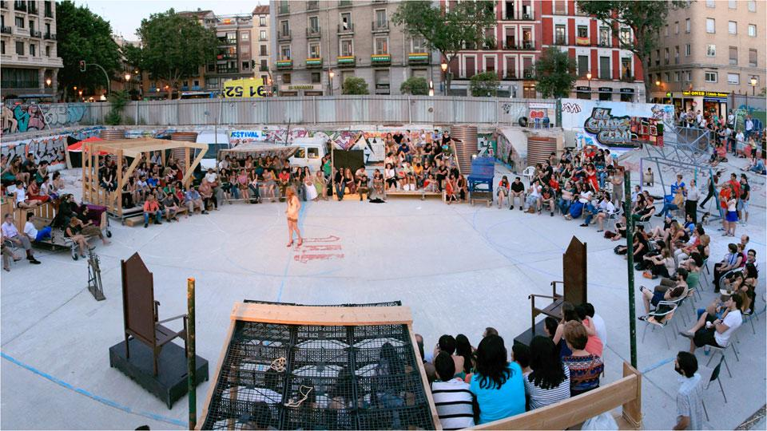
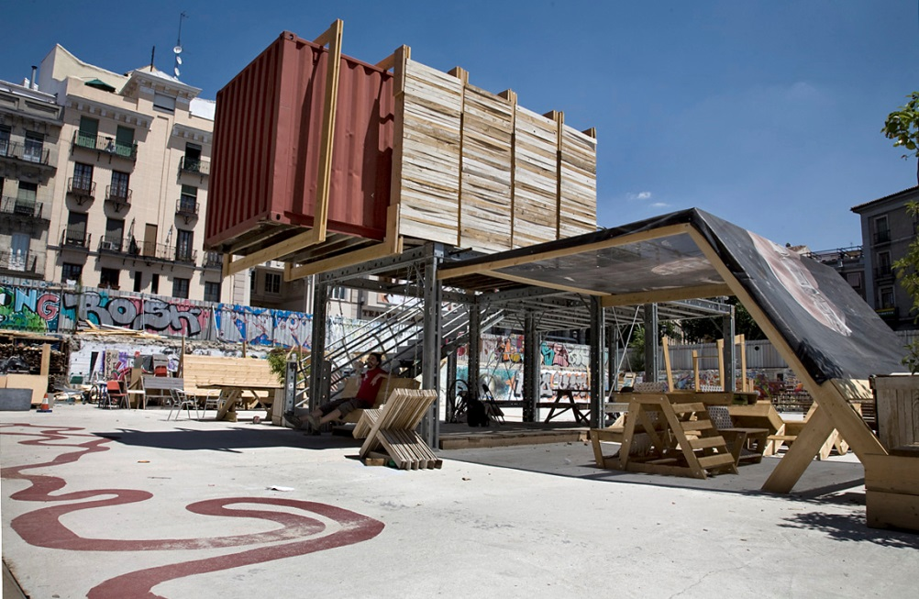
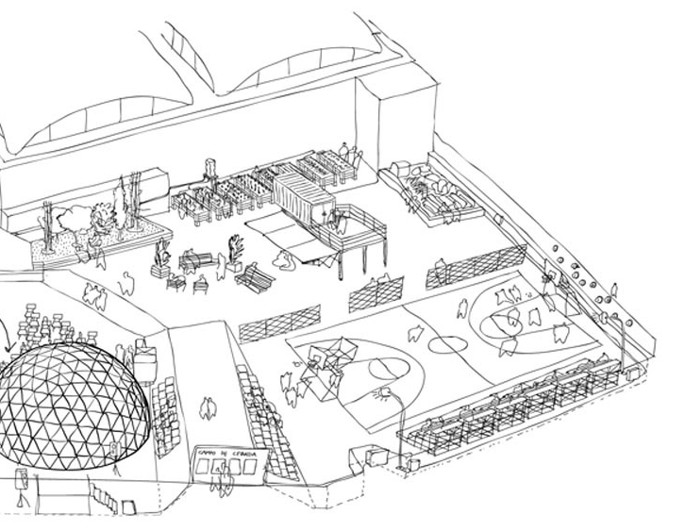
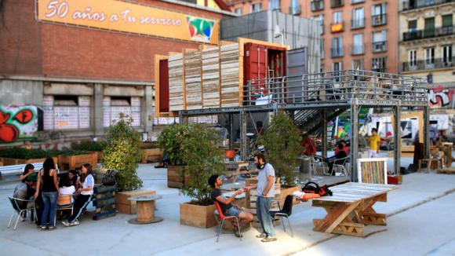
Campo de la Cebada, Madrid

