Slide 1
Environmental Thermal Engineering
Lecture # 1
Min soo Kim
Mechanical & Aerospace Engineering

Slide 2
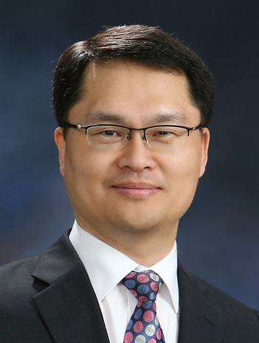
Professor
Name : 김 민 수 (KIM, Min Soo)
Homepage : http://reflab.snu.ac.kr
E-mail : minskim@snu.ac.kr
Tel : 02-880-8362, 02-880-4301
C.P : 010-6207-8362
Office hour : After class
(right after the class)
Office place : lecture room/ 301-1507/
T.A : 김동규 (Kim, Dong Kyu, 314 – 308)
Tel : 02-880-7545(3308)
E-mail : zero0403@snu.ac.kr

Slide 3
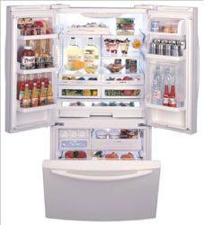
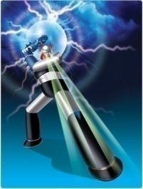
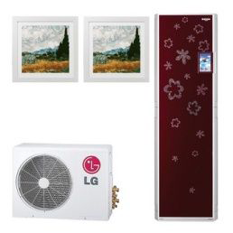

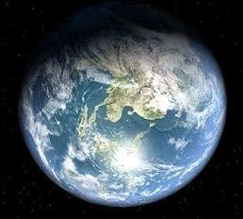
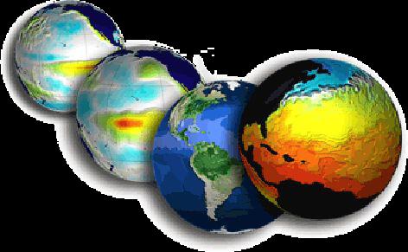
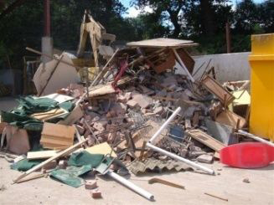
Environmental Thermal Engineering?
Environmental Thermal Engineering
Refrigeration
Energy
Air conditioning
Environment
Geo engineering
Climate
Waste

Slide 4
Environment and Pollution

Slide 5

  Global warming? Climate change?
Growing Scientific and public opinion that CO₂ emissions are contributing to climate change…
Priority of 110th U.S. Congress…
U.S. responsible for 1/3 of global CO₂ emissions…
Electricity sector responsible for 1/3 of U.S. CO₂ emissions…
General agreement that technology solutions are needed…

Slide 6
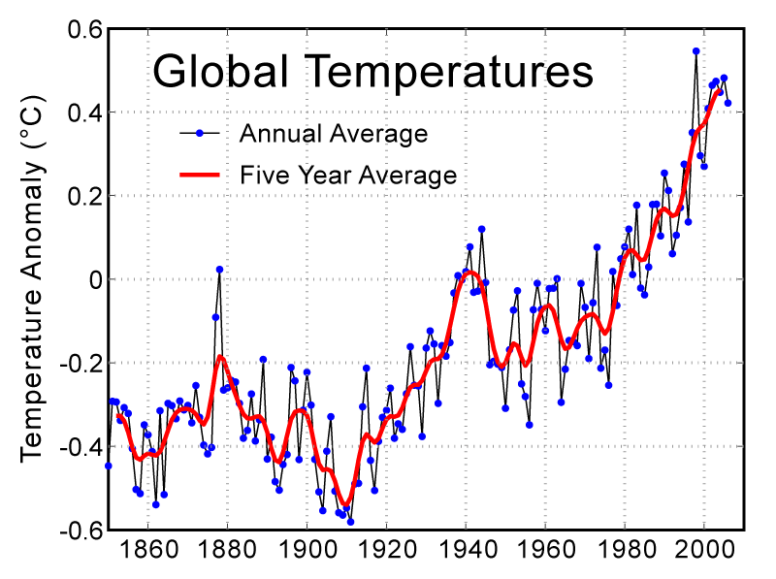
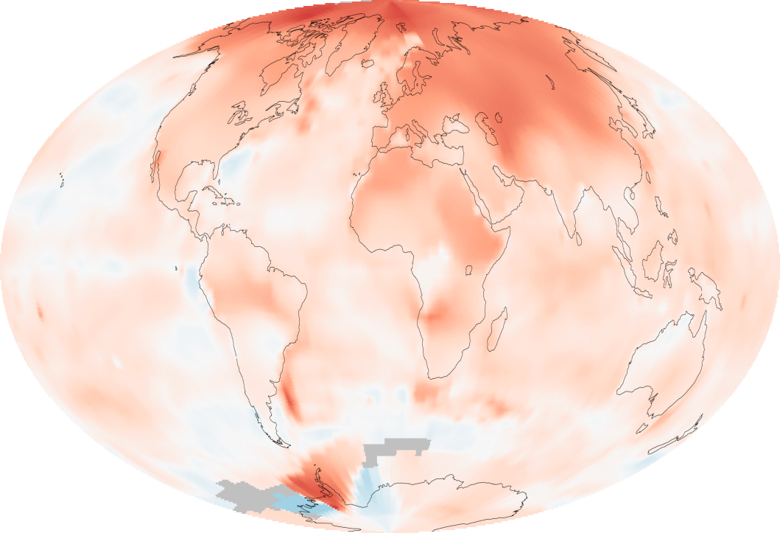
  Climate change?
Red : Warmer than Past
Blue : Cooler than Past
(Past : Average temperatures recorded
between 1951 and 1980)

Slide 7
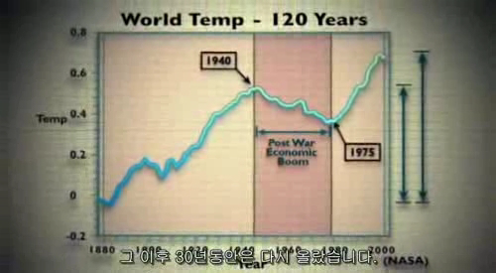
  Meanwhile, in 1940-1970’s?

Slide 8
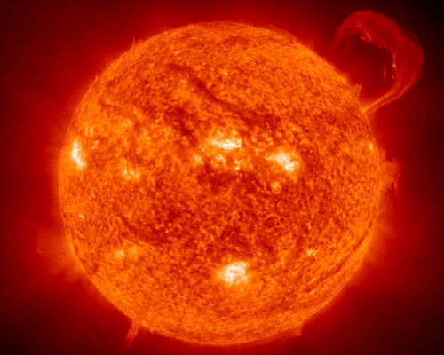
  Sun

Slide 9
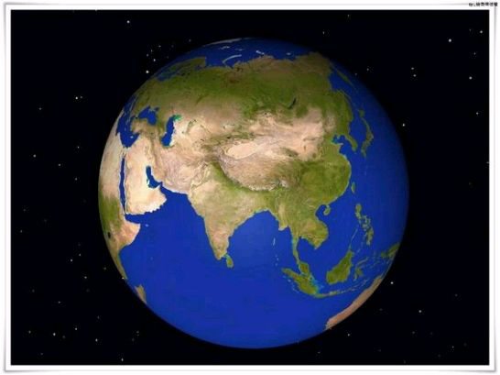
  Earth

Slide 10
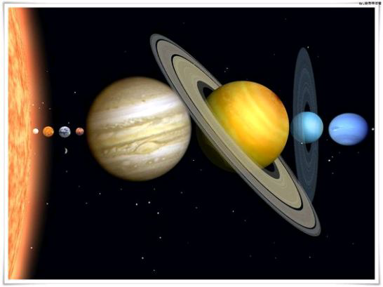
  Solar system

Slide 11
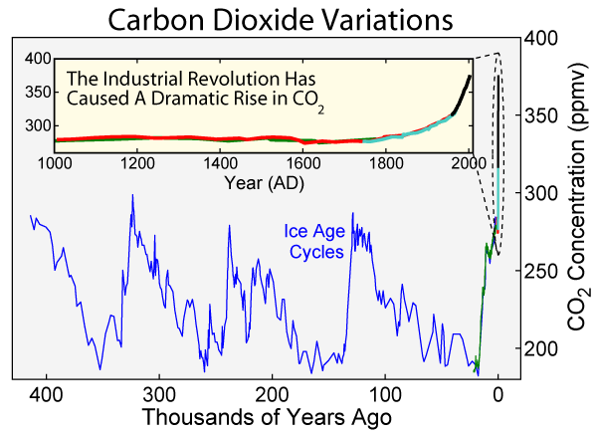
  Change of carbon dioxide

Slide 12
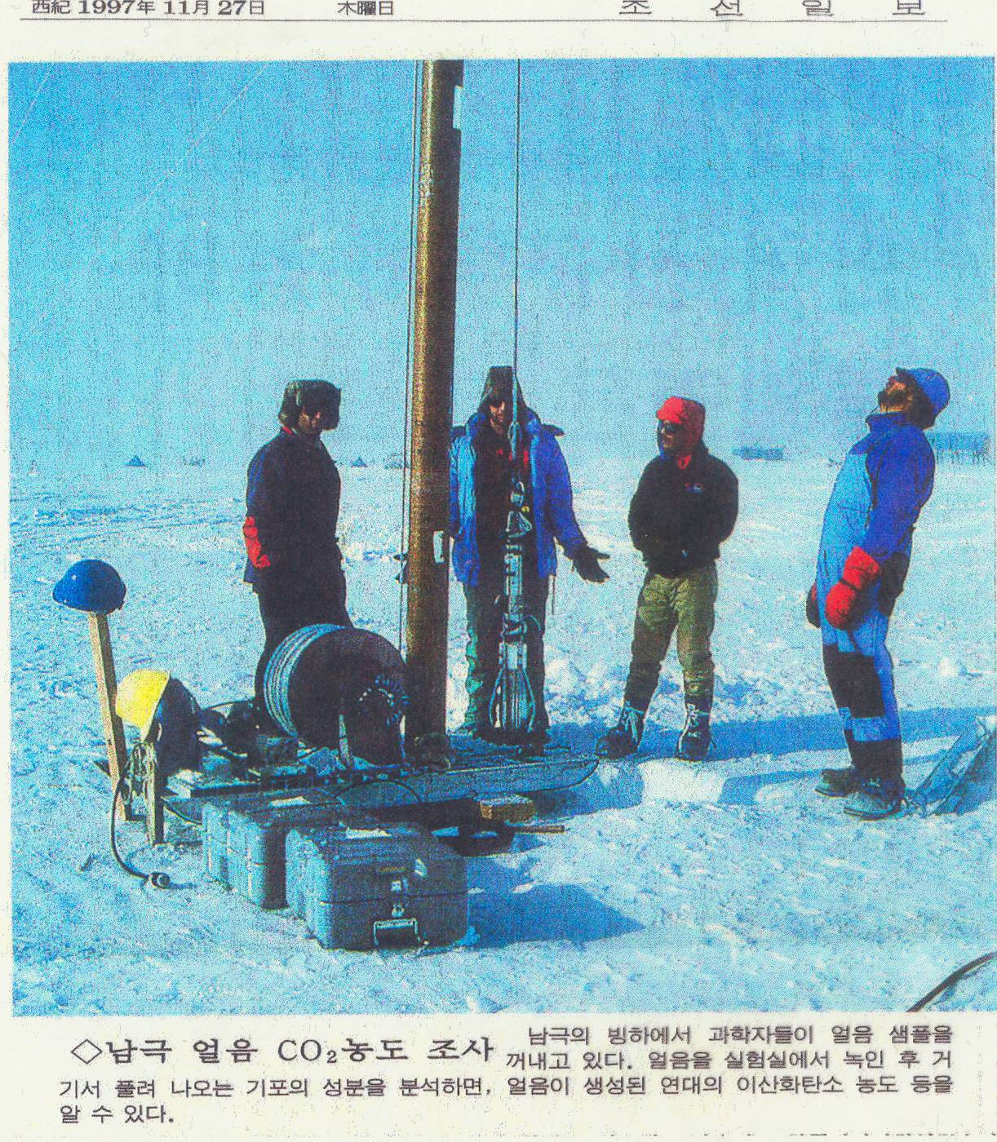
  Density measurement for CO₂
FIGURE Investigation of CO₂ concentration in the Antarctic

Slide 13
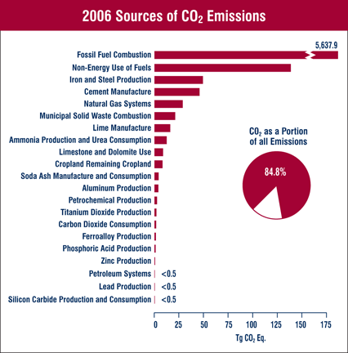
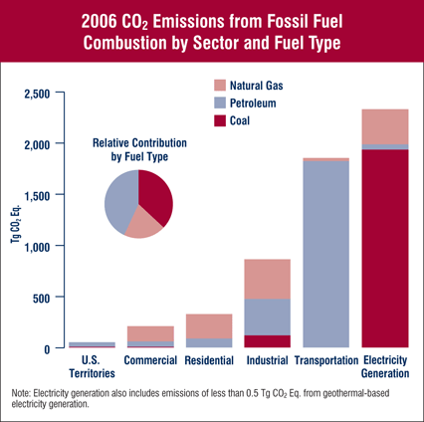
  Sources of CO₂ emissions
Images : http://www.epa.gov/ of U.S.

Slide 14
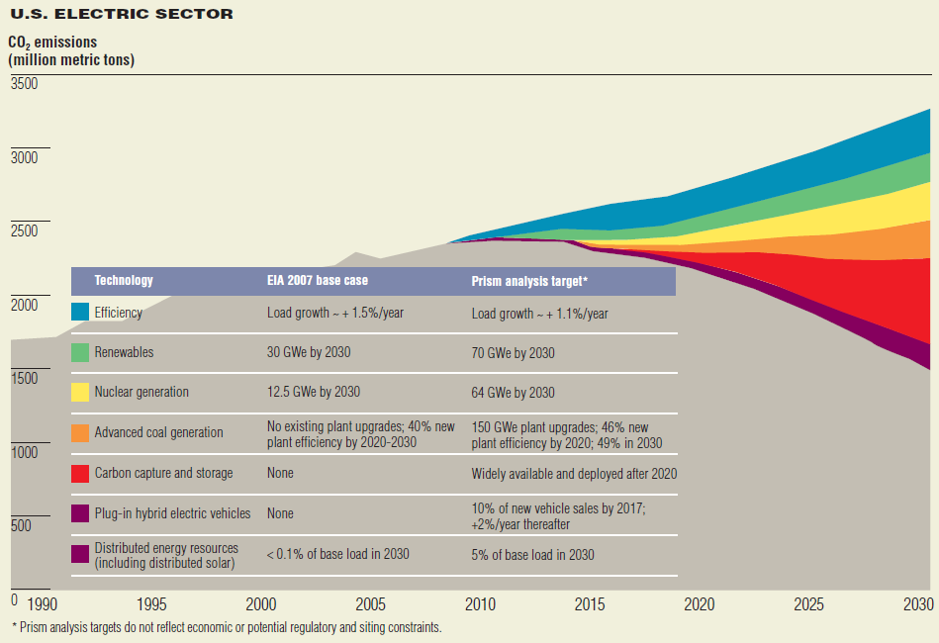
  CO₂ Reduction method
Source: EPRI, PRISM Analysis of Nov.1st . 2007

Slide 15

Cold temperature phenomena

Slide 16
Application of environmental
thermodynamics

Slide 17
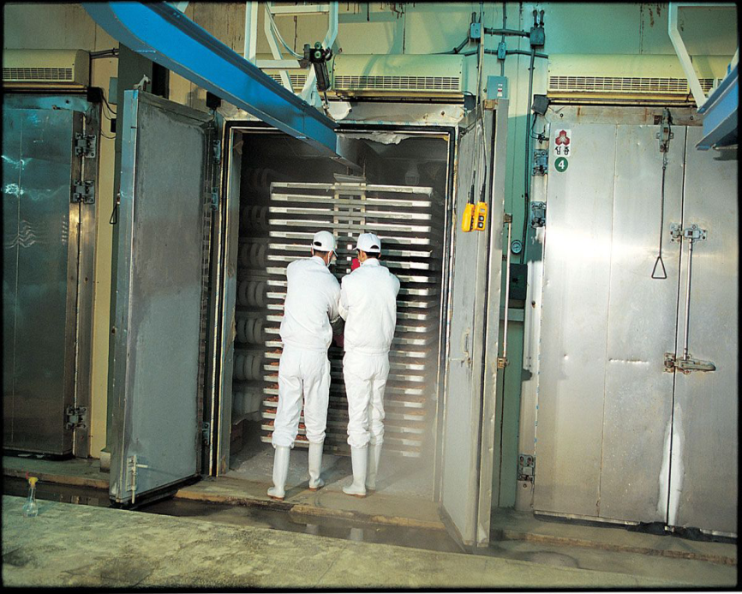
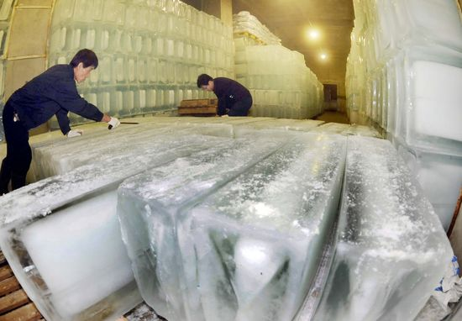
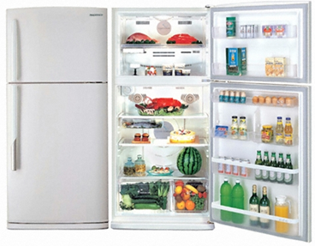
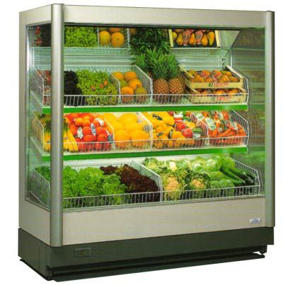
Food containing

Slide 18
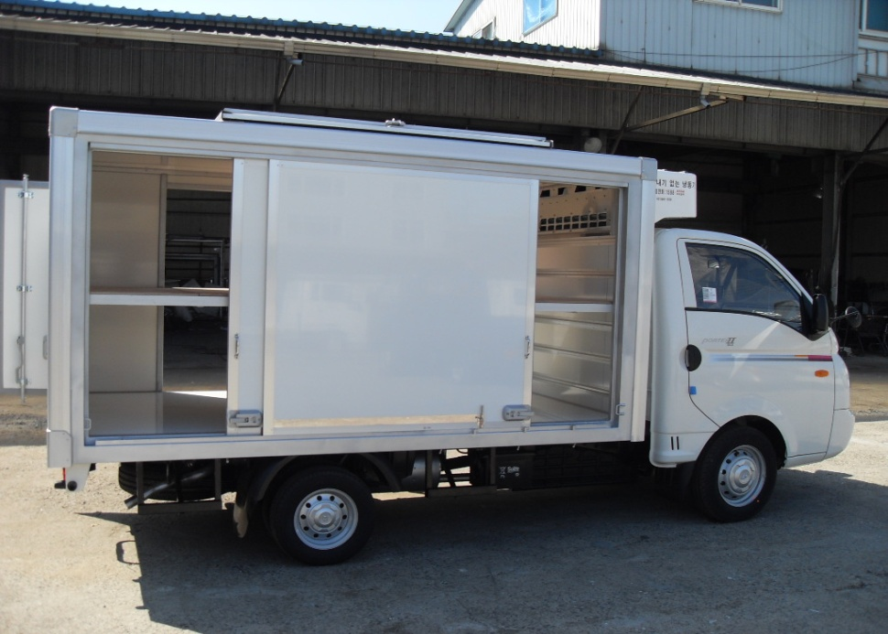
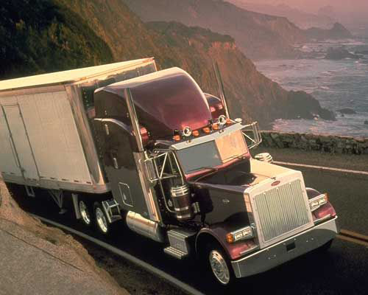
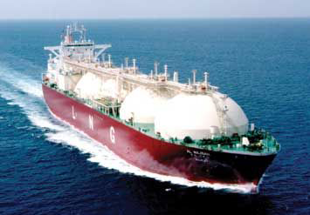
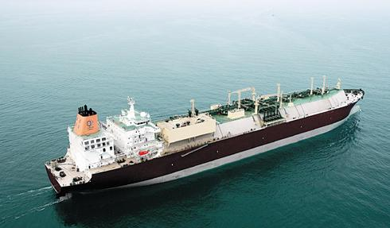
Transportation

Slide 19
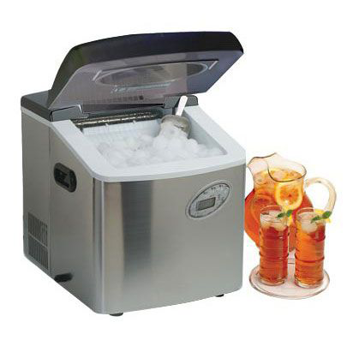
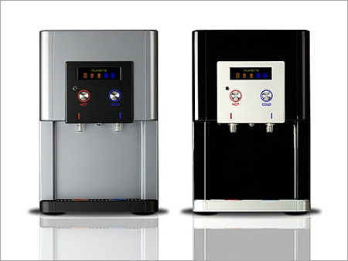
Living convenience

Slide 20
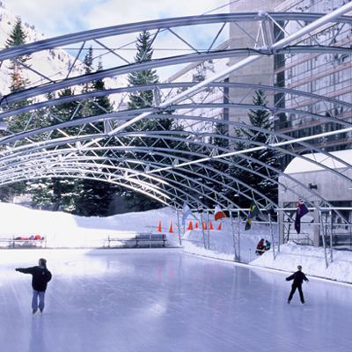
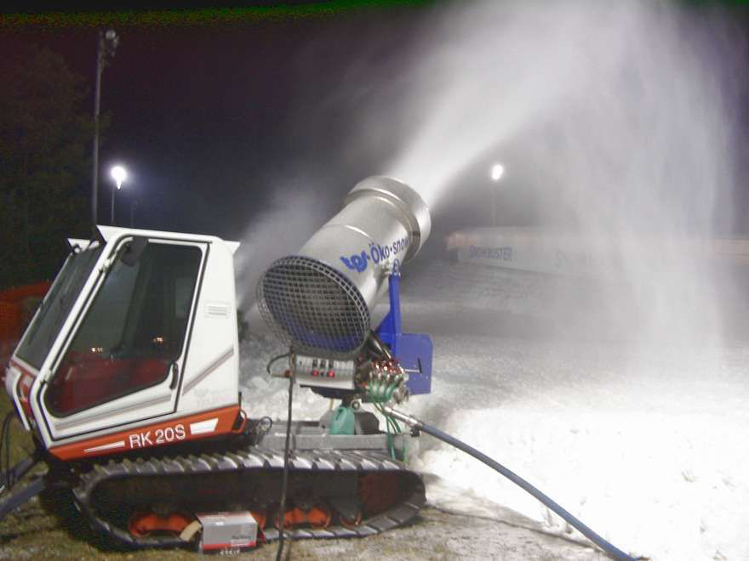
Leisure activities

Slide 21
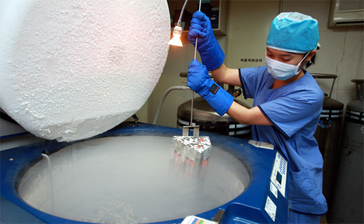
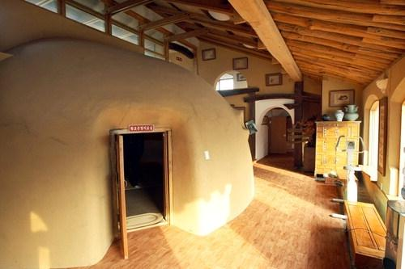
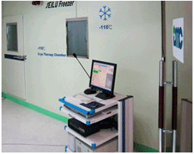
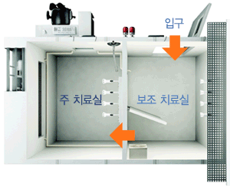
Medical service

Slide 22
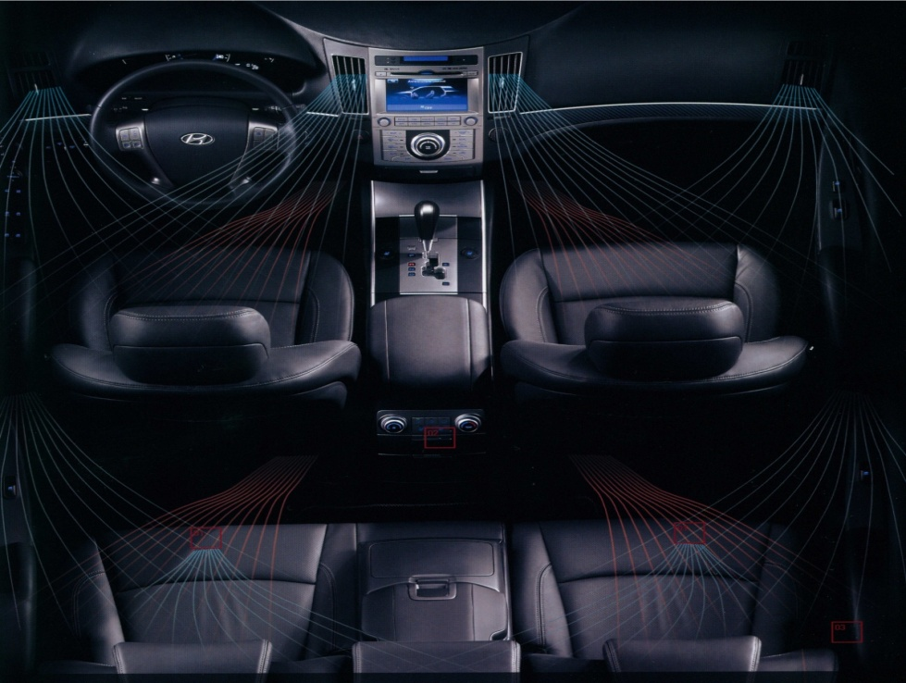
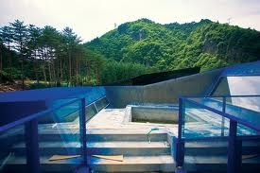
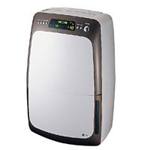
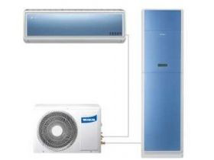
Air conditioning system

Slide 23
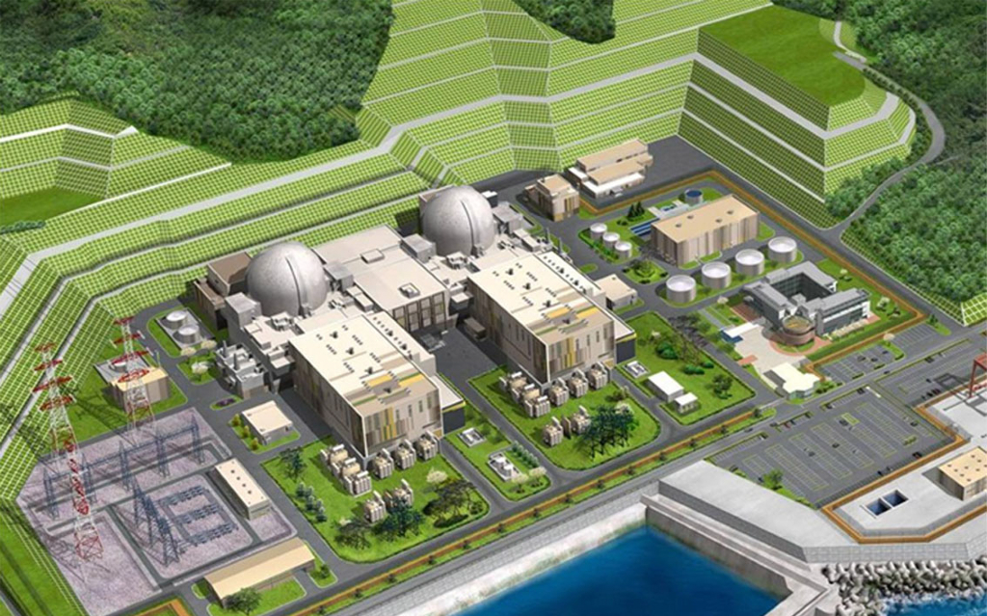
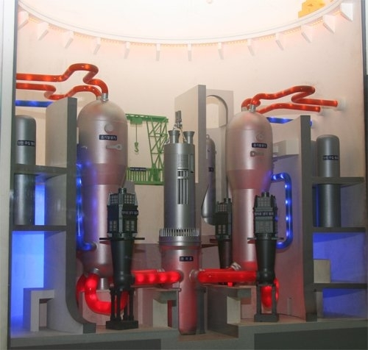
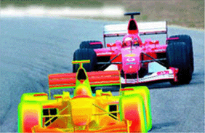
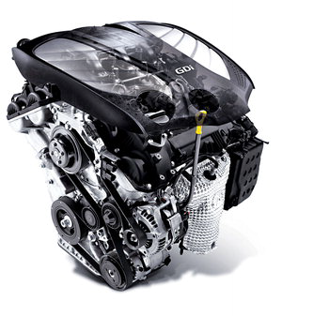
Refrigeration system

Slide 24
New regeneration energy

Slide 25
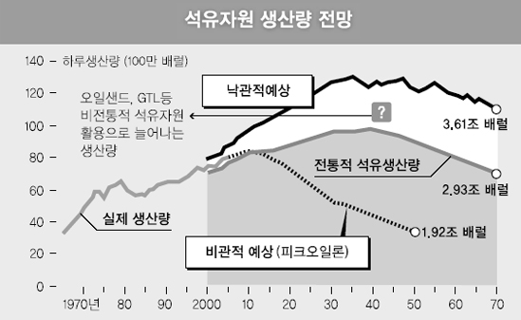
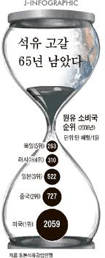
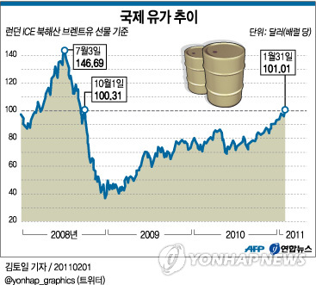
Oil depletion
Source: 한국일보 2007-12-17
Source: 연합뉴스 2011-02-01

Slide 26
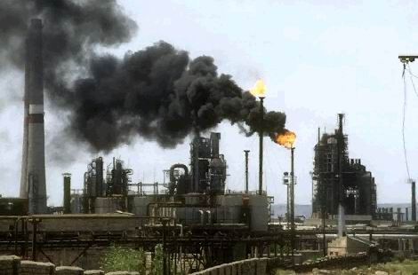
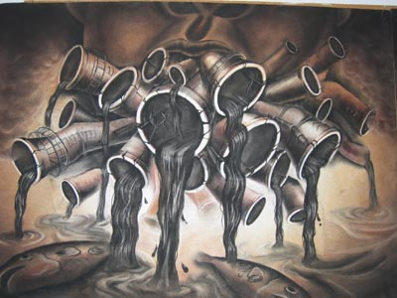
Environmental pollution

Slide 27
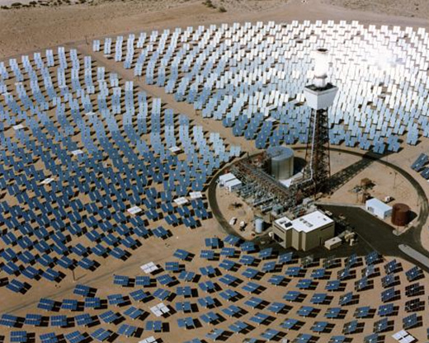
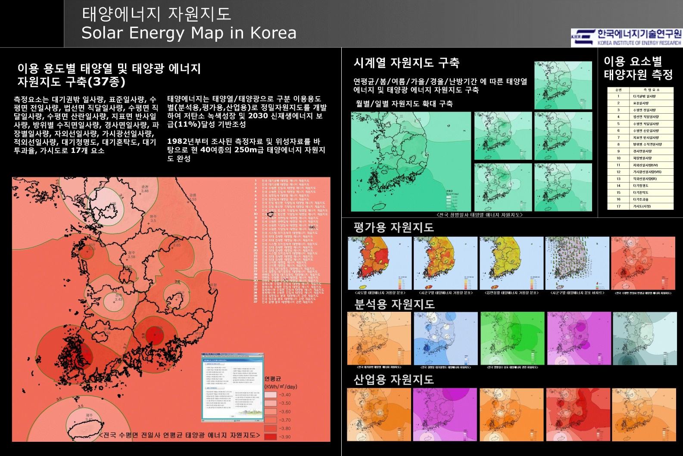
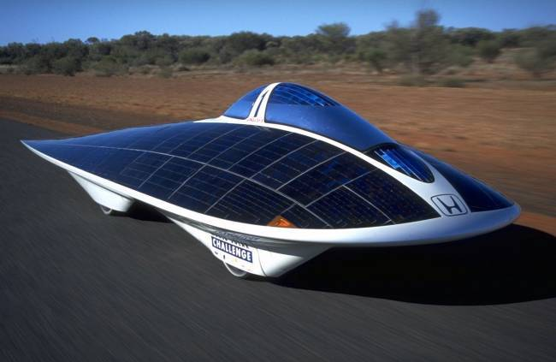
Solar energy

Slide 28



Wind power energy

Slide 29





Fuel cell
Pt
H
H⁺
H
H⁺
① Hydrogen reacts with the Pt catalyst on the PEM to form protons and release electrons.
H⁺
H⁺
H⁺
H⁺
② The protons travel across the PEM.
PEM FUEL CELL Rx.
H⁺
O
Pt
H
Anode : 2H₂ → 4H⁺ + 4e⁻
Cathode : O₂ + 2H⁺ + 2e⁻ → H₂O
Overall : 2H₂ + O₂ → 2H₂O + Electrical Energy + Heat Energy
H⁺
O
H
O
③ The protons combine with O₂ and electrons to form water.

Slide 30


Geothermal energy

Slide 31



Bio energy

Slide 32


