Slide 1
Environmental Thermal Engineering
Lecture # 17
Min soo Kim
Mechanical & Aerospace Engineering

Slide 2

Natural energy sources
Solar Energy

Slide 3
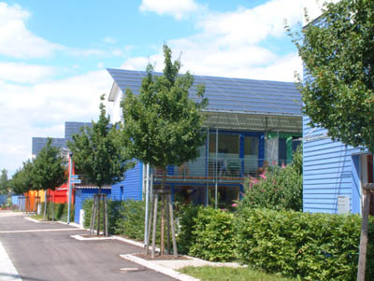
Solar Generation
Advantages
Very low running cost
No mechanical vibration, no noise
Life of solar cell is more than 20 yrs
Infinite energy source
No pollutant generation

Slide 4
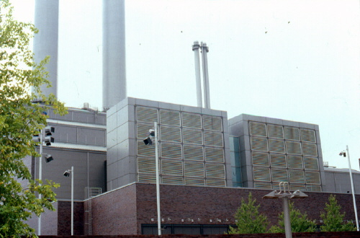
Solar Generation
Disadvantages
Solar cell is very expensive
High initial cost
Variation of energy generation since cloudy or rainy weather
Need large area
Low energy density

Slide 5
Solar Generation
Classification
Photovoltaic system
➔ Photo + Volta
Generation with light, useful for an isolate home generation
Solar heat system
➔ Use solar heat
Generation with heat, useful for power plant

Slide 6
Photovoltaic generation
Energy generation with the light
Photovoltaic effect is used
Relatively low power(~1.5W)
→ Module is used
Energy generation efficiency is about 10~15%
For cloudy day and night, storage battery is used
N-type
+
+
+
+
+
+
+
-
-
-
-
-
-
-
P-type
Wire
Wire
When cell is not exposed
N-type
+
+
+
+
+
+
+
-
-
-
-
-
-
-
P-type
Wire
Wire
When cell is exposed

Slide 7
Photovoltaic generation
Photovoltaic cells
The photovoltaic cells were developed at Bell Labs in 1950 primarily initially for space applications.
The Hubbell telescope utilizes solar panels for its energy requirements.
Very expensive
: Silicon purification is difficult and a lot of silicon is wasted
Cooling system needed
: high temperature lowers system efficiency

Slide 8

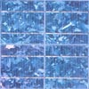
Photovoltaic generation
Type of photovoltaic cell [1]
Monocrystalline Silicon Cells
: High efficiency (~15%)
Complicate manufacturing process
Multicrystalline Silicon Cells
: Slightly less efficiency (~12%)
Simple manufacturing process
(a) Monocrystalline type
(b) Multicrystalline type

Slide 9

Photovoltaic generation
Type of photovoltaic cell [2]
Amorphous Silicon
: Absorbs light more effectively
→ Thinner film
Can deposit both rigid and flexible bodies
Less efficiency (~6%)
(c) Amorphous type

Slide 10
Photovoltaic generation
Energy generation Chart
Secondary
Generator
Solar cell
Energy is stored in a storage charger in a daytime
For long time cloudy weather or emergency case, Secondary generator is required
Inverter converts DC to AC
(Solar cell generates DC)
Charger
Power
Control
system
Storage
Charger
Inverter
Electricity

Slide 11
Photovoltaic generation
Classification of photovoltaic generation
Stand-alone system
Hawa-island(60KW)
Wa-island(30KW)
Grid-connection system
Changwon City Hall(30KW)
Samsung Laboratory(100KW)
Power Plant
Solar light
Generator
System
Solar light
Generator
System
Stand alone system
Grid connection system

Slide 12
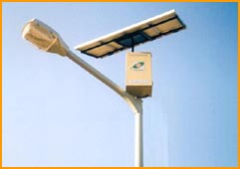
Photovoltaic generation
Properties
Energy is stored in a storage charger for night
Cost of a storage charger is very expensive
→ Use power control system
For long time cloudy weather or emergency case, Secondary generator is required
A street lamp with photovoltaic generator

Slide 13
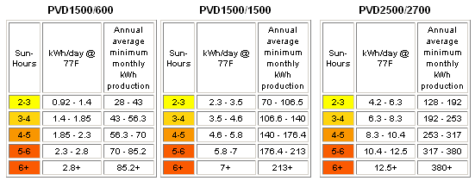
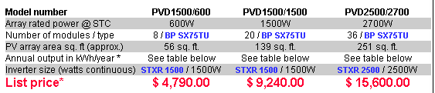
Photovoltaic generation
Cost?
From www.southwestpv.com

Slide 14
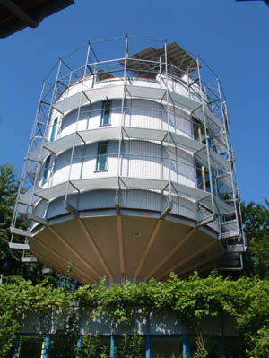
Photovoltaic generation examples
Photovoltaic generator in Germany
(Schlierberg, Germany)
Photovoltaic generator in Germany
(Rotating toward the sun)

Slide 15
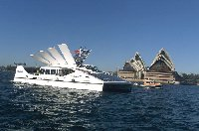
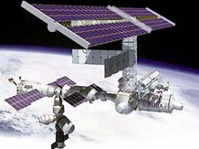
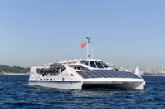
Photovoltaic generation examples
Photovoltaic generator in satellite
Photovoltaic generation ferry
(Sydney)

Slide 16


Photovoltaic generation examples
Future : Photovoltaic generation in the moon
Solar energy in the moon is approximately
Energy is transferred to earth by microwave
24 hours full time generation
(independent of weather)
Module size is 10x5[km] and receiving antenna diameter is 10~13km to produce 10GW

Slide 17
Solar heat generation
Energy generation with solar heat
Concentrate solar heat to over 400℃ with reflector
Turbine produce electricity with high temperature steam water
Dessert is suitable for solar heat generation since strong solar radiation quantity
Solar heat Concentrator
Heat exchanger
Pump
Turbine
G
Generator

Slide 18
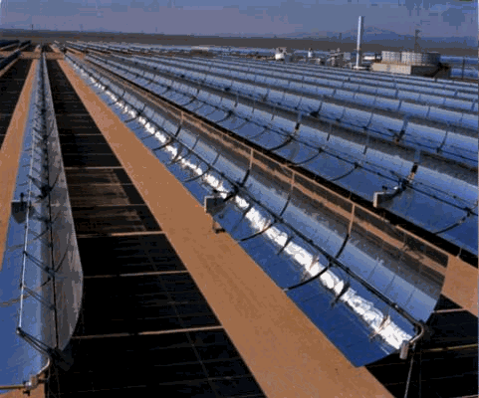
Solar heat generation
Classification of solar heat generation [Trough]
Trough type
California, USA(354MW)
Rotate toward the sun
Schematic of Trough type
Trough type generator

Slide 19
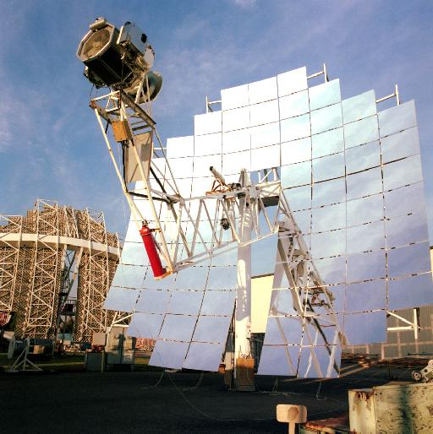
Solar heat generation
Classification of solar heat generation [Dish/engine]
Dish/engine type
Receiver get heat energy by
Concentrator

Slide 20
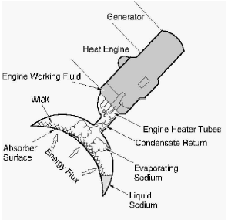
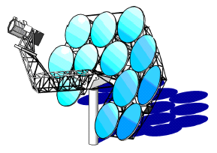
Solar heat generation
Classification of solar heat generation
Component of dish engine type generator
Receiver
Concentrator
Schematic view of receiver

Slide 21
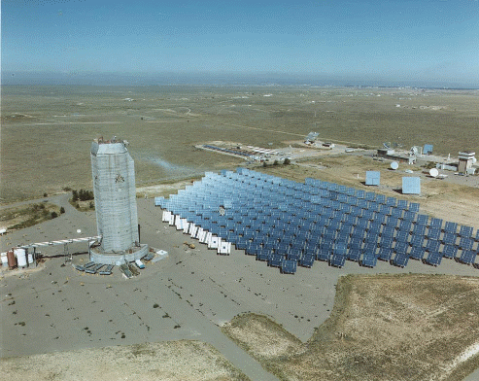
Solar heat generation
Classification of solar heat generation [Power type]
Power tower type
Schematic of power tower type
Power tower type generator

Slide 22
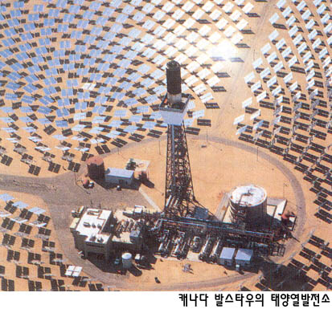
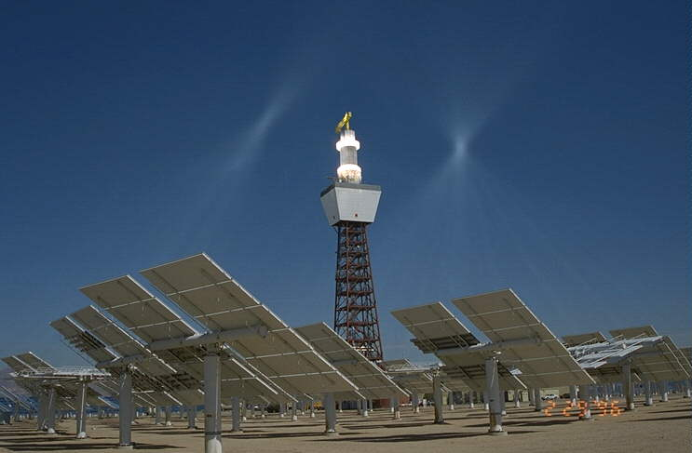
Solar heat generation examples
Power tower type solar power generator in Canada
Power tower type generator

Slide 23
Natural energy sources
Ocean Thermal Energy Conversion (OTEC)

Slide 24
Ocean Thermal Energy Conversion
Definition : Ocean Thermal Energy Conversion
Seawater temperature is almost constant
More than 15℃ difference in Tropical region
➔ Power generation is available by using temperature difference in the sea
20℃ - Hot
5℃ - Cold

Slide 25
Ocean Thermal Energy Conversion
Theory
Shallow warm water in
Heating with shallow warm seawater
→ Evaporator
Cooling with Deep cold seawater
→ Condenser
For vaporization, Closed cycle and refrigerant is used
Heat exchanger
Turbine
Pump
Generator
G
Heat exchanger
Deep cold water in

Slide 26
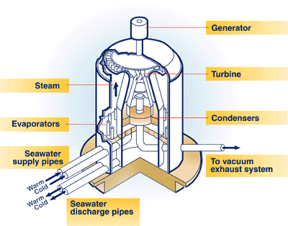
Advantages of OTEC
Infinite energy source
No pollutant generation
24 time full time generation ability
Adjustable generation quantity
Produces desalinated water for industrial, agricultural, and residential uses
Very low running cost

Slide 27
Disadvantages of OTEC
Consideration erosion by seawater
Need optimized refrigerant
Need large thermal difference
(tropical region is suitable)
Low system efficiency
A 100 MW OTEC plant would need to pump 450 cubic meters of both cold & warm water and would require a cold pipe of 20 metres diameter

Slide 28
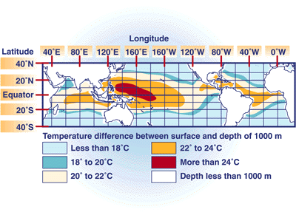
Ocean Thermal Energy Conversion
Suitable area for OTEC
Temperature difference is over 20 Celsius degree
Near term and continental shelf is preferred
(Safety and maintenance cost)
Narrow shelves
Temperature difference in the world

Slide 29
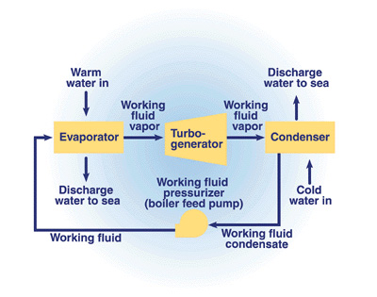
Ocean Thermal Energy Conversion
Classification of OTEC : Closed cycle system
Use refrigerant to generate electricity
Simple and efficient cycle
Efficiency of energy conversion
→ 5%
Efficiency of entire system
→ 2.5%
Low construction cost
Closed loop system

Slide 30
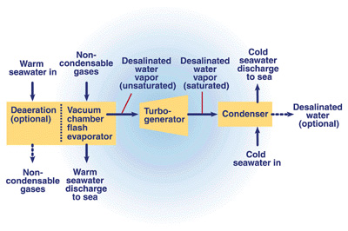
Ocean Thermal Energy Conversion
Classification of OTEC : Open cycle system
Use warm seawater as working fluid
Warm surface water is evaporated under a partial vacuum
Efficiency of energy conversion
→ 5.5%
Efficiency of entire system
→ 3%
Generate fresh water
Open loop system

Slide 31
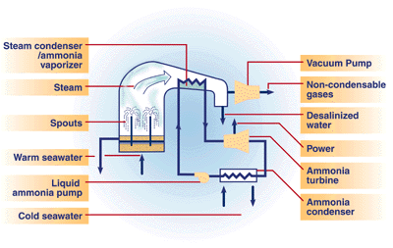
Ocean Thermal Energy Conversion
Classification of OTEC : Hybrid OTEC system
Combine open and closed cycle system
Efficiency is high but initial cost is high
Generate fresh water
Hybrid OTEC system

Slide 32
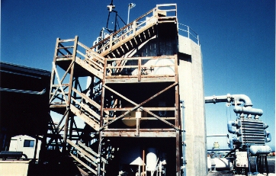
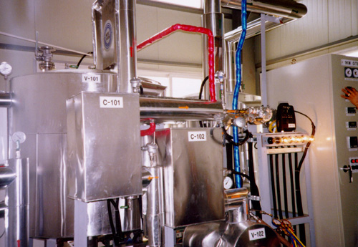
OTEC examples
Open Cycle OTEC in operation at Keahole Point, Hawaii Island
1KW OTEC system

Slide 33

Natural energy sources
Geothermal Energy

Slide 34
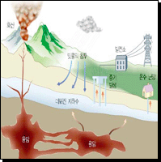
Geothermal Energy
Definition 1 : Use hot water to generate energy
Use HOT water from earth as energy source for electricity or heating
Temperature 20~150℃
→ Supply heat energy to demands
Temperature 102-182℃
→ Can generate electricity
Very simple and low running cost

Slide 35

Geothermal Energy
Properties
Very high efficiency → Approximately 50~70%
Needs separator to remove water
Generate a small amount of HSO₄
Very limited energy source site
Limited resource quantity
Extract rate is much more than recovery rate
Difficulty to transfer heat energy far
Unrecoverable energy

Slide 36
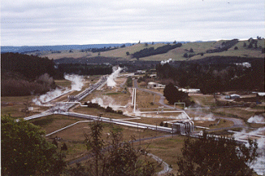
Geothermal Energy
Geothermal energy generation : Property
Unlimited resource quantity
No pollutant generated
High energy efficiency
Difficulty to transfer heat energy far
Very limited energy source site
Geothermal power plant

Slide 37
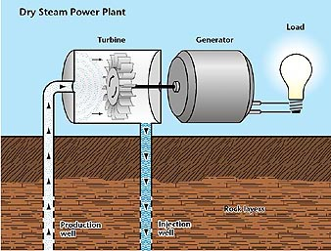
Geothermal Energy
Classification of Geothermal Generator [1]
Hot steam type
Used if energy source is primary steam
Very early method
Dry steam power plant

Slide 38
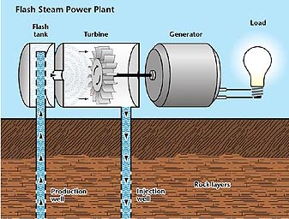
Geothermal Energy
Classification of Geothermal Generator [2]
Flash stream type
Used if energy source is primary water
Fluid is sprayed into a tank held at a much lower pressure than the fluid
Flash stream power plant

Slide 39
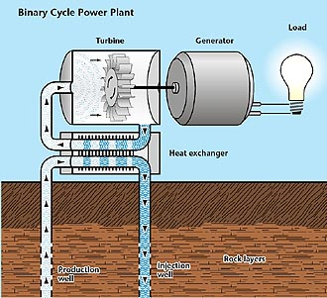
Geothermal Energy
Classification of Geothermal Generator [3]
Binary cycle power plant
Most geothermal areas contain moderate-temperature water
→ Difficulty in vaporization
Refrigerant is used
No gases is emitted
Binary cycle power plant

Slide 40
Geothermal Energy
Problems
Extract rate is faster than recover rate
Limited energy amount
Limited suitable area
Is there more efficient geothermal system?

Slide 41
Geothermal Energy
Use the earth infinite Heat source and sink
Heat pump system using the earth as heat source and sink is suggested
Temperature of the earth is almost constant independent of weather, climate
Work as heat sink in the summer
Work as heat source in the winter
Ground

Slide 42
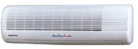
Geothermal Energy
Heat pump using geothermal method
Expansion valve
Evaporator
Condenser
Compressor
Ground
Indoor unit
Outdoor unit
Heating mode in winter

Slide 43
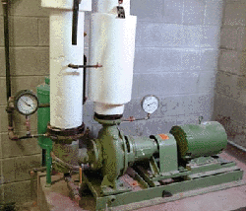
Geothermal Energy
Geothermal Heat pumps
Ground source heat pump
Geothermal earth connection subsystem
Geothermal heat pump subsystem
Geothermal heat distribution subsystem
Enables heat pump system in Korea

Slide 44
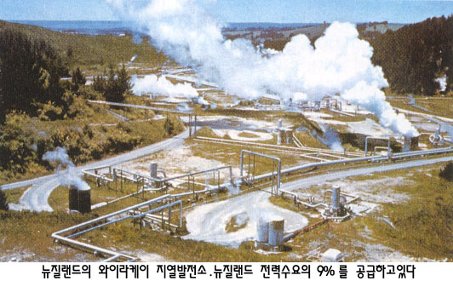
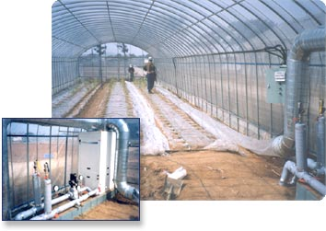
Geothermal Energy examples
Geothermal power plant
(New Zealand)
경기도 수원 농업기술연구원
비닐하우스 - 냉/난방 운용(50평×2동)

Slide 45

Natural energy sources
Wind Force Energy

Slide 46
Advantage of Wind force generation
Very low running cost
Infinite energy source
Almost no pollutant generation
Can be constructed in a small area
Good energy source for island
A ground can be utilized with other industry at the same time

Slide 47
Disadvantage of Wind force generation
Restricted area only
(wind velocity must be over 4 m/s)
Energy generation fluctuation as wind velocity
Limitation of blade size
Noise problem

Slide 48
Wind force generation
Wind force generation in the world (2000)
Country | Capacity (MW)
USA Denmark Germany Holland Spain Sweden U.K China India Korea | 2141 1420 2874 379 880 176 338 200 992 3

Slide 49
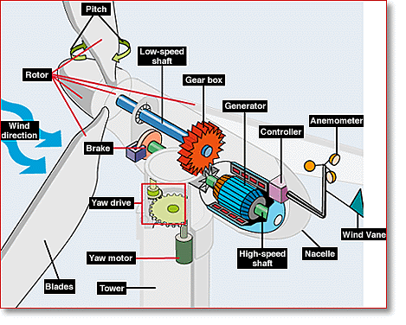
Wind force generation
Wind Turbine
Active yaw control (rotation)
Wind blade braking system
pitch control
drum breaking
Higher efficiency for large size
Lower noise for large size
More dead zone for large size
Lighter blade weight
Schematic of Wind turbine

Slide 50
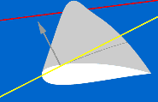
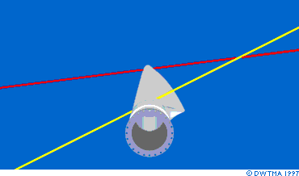
Wind force generation
Component of wind turbine : Blade
Changing the Wind Speed Changes Wind Direction Relative to the Rotor Blade
Blades twists
Made of glass fiber reinforced plastics for weight and strength
Natural frequency test
Wind blade rotation

Slide 51
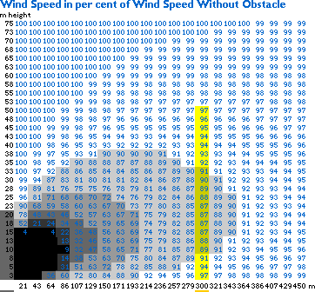
Wind force generation
Wind Shade [1]
Gray vertical bar
: Obstacle (20m tall)
Yellow vertical bar
: Turbine tower(50m tall)
Blue number
: Ratio of velocity with obstacle
To get 90% wind velocity ratio, tower must be away from obstacle at least for 300m in this case
Wind Shade for wind velocity

Slide 52
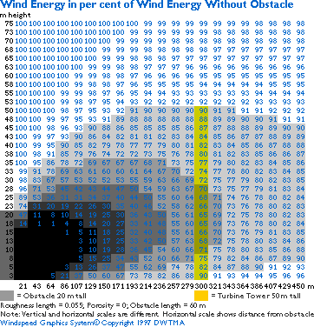
Wind force generation
Wind Shade [2]
Wind energy is in proportion to the cubic of wind velocity
To get 70% wind energy ratio, Turbine tower must be away from obstacle for at least 321m in this case
Avoid obstacle around wind tower
Wind Shade for wind energy

Slide 53
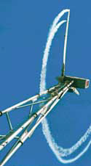
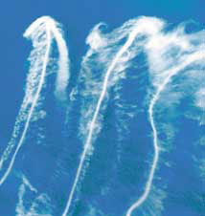
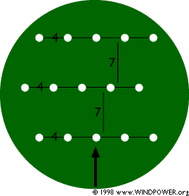
Wind force generation
Wake effect and park effect
Wake effect from wind turbine
Tower distribution for park effect
(Approx. 5% energy loss)

Slide 54
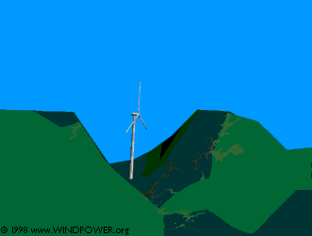

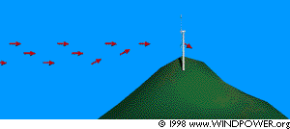
Wind force generation
Speed up effect : Tunnel effect and Hill effect
Tunnel effect
Hill effect

Slide 55
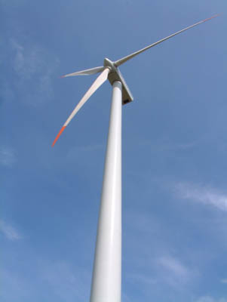
Wind force generation
Suitable area for wind force generation
Good wind velocity and consistency
Tunnel Effect
No strong blast, no turbulent flow
No obstacle around the generator
No excessive snow, no severe cold
(high altitude area suggested)
Not often lightening area

Slide 56
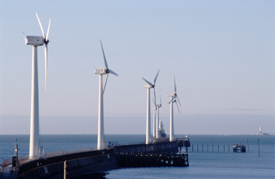
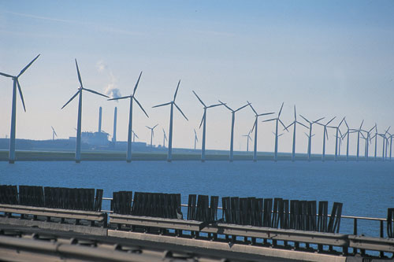
Wind force generation examples [1]
Wind turbine in the seaside
(Vindeby, Denmark)
Wind turbines
(Blyth, U.K, 90MW, Biggest)

Slide 57
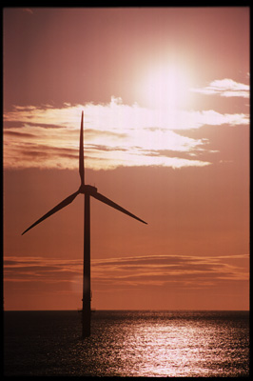
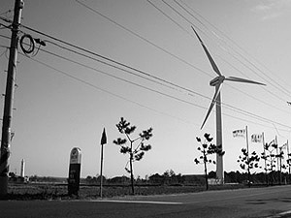
Wind force generation examples [2]
Wind turbine
(Daebo, Korea)
Wind turbines in the sea
(Denmark)

Slide 58

Natural energy sources
Wave force generation

Slide 59
Advantages of wave force generation
Small area for small energy
→ light house
24-hour generation
High wave altitude is needed
→ 2m high wave has 2 kW per seashore 1m

Slide 60
Disadvantages of wave force generation
Not constant wave velocity
(backward wave, no wave)
High initial construction cost
Difficulty in building facilities in the sea
Hard condition such as erosion
Low energy density
No wind!

Slide 61
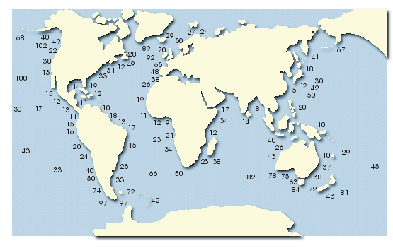
Wave force generation
Suitable area wave force generation
High wave
: 2m high wave has 2kW per
seashore 1m
Suitable small area needs small energy such as light house
Wave energy levels (kW/m of wave front)

Slide 62
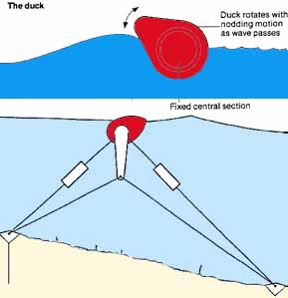
Wave force generation
Kinds of wave force generator : Floating or Pitching Device
Floats or Pitching Devices method
Efficiency is high
Amount of generation is small
Salter Duck wave energy conversion system

Slide 63


Wave force generation
Kinds of wave force generation : Oscillating water column method
Generator
Air
Generator
Turbine
Air
Air
Shore
Wave
Wave
Sea level rise
Sea level fall
Schematic of on shore wave force generation
Schematic of off shore wave force generation

Slide 64
Wave force generation
Comparison of Oscillating water column methods
 | On shore | Off shore
Type Survivability Number of Sites Intensity of wave energy Fabrication Environmental | Modular Good Unlimited Very high Simple & inexpensive Non visible/non audible Protects coastline | Monolithic A potential problem Very limited Greatly reduced Complicated & expensive Visible/audible Damages coastline

Slide 65

Wave force generation
Kinds of wave force generation : Wave Surge or Focusing Devices
Transferring or focusing the wave to concentrate energy
Water stored in reservoir generates electricity
TAPCHAN wave energy device

Slide 66




Wave force generation examples
Wave force generator
(Floating or pitch type)
Buoy with wave force generator

Slide 67

Wave force generation examples
Wave force generating ferry - Mighty whale
Developed in Japan(1998)
Use wave force as main energy source
High construction cost
Not available when wave is calm
Prototype : Kaimai(1978)
Mighty Whale

Slide 68


Wave force generation examples
Wave force generating ferry - Mighty whale and Kaimai
Mighty Whale (cross sectional view)
Wave force generation ferry
Kaimai (made in 1978)

Slide 69
Natural energy sources
Tidal power generation

Slide 70

Tidal power generation
Theory
Store seawater in flow and rotate turbine with stored seawater in ebb
Generation can carry out twice in flow and ebb
The water level difference must be over 1m
There’s time cannot generate electricity twice in a day
Tidal power plant

Slide 71
Tidal power generation
Advantages of tidal force generation
Very low running cost
Infinite energy source
No pollutant generation

Slide 72
Tidal power generation
Disadvantages of tidal force generation
High construction cost
Very restricted area only
Difference of sea water level in flow and ebb isn’t constant
Must consider environmental problem
Need large area for reservoir
There’s time cannot generate electricity

Slide 73
Tidal power generation
Situation of tidal power in the world
Power plant
Rance (France, 240 MW, biggest)
Annapolis(Canada, 20 MW)
Kislaya(Russia, 800 KW)
Changsia(China, 3 MW)
Potential area in Korea
Garolim(40 MW)
Sihwaho

Slide 74
Tidal power generation
Classification
Single reservoir – single flow system
Generate only in ebb
Single reservoir – double flow system
Henerate in both flow and ebb
Double reservoir – connection system
    High level reservoir, low level reservoir
Generate continuously, low efficiency
Double reservoir – isolation system
    Two single reservoir (single flow) system

Slide 75

Tidal power generation
Turbines in tidal power station : Bulb turbine
Plant in Rance(France) used this model
Making access for maintenance difficult
→ water must be prevented from flowing past the turbine for maintenance
Bulb turbine

Slide 76

Tidal power generation
Turbines in tidal power station : Rim turbine
Plant in Annapolis(Canada) used this model
Reduce maintenance problems as the generator is mounted in the barrage
Difficult to regulate the performance of these turbines and it is unsuitable for use in pumping
Rim turbine

Slide 77

Tidal power generation
Turbines in tidal power station : Tubular turbine
The blades are connected to a long shaft and orientated at an angle so that the generator is sitting on top of the barrage.
Tubular turbine

Slide 78

Tidal power generation
Tidal turbines
Use tidal power directly like wind turbine
Reduced environment problem in comparison with conventional system
Relatively small capacity
Present no difficulty to migrating fish
Tidal turbines

Slide 79

Tidal power generation
Tidal fences
Effective barrages which completely block a channel
All the electrical equipment (generators and transformers) can be kept high above the water (Good for maintenance)
Reduced environmental problem
Tidal fence is established The islands of Dalpiri in Philippines (1100kW)
Tidal fences

Slide 80

Tidal power generation
Examples
Tidal power plant in Rance

Slide 81


Tidal power generation
Examples
Tidal power generation Turbine
Water turbine

