Slide 1
Chapter 4.
Physical Transformations of Pure Substances
The Stability of Phases
Basic Principle:
The tendency of systems slides down to lower chemical potential.
The principle of uniform chemical potential applies.
However, many phases can be in equilibrium.
Temperature dependence of phase stability
μ (s), μ (l), μ (g): the chemical potentials of the solids, liquids, and gas phases.
As T rises, the chemical potential falls because S_{m} is always positive.
The gradient is steeper for gases than for liquids (S_{m}(g) > S_{m}(l)), and
steeper for a liquid than the solid (S_{m}(l) > S_{m}(s)).

Slide 2
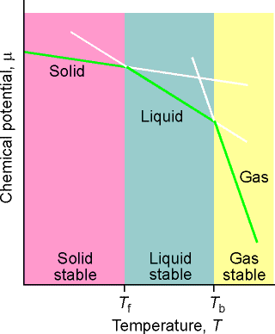
Pure Substance
The schematic temperature dependence of the chemical potential of the solid, liquid, and gas phases of a substance.
(In reality, the lines are curved).
The phase with the lowest chemical potential at the specified T and P is the most stable.
The transition temperatures, the melting and boiling temperatures, are the temperatures at which the chemical potentials of two phases are equal.
curvature
Solid
$$×$$
Chemical potential, μ
Liquid
Gas
Solid stable
Liquid stable
Gas stable
T_{f}
T_{b}
Temperature, T

Slide 3
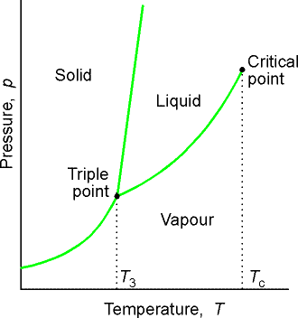
Figure 4.4
The general regions of pressure and temperature where solid, liquid, or gas is stable (that has the lowest chemical potential).
The solid phase is the most stable phase at low temperatures and high pressures.
Critical point
Solid
Liquid
Pressure, p
Triple point
Vapor
T₃
T_{c}
Temperature, T

Slide 4
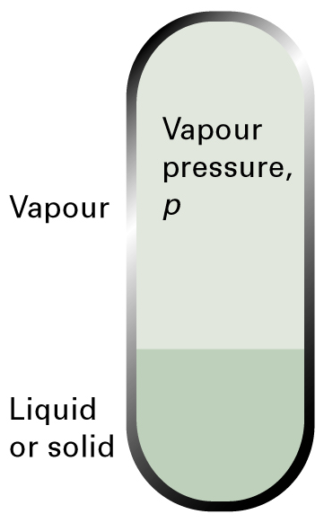
Uniform Chemical Potential
In Equilibrium
Figure 4.5
The vapor pressure of a liquid or solid is the pressure exerted by the vapor in equilibrium with the condensed (L or S) phase.
Vapor
V atom
↓
↑
T < T_{sublimation}
(T < T_{boiling})
S atom
Solid

Slide 5
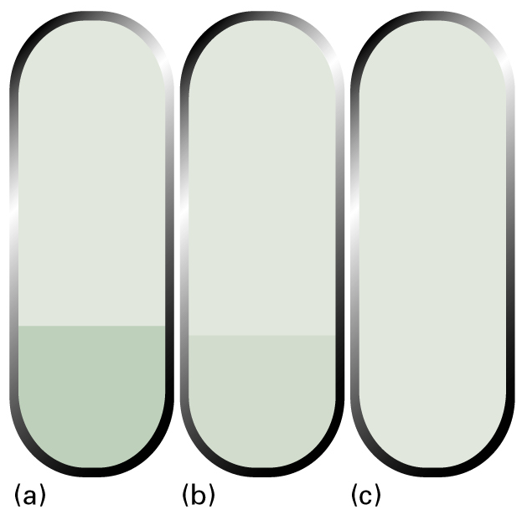
T < T_{c} or
P < P_{c}
T > T_{c} or
P > P_{c}
Figure 4.4
A liquid in equilibrium with its vapor.
When a liquid is heated in a sealed container, the density of the vapor phase increases and that of the liquid decreases slightly.
There comes a stage at which the two densities are equal, and the interface between the fluids disappears. This disappearance occurs at the critical temperature.
The container needs to be strong: the critical temperature of water is 374˚C and the vapor pressure is then 218 atm.
V
V
V = L
L
L
T + P going up

Slide 6
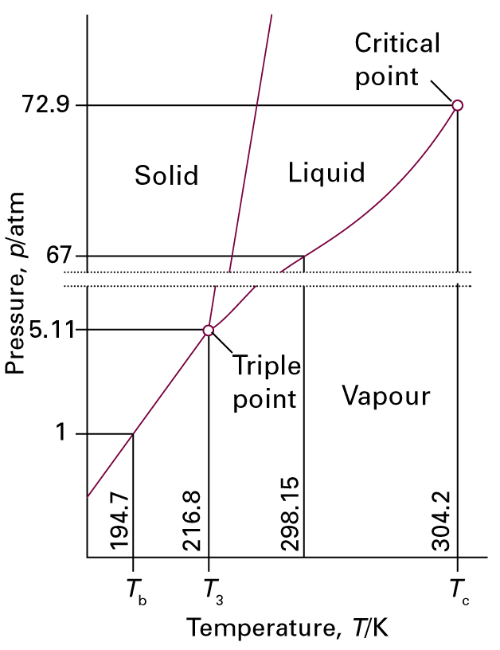
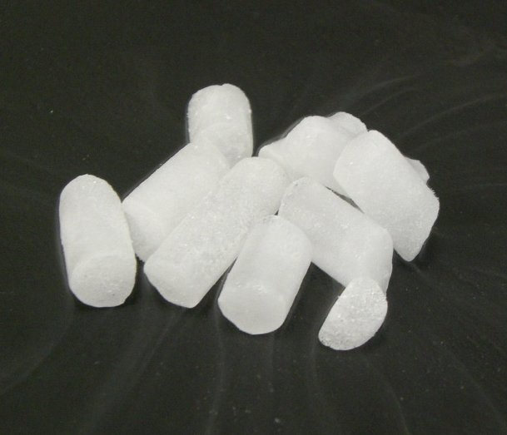
Figure 4.8
Phase diagram for carbon dioxide.
As the triple point lies at pressures well above atmospheric, liquid carbon dioxide does not exist under normal conditions
A pressure of at least 5.11 atm must be applied.
Dry ice

Slide 7
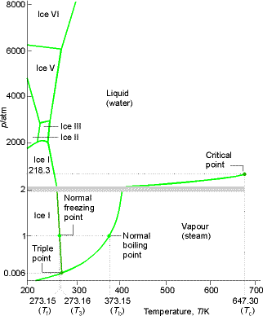
8000
Ice VI
+ Many Metastable Ice Phases
6000
Ice V
Liquid (water)
Figure 4.9
Equilibrium Phase Diagram for water showing the different solid phases of ice.
4000
p/atm
Ice III
2000
Ice II
Ice I
Critical point
218.3
2
Normal freezing point
Ice I
Vapor (steam)
1
Normal boiling point
Triple point
0.006
200
300
400
500
600
700
273.15 (T_{f})
273.16 (T₃)
373.15 (T_{b})
Temperature, T/K
647.30 (T_{c})

Slide 8
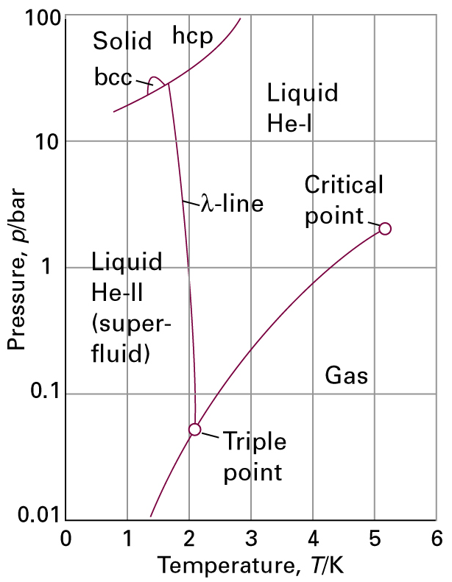
Figure 4.11
The phase diagram for helium (⁴He).
The λ-line marks the conditions under which the two liquid phases are in equilibrium.
Helium-II is the superfluid phase.
Note that a pressure of over 20 bar must be exerted before solid helium can be obtained.
Different solid phases:
hcp: hexagonal close packing
bcc: body-centered cubic
_
_

Slide 9
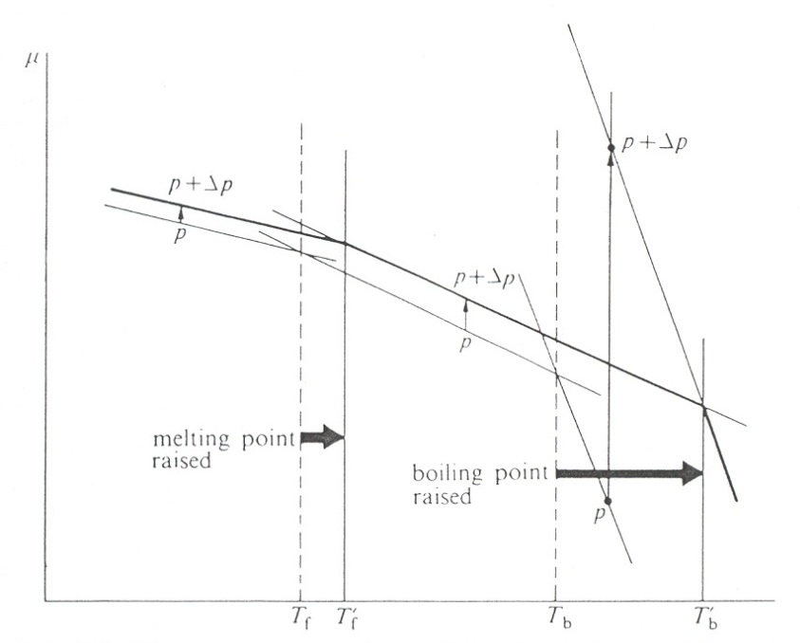
4.4(b) Chemical Potential Dependence on Pressure
An increase in pressure raises the chemical potential (because V is certainly positive), and increases it much more for gases than either liquids or solids.
The molar volume of a gas is about 1000 times larger than that of liquid or solid.
An increase in pressure increases the chemical potential of a liquid slightly more than the potential of a solid, resulting in the raising of the freezing point.
μ
P + ΔP
P + ΔP
P
P + ΔP
P
Figure 4.13
The pressure dependence of the chemical potential, and its effect on the melting and boiling points.
Melting point raised
boiling point raised
P
T_{f}
T´_{f}
T_{b}
T´_{b}

Slide 10
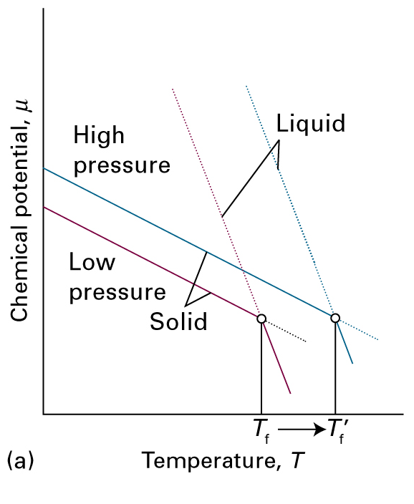
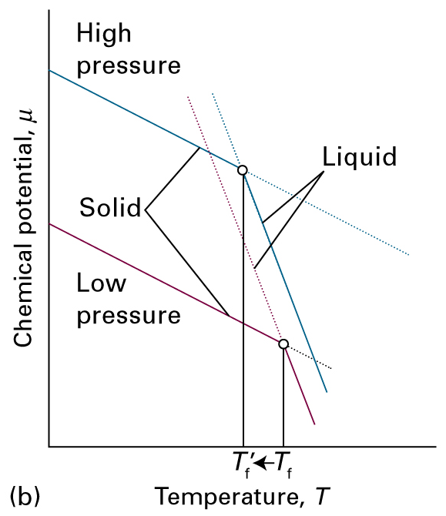
Figure 4.13
general
water
S - L
The pressure dependence of the chemical potential depends on the molar volume of the phase. (In practice, the lines are curved.)
In general, the molar volume of solid is less than that of the liquid, and μ (s) increases less than μ (l). As a result, the freezing temperature rises.
The molar volume is greater for the solid than the liquid (as for water or Si):
μ (s) increases more strongly than μ (l).
The freezing temperature is lowered.

Slide 11
4.4(c) The Effect of Applied Pressure on Vapor Pressure
When pressure is applied to a liquid phase, its vapor pressure rises.
Molecules are squeezed out of the liquid phase, and escape as a gas.
_____
at T < T_{b}

Slide 12
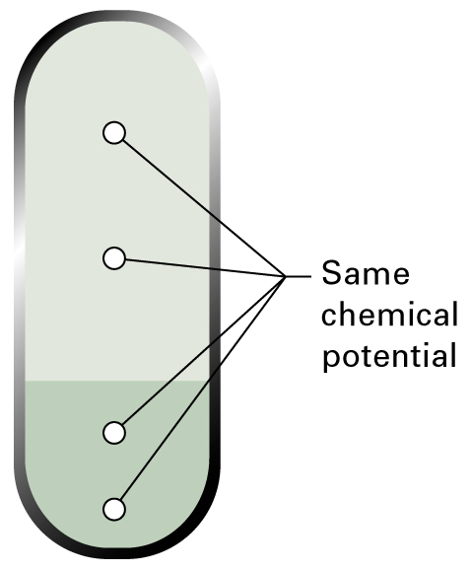
***
When two or more phases are in equilibrium,
Chemical potential of a component is
the same in each phase, and is the same at all points in each phase.
V
__
L
at T < T_{b}
at P

Slide 13
at T < T_{b}
Equating the changes in chemical potentials of the vapor and the liquid gives
Integration for the case when there is an additional pressure on the liquid gives:
Ideal gas
(4.4)

Slide 14
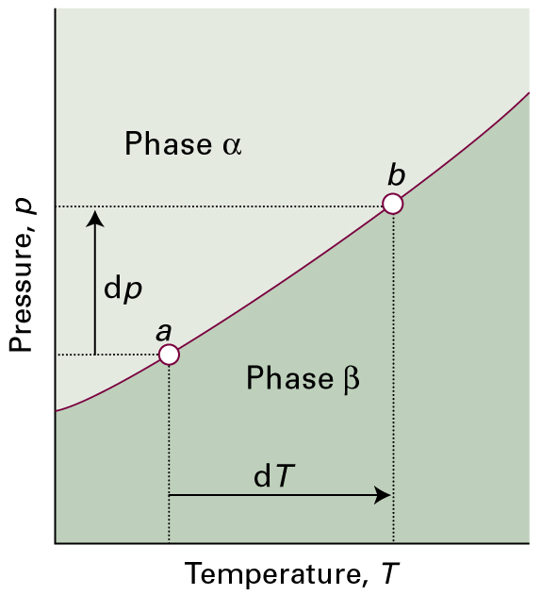
4.5 The Location of
Phase Boundaries
Figure 4.15
α phase – β phase
solid - liquid
liquid - vapor
solid - vapor
When pressure is applied to a system in which two phases are in equilibrium (at a), the equilibrium is disturbed.
It can be restored by changing the temperature, so moving the state of the system to b. It follows that there is a relation between dp and dT that ensures that the system remains in equilibrium as either variable is changed.

Slide 15
Boundary of α Phase – β Phase
4.5 Phase Diagrams
The boundaries between two phases lie at the values of p and T where the two phases can exist.
(1)
(2)
Combining eqs (1) and (2), we know
___________________
(3)
_____
Clapeyron equation
(4)
(4.6)

Slide 16
Solid-Liquid Boundary
_______
At melting points T_{f}
The molar entropy change of melting
From eq (4)
(5)
(4.9)

Slide 17
On integrating eq (5), the equation of the solid-liquid equilibrium curve
(6)
where p* and T* are the pressure and temperature on some point of the equilibrium line.
When T is close to T*, the logarithm can be approximated using
(4.7)
which is linear in T.

Slide 18
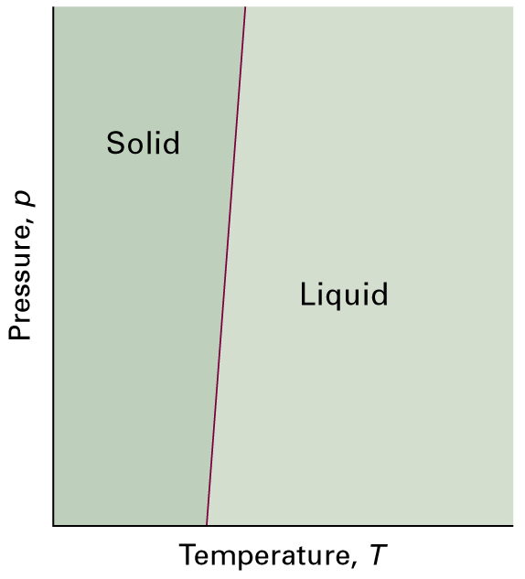
Figure 4.16
A typical solid-liquid phase boundary slopes steeply upwards.
This slope implies that, as the pressure is raised, the melting temperature rises. Most substances behave in this way.

Slide 19
Example:
What is the freezing point of water under a pressure of 1500 atm?
(assuming independent of P and T)
Solution:
Note that water freezes 0ºC at 1 atm.

Slide 20
4.5( c) The Liquid-Gas Boundary
_______
ΔH_{vap,m} : the molar enthalpy of vaporization
ΔV_{vap,m} : the molar volume change on vaporization
is much smaller than in the case of solid-liquid equilibrium.
The slope depends on ΔV_{vap,m}, and the volume of the gas is sensitive to P. Increasing pressure decreases V(g) and therefore ΔV_{vap,m} also.
The slope increases as p increases, and this is why the line drawn in Figure 4.17 curls upwards.

Slide 21
Assuming that the gas behaves ideally, V_{m}(g) may be replaced by
On rewriting,
(7)
(4.11)
Assuming that ΔH_{vap,m} does not depend on the temperature,
Ideal Gas +
Negligible Volume of Liquid
where p* is the pressure at some temperature T*.

Slide 22
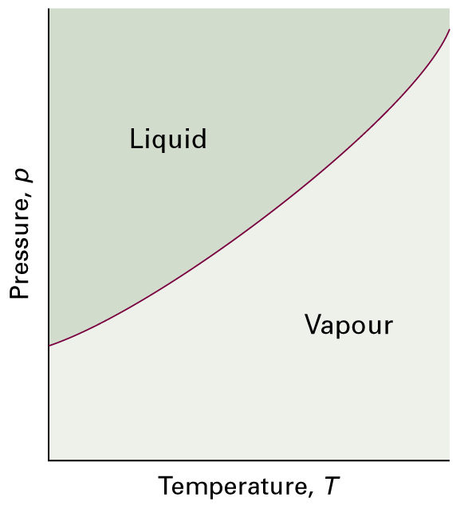
Figure 4.17
A typical liquid-vapor phase boundary.
The boundary can be regarded as a plot of the vapor pressure against T.
The phase boundary terminates at the critical point (not shown).

Slide 23
4.6(d) Solid-Vapor Boundary
________
ΔH_{sub,m}: the molar enthalpy of sublimation
Similarly,
______
usu. ΔH_{sub,m} > ΔH_{vap,m}
The slope is steeper for sublimation than for vaporization. (See Fig. 4.18)
_________________________________________________________
The solid-liquid-gas equilibrium
Triple point: A point where solid, liquid, and gas can all coexist in
equilibrium. It is given by the values of p and T for which all three chemical potentials are equal.
-2014-4-24

Slide 24
4.6 More Remarks about Phase Transitions
At the transition point,
Since both ΔV_{m} and ΔH_{m} are non-zero, it follows that and can be different on either side of the transition. In other words, the derivatives of Gibbs free energy can be discontinuous. This is the basis of the term First-Order Phase Transition.
The case in which the first derivative of G is continuous, but the second derivative is discontinuous.
→ the Second-Order Phase Transition.

Slide 25
Second-Order Phase Transition
A continuous slope of μ implies that the entropy and volume (and hence the enthalpy) do not change at the transition.
The heat capacity is discontinuous at the transition but does not become infinite.
The type of transition may include:
Order-Disorder Transition
Ferromagnetic Transition
Ferroelectric Transition
Fluid-Superfluid Transition
. . . . .

Slide 26
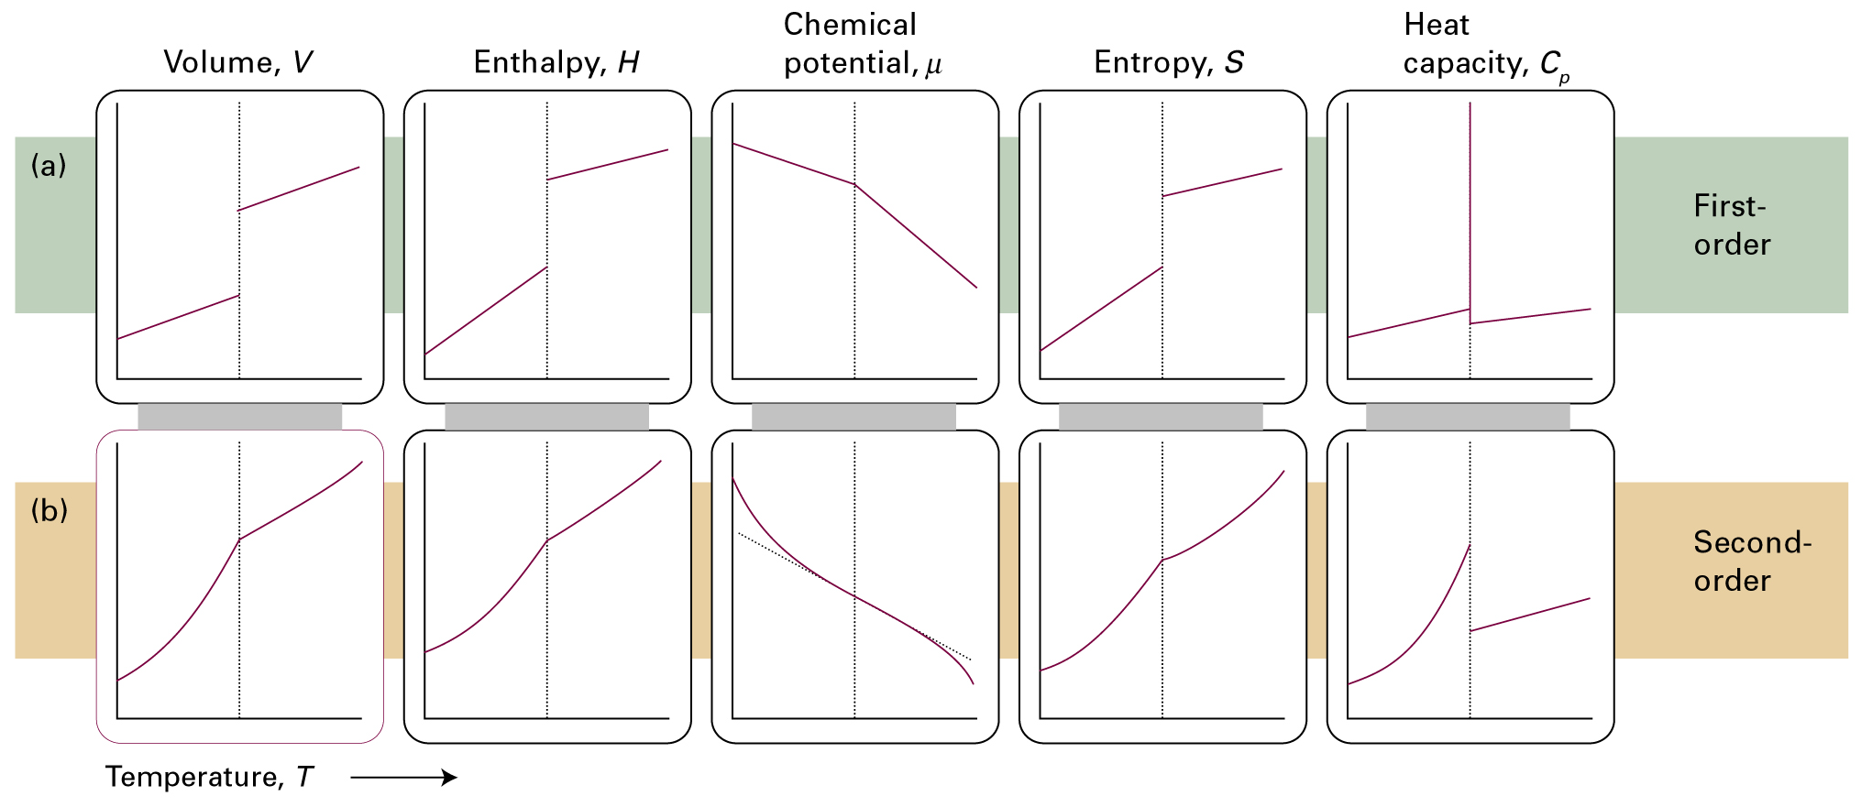
***
_
_
_
_
X
V H G S C_{p}
Figure 4.19
(a) first-order and (b) second-order phase transitions.

Slide 27
c
a = b ≠ c
a = b = c
a
b
slow
Equal rates
Phase transition
Fast
Equal rates
Fast
Equal rates
Tetragonal phase
Cubic phase
(a)
(b)
Figure 4.21
One version of a second-order phase transition in which (a) a tetragonal phase expands more rapidly in two directions than a third, and hence becomes a cubic phase, which (b) expands uniformly in three directions as the temperature is raised.
There is no major rearrangement of atoms at the transition temperature, and hence the enthalpy of transition may become zero.

Slide 28
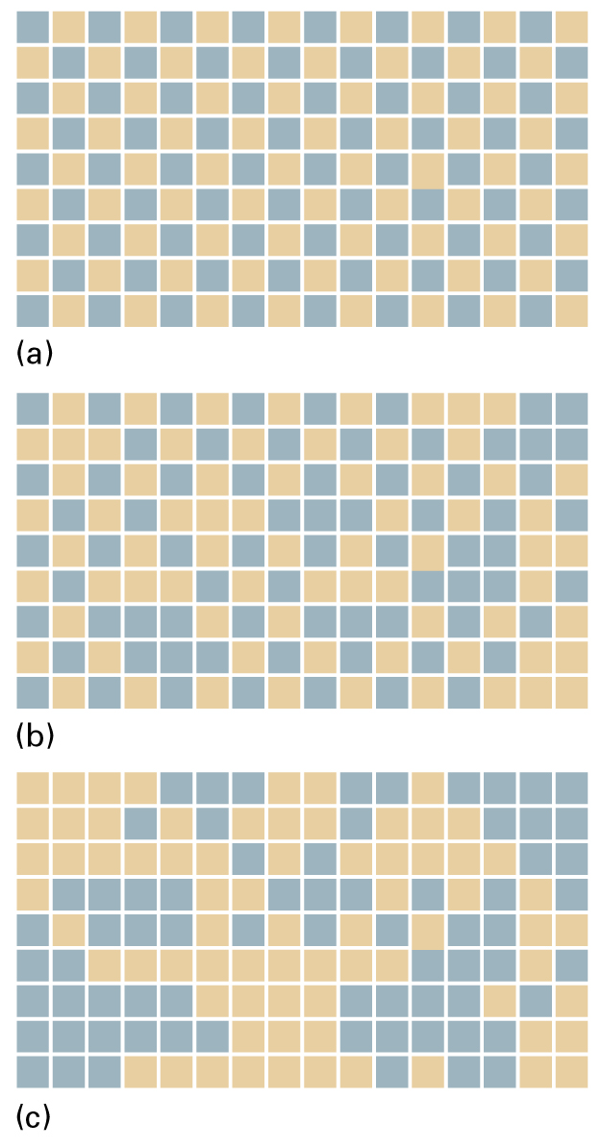
Figure 4.22
Order-Disorder Transition
At T = 0, there is perfect order, with different kinds of atoms occupying alternate sites.
As the temperature is increased, atoms exchange locations and islands of each kind of atom form in regions of the solid. Some of the original order survives.
At and above the transition temperature, the islands occur at random throughout the sample.
T = 0 K
T < T_{c}
T < T_{tr}
A and B atoms like each other,
compared to the A-A or B-B atoms.
T > T_{c}
T > T_{tr}

Slide 29
Problems from Chap. 4
D4.1 D4.3
E4.1(a) E4.8(a) E4.12(a)
P4.13 P4.12

