Slide 1
Recommended Alerts
Seong-Jun Lee

Slide 2
Bibliographic
Title: Recommended Alerts
Filing Date : 28.12.2006
Applicant : GOOGLE, INC.
Inventor : SINGERMAN, Brian

Slide 3
Background
Ever-increasing amounts of information by Internet
How to find information from there?
With user’s effort + Search engines
Without user’s effort + Recommendation
Key idea of Recommended Alerts
Automatic recommendation
Push method of distributing information

Slide 4
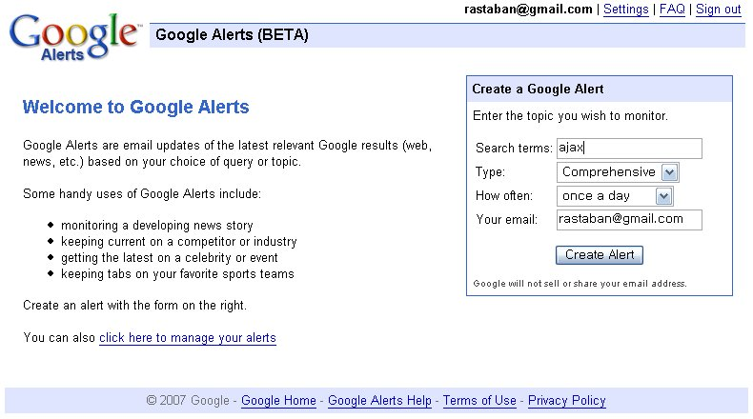
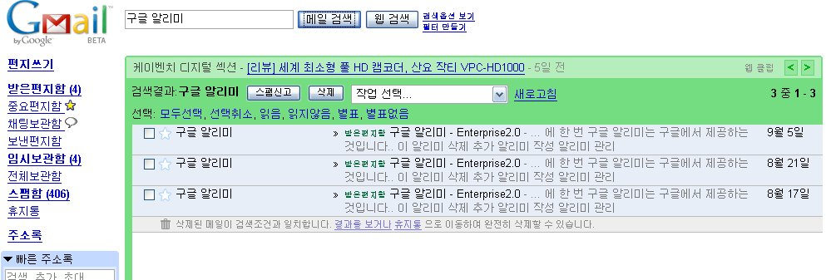
Alerts?
Register alerts
Receive contents

Slide 5
More about Recommended Alerts
Return set of one or more key terms
By user history information
User profile
Alert categories that the user has indicated are of interest
By computing activity
Sending/Receiving email
Visiting/authoring/updating web pages
Downloading content
By term in document
Visited by user
By scoring function
Weighted sum of above

Slide 6
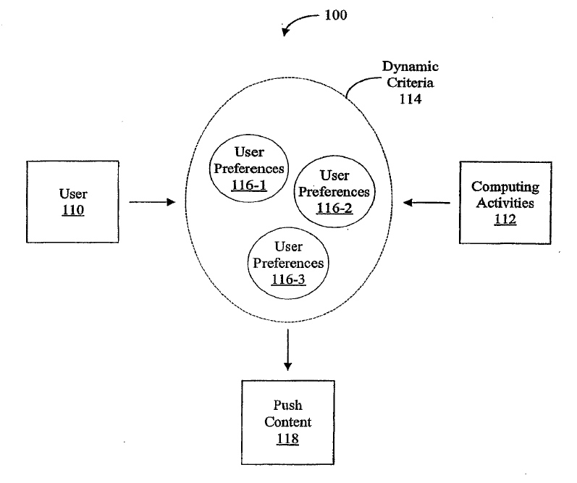
More about Recommended Alerts

Slide 7
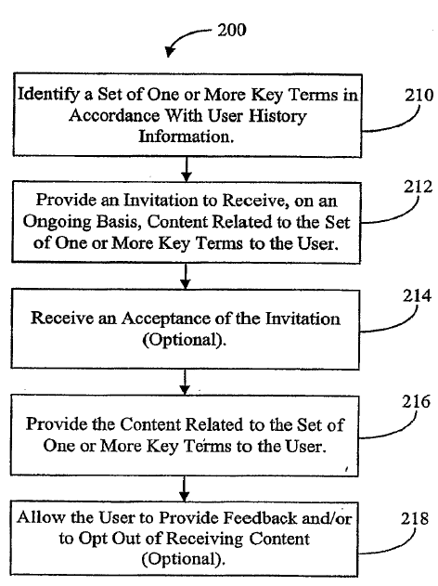
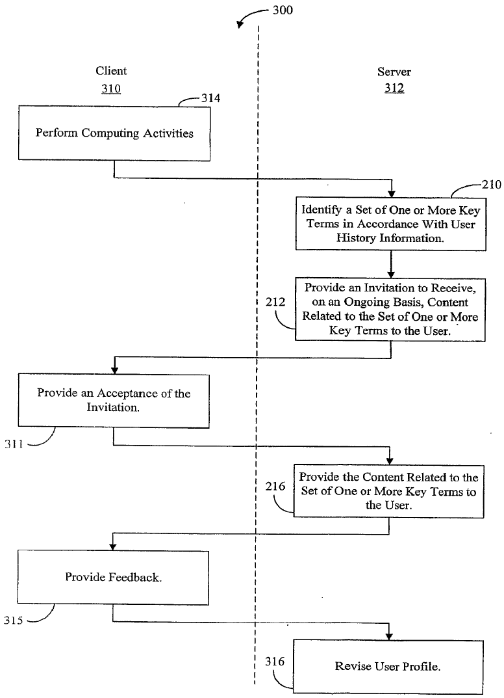
Brief sequence of Recommended Alerts
Retrieve key terms from user history
Send invitation
Receive acceptance
Provide additional key terms to user
Receive user feedback to opt out of receiving content

Slide 8
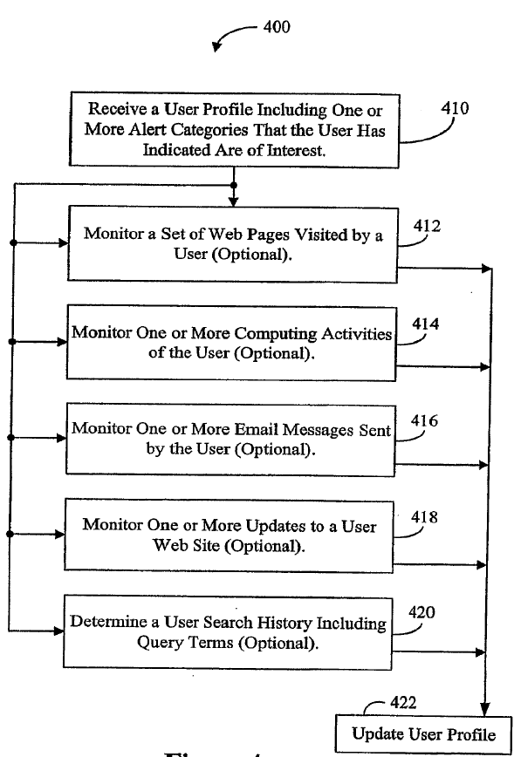
Determining computer activities for a user
Receive user profile
Monitor
Visited web pages
Computing activity
Email send/receive
Update web site
Search history(query terms)
Feedback to user profile
Gather additional information
about user’s interest

Slide 9
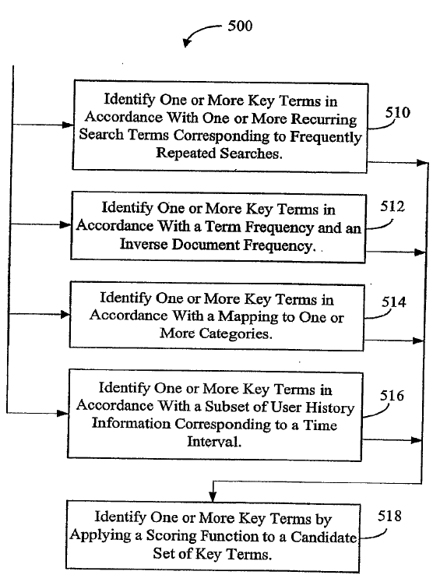
Identifying one or more key terms(for user)
Identify Key Terms by…
Frequently repeated search terms
TF-IDF
Categories
E.g. “Apple” can be supplemented by “computer,” “electronics,” “food”
Subset of user history info. Corresponding to a time interval
By scoring function(weighted sum of above)

Slide 10
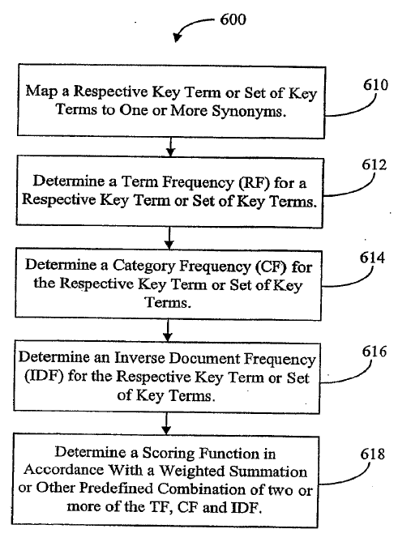
Identifying one or more key terms(term itself)
Identify Key Terms by…
Synonyms
Term Frequency
Category Frequency
Inverse document Frequency
Scoring function(weighted sum of above)

Slide 11
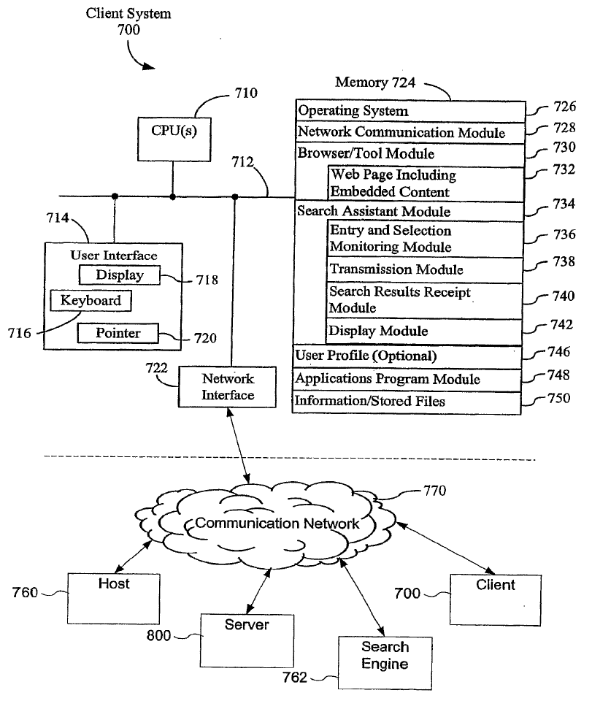
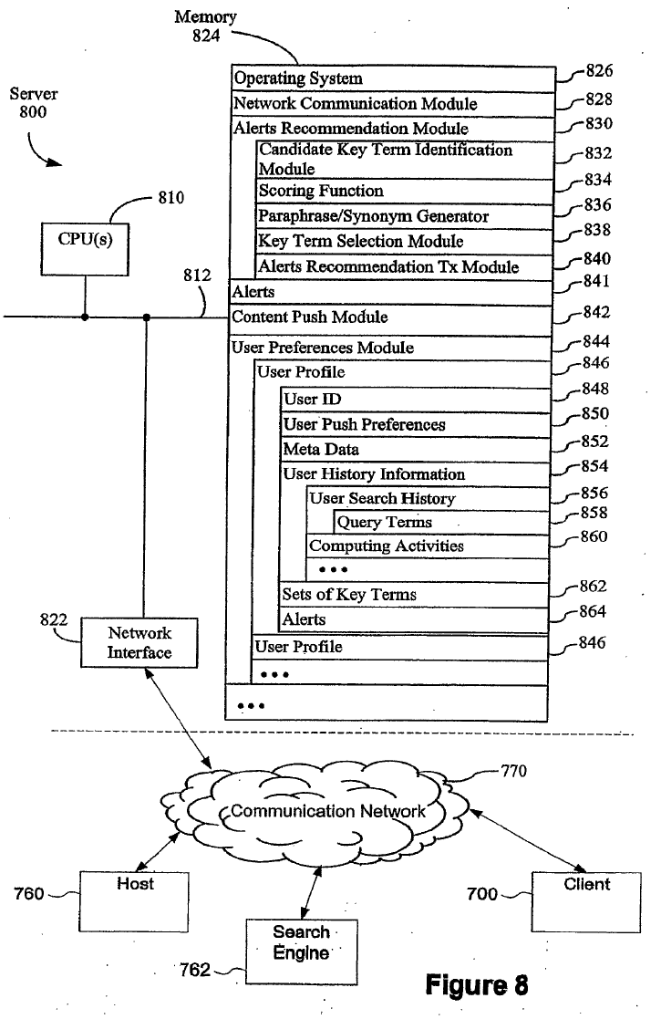
Client/Server System

Slide 12
Client System
736: monitoring user input
738: sending query to search engine
740: receiving search results from search engine

Slide 13
Server System
841: a set of established alerts
842: distributing content to users using (841)
850: how the user prefers to receive alerts
852: demographic information about user
862: set of key terms associated with various documents and computer activities
864: user subscribed alerts

Slide 14
Summary
In short,
Recommend terms for alerts
By using user’s information
With various measure
By that term,
Recommend content every week(day, .. Etc.)

Slide 15
Thank You

