Slide 1
Ch. 15 Kinematics of Rigid Bodies
Prof. SangJoon Shin
Notes:
- PPT 메뉴 탭 – 디자인 – 사용자 지정 – 슬라이드 크기 – 표준(4:3) 으로 작업할 것.

Slide 2
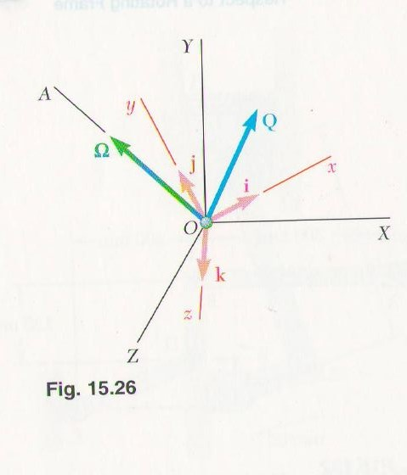
15.10 Rate of change of a vector w.r.t. a Rotating Frame
Sec 11.10 --- rate of change of a vector is the same w.r.t. a fixed frame
a frame in translation
how about w.r.t. a rotating frame of reference?
Fig.15.26. ---- fixed frame OXYZ
rotating frame Oxyz, : angular velocity
: vector function
2

Slide 3
15.10 Rate of change of a vector w.r.t. a Rotating Frame
Differentiate, rate of change of , w.r.t. rotating frame Oxyz
Differentiate , w.r.t. the fixed frame OXYZ, are variable
(15.27)
(15.28)
(15.29)
velocity of a particle at the tip of $\vec{Q}$
(15.30)
(15.31)
Rate of change of $\text{w}\text{.}\text{r}\text{.}\text{t}\text{. }$
$$\text{rotating} \text{frame} \text{Oxyz}$$
Induced by the rotation of Oxyz
3

Slide 4
15.11 Plane Motion of a Particle Relative to a Rotating Frame
(15.29)의 부연설명
는 만일, 벡터 Q가 frame Oxyz에 fixed 되어 있어
이 된다면 (15.29)식의 마지막 3개 항과 같이 됨.
그러한 경우 는 이 tip에 위치하여 있는 particle의 velocity를 나타내게 되며,
이는 frame Oxyz에 rigidly attached 되어 있는 질점의 velocity를 의미함.
Frame Oxyz는 Frame Oxyz 에 대하여 의 angular velocity로 회전하고 있으므로
마지막 3 개 항
4

Slide 5
15.10 Rate of change of a vector w.r.t. a Rotating Frame
When is represented by the unit vectors in Oxyz, Eq.(15.31) simplifies the
determination of , since no need to separate computation of the derivatives of
the unit vectors defining the rotating frame.
5

Slide 6
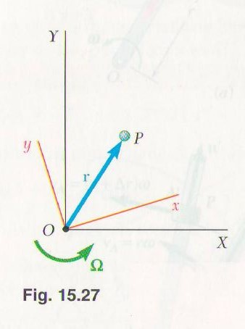
15.11 Plane Motion of a Particle Relative to a Rotating Frame
Fig. 15.27. ---- two frames of ref, in the plane of the figure
fixed frame OXY, rotating frame Oxy
: rate of change of , w.r.t. a fixed frame
6

Slide 7
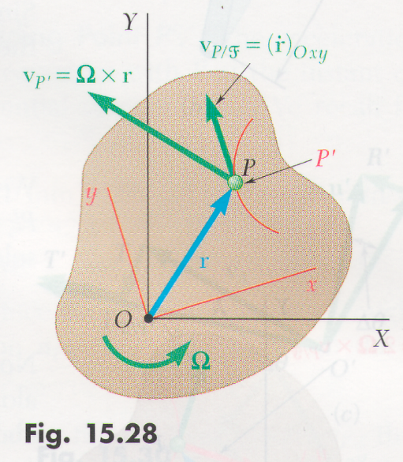
15.11 Plane Motion of a Particle Relative to a Rotating Frame
: w. r. t the rotating frame OXY
: angular velocity of the frame Oxy w. r. t OXY
(15.32)
: P’ velocity in the slab
which coincides with P
at the instant
(15.33)
vel. Of P relative to F
Abs. velocity of P
vel. of P’ of moving frame F coinciding with P
7

Slide 8
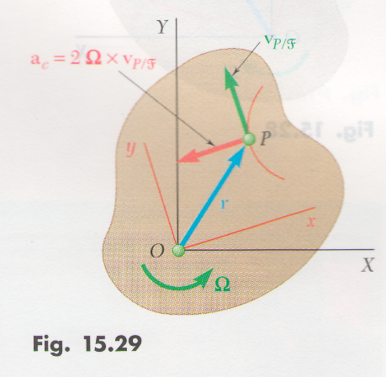
15.11 Plane Motion of a Particle Relative to a Rotating Frame
Absolute acceleration --- rate of change of , w, r, t OXY
(15.34)
: complementary
Coriolis acceleration
(15.36)
8

Slide 9
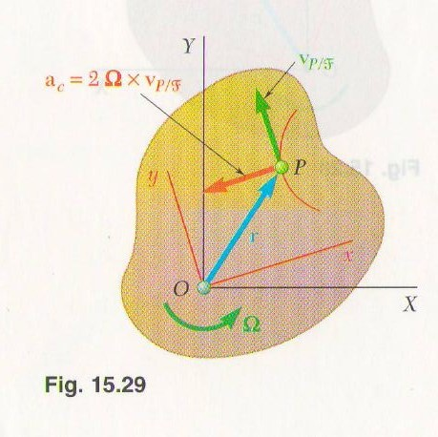
15.11 Plane Motion of a Particle Relative to a Rotating Frame
Compared with Eq. (15.21)
→ if the frame is rotating, necessary to include Coriolis’ acceleration
Direction of
, rotating through 90°
in the sense of rotation of the moving frame (Fig. 15.29)
Abs. Accel of P
Accel. of P’ of moving frame F coinciding with P
Accel. of P’ of relative to F
accel. w. r. t a frame in translation
9

Slide 10
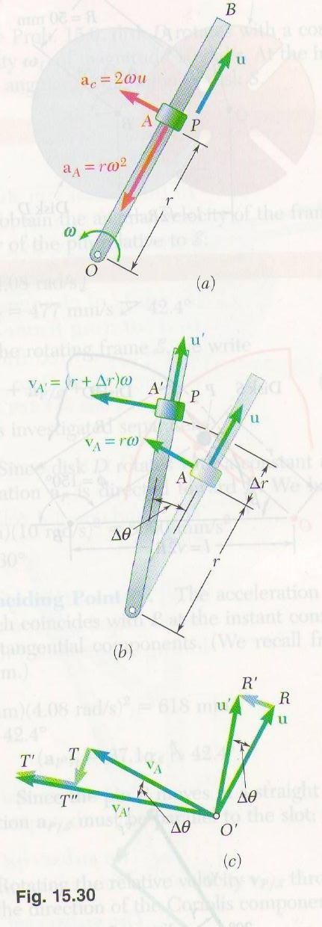
15.11 Plane Motion of a Particle Relative to a Rotating Frame
Significance of
Abs. velocity of P at time t and (Fig. 15.30(b))
At t, velocity components
Fig 15.30(c) , change in velocity during
---- change in the direction of , represents
--- change in direction of due to the rotation
---change in magnitude of due to the motion of P along
the rod
“combined effect of the relative motion of P and of the rotation of
the rod
10

Slide 11
15.11 Plane Motion of a Particle Relative to a Rotating Frame
- sum of these two →
Eqs. (15.33.),(15.36) → mechanism which contain parts sliding on each other
abs. and relative motions of sliding pins and collars.
---- useful in long-range projectiles, apprecialbly affected by the earth rotation.
* system of axes attached to the earth--- not truly a Newtonian frame.
→ rotating frame of ref., formulas derived in this section facilitate the study
of the motion w.r.t. axes attached to the earth.
11

