Slide 1
Reduction of Sludge Production
- Alternative to Energy Recovery from Waste Sludge
Ki-Hoon Kang
Technology R&D Institute
DAELIM Industrial Co., Ltd.
Sep. 30, 2014

Slide 2
Introduction

Slide 3

Waste Activated Sludge
THE PROBLEM
Waste activated sludge (WAS)
generation in Korea (KMOE, 2011) :
- 8,292 ton/day in 2009,
- 10,936 ton/day by 2013 (estimated)
Prevention of ocean dumping
by London Treaty
⇒ require appropriate alternatives
WAS volume reduction methods :
- anaerobic digestion
- pretreatment for enhanced efficiency
⇒ require a relatively high amount of energy consumption

Slide 4
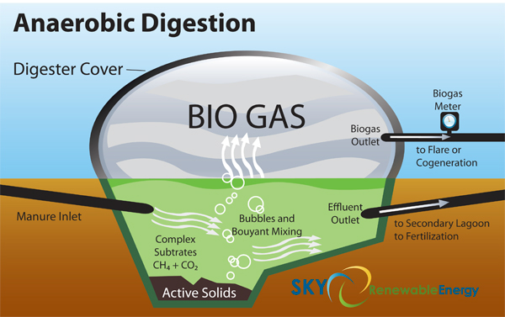
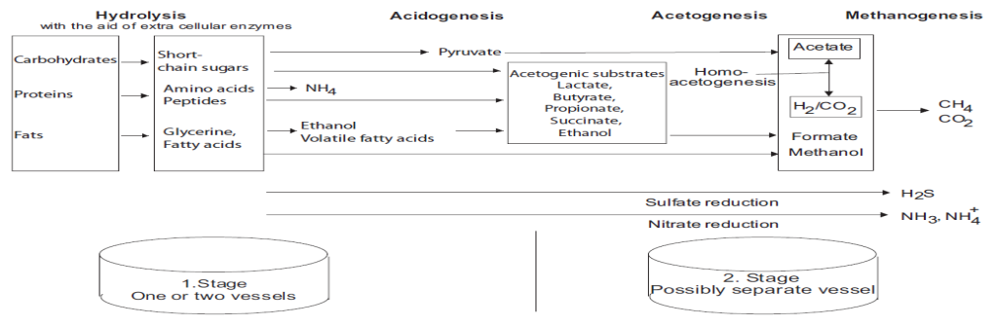
Waste-to-Biogas
ANAEROBIC DIGESTION
Methane fermentation : hydrolysis, acidogenesis, acetogenesis, and methanation
The individual phases : partly stand in syntrophic interrelation and place different requirements on the environment
Two stages: the first 2 phases and the last 2 phases are linked closely with each other

Slide 5
Waste-to-Biogas
Anaerobic Digestion Reactors
Low-rate anaerobic reactors
High-rate anaerobic reactors
Anaerobic pond
Anaerobic contact process
Anaerobic filter (AF)
Septic tank
Upflow anaerobic sludge
blanket (UASB)
Imhoff tank
Fluidized bed reactor
Standard rate
anaerobic digester
Hybrid reactor: UASB/AF
Anaerobic sequencing batch
reactor (ASBR)
Slurry type bioreactor, temperature, mixing,
SRT or other environmental conditions are not regulated. Loading : 1-2 kg COD/m³-day
Able to retain very high concentration of active biomass in the reactor. Thus extremely high SRT could be maintained irrespective of HRT. Loading: 5-20 kg COD/m³-d

Slide 6
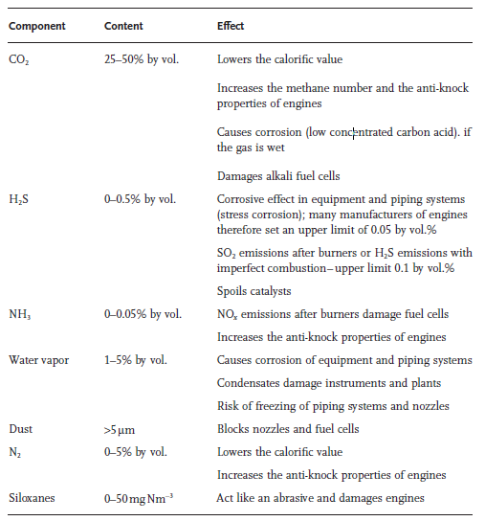
Waste-to-Biogas
BIOGAS COMPOSITION PRODUCED BY AD
The gas components: specified to the plant and substrate and should be checked regularly on a long-term basis

Slide 7
Pretreatment Methods for Enhanced Biogas Production

Slide 8
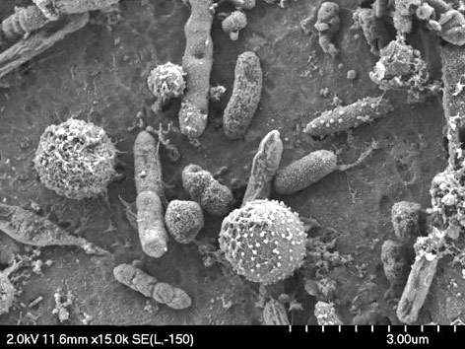
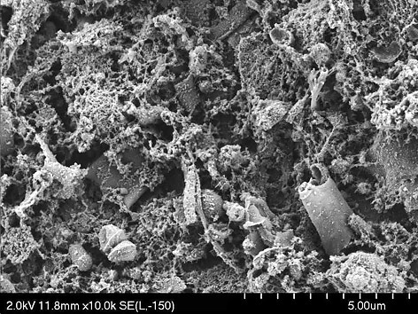
Pretreatment Methods for Enhanced Biogas Production
P. L. McCarty at Stanford University
Looking for a way to improve anaerobic digestion (in the late 1970s)
- Primary Sludge (PS) : easily digested
- Waste Activated Sludge (WAS) : only 1/3 can be digested
Waste Activated Sludge : mostly consisted of microbial cells
- Protection by cell walls, most cellular material is unavailable to anaerobic microbes.
Pretreatment Methods : focused on ‘Cell Lysis”
- Volatile solids reduction (VSR) can be increased 2~3 times.
- Biogas production can be doubled.

Slide 9
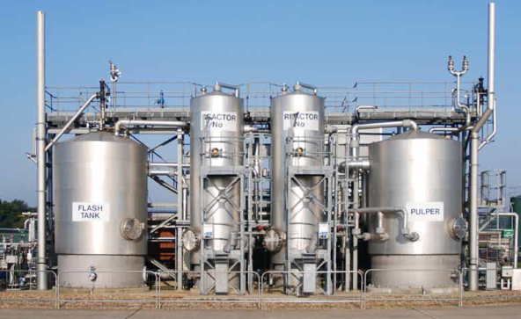
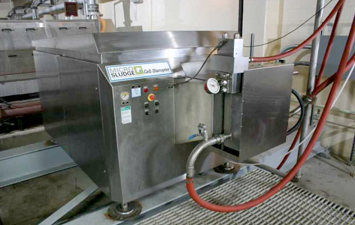
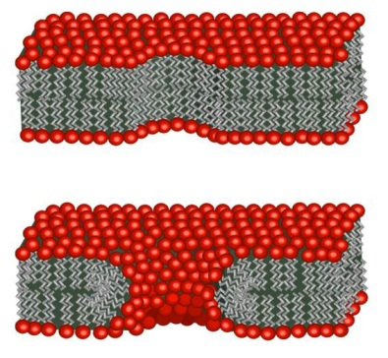
Pretreatment Methods for Enhanced Biogas Production
Methods of Cell Lysis
High temperature (Hydrolysis)
- CambiTM by Cambi AS, Norway : 165°C at 6 bar for 20~30 min
- ExelysTM by Veolia, France : 165°C at 9 bar for 30 min
High Pressure
- MicroSludge® by Paradigm Environment, Canada : homogenizer (60 bar)
Physical Force
- OpenCel® by OpenCel LLC, Atlanta : focused pulse
- Ultrasound homogenizer
Others : high or low pH, chemical oxidation, etc.
CambiTM MicroSludge® Homogenizer OpenCel® (pores on cell well)

Slide 10
Pretreatment Methods for Enhanced Biogas Production
Carbon source production from sludge using Cell Lysis
Methanol alternatives as C source for denitrification
- Reduced sludge production & reduced
- Utilization as C source has 10 times its value making biogas
⇒ Reduced greenhouse gas emission
⇒ Reduced O&M cost
Major Issues on Pretreatment of Sludge
Cost can be higher than the benefit it can provide !!
- Benefit (increased biogas production) should be greater than CAPEX + OPEX.
- There are various unforeseeable and hidden costs.

Slide 11
Reduction of Sludge Production

Slide 12



Reduction of Sludge Production
Paradigm Shift
New technology for source reduction during wastewater treatment by manipulating microbial growth kinetics
1st Generation
2nd Generation
3rd Generation
New Generation
Conventional
Wastewater Treatment
Advanced
Wastewater Treatment
Wastewater Reuse
Minimized Sludge Production
BOD (Organic matters),
SS (Particulates)
BOD, SS,
Nutrients (TN, TP)
High water quality for
wastewater reuse
High water quality
+ Sludge Reduction
Process Diagram
Influent
Bioreactor
Effluent
Settling
Anaerobic Sludge Holding Tank
RAS
WAS

Slide 13

Reduction of Sludge Production
PRINCIPLE OF SLUDGE REDUCTION
The abrupt change in growth environments
- “Uncoupling metabolism” most widely studied
- Yield reduction while maintaining substrate uptake rate
- The reduction of ATP production in microbial cells
Possible Explanation
Uncoupling Metabolism
Carbon O₂
H₂O+CO₂
Metabolism limitation
Catabolism
Etc.
Microbial
degradation
ADP P_{i}
ATP
Theory of sludge reduction
Motility
(Movement)
Predator-prey interaction
Substrate
inhibition
Basic metabolism
(Life conservation)
Low growth unit domination
Anabolism-Growth
(Sludge production)

Slide 14
Determination of Optimal HRT of the Anaerobic SHT
Monitoring NH₃-N concentration while incubating anaerobically
- in the same growth condition of SHT
- no substrate addition during incubation
Abrupt increase in NH₃ release rate
- considered as the start of endogenous phase
- considered as optimal HRT of SHT
Biomass N → NH₃-N + Biomass debris N
[Conditions for the incubation of sludge]
Incubation Condition | Exp. 1 | Exp. 2 | Exp. 3 | Exp. 4
MLSS (mg/L) | 5,000 | 5,000 | 10,000 | 10,000
Temp. (°C) | 30 | 35 | 30 | 35

Slide 15
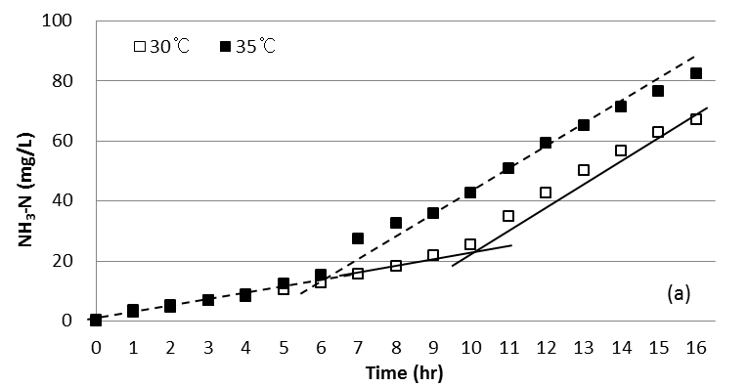
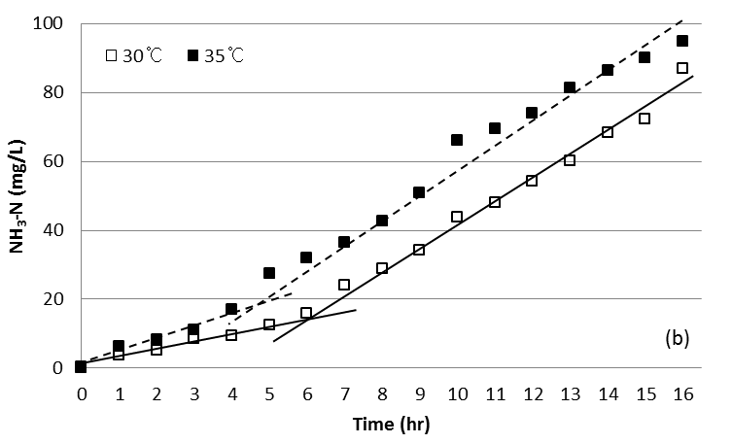
Determination of Optimal HRT of the Anaerobic SHT
Ammonia Concentration with Time
MLSS = 5,000 mg/L
MLSS = 10,000 mg/L
- Increase in the release rate = the increased degradation of microbial cells
- Optimal point : the start of full endogenous phase at each experimental
as the optimal hydraulic retention time for SHT.

Slide 16
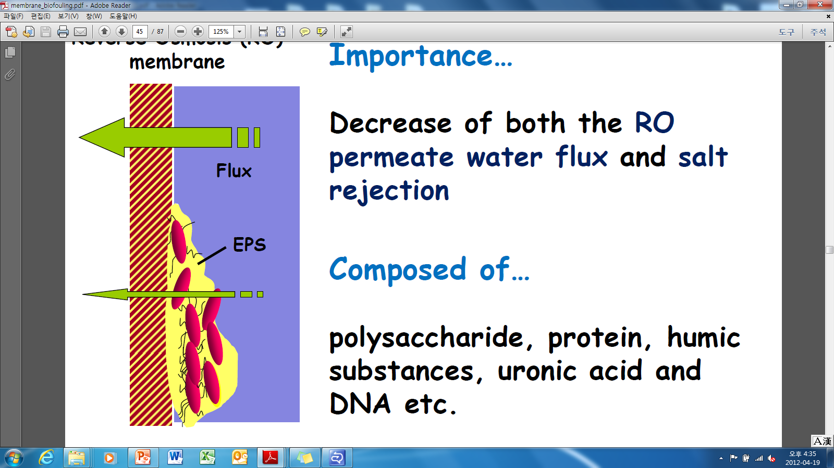
Determination of Optimal HRT of the Anaerobic SHT
▌ Membrane fouling by EPS
Extracellular polymeric substances (EPS) ?
- EPS are metabolic products accumulating on the bacterial
cell surface
Importance…
- EPS is the main cause of membrane fouling
- Reduce water permeability and increase operation cost
Composed of…
- polysaccharide, protein, humic substances, DNA etc.
Divided into…
- Bound EPS
- Soluble EPS
Notes:
EPS has been recognized as the main source of the membrane fouling in MBR systems and it mostly consists of polysaccharide and protein. Especially, for MBR system coupled with SHT, effects of EPS release in SHT should be considered since the harsh condition of SHT such as little oxygen and substrate may cause higher amount of EPS release by microorganisms. The increased release of EPS, therefore, may act as obstacle to the application of SHT to MBR system.

Slide 17
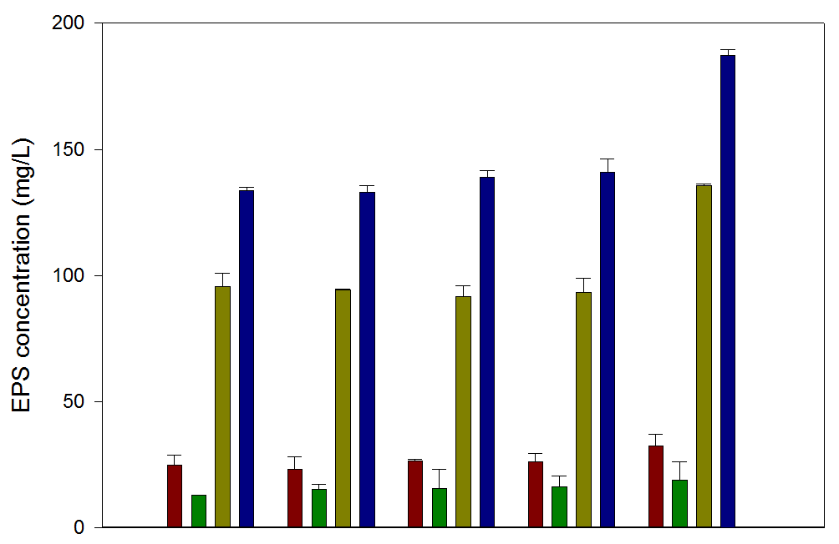
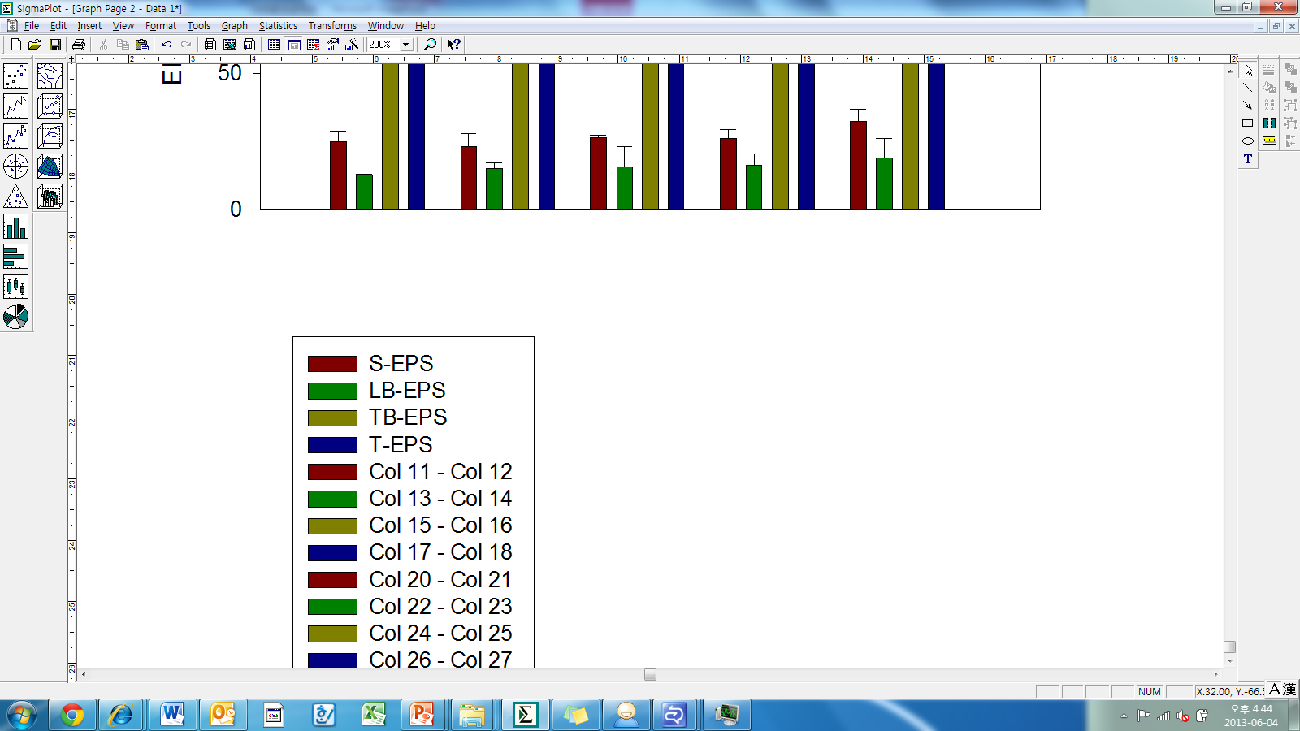
Determination of Optimal HRT of the Anaerobic SHT
▌ EPS concentrations with respect to anaerobic incubation time
0 h
2 h
6 h
12 h
24 h
Incubation Time
Notes:
This graph shows the EPS concentration of the incubated sludge with different retention time. As can be seen, the increase in total EPS was not significant until the incubation time of 12 hr, while the total EPS concentration after 24 hr was significantly increased. Since EPS can be utilized as substrate by microorganisms, the increase in EPS concentration indicates the greater rate of cell lysis than that of EPS consumption. Although no significant change in the ratios of each EPS fraction with incubation time, LB-EPS was slightly decreased, while TB-EPS showed slight increasing trend.

Slide 18
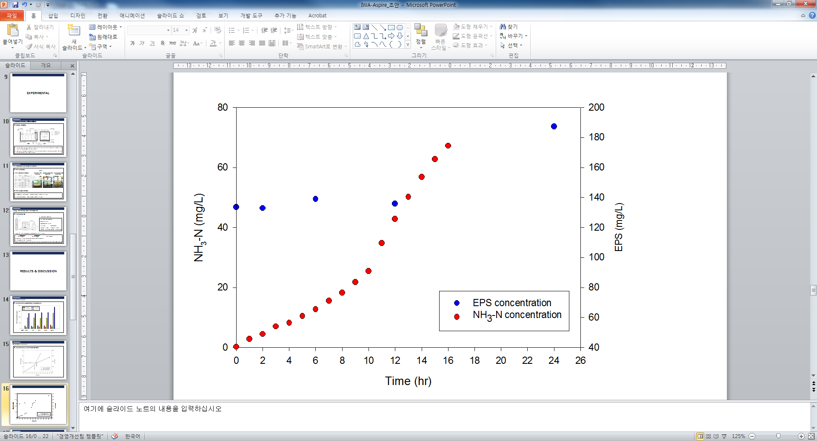
Determination of Optimal HRT of the Anaerobic SHT
▌ Comparison between EPS and ammonia release with incubation time
NH₃-N and EPS release
▌ Variation of NH₃-N and EPS concentration
Notes:
This graph shows comparison of the experimental results of the ammonia and EPS release. Ammonia release rate for red symbol was increased after 10 hr, whereas accelerated EPS release for blue symbol was observed after 12 hr. 2 hr of the lag time may have been caused because the release rate of EPS could be increased only after the EPS consumption rate was surpassed. Since induction of microorganisms into the initial stage of endogenous phase is critical for the reduction of sludge production, the time required to accelerate the rate of ammonia release was considered as the optimal retention time of SHT.

Slide 19
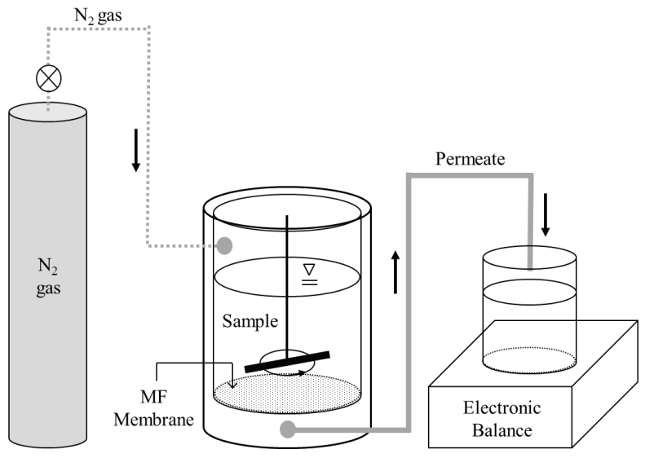



Determination of Optimal HRT of the Anaerobic SHT
▌ Filterability test
Experimental Conditions
Flat sheet PVDF membrane
Pore size: 0.1 ㎛
Membrane area: 32 cm²
Filtration
Backwashing
- Pressure : 0.5 bar
- Pressure : 0.5 bar
- Volume : 150 ml∙MLSS
- Volume : 150 ml∙DI water
Reversibility of the membranes by backwashing after filtrations
$$IF_{n}=\frac{J_{p(n−1)}−J_{p(n)}}{J_{P(0)}}$$
$$RF_{n}=\frac{J_{s(n+1)}−J_{e(n)}}{J_{P(0)}}$$
$$TF_{n}=IF_{n}+RF_{n}$$
IF, RF and TF : irreversible, reversible and total fouling, respectively.
n : the number of the filtration cycle
J_{p(n)}, J_{s(n)} and J_{e(n)} : average flux of DI water after rinse, the starting and ending flux of the sludge sample, respectively.
Notes:
Filterability test of each sludge sample incubated with different periods of time was carried out using 150 mL stirrer cell and flat sheet PVDF membrane as described in this figure. During the filtration, trans-membrane pressure (TMP) was constantly maintained to 0.5 MPa and permeate flux was monitored by a balance. After filtration of each sample, cake layer was gently removed with deionized water, and the membrane was reversely placed for backwashing. This filtration and backwashing cycle was repeated 3 times.

Slide 20
Determination of Optimal HRT of the Anaerobic SHT
▌ Filtration curves of the sludge samples
1st filtration
2nd filtration
3rd filtration
Notes:
As results of the filtration test, filtration curves of the samples incubated up to 12 hr exhibited no significant differences. After the twice of backwashing, the flux was recovered greater than 90% and 80%, respectively, both with the samples incubated for 0 and 12 hr. On the other hand, filtration curve of the sample incubated for 24 hr, the green symbol indicated more rapid decrease in flux and less recovery by backwashing. After the first backwashing, the flux was recovered about 78%, and after second backwashing the recovery was limited to about 59%.

Slide 21
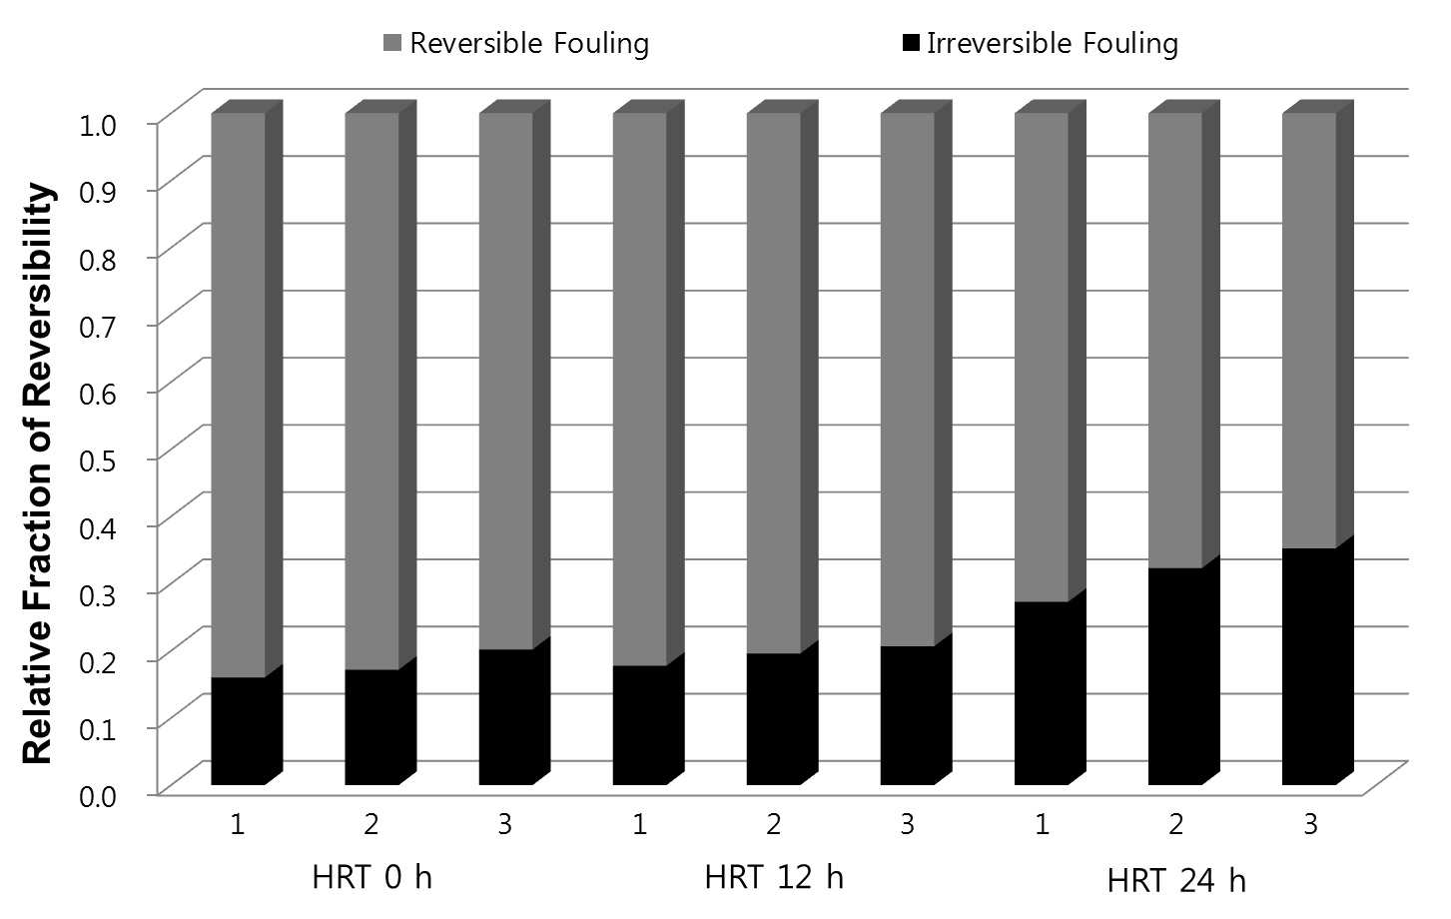
Determination of Optimal HRT of the Anaerobic SHT
▌ Relative fraction of fouling reversibility
Notes:
Reversibility of the fouling by backwashing was calculated and represented in this graph. In tests with the samples incubated up to 12 hr, the irreversible fouling was in the range of 16~18% and no considerable increase in irreversibility was observed in the repeated filtration with backwashing. On the other hand, in tests with the sample incubated for 24 hr, the irreversible fouling in the first filtration was about 27%, and increased to 35% at the third filtration. The decreased reversibility of the sample incubated longer than 12 hr indicates the importance of proper design of SHT in terms of hydraulic retention time. If the retention time is longer than the time to the initial stage of endogenous phase, the EPS release rate will surpass the uptake rate. The accumulated EPS will increase the irreversible fouling of the membrane, which requires more frequent chemical cleaning, more operating cost, and in the end shorter membrane life time.

Slide 22
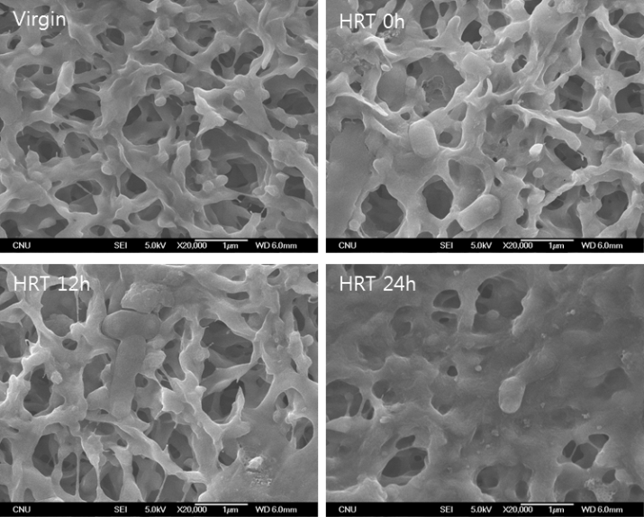
Determination of Optimal HRT of the Anaerobic SHT
▌ SEM images of the membranes after 3 times filtration of the mixed liquor
Notes:
The increased irreversible fouling was also visually identified by taking SEM images as shown in these pictures. After the filtration tests, the membranes were backwashed again before taking images. In the membrane used for the filtration of 24 hr sample, more significant fouling was observed compared to other membranes.

Slide 23
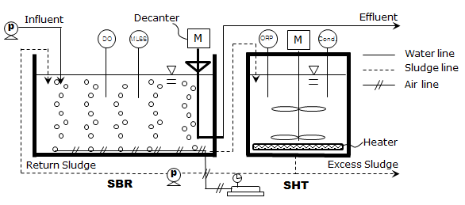
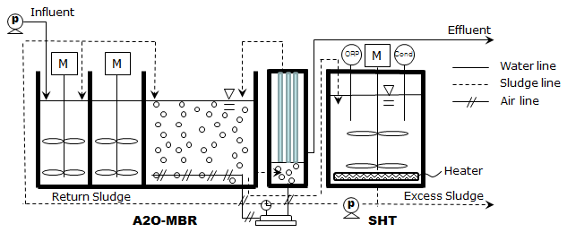

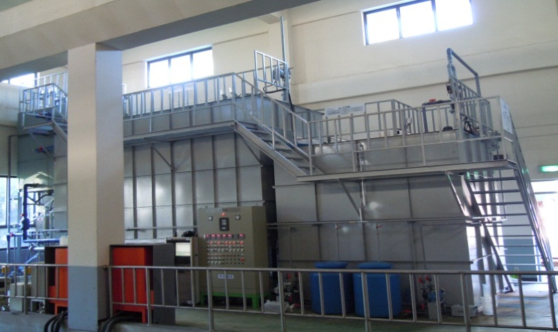
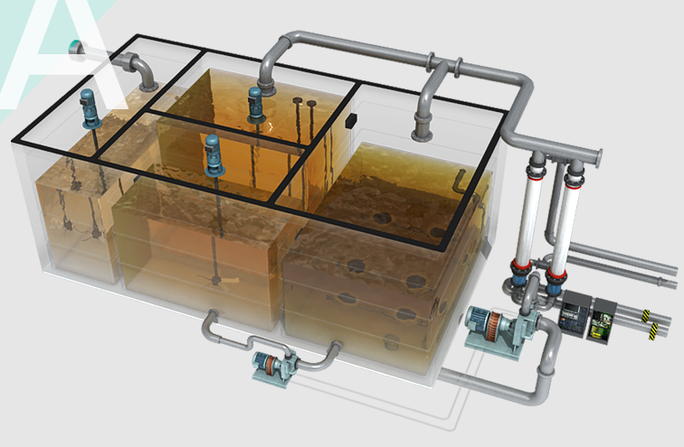
Pilot Operation – SBR and MBR
SBR system with SHT
MBR system with SHT
Notes:
Actually the principle of the sludge reduction by sludge holding tank is not completely clear. However, of these possible explanations, uncoupling metabolism is known as the most plausible mechanism. Microorganisms are induced to initial stage of endogenous growth phase by introducing recycled sludge into anaerobic SHT for a certain period of time.Once the microorganisms are moved from the SHT to bio-reactor with a relatively high amount of substrate and oxygen, inhibition effect of microbial metabolism takes place due to a rapid environmental change and it cause sludge yield reduction.

Slide 24
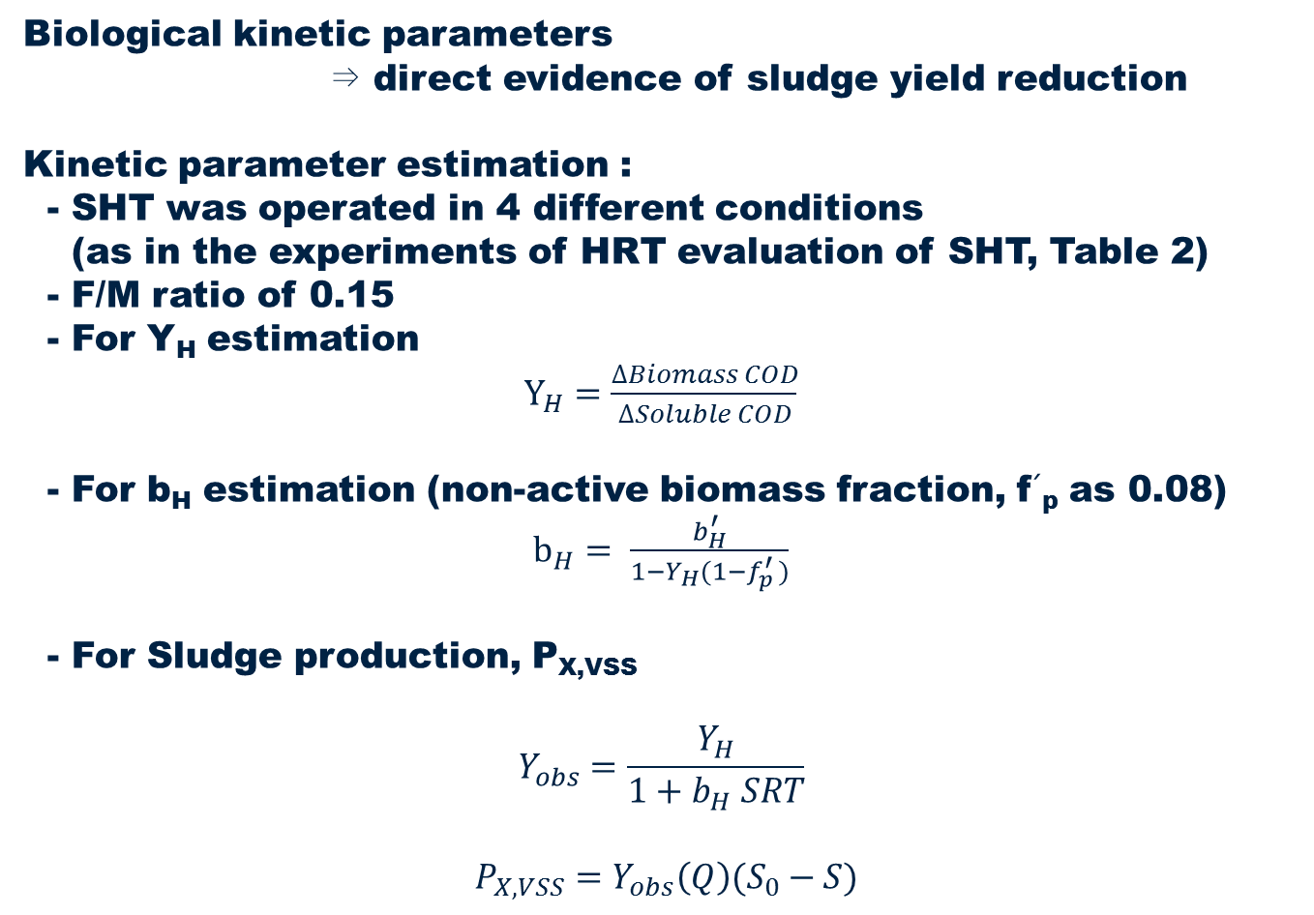
Kinetic Parameter Estimation
Biological kinetic parameters
⇒ direct evidence of sludge yield reduction
Kinetic parameter estimation :
- SHT was operated in 4 different conditions
(as in the experiments of HRT evaluation of SHT, Table 2)
- F/M ratio of 0.15
- For Y_{H} estimation
$Y_{H}=\frac{∆Biomass COD}{∆Soluble COD}$
- For b_{H} estimation (non-active biomass fraction, f´_{p} as 0.08)
$b_{H}= \frac{b_{H}^{′}}{1−Y_{H}(1−f_{p}^{′ })}$
- For Sludge production, P_{X,VSS}
$$Y_{obs}=\frac{Y_{H}}{1+b_{H} SRT}$$
$P_{X,VSS}=Y_{obs}\left(Q\right)(S_{0}−S)$
Notes:
Actually the principle of the sludge reduction by sludge holding tank is not completely clear. However, of these possible explanations, uncoupling metabolism is known as the most plausible mechanism. Microorganisms are induced to initial stage of endogenous growth phase by introducing recycled sludge into anaerobic SHT for a certain period of time.Once the microorganisms are moved from the SHT to bio-reactor with a relatively high amount of substrate and oxygen, inhibition effect of microbial metabolism takes place due to a rapid environmental change and it cause sludge yield reduction.

Slide 25
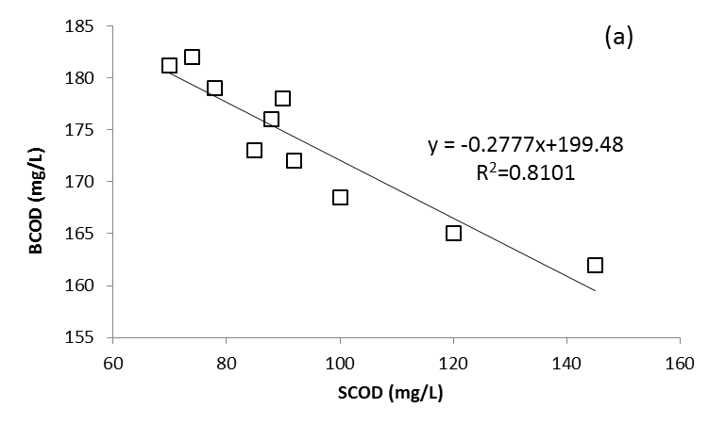
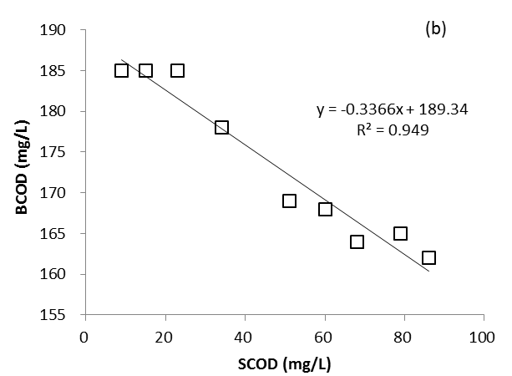
Kinetic Parameter Estimation
Experimental results obtained for Y_{H} estimation for (a) SBR and (b) MBR systems
Notes:
Actually the principle of the sludge reduction by sludge holding tank is not completely clear. However, of these possible explanations, uncoupling metabolism is known as the most plausible mechanism. Microorganisms are induced to initial stage of endogenous growth phase by introducing recycled sludge into anaerobic SHT for a certain period of time.Once the microorganisms are moved from the SHT to bio-reactor with a relatively high amount of substrate and oxygen, inhibition effect of microbial metabolism takes place due to a rapid environmental change and it cause sludge yield reduction.

Slide 26
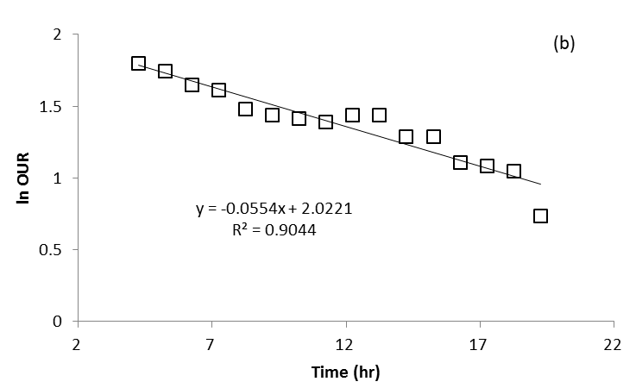
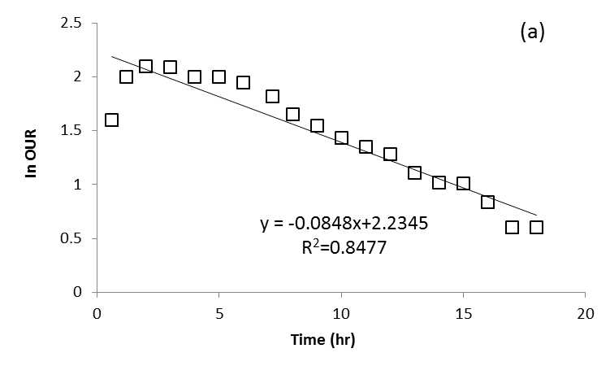
Kinetic Parameter Estimation
Experimental results obtained for b_{H} estimation for (a) SBR and (b) MBR systems
Notes:
Actually the principle of the sludge reduction by sludge holding tank is not completely clear. However, of these possible explanations, uncoupling metabolism is known as the most plausible mechanism. Microorganisms are induced to initial stage of endogenous growth phase by introducing recycled sludge into anaerobic SHT for a certain period of time.Once the microorganisms are moved from the SHT to bio-reactor with a relatively high amount of substrate and oxygen, inhibition effect of microbial metabolism takes place due to a rapid environmental change and it cause sludge yield reduction.

Slide 27
Kinetic Parameter Estimation
Kinetic parameters estimated for the SBR and MBR systems operated with SHT
Conditions |  | SBR | MBR
SHT | MLSS (mg/L) | 5,000 | 8,000
 | Temp. (°C) | 30±1
SRT(day) |  | 68.4 | 149.6
Y_{H} |  | 0.28 | 0.34
b_{H} (d⁻¹) |  | 0.11 | 0.080
Y_{obs} |  | 0.032 | 0.026
Reference | Condition |  | Y_{obs} | Units
Ozdemir and Yenigu (2013) | SRT (day) | 10 | 0.310 | kg MLVSS/ kg COD removed
 |  | 37 | 0.220
 |  | 53 | 0.206
 |  | 110 | 0.130
Rensink and Rulkens (1997) | Conventional activated Sludge (23ºC) |  | 0.15 – 0.17 | kg SS/ kg COD removed
Zhang (2000) | MBR with submerged membrane (suction mode) (20ºC) |  | 0.00–0.12 | kg SS/ kg COD removed
 | MBR with submerged membrane (gravitational mode) (20ºC) |  | 0.10–0.15
Wei et al. (2003) | Conventional activated Sludge (20 ºC) |  | 0.17 | kg SS/ kg COD removed
Notes:
Actually the principle of the sludge reduction by sludge holding tank is not completely clear. However, of these possible explanations, uncoupling metabolism is known as the most plausible mechanism. Microorganisms are induced to initial stage of endogenous growth phase by introducing recycled sludge into anaerobic SHT for a certain period of time.Once the microorganisms are moved from the SHT to bio-reactor with a relatively high amount of substrate and oxygen, inhibition effect of microbial metabolism takes place due to a rapid environmental change and it cause sludge yield reduction.

Slide 28
Kinetic Parameter Estimation
Sludge production of MBR and SBR compared to conventional activated sludge (CAS)
Notes:
Actually the principle of the sludge reduction by sludge holding tank is not completely clear. However, of these possible explanations, uncoupling metabolism is known as the most plausible mechanism. Microorganisms are induced to initial stage of endogenous growth phase by introducing recycled sludge into anaerobic SHT for a certain period of time.Once the microorganisms are moved from the SHT to bio-reactor with a relatively high amount of substrate and oxygen, inhibition effect of microbial metabolism takes place due to a rapid environmental change and it cause sludge yield reduction.

Slide 29
Treatment Efficiency - SBR
Item | Influent (mg/L) | Effluent (mg/L) | Average efficiency (%)
COD_{Cr} | 89.4~310.8 | 4.6~7.4 | 95.7
SS | 74~191 | 1.8~6.8 | 96.1
TN | 19.8~41.1 | 7.8~13.3 | 65.4
TP | 1.7~5.0 | 0.7~0.9 | 71.4
Notes:
Actually the principle of the sludge reduction by sludge holding tank is not completely clear. However, of these possible explanations, uncoupling metabolism is known as the most plausible mechanism. Microorganisms are induced to initial stage of endogenous growth phase by introducing recycled sludge into anaerobic SHT for a certain period of time.Once the microorganisms are moved from the SHT to bio-reactor with a relatively high amount of substrate and oxygen, inhibition effect of microbial metabolism takes place due to a rapid environmental change and it cause sludge yield reduction.

Slide 30
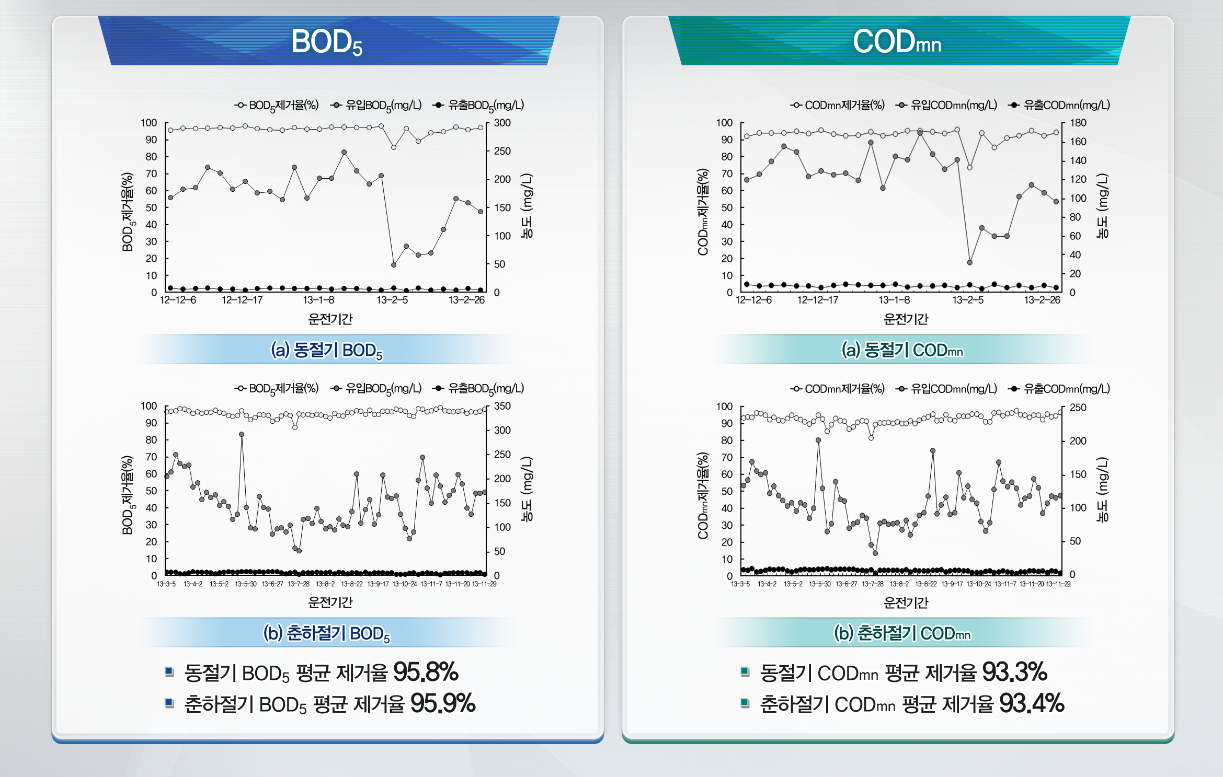
Treatment Efficiency - MBR

Slide 31
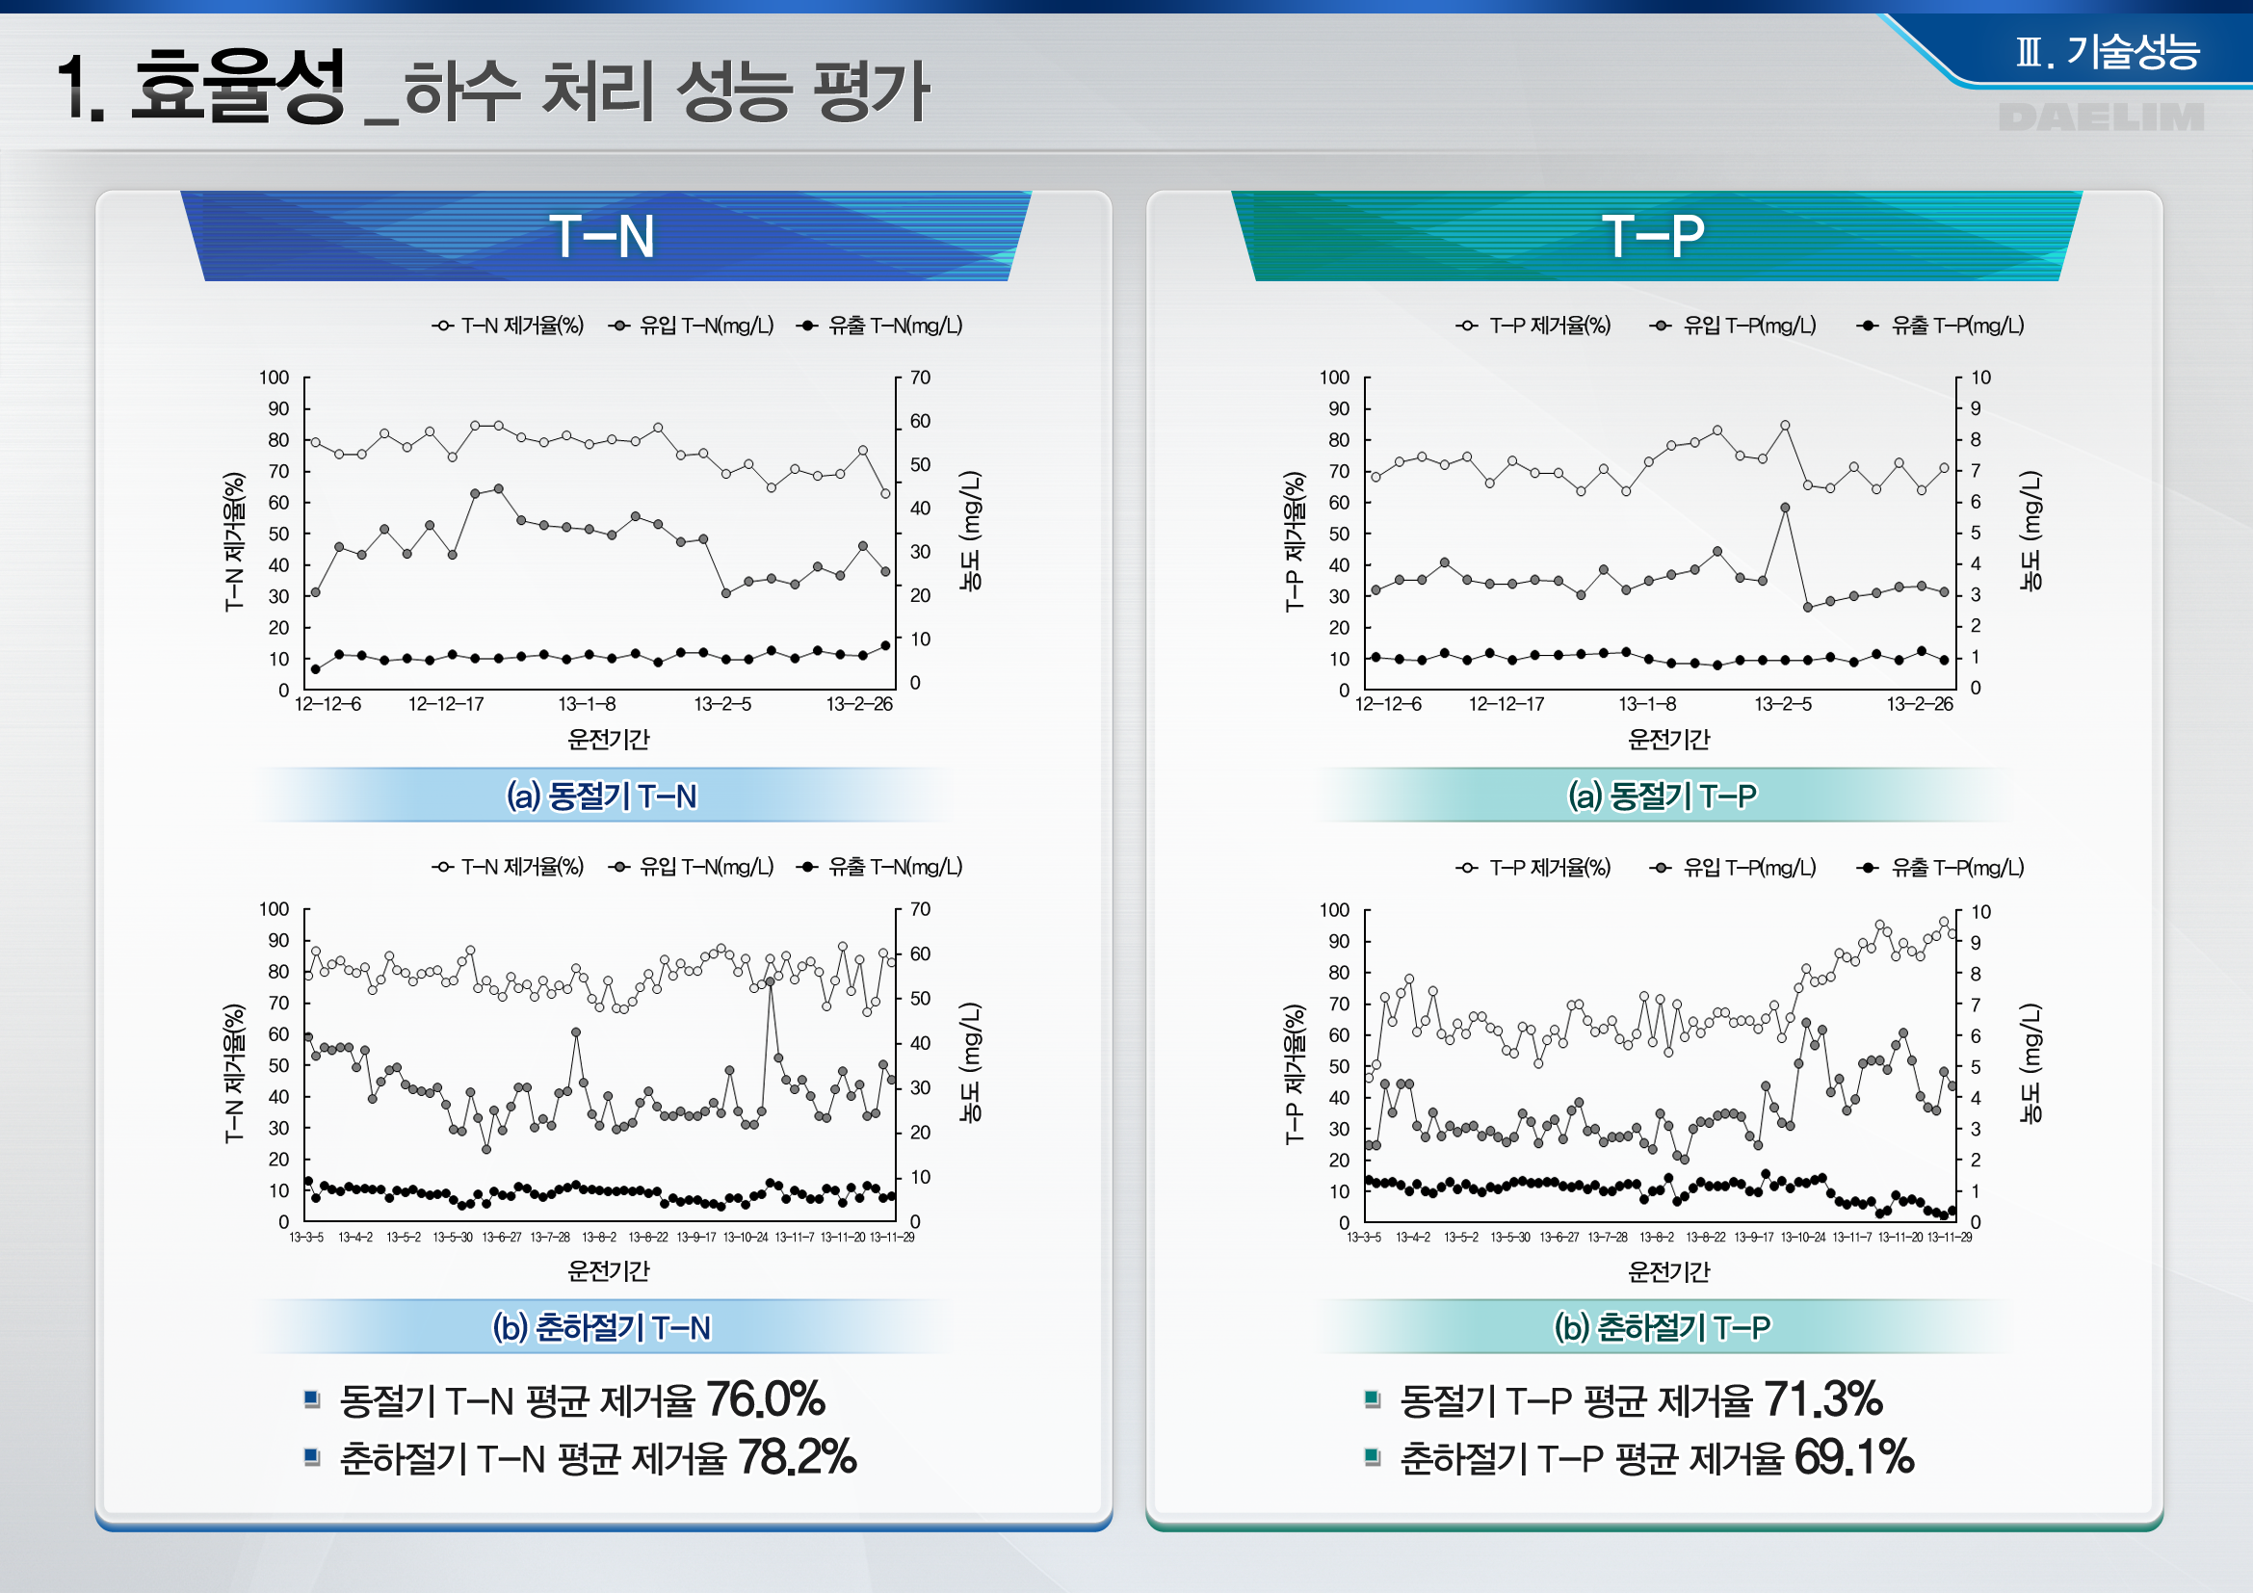
Treatment Efficiency - MBR

Slide 32
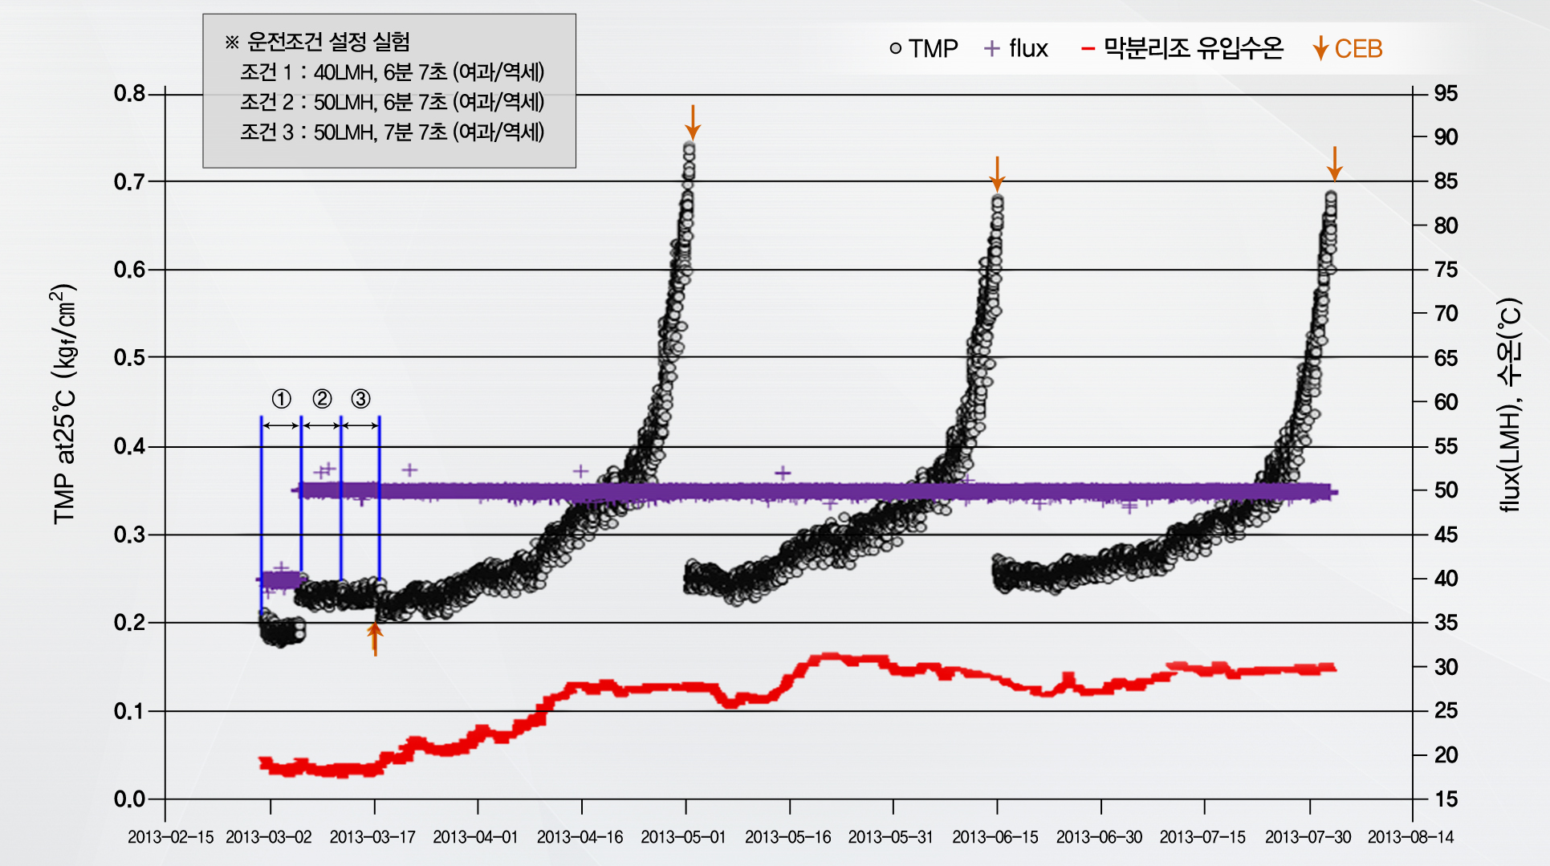
Treatment Efficiency - MBR

Slide 33

Conclusion
Sludge reduction rate by evaluating microbial kinetic parameters
: Pilot scale SBR and MBR systems operated with anaerobic side-stream SHT,
by 61.0% and 72.0%, respectively.
Treated water quality
: not deterioration of the effluent water quality but phosphorus removal
SRT Optimization between sludge reduction and phosphorus removal
: In consideration, production of chemical sludge, operation cost and
release of extracelluar polymeric substances (EPS) in SHT
SHT application for various BNR processes with reduced WAS
: will contribute to minimize environmental and economic problems
pertaining to the final disposal of sludge.
Notes:
Actually the principle of the sludge reduction by sludge holding tank is not completely clear. However, of these possible explanations, uncoupling metabolism is known as the most plausible mechanism. Microorganisms are induced to initial stage of endogenous growth phase by introducing recycled sludge into anaerobic SHT for a certain period of time.Once the microorganisms are moved from the SHT to bio-reactor with a relatively high amount of substrate and oxygen, inhibition effect of microbial metabolism takes place due to a rapid environmental change and it cause sludge yield reduction.

Slide 34
Thank You !

