Slide 1
Chapter 3. Waterfront Design Bonnie Fisher

Slide 2
The approach to urban design is based on a number of premises about urban design concepts and specific physical elements that characterize the waterfront zone:
No waterfront is exactly like another
Features that recall the underlying structure of landscape should be usead to reinforce spatial forma and identity
Barriers to the waterfront need to be removed
Multiple linkages to the waterfront should be created
Single-purpose transportation systems should be redisegned to créate multimodal corridors at the water´s edge
Change and adaptation are greater value than slavish historicism
Improvements in infrastructure
The city should be extended to the waterfront
The influence of waterfront should extend inland
Spatial dimension of offshore water should be recognized for its power to shape adjacent land areas
Transitional space with care and consideration
Waterfront buildings should be permeable and designed with consideration of scale
Civic and community leadership

Slide 4
1. The Urban Waterfront
The urban waterfront has long been the site of intensive development and alteration of the natural realm.
Traditionally, port cities grew: gaining ground, capturing the amenity of the shoreline, improvements for stabilization, reclamation.
Industrial age
Over the past several decades, with shifts in transportation technology and the decline of industry in the history urban center, opportunities to reunite the waterfront with the city have emerged.
Today the more enlighted cities are those that conceive of freeway removal and infrastructure development not as single-transportation projects but acts of city rebuilding, these cities realize that investments involved must achieve multiple objectives.

Slide 5
2. Civic Responsability and Leadership
Successfully implement change requires not only large scale thinking about nature of the city but aalso sufficient leadership and commitment to make major public improvements iver a long period of time.
Design competition is often proposed. The disadvantage is that juries are too often seduced by what looks good on paper and represents the latest stylistic predilections.
The success of a competition depends on the jury that is selected, the clarity of objectives and seriousness of the intent to follo through and built the project.
Urban waterfront should be designed as a series of creative and well-planned interventions.
Strong leadership, clear goals and authority

Slide 6
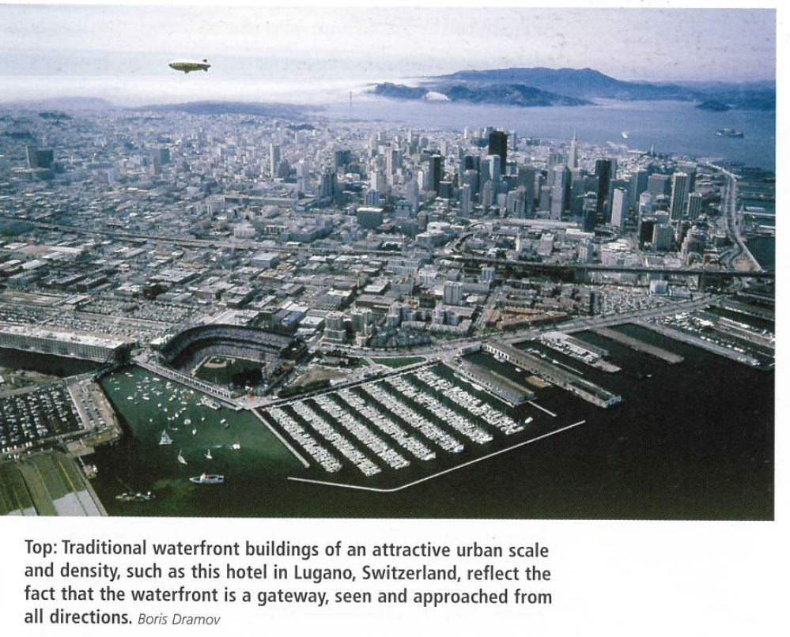

Slide 7
3. Meaning and Identity
Urban waterfront redevelopment involves building new meaning and identity for a place that has experienced decline and that is now undergoing transformation.
From waterfronts that have become great, memorable places by establishing a special identity and character arise a problem. With the success of initial project, many others -by association- are drawn to the same place, until the individuality of the place, the very thing that made it so inviting to begin with, is obscured.

Slide 8
4. Extending the Urban Fabric
Introducing a mix of new activities is one of the most effective strategies for revitalizing the urban waterfront.
However sometimes policies prevent the urban fabric from being extended to the waterfront. As a result of certain natural policies, large habitats preserves are sometimes set aside of wildlife but made inaccessible to the general public, or are reserved for special, visitors oriented uses that do little to make the waterfront a part of daily life in the city.

Slide 10
5. Waterfront Buildings
Should reflect the fact that the waterfront is a Gateway. Buildings should be designed with balanced façades.
Creativity will also be required in meeting the servicing requirements of large and complex buildings.
The task of integrating modern activities into waterfront buildings is even more difficult on pier structures, which are being increasingly adapted for new urban uses.
One problem is the high cost of rehabilitating aging pier structures. Even more significant tan cost is the issue of how to integrate maritime structures into the fabric of the city.
Too often, preservation and replication of the past are the only criteria applied to plans for the reuse and revitalization of a waterfront.
There is no a single way of approaching and development.

Slide 11
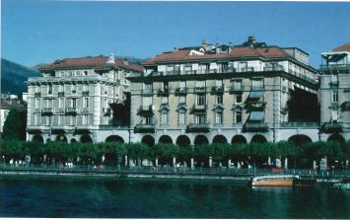

Slide 12
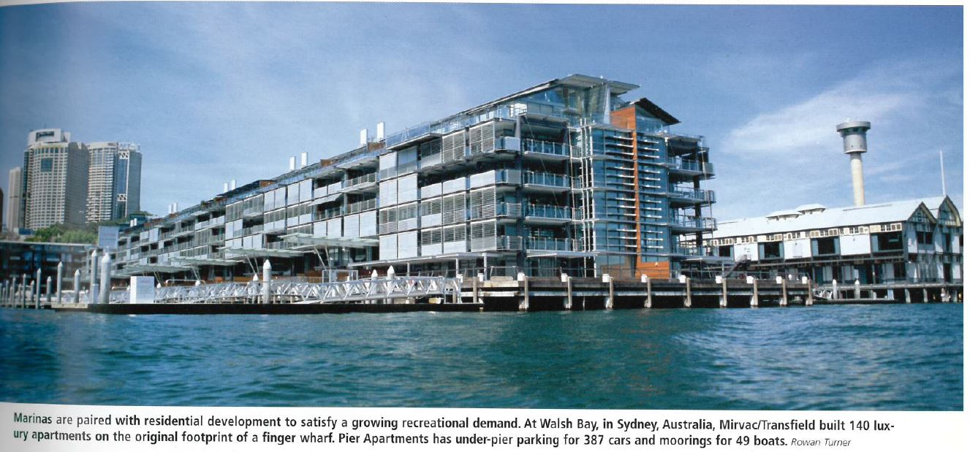
6. Bringing the Amenity of the Water Island
Need to give attntion not only to what happens right at the waters edge and over it, both landside and waterside but also to the progression of experiences that lead into the embrace of the city.
Connections: through a system of public spaces that open to the city, esplanades, portals, stairs, canopies, bridges, piers, etc. Creating visual and physical connection.
World War II
Postwar
1960s

Slide 13
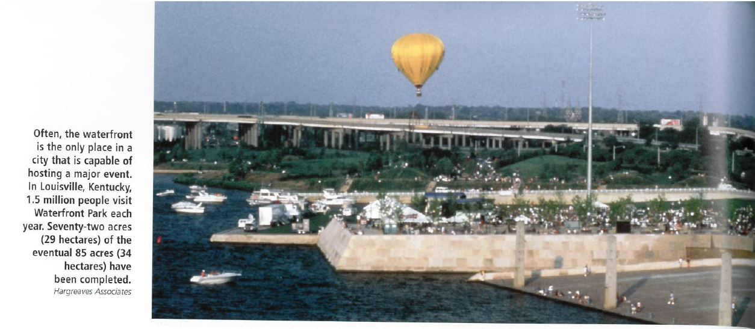
7. Spatial Dimension of Water
Each body of wáter has a distinctive spatial form and carácter that gives the waterfront its temperament. Rivers, bays and coves, oven beaches..
1930-1940: recreational design, “stage for activity”
The more open the wáter space, the more flexible it remained.

Slide 14
8. Waterborne Transportation
Key to bringing activities and people to it. Is an authentic maritime activity that relates back to the historic role of the waterfront as a center for the movemento of people and goods.
Development of vessels increase oportunities enormously.
Ferries
Waterborne transit cannot be expected to suceed if it is not visible or if it is poorly located.

Slide 15
9. Movement and a Sense of Place
Embarkation, arrival and movement through and to the waterfront are an essential part of its identity.
Concerned about the development of automobile freeways and major corridors, however, eliminating them would deprive the waterfront of one of the basic activities that give it life.
“Level of service”
Recognition that a certain amount of congestion is fitting to a healthy urban center, and that successful solutions consider a number of factors beyond the capacity available to a single mode of travel.
Design approaches to transportation and circulation need to be based on the appropiate size ans scale of the site and facilities and how much is desirable to fit it within the facilities.
Mix of transportation modes
Not only a place to move through but a destination in itself. Open space should be incorporated generously into transportation design.

Slide 17
10. The Sensory Experience
It is a place not only to work but also to live and play.
Getting people to engage in a range of experiences means creating visual and symbolic meanings, embracing the sensory qualities of the environment.
Contrast between land and wáter is heightened.
Good waterfront design is both engaging and flexible, offering meaning in layered experiences, leaving something to imagination and room for direct, personal experience
Good waterfront design seeks multiplicity of purposes and meanings, and allows a place to change, adapt and gain in value over time.

Slide 18
11. Heightening Awareness of the Waterfront
The most memorable interventions are those that reveal the instrinsic qualities of the landscape and so, heighten awareness of the waterfront environment.
Contrast is an effective tool for heightening awareness of the waterfront environment.
Elements that offer two realities: one that is closely connected to the everyday life of the city, and another that reflects a more intense consciousness of the natural world.

Slide 20
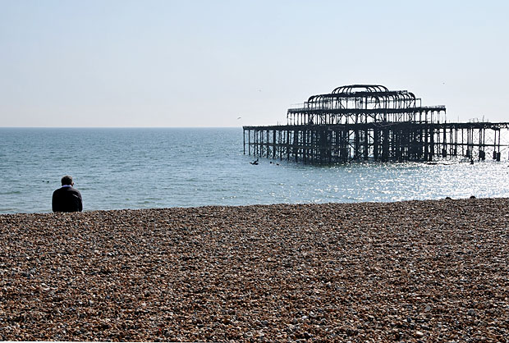

Slide 22
12. The Line of Force
The water´s edge is a line of forcé in the landscape, expressing the interaction of the shore with the wáter body wheter it moves inland or pushes outward; straight or sinuous; adheres tighty or rugged outcropping.
In urban waterfronts, this line is reinforced by a seawall or floodwall placed at the outermost reach where land can feasibly encroach into the water space.
Urban waterfronts are linear in nature.
In successful waterfront design, humulity plays an important role , simple “moves” that are more long-lasting.

Slide 24
13. The Duality of the Water´s Edge
Boundary between two worlds.
It is a transitional space that holds great latent potential.
Juxtaposition of land and wáter and heightening the contrast betwwen these two uniquely characterizes urban waterfront.
Developed cities waterfront is the most powerful representation of the presence of a natural world. Outside the domination of urban dwellers.
Public access to water should not only imply direct linkages, but also physical, vidual and cultural dimensions.
The waterfront is temporal.
The principles that guide the design of the urban waterfront are not unique.

Slide 25
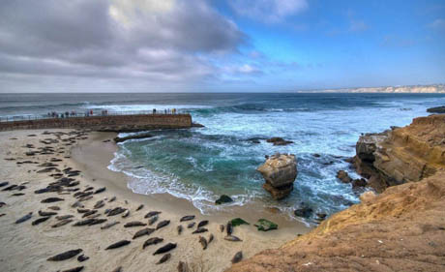
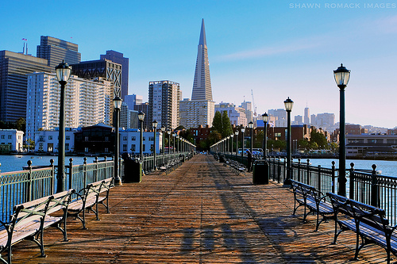
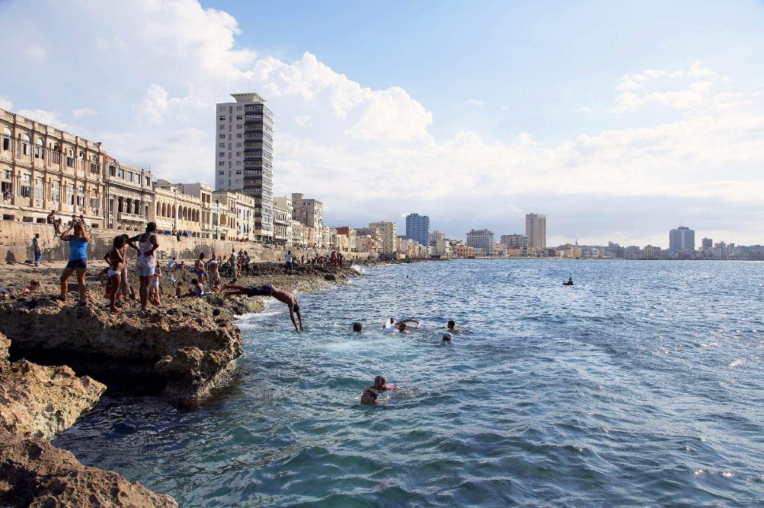

Slide 26
Chapter 4. Environmental Issues in Waterfront Development Gavin McMillan and Emma Stark Schiffman

Slide 27
4.1. A Systems Approach
From environmental perspective, the waterfront is part of a much larger context and complicated by the intrincacy of its ecosystems.
Dynamically linked on different scales. Waterfront becomes defined through the continious overlapping of and and wáter.
Urban development entails examining the relationship between development and regional wáter ecosystems.
Interdisciplinary, integrative.

Slide 28
4.2. Major Issues
1. Flooding
2. Natural Resources
3. Cultural Resources
4. Contaminantion

Slide 29
1. Flooding
Timeless and inmediate.
Natural phenomenon that can be expected/predicted.
Leaves its marks in natural and build systems.
Need to map: floodway and floodplain boundaries.

Slide 30
Examples: Davenport, Iowa

Slide 31
Examples: Rock Island, Illinois

Slide 32
2. Natural Resources
Waterfronts are the result of interaction between hydrological and geological systems, where life in its full variey appear. This interaction is not a line but a zone.
Ecotone is called to the overlapping of two ecosystems. Soil conditions, nutrients, flora-fauna are the richest in the world.
A conservationist approach maintain environment quality and resources on a particular balance among species present given área, regardles of wheter these resources are physical, biological or cultural.

Slide 33
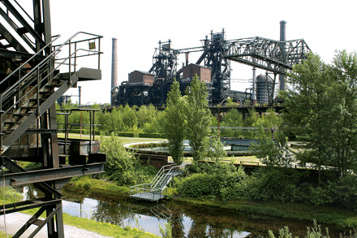
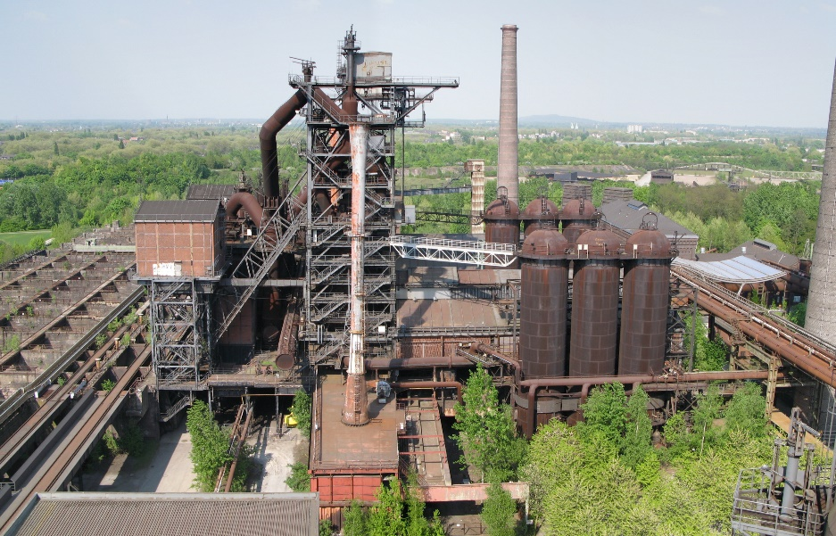
Examples: Landschaftspark, Duisburg-Nord

Slide 35
3. Cultural Resources
Started when people first began to leave their marks: palimpsest of human activity and influence of waterfront sites.
A settle start due to opportunities that it offers: mining, trade, transportation, ceremony, life, growth, development.
Value of resources grew, towns grew, their dependency on water too, modify the wider environment and site-specific physical modifications: harbours, bays, rivers…
Environmental impacts of waterfronts towns began to appear in physical form.

Slide 36
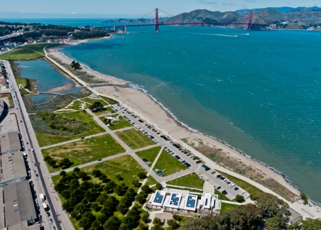
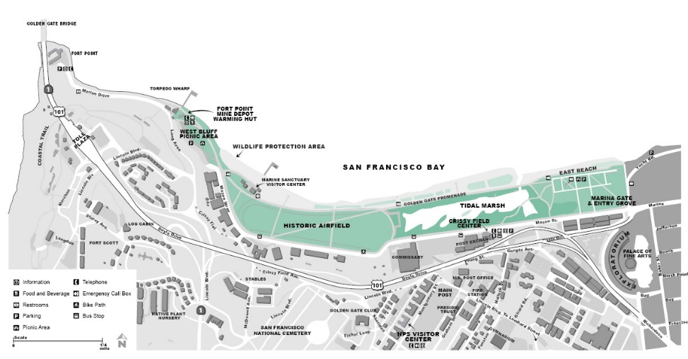
Examples: Crissy field, part of the Golden Gate National Recreation Area, on San Francisco

Slide 37
Examples: Pointe-à-Callière, the waterfront Montreal Museum of Archaeology and History

Slide 38
4. Contamination
Industrial development damaged waterfronts.
Materials brought, processed, sent, leaving only waste. So value is reduced which créate additional waste.
Even non-wáter dependant industries used wáter as part of cleaning industry processes, leaving chemical and metals intentionally or accidentally.
Other potential contaminants: VOC´s, SVO´s, PCB´s affect groundwaters
We can find three different approaches:
1. Hog an Haul
2. Cap and cover
3. Regenerative processes as part of the design

Slide 39
Examples: BP-Amoco refinery

Slide 40
Examples: Duisburg-Nord

Slide 41
Examples: Harbour Park in Kenosha, Wisconsin

Slide 42
4.3. Approaches to the Issues
Sites affected by flooding, natural resources, cultural resources and contamination can´t be made usable without action of developers
Developers and designers wheter functional elements of system should be adressed individually or systematically
In the case of flooding:
In the case of natural resources:
In the case of cultural resources:
In the case of contaminants:

Slide 43
1. Reactive Strategy
Conventional problema-solving methology to ensure regulatory requirements compliance or meet legal due diligence standards: identify the problema, avoid, remove, mitigate.
Sharp dividing line between analysis and design. 1º Analysis 2º Reaction for analysis
Restrict the assesment to a set of format based on regulatory requirements
Phase 1: grafic and surficial analysis
Phase 2: intrusive analysis and evaluation of physical site conditions
Impossible to undertake direct experiments on environmental systems to understand how they work. Computer data can help but still unvaluable tool for development.
At the end there is a choice and so a subjective intention.
What happens when developers want more tan specific factors? Look beyond regulatory requirements, examine opportunities: Proactive strategy

Slide 44
2. Proactive strategy
Opportunities are usually found at sites that have been modified
The already altered or adaptative nature of waterfront environmental systems and the cultural values créate an ideal situation for approaching environmental issues proactively with respect to planning and design.
In proactive approach environmental issues are opportunities for achieving better ecological function.
Two keys characteristics:
1. Looking forward.
2. Integrative
Success or failure of ecological assesment is likely to depend on how skillfully its managers balance science and values. This balance is achieved by:
1. Public involvement and skateholder buy-in
2. Over inclusión of social values in decisión making process
Technical + values.

Slide 45
Conclusion

