Slide 1
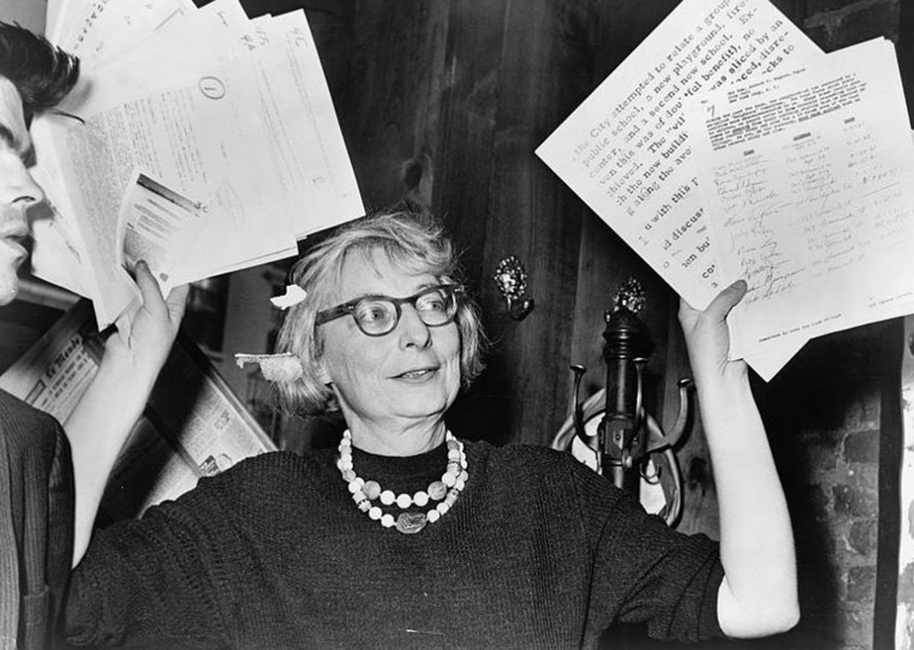
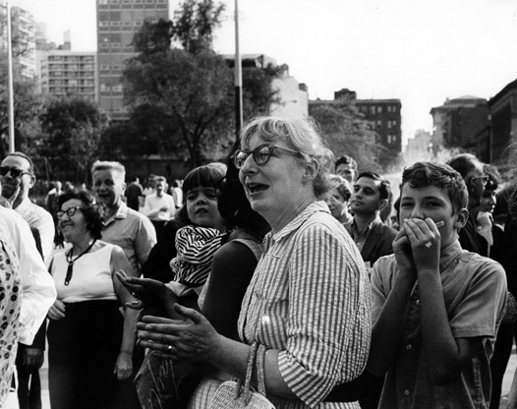
Part 4 Different Tactics
Joo Young Park
Seoul National University
Urban Design

Slide 2
Before going…
Most of the objectives that were explained earlier...
Unslumming of slums
City diversity
Vital street
are not considered as an objective now adays in urban planning
But subsidizing dwelling, transportation, visual order are all traditional problems of modern urban planning and also objectives

Slide 3
Table of Contents
Subsidizing Dwellings
Erosion of Cities of Attrition of Automobiles
Visual order : Its Limitations and Possibilities
Salvaging Project
Governing and Planning Districts
The King of Problem a City is

Slide 4
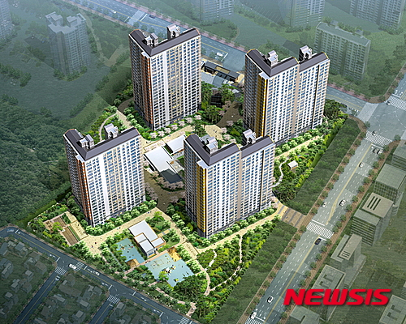
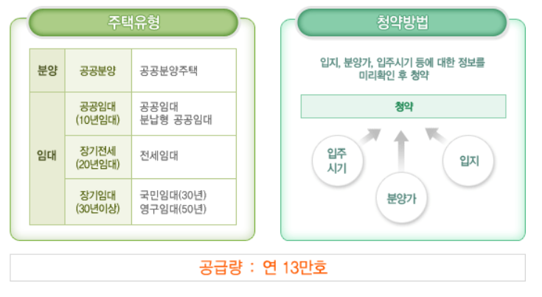
16. Subsidizing Dwellings
Subsidizing dwellings have been done for the poor who couldn’t afford houses sold by private enterprises
Public Housing (공공주택)
Away from supplier oriented supply, Public sector get funds and build it for rent or sale
Supply based on income groups to provide diverse kind of houses in fast pace. Therefore, it is consumer oriented
Suwonho district public housing (LH)

Slide 5
16. Subsidizing Dwellings
Subsidizing is for people who cannot afford good-quality houses
Also in many cities, provide of houses is so few that without congestion and high density, cities cannot accommodate so many people
Extra-needed houses don’t coincide with ability of the people living → need subsidize
Subsidizing means that how to fill the gap between amount paid and price of the house

Slide 6
16. Subsidizing Dwellings
Jane Jacobs suggested rent guarantee method
Physical unit will not be the housing complex rather, individual buildings
Housing subsidy should support landlord to build new building and also give rent cost
But because they support landlord, landlord should build the building at the exact place designated and should choose a resident who lives in certain distance or area

Slide 7
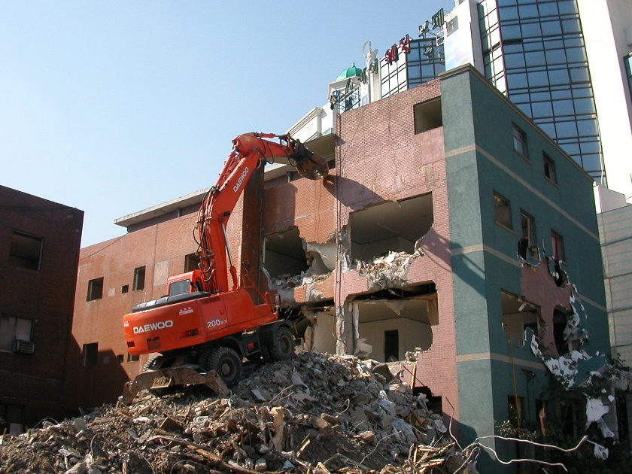
16. Subsidizing Dwellings
subsidizing method does not accompany large scale demolishing or reconstruction
So many owners and landlords can participate in the plan
Diverse, cheerful, change of the city should not be depended on official or constructor
And for this subsidy method to be free from invalidation and corruption, every 8~10 year test should be done to find out if it is operating well
For public housings to gain popularity, conscious of community should be made Such as ‘you can fix the building, but leave the people living there’

Slide 8
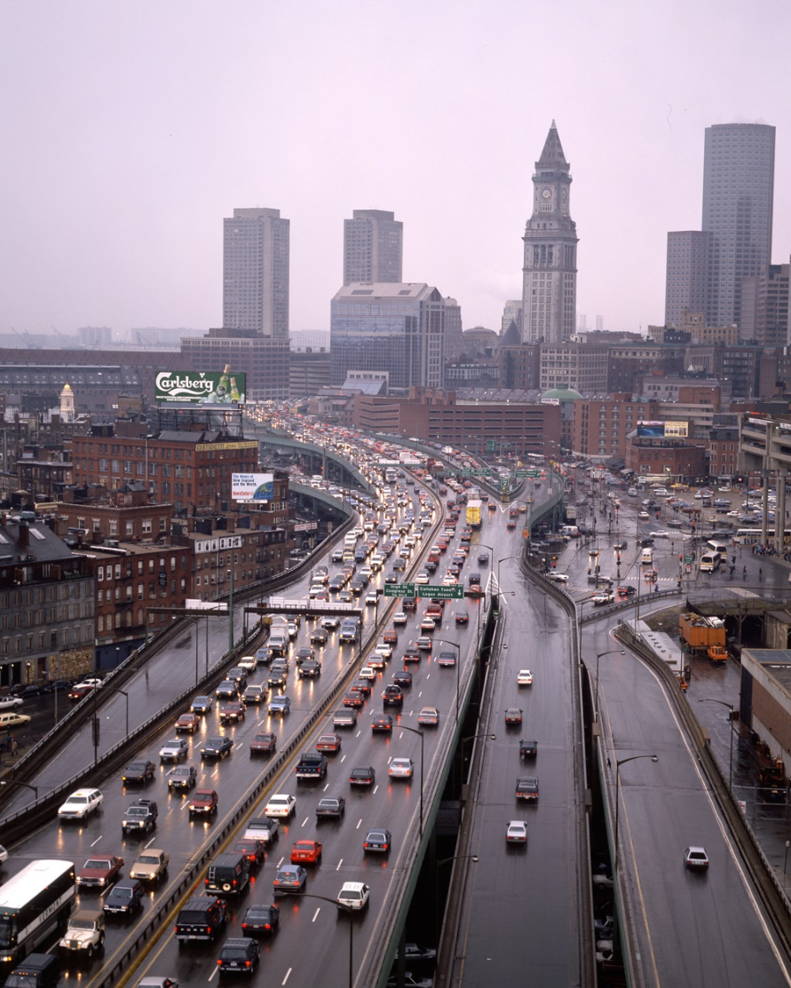
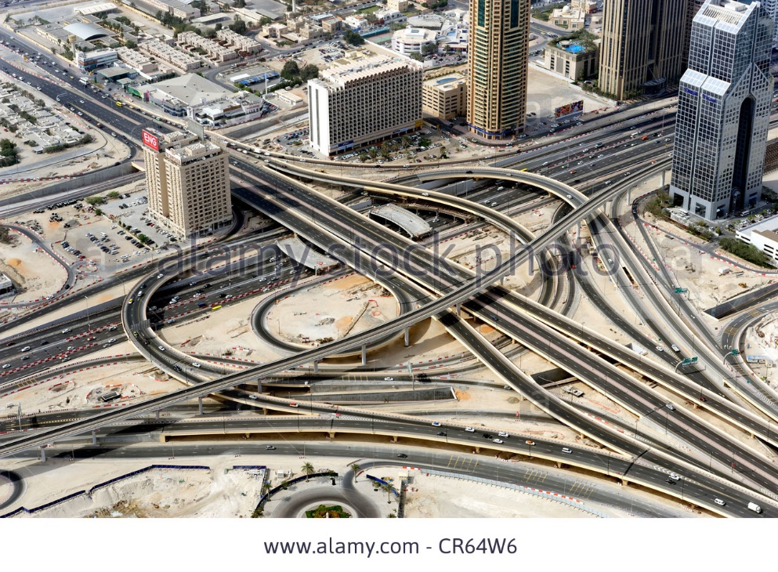
17. Erosion of Cities of Attrition of Automobiles
To accommodate Traffic arteries, parking lots and filling stations, city texture became segmented to distracted and irregular pieces
Because of this, intricate and concentrated land use gets fragmented
City becomes same in every places and all the places become ‘Noplace’
Then how to provide transportation without destroying this intricate and concentrated land use?

Slide 9
17. Erosion of Cities of Attrition of Automobiles
Automobiles should not take criticism
Before automobiles came up, we were using horses
Automobiles are more quite and cleaner than horses. Moreover, they do the same work with fewer number of engine
Due to its power and fast speed, mass amount of people concentrated at the city and movement of goods became efficient
But nowadays, 10 horses → 1 car : 1 horse → 5~6 cars
Too many cars brought inefficiency
Also it brought battle between pedestrians and cars

Slide 10
17. Erosion of Cities of Attrition of Automobiles
Gruen’s Plan
Pedestrian only area
Automobiles only area
Except high-density downtown area, separation of pedestrian only and Car only areas makes inefficiency because we need to make extra facilities
Automobile’s city erosion
Expansion of street
One-way street
Installation of traffic light
Form of highway
Form of main road (connecting between cities)
More and more land for the parking lot
None of these phenomenons are critical, but these give positive feedback on city erosion (cumulative)

Slide 11
17. Erosion of Cities of Attrition of Automobiles
As Automobiles increase..
Then city downtowns should be scattered rather than focused
Absolute moving distance will increase for the cars also
Public transits lose an efficiency
More space allotted for cars → more demand for cars → more space needed for cars
If Automobile accessibility gets higher, at all times, public transport use decreases
Too much Automobile space means decrease in taxation site and unproductive economic activity
Concentration
Accessibility

Slide 12
17. Erosion of Cities of Attrition of Automobiles
Attrition of automobiles operates by making conditions less convenient for cars
Erosion is happening when necessity and convenience for automobiles increase
Tactic
1) It’s using sidewalk; widening sidewalk for people to enjoy walking such as trees and outdoor billboards, Then road will automatically shrink
2) For diversity, making block’s length shorter might help decrease automobiles because it will disturb traffic flow
3) Increasing effectiveness of public transports(Bus)
The speed of the buses should be faster
By reducing signal interval
4) Making confusing road usage for automobiles
5) Priority for the trucks rather than automobiles
Trucks means services and jobs

Slide 13
Korean Cases
Which would be the ideal street that meets both pedestrians and Automobiles’ needs
Pedestrian friendly
Pedestrian
&
Automobile friendly
Automobile friendly

Slide 14
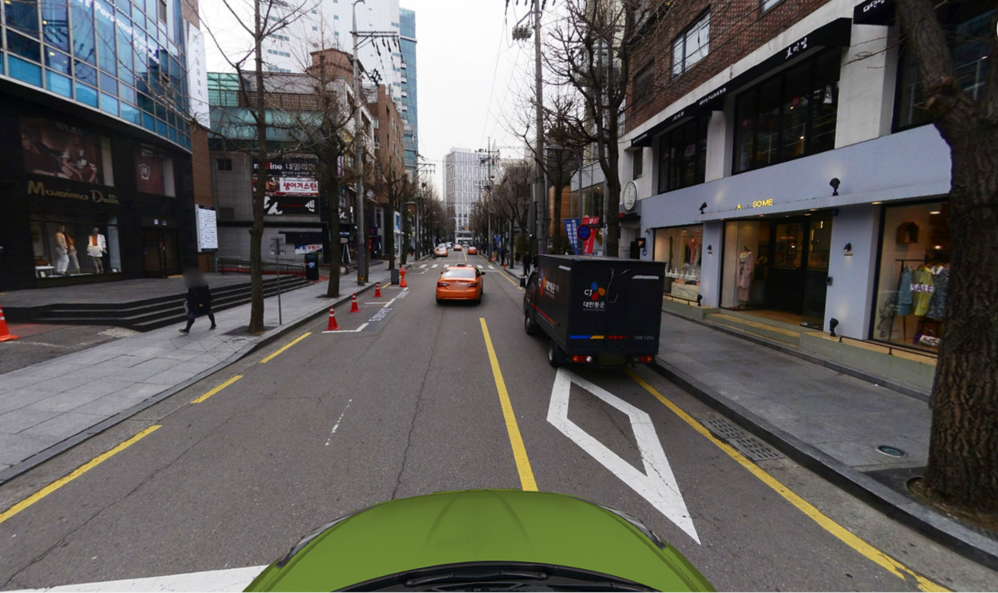
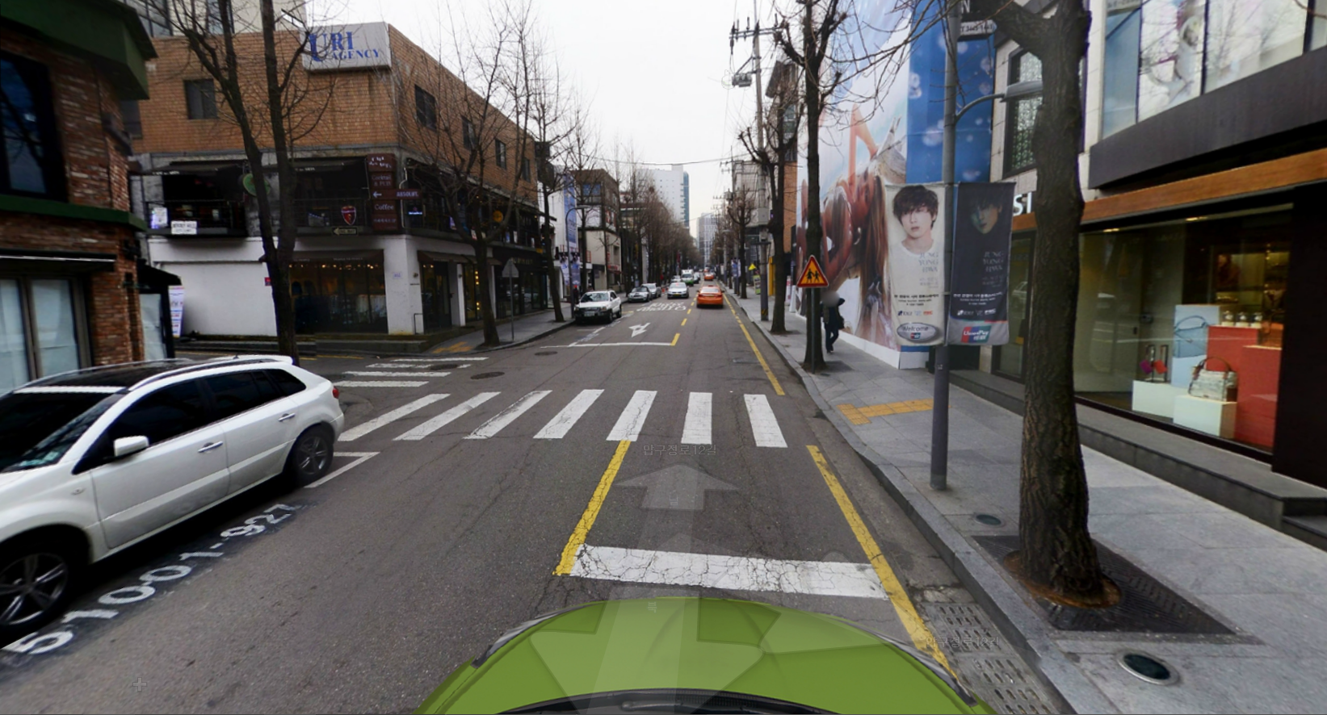
Korean Cases
Pedestrian Friendly- Garosu-gil

Slide 15
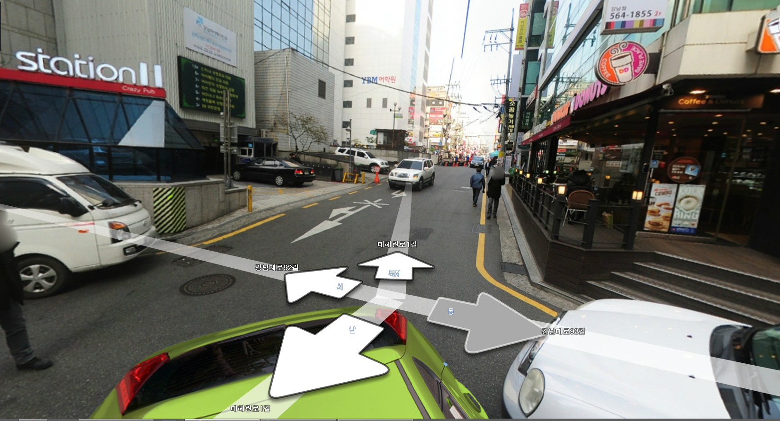
Korean Cases
Automobile Friendly- Taehaeran-gil

Slide 16
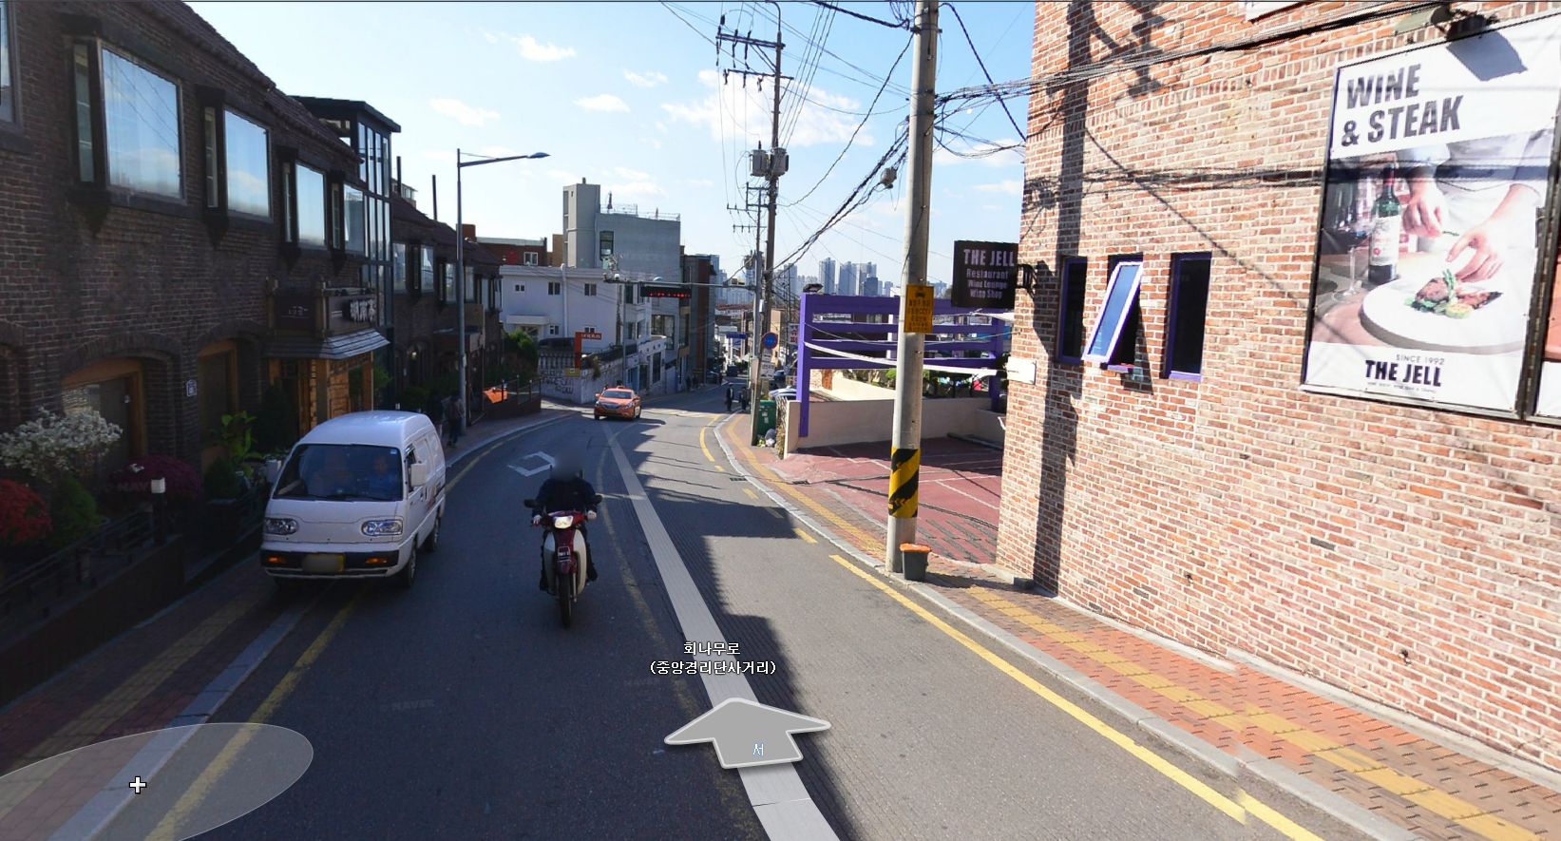
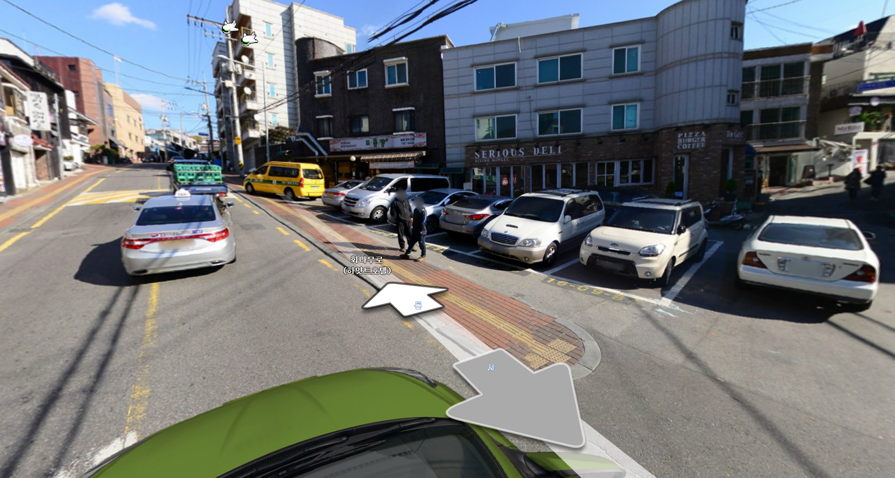
Korean Cases
Pedestrian & Automobile Friendly- Gyeongridan-gil

Slide 17
18. Visual Order: its Limitations and Possibilities
Many people think of city as an art but, city cannot be an art
City is so complicated and is like a living organism
Confusion between art and living is nor an art nor a living
Urban Designers should not try to substitute living as an art but try to make art and living both elegant to tell us the meaning and order of living
Urban Designers who try to fix a frame of the city which is kind of demonstration is fundamentally wrong
Rather, diversity drawn from mixture of uses is more effective
Only mixture of uses and vitality will give appropriate structure and form
The tactic we need is not a chaos but allusion of meaning and order

Slide 18
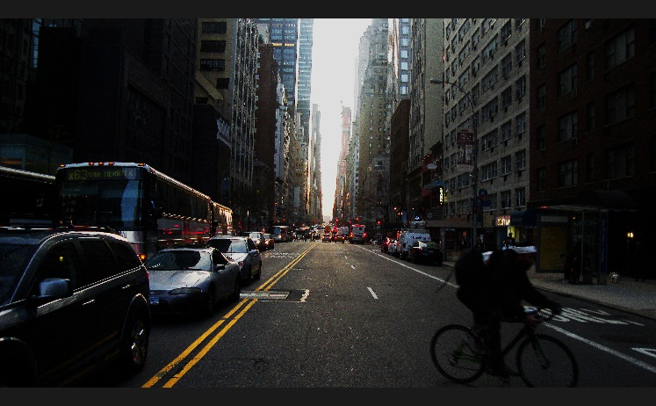
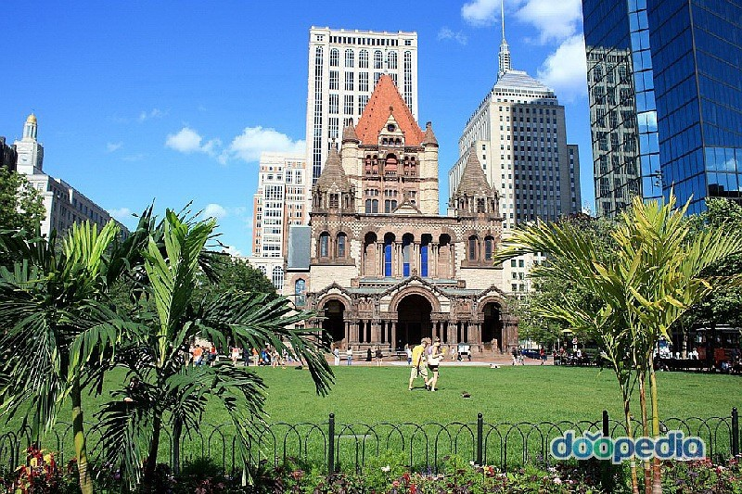
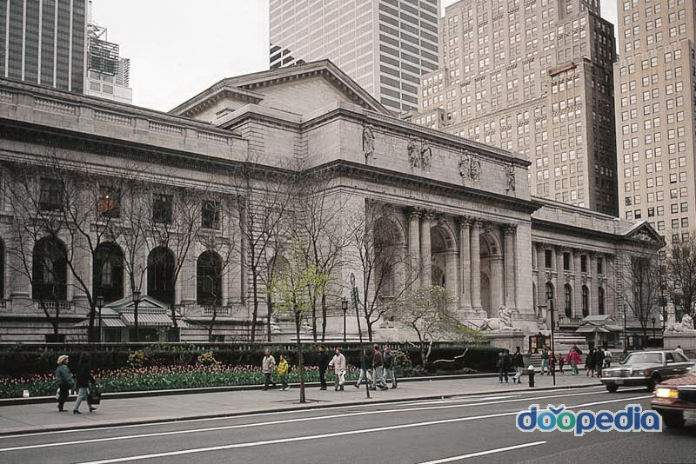
18. Visual Order: its Limitations and Possibilities
Street is an important visual landscape
Infinity is not needed for city impression
Rather, street needs visual obstacles which interrupt
infinite vision while shows boundary line and identity
Adding additional street to make irregularity
Adding large-scale building or small park structure

Slide 19
19. Salvaging Project
Project has always been thought of as separated complex
To stop making complex a slum, we have to make people to voluntarily select to live there
Planners should consider whether fundamental principals are applied
Is mixture of uses sufficient?
Isn’t size of the blocks too large?
Is diverse age and type of buildings are mixed?
Are Enough people gathered?
What is urgent is low income housing projects
It should be safe and convenient
it should be connected with other streets which are outside the complex
New street should be connected with some of fixed special places

Slide 20
19. Salvaging Project
Adopting other functions in the street-side new buildings
It should be generally different from residential use
Without sufficient mix use, street will lose vitality, become dangerous, and inconvenient to use
But when forming the street, non-residential uses have many disadvantages
They need many things to settle and will need public funds
Interlock between residence and income level must be stopped for settlement
People with different income-level can be mixed in the same place
Rent must go high as income goes up
By doing mixture, unslumming can be done

Slide 21
20. Governing and Planning Districts
Planning for vitality must stimulate and catalyse the greatest possible range and quantity of diversity of a big city
Need to diagnose, in specific places, what is lacking to generate diversity
Aim at helping to supply the lacks as best as they can
Planning for vitality must promote continuous networks of local street neighbourhoods
Keeping the public spaces of the city safe
Handling strangers as an asset
Keeping casual public tabs on children in public places
For this to happen, administrators need not only understanding service and technique, they need to understand specific place thoroughly
As cities are a problem of organized complexity, horizontal structures in city planning would work better than vertical structures

Slide 22
21. The Kind of Problem a City is
City as an organic complexity
Half-dozen or even several dozen quantities are all varying simultaneously and in subtly interconnected ways
Cities don’t exhibit one problem in organized complexity
Traditional urban planners thought cities as an simple or inorganic complexity
Technique to understand cities…
Think about the processes
Work inductively, reasoning from particulars to the general
Seek for ‘unaverage’ clues involving very small quantities, which reveal the way larger and more ‘average’ quantities are operating

