Slide 1
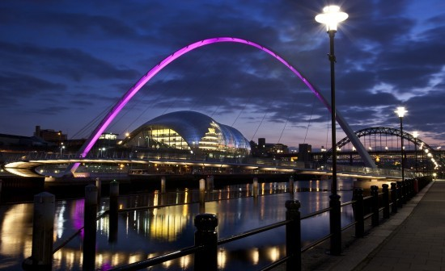
Advanced Urban Design (Urban Regeneration), 2015. 11. 19, Seoul National University
Urban Regeneration in Gateshead, UK
Written by:
Jinsung Kim (김진성)
Presented by:
Junghwan Park (박정환)
Master’s Course,
Urban Design Lab,
Department of Civil and Environmental Engineering,
Seoul National University

Slide 2
Table of Contents
Background
What was it?
Characteristics
Who did it?
Evaluation
Conclusion
The Future of Gateshead

Slide 3
I. Background

Slide 4
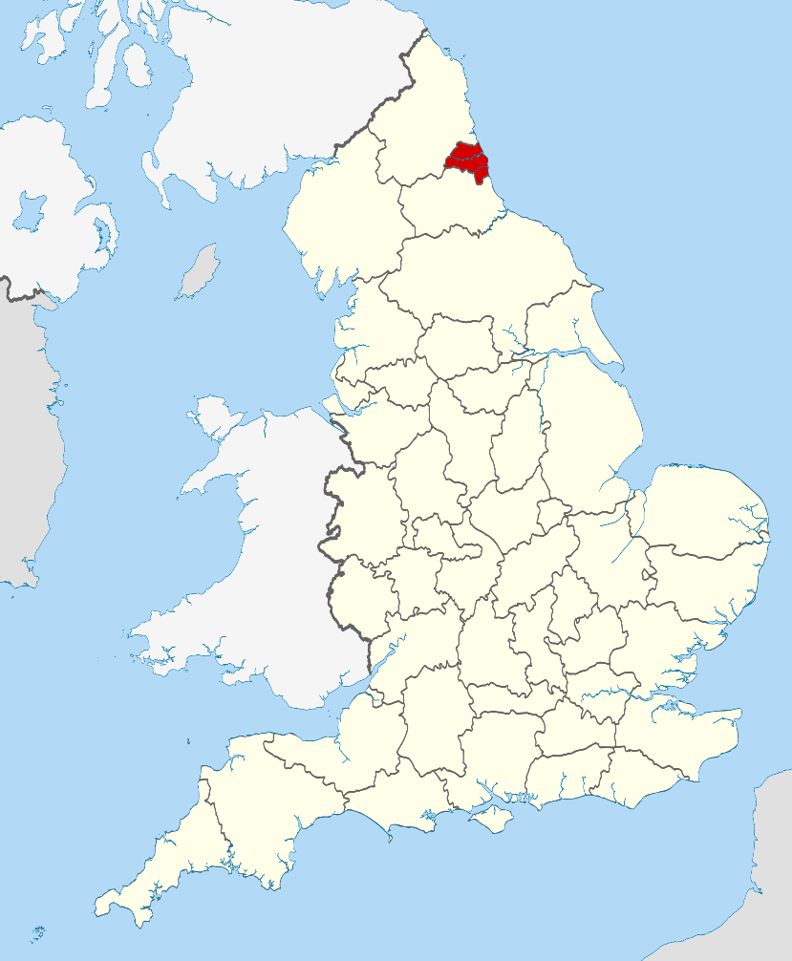
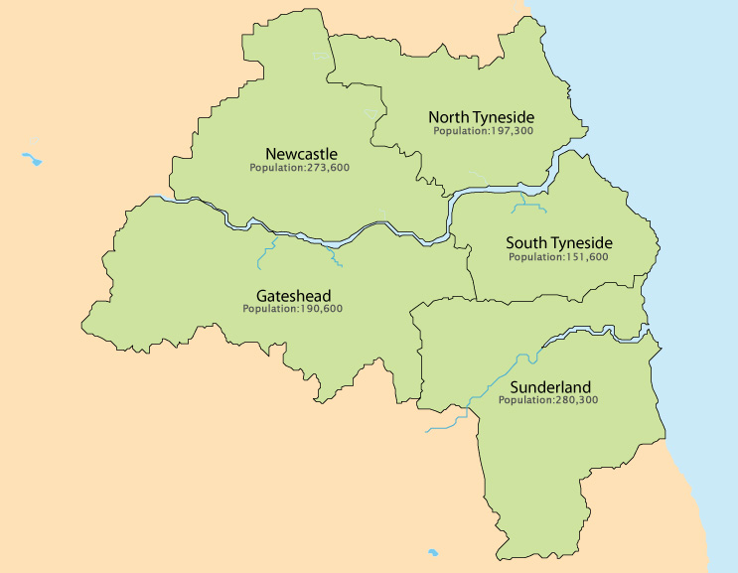
Gateshead: Geography
Located at The Tyne and Wear County
Economic & Geographic Hub of the North-east
Gateshead total area: 142㎢ (Similar to Sungnam-Si, Korea)
2/3: Urban Area, 1/3: Rural Area

Slide 5
History of Gateshead & Newcastle upon Tyne
Gateshead
The history of Gateshead does not go so far
Coal mine industry in the area started since 1344
After 1576, the amount of coal mined annually increased 11 times for a hundred years -> As a result, its population doubled to 5,500
Afterwards, the surge of the Industrial Revolution further expedited the prosper of the city, resulting in a 0.1 million population increase during the 19th century
Newcastle upon Tyne
Similar with Gateshead, prospered with the raise of coal and steel industries
Transportation system was developed early (tram in 1901)
Fourth biggest city in England for printing
Fell behind since the Great Depression in 1930

Slide 6
History of Gateshead & Newcastle upon Tyne
Coal mining industry -> Fading industry (Early 20th century)
Town facilities -> Destroyed (During the Second World War)
Steel & mining industry -> all dead (1970s, Thatcher – Mine Closure Policy)
Unemployment rate in Gateshead were up to 23% in 1980s
1980s
50%
Present
3%
The percentage of workers in 4 heavy industries (shipbuilding, mining, steel, machine)

Slide 7
II. Gateshead Regeneration: What was it?

Slide 8
Timeline
Millenium Bridge
Angel of the North
2008
2004
International Garden Festival
2002
Leisure Facilities
Public Art Programme
Sage Music Centre
1994
Baltic Centre for Contemporary Art
1990
Gateshead
Heritage
1986
<Influenced by ‘the Angel’>
Identification of Possibility
Regeneration Project through Art & Culture

Slide 9
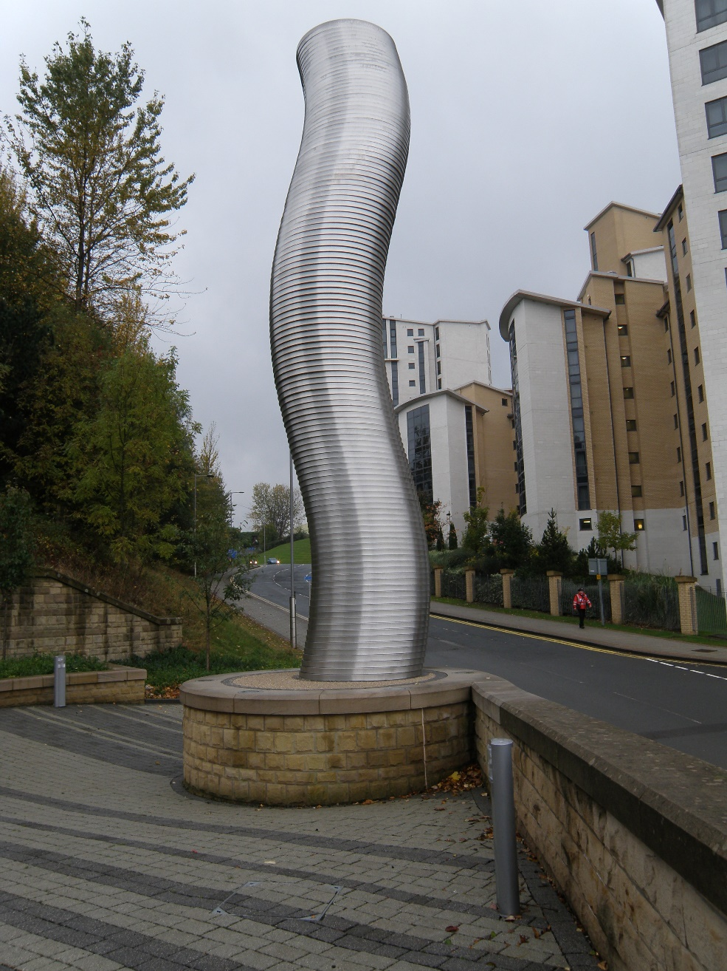
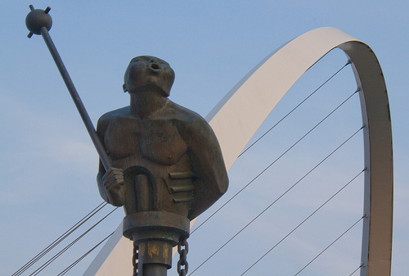
Dawn of the Regeneration Project
1986 ~ Present
Public Art Programme
49 artworks around the city, including ‘The Angel of the North

Slide 10
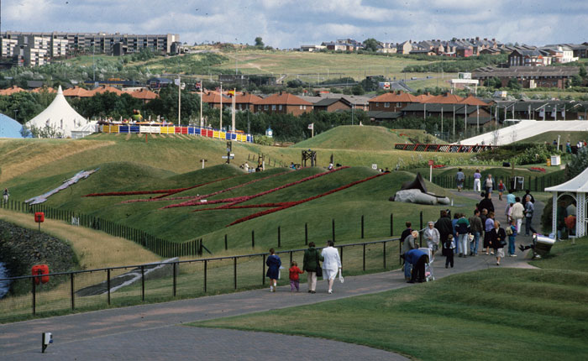
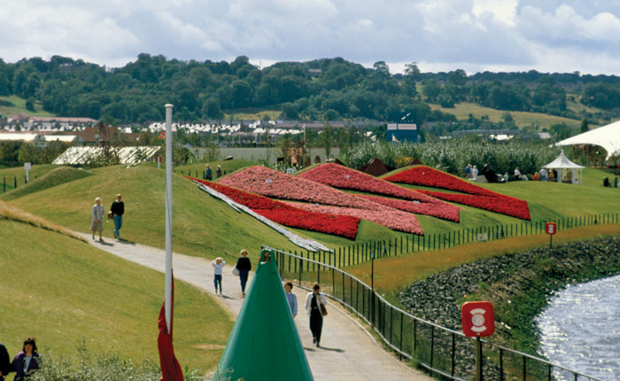
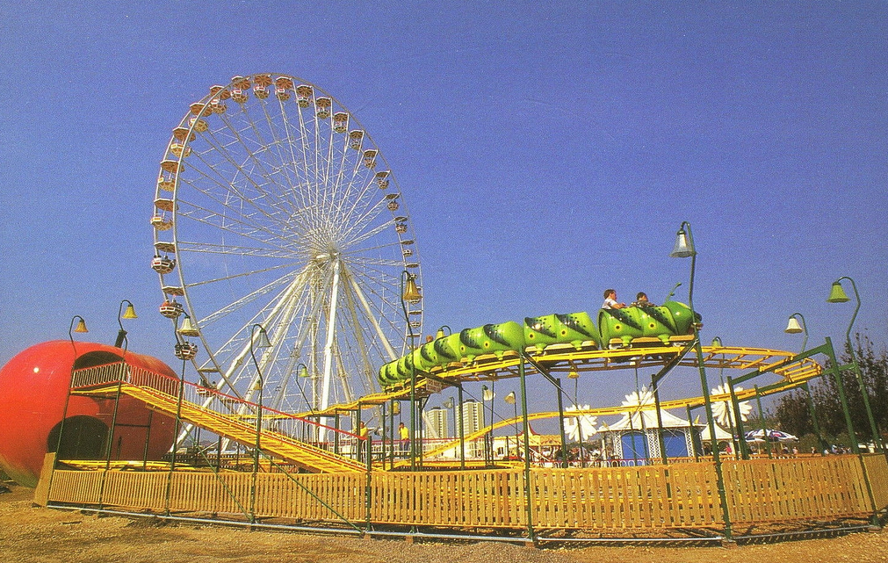
Dawn of the Regeneration Project
1990
International Garden Festival
Flower Festival, Public Art, Big Wheel
Festival Area: Abandoned coal warehouse
3 million visitors
A fuse for Gateshead’s plan for
cultural regeneration

Slide 11
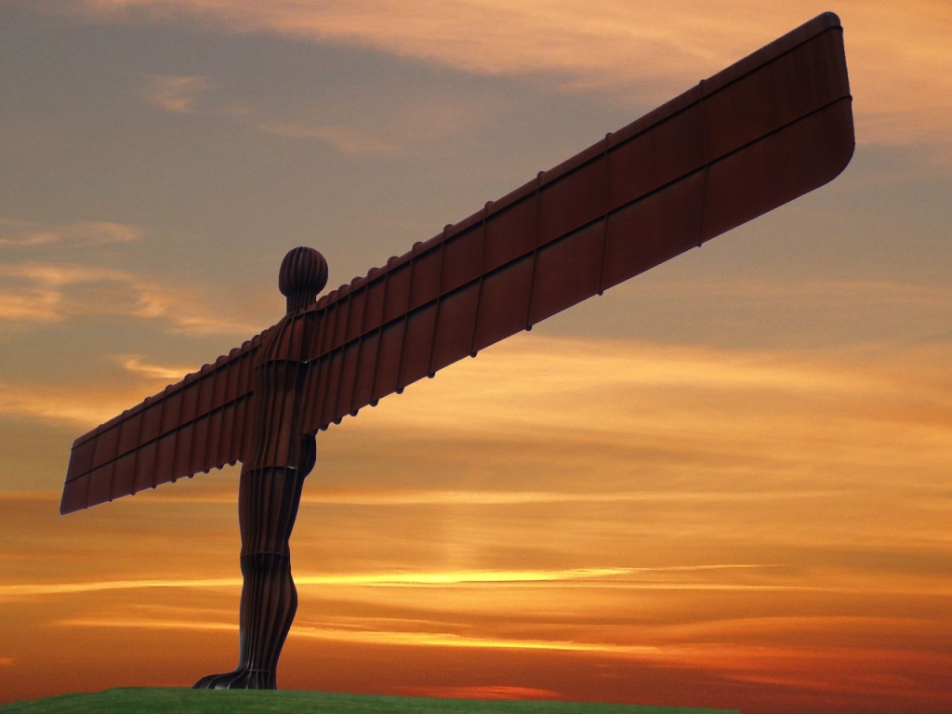
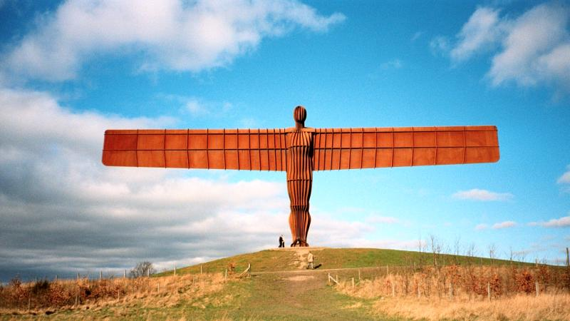
Dawn of the Regeneration Project
1994 ~ 1998
The Angel of the North
“A political statement with wings, The Angel Of The North is a contemporary sculpture designed by Antony Gormley from 1998. The looming steel sculpture is 20 metres tall with wings measuring 53 metres across. It’s angled 3.5 degrees forwards to create “a sense of embrace”, according to the artist. The angel signifies that beneath the site of its construction, coal miners worked tirelessly for 200 years. It also aims to be a positive focus for locals’ ever-changing hopes and fears.”

Slide 12
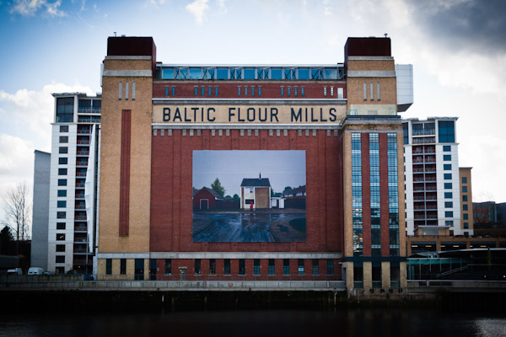
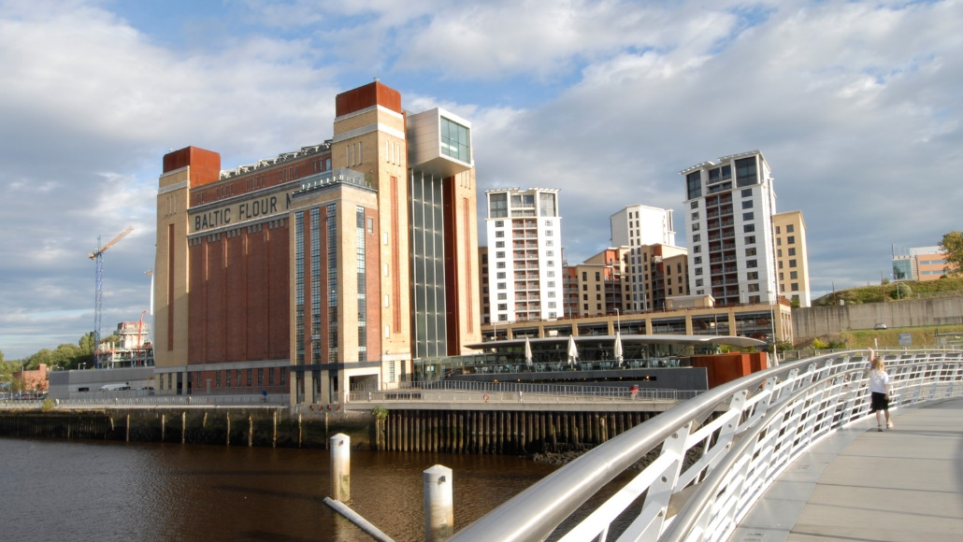
Gateshead Waterfront Regeneration
2002
Baltic Centre for Contemporary Art
Baltic Mill -> Art Centre
Ellis Williams
0.5 million visitors every year
Communication with residents

Slide 13
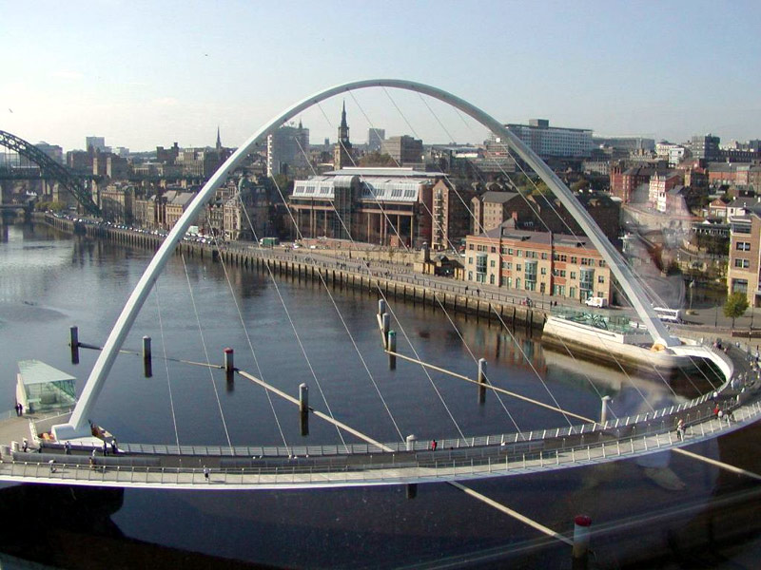
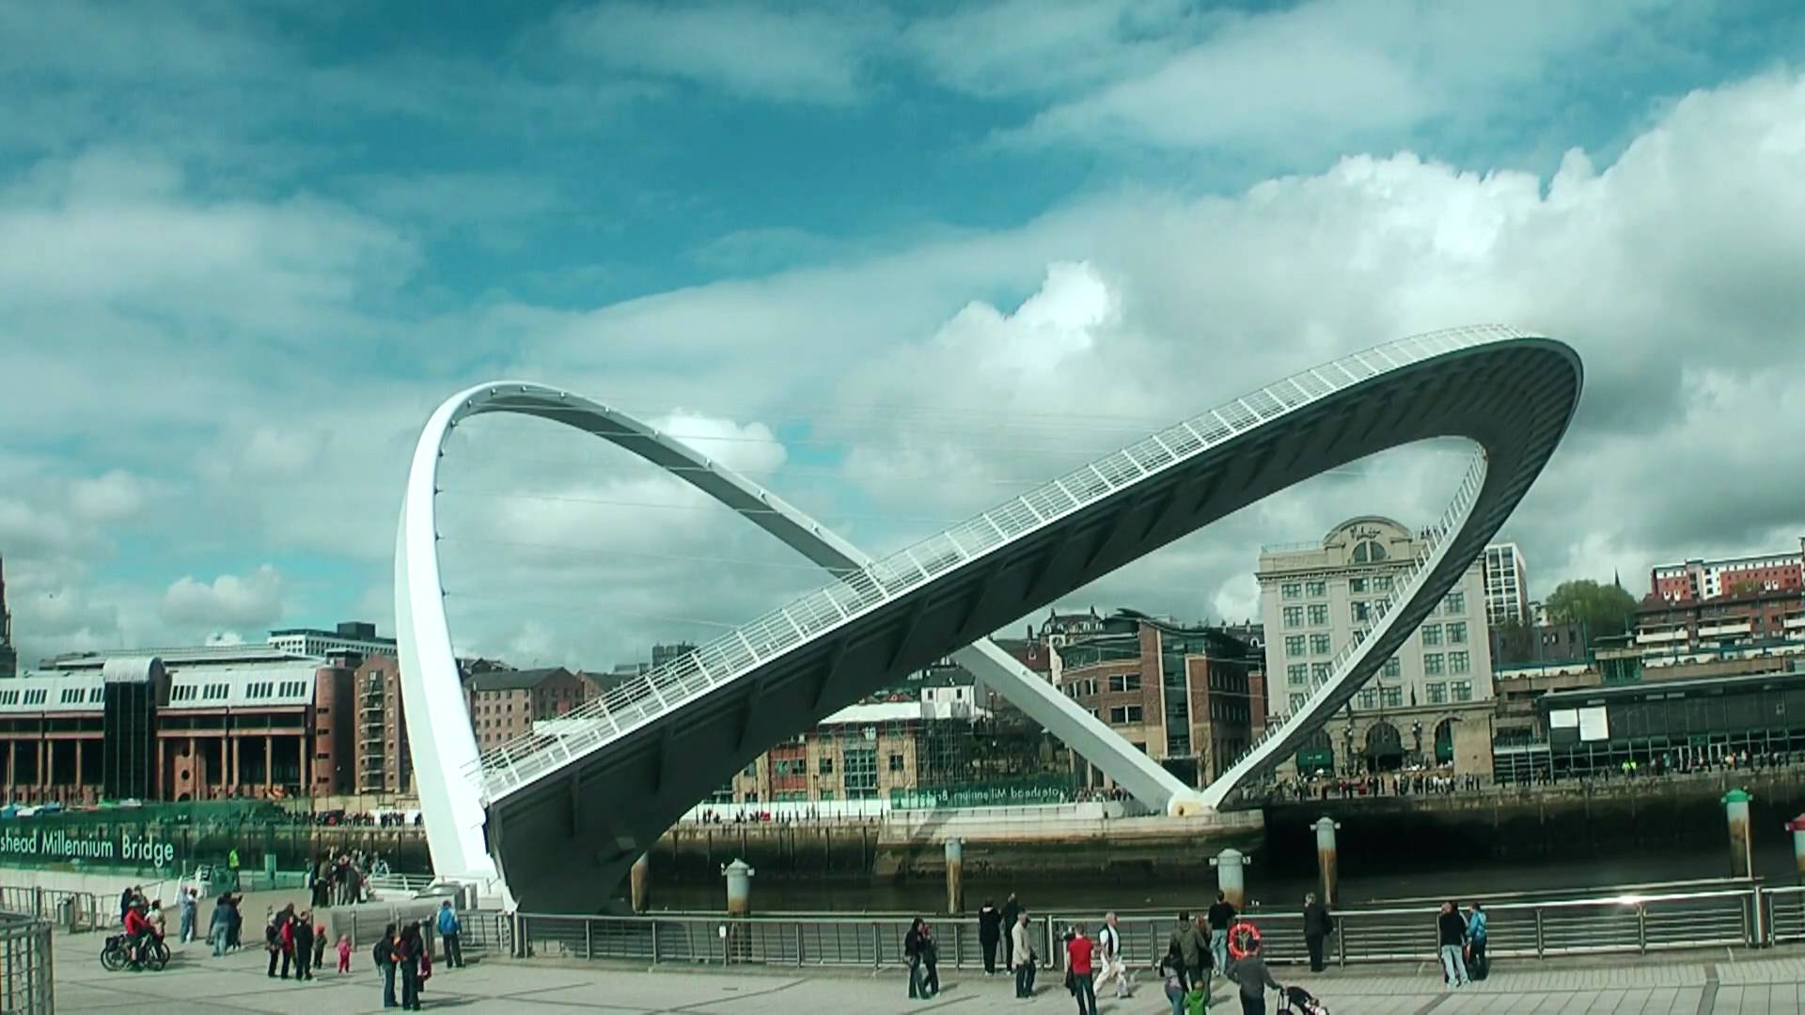
Gateshead Waterfront Regeneration
2002
The Millennium Bridge
Function + Tourism
Takes 4.5 minutes to move

Slide 14
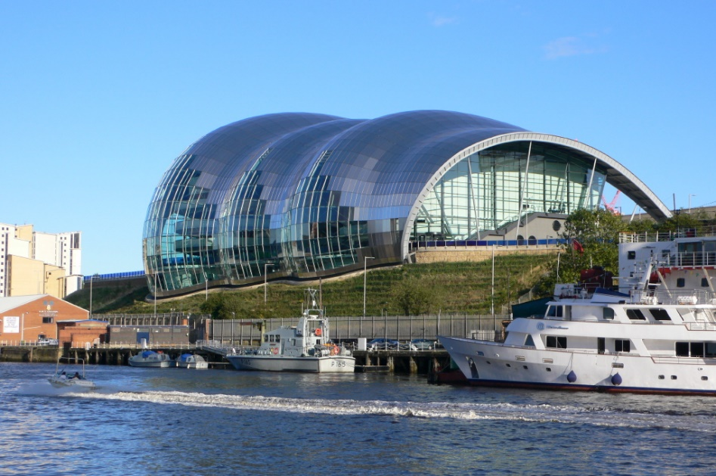
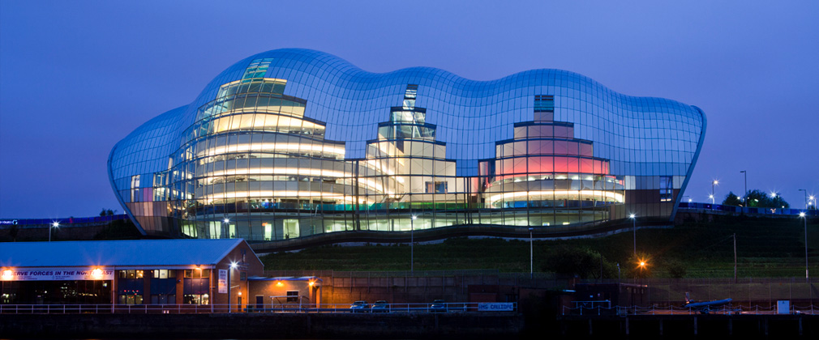
Gateshead Waterfront Regeneration
2004
Sage Music Centre
Norman Foster
Music show + Education + Conference

Slide 15
III. Gateshead Regeneration: Characteristics

Slide 16
Characteristics
1.
Civic Leadership
2.
Asset Pooling
- Gateshead City Council lead all the projects during the regeneration
- Newcastle upon Tyne was not so positive towards the Culture-led Regeneration until 1990s
- Gateshead Politics -> Communication Oriented
- Newcastle Politics -> Authoritative
Two cities-> rivals from the past
NGI: Newcastle Gateshead Initiative
(Founded in 2002, Millennium Bridge)
Strong Partnership
Newcastle: 2 Universities, hospital, Newcastle United, Georgian Town Centre
Gateshead: The Angel of the North, Baltic Centre of contemporary Art,

Slide 17
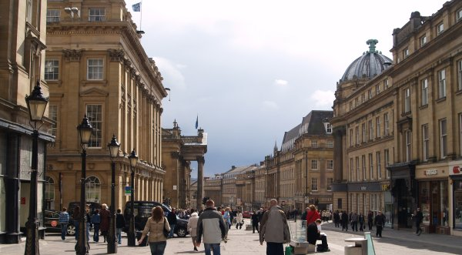
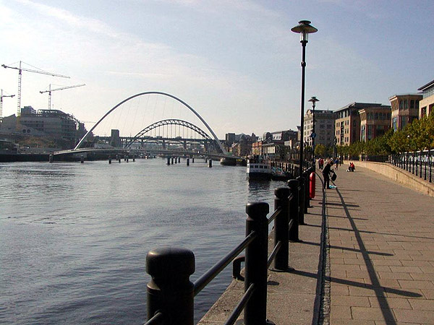
Characteristics
Newcastle: Grainger Town, Grey Street (Historical Street from 1820s)
40 million pounds for renewal
Gateshead: Quayside
(Waterfront Development)
Tyne and Wear Development Corporation
3.
Building on Local Assets

Slide 18
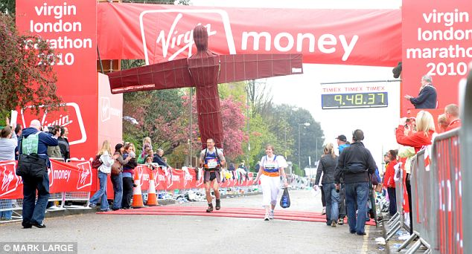
Characteristics
4.
Culture-led

Slide 19
Know-how: how did they succeed?
1.
Long-term Commitment
2.
High Standards
Mayor
Baltic Art Centre: Elitism
During the remodeling for 3 years, did performances and projects to let people see its process
Sage Music Centre: the best facilities
Northern Sinfonia Orchestra
High quality performances
- Mid 80s ~ 1992
Culture Director
Planning Director

Slide 20
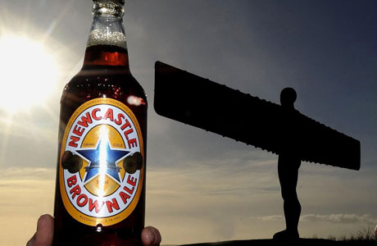
Know-how: how did they succeed?
3.
Flexibility and an Organic Vision
4.
Confidence and Local Ownership
External pressure to make Baltic Art Centre as a traditional museum
As a result of open competition, 28 year old architect Dominic Williams
Millennium Bridge
Sage Music Centre
All were not planned from the start, but were done quite flexibly when opportunity came
Giving citizens sense of confidence
Creative artworks through residents’ participance

Slide 21
IV. Gateshead Regeneration: Who did it?

Slide 22
NGI(Newcastle Gateshead Initiative)
“NewcastleGateshead is the destination management and marketing agency for NewcastleGateshead; a public private partnership supported by Gateshead Council and Newcastle City Council, working with around 170 private sector partner organisations across NewcastleGateshead and the wider region.”
“All of our activity aims to promote and position NewcastleGateshead as a world-class, vibrant tourism destination, through targeted marketing and PR campaigns nationally and internationally and through the work of our cultural programming team and convention bureau.”
Established in 2000
Corporate Brand Values
Creative – in all that we do as well as in our approach to challenges and opportunities.
Positive – relentlessly proactive and enthusiastic with a ‘can do’ attitude.
Committed – a professional and dedicated team delivering high quality work.
Collaborative – keen to share, shape and deliver in partnership.
Welcoming – open, accessible, friendly to all.

Slide 23
ONE(One North East)
One North East was created in 1999, as one of 8 Regional Development Agencies established to transform the English regions through sustainable economic development.
Since that time One North East has led the economic regeneration and development of the north east of England, making a significant contribution to the improving prospects of our region both economically and physically.
In June 2010 the coalition Government announced the abolition of the Regional Development Agencies. As a result One North East ceases operation on 31st March 2012.
Total Investment: 4조 8,533억원 (2.7billion pounds)
4.5 pounds profit from every 1 pound
0.16 new jobs, 0.19 new business created

Slide 24
V. Gateshead Regeneration: Evaluation

Slide 25
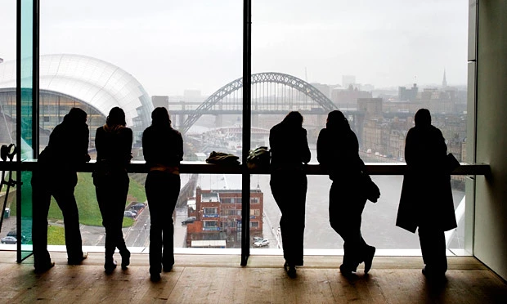
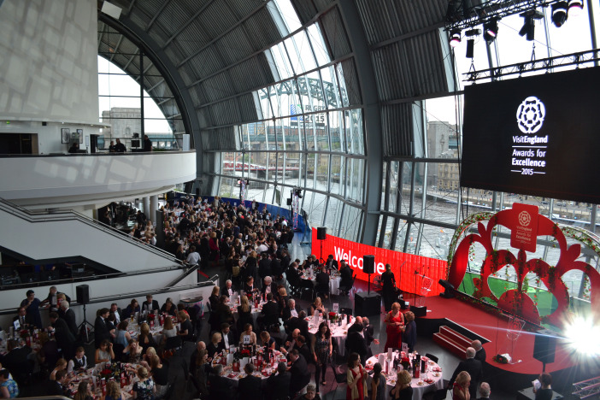
Evaluation
1. Population Increase
1981~2000: Gateshead(-7%), Newcastle(-5%)
Increased up to 190,000(G), 290,000(N)
2. Number of Visitors
Economic value

Slide 26
VI. Conclusion

Slide 27
Conclusion
1. Its success came from long-time efforts
2. Cooperation between cities & strong leadership is a key factor
3. Its ways of utilizing local assets
4. Continuing small achievements to a big apple
5. City marketing through cultural model was successive

Slide 28
VII. The Future of Gateshead

Slide 29
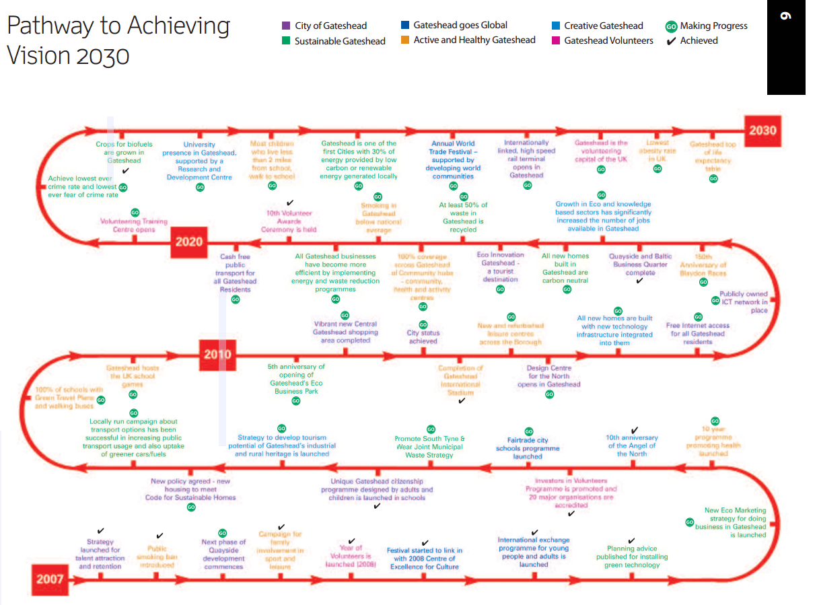
Gateshead Vision 2030

Slide 30
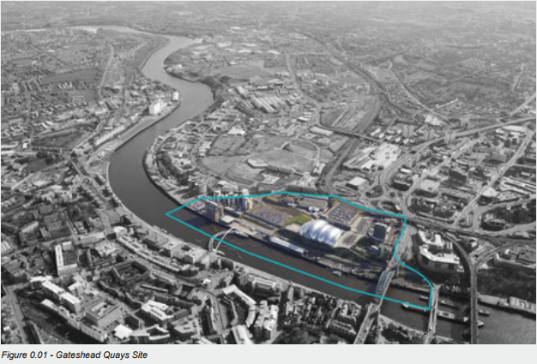
Gateshead Quay Masterplan

Slide 31
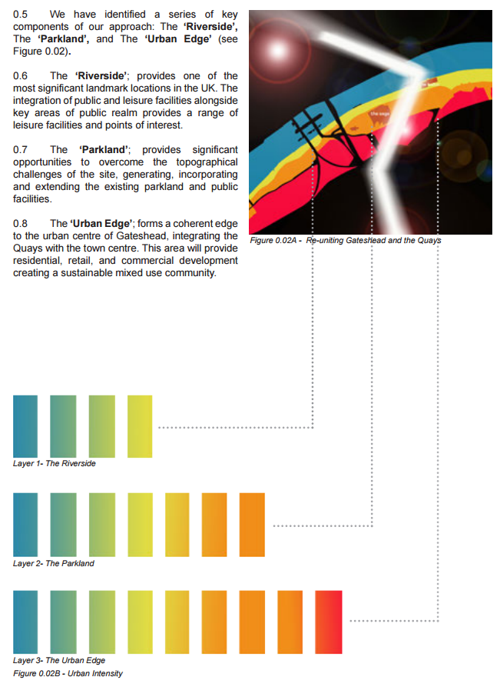
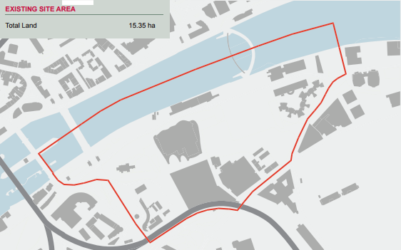
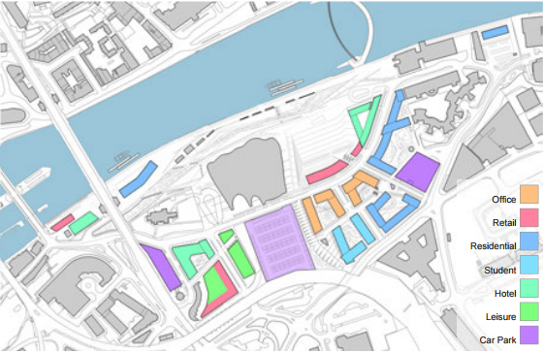
Gateshead Quay Masterplan

Slide 32
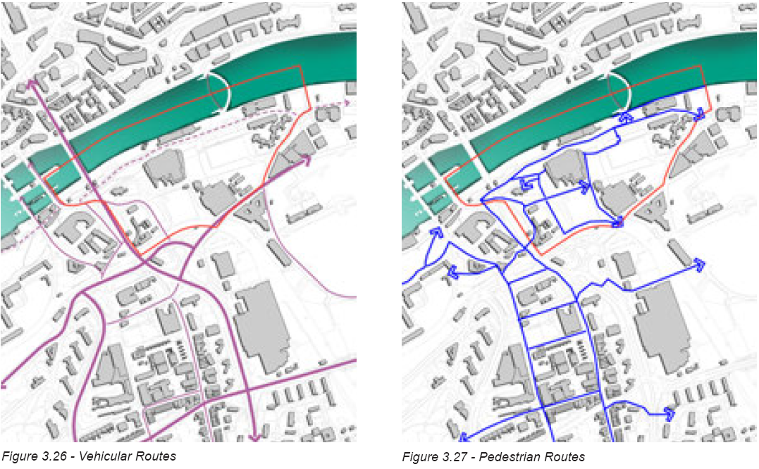
Gateshead Quay Masterplan

Slide 33
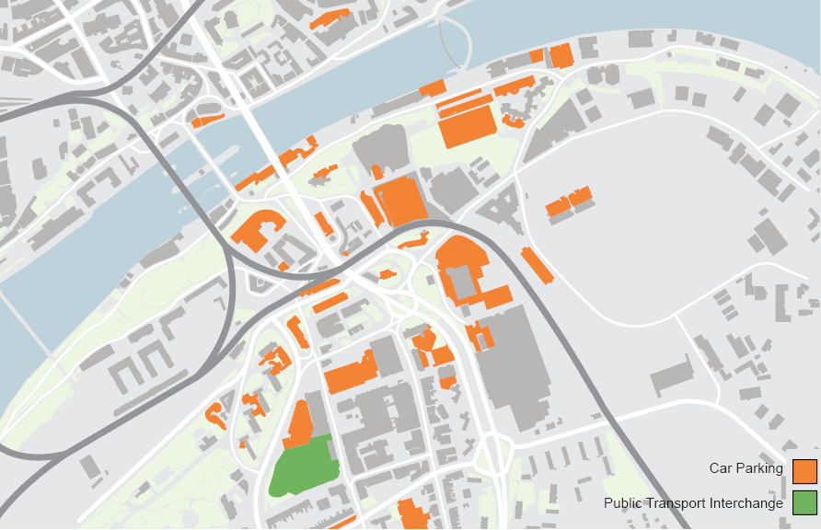
Gateshead Quay Masterplan

Slide 34
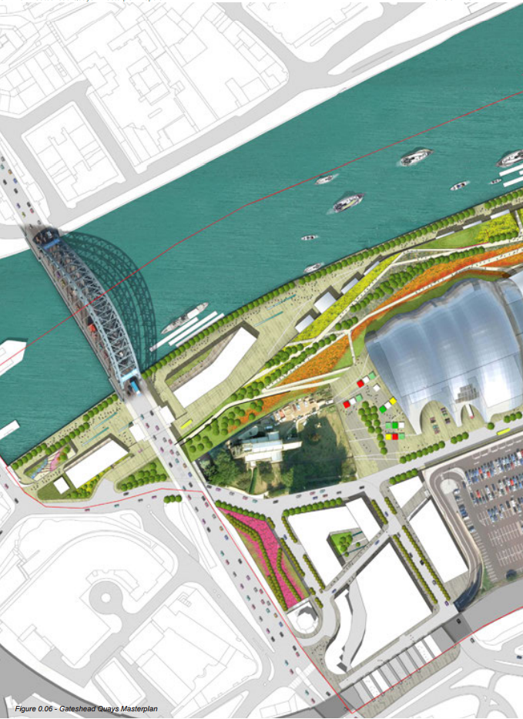
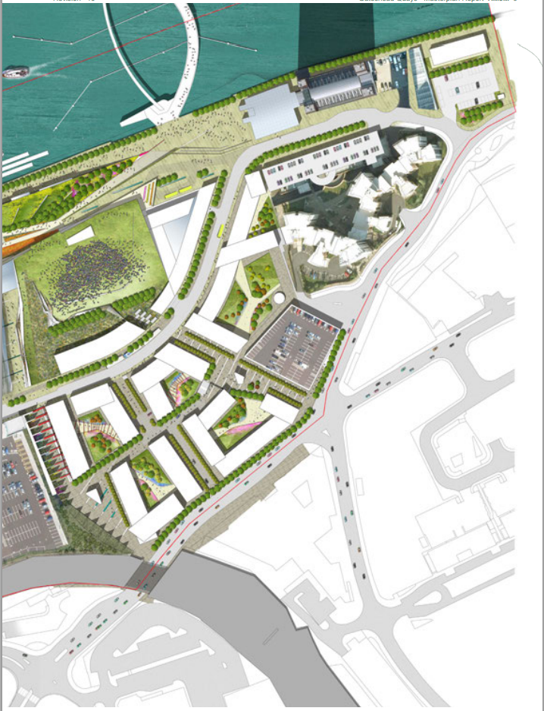
Gateshead Quay Masterplan

