Slide 1
Environmental Thermal Engineering
Lecture # 2
Min soo Kim
Mechanical & Aerospace Engineering

Slide 2
  Carnot cycle and
  Actual vapor-compression cycle

Slide 3
Fundamentals of cycle
The vapor-compression cycle
Most important refrigeration cycle
(Most widely used cycle)
Process
Vapor compressed
Condensed to a liquid
Pressure is dropped
Evaporate at a low pressure

Slide 4
Fundamentals of cycle
Carnot heat engine and refrigeration cycle
Temperature, K
Temperature, K
2
3
3
2
4
1
1
4
Entropy, kJ/kg·K
Entropy, kJ/kg·K
Carnot heat engine
Refrigeration cycle

Slide 5
Fundamentals of cycle
Schematic and T-S diagram of Carnot ref. cycle
Condenser
3
2
Temperature, K
3
2
Turbine
1
4
1
Compressor
4
Entropy, kJ/kg·K
Evaporator

Slide 6
Fundamentals of cycle
Processes of the Carnot refrigeration cycle
Temperature, K
1 - 2 Adiabatic compression
2 – 3 Isothermal rejection of heat
3 – 4 Adiabatic expansion
4 – 1 Isothermal addition of heat
3
2
4
1
Entropy, kJ/kg·K
The reason why we discuss the Carnot cycle
The Carnot cycle serves as a standard of comparison.
The Carnot cycle provides a convenient guide to the temperatures that should be maintained to achieve maximum effectiveness

Slide 7
COP
Coefficient of performance (1)
The concept of the performance index of the refrigeration cycle is the same as efficiency.
It represent the ratio

Slide 8
COP
Coefficient of performance (2)
The performance term in the refrigeration cycle is called the coefficient of performance (COP) , define as,

Slide 9
COP
Condition for highest coefficient of performance
Express the COP of the Carnot cycle in terms of the temperatures that exist in the cycle. We know the heat transferred in a reversible process can express T his way.

Slide 10
T-S diagram analysis
T-S diagram (1)
Temperature, K
3
2
Net work
4
1
Refrigeration
Entropy, kJ/kg·K
This Figure can represent the amount of useful refrigeration and the net work .

Slide 11
T-S diagram analysis
T-S diagram (2)
The useful refrigeration and net work
Useful refrigeration =
Net work =
Expression for COP of Carnot refrigeration cycle

Slide 12
T-S diagram analysis
How can we achieve a highest COP in Carnot cycle?
A low value of T₂ will make the COP high
A high value of T₁ will make the COP high
The value of T₁ has a more pronounced effect on the COP than T₂, because a high value of T₁ increases the numerator and decreases the denominator.

Slide 13
T-S diagram analysis
Temperature limitation
Temperature, K
Entropy, kJ/kg·K
Can we have the infinite COP as T₁ is set equal to T₂ ?

Slide 14
T-S diagram analysis
Heat transfer
Temperature, K
3
2
4
1
Entropy, kJ/kg·K
      In this heat rejection process, refrigerant must transfer its heat to somewhere.
      In this refrigeration process, refrigerant must add the heat from the cold room.
2 → 3
4 → 1

Slide 15
T-S diagram analysis
Example
Temperature, K
303.15 K
253.15 K
Entropy, kJ/kg·K
If the refrigeration system must maintain a cold room at – 20 ℃ and can reject heat to the atmosphere at 30 ℃, how can we control the temperatures, T₁ and T₂?

Slide 16
T-S diagram analysis
The answer (1)
Temperature, K
303.15 K
253.15 K
Entropy, kJ/kg·K
T₁ must be higher than 303.15K.
T₂ must be lower than 253.15K.

Slide 17
T-S diagram analysis
The answer (2)
Temperature, K
303.15 K
253.15 K
Entropy, kJ/kg·K
For higher COP, we can keep the ΔT as small as possible.

Slide 18
Overall heat transfer
Reduction of ΔT
q = heat, W
U = overall heat-transfer coefficient,
A = heat-transfer area,
ΔT = temperature change, K
Reduction of ΔT can be accomplished by increasing A or U in equation.

Slide 19
Overall heat transfer
How to accomplish high U ?
In reality, we can make U high rather than make A high for given q, because we need to make less the space of refrigerator.
But a large heat transfer area is accomplished

Slide 20
Overall heat transfer
For a high value of U (1)
We can make the air speed around heat exchanger high.
air

Slide 21
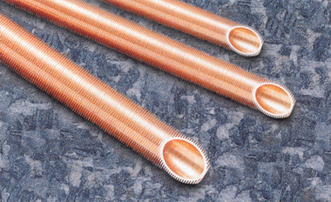
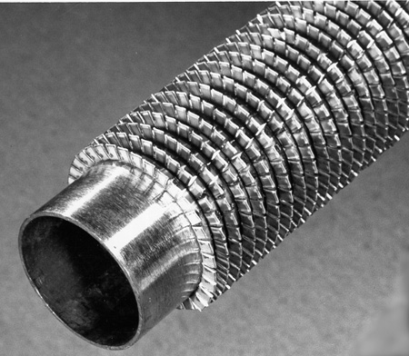
Overall heat transfer
For a high value of U (2)
We can use the finned tube.
The low finned tube
Helically finned tube

Slide 22
Overall heat transfer
For a high value of U (3)
The water around the heat exchanger will help the heat exchange.
water
(But it will promote to corrode the heat exchanger.)

Slide 23
Revision of the Carnot cycle

Slide 24
Compression process
1 → 2
Temperature, K
3
2
4
1
Entropy, kJ/kg·K

Slide 25
Compression process
Two kinds of compression
Wet compression
compression with liquid droplet
Dry compression
compression with no droplet of liquid

Slide 26

Compression process
Problem of wet compression
Liquid refrigerant may be trapped in the head of the cylinder by the rising piston, possibly damaging the valve or the cylinder head.
High-speed compressor are susceptible to damage by liquid because of the short time available for heat transfer.
The droplet of liquid may wash the lubricating oil from the walls of the cylinder, accelerating wear.

Slide 27
Revision of the Carnot cycle
Dry compression
Superheat horn
2
Temperature, K
3
1
4
Entropy, kJ/kg·K
If the refrigerant entering compressor is saturated vapor, the compression from point 1 to 2 is called dry compression.

Slide 28
Revision of the Carnot cycle
Superheat horn
Superheat horn
2
Temperature, K
3
1
4
Entropy, kJ/kg·K
On the temperature-entropy diagram superheat horn represent the additional work for dry compression.

Slide 29
Expansion process
3 → 4
Temperature, K
3
2
4
1
Entropy, kJ/kg·K

Slide 30
Another revision in expansion process
The practical difficulties in expansion engine (1)
The possible work that can be derived from the engine is a small fraction of that which must be supplied to the compressor.
Practical difficulties such as lubrication intrude when a fluid of two phases drives the engine.
The economics of the power recovery have in the past not justified the cost of the expansion engine.

Slide 31
Expansion process
The practical difficulties in expansion engine (2)
But the possibility of using an expansion engine should continue to be studied as the energy cost increases.

Slide 32
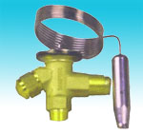
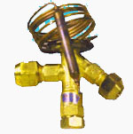
Expansion process
Throttling device
Because necessity still remains of reducing the pressure in the expansion process we can use throttling device such as a valve.
Expansion valve

Slide 33
Expansion process
Isenthalpic process
Throttling happens in expansion device such as an expansion valve.
No changes in potential and kinetic energy and with no heat loss, h₃ = h₄; that is, the process is isenthalpic.
The constant-enthalpy throttling process is irreversible, and during the process the entropy increases.

Slide 34
Expansion process
Throttling process
2
Temperature, K
3
1
4
Entropy, kJ/kg·K
The throttling process take place 3 → 4 in this figure.

Slide 35
Standard vapor-compression cycle

Slide 36
Standard vapor-compression cycle
Compression process
2
Temperature, K
1-2 process
Reversible and adiabatic compression from saturated vapor to the condenser pressure
3
1
4
Entropy, kJ/kg·K

Slide 37
Standard vapor-compression cycle
Condensation process
2
Temperature, K
2-3 process
Reversible rejection heat at constant pressure, causing de-superheating and condensation of the refrigerant.
3
1
4
Entropy, kJ/kg·K

Slide 38
Standard vapor-compression cycle
Expansion process
2
Temperature, K
3-4 process
Irreversible expansion at constant enthalpy from saturated liquid to the evaporator pressure
3
1
4
Entropy, kJ/kg·K

Slide 39
Standard vapor-compression cycle
Evaporation process
2
Temperature, K
4-1 process
Reversible addition of heat at constant pressure causing evaporation to saturated vapor
3
1
4
Entropy, kJ/kg·K

Slide 40
Standard vapor-compression cycle
P - h diagram of refrigerant
Critical point
s = constant
= constant
The pressure- enthalpy diagram is the usual graphic means of presenting refrigerant properties.
Pressure, kPa
t= constant
Saturated-liquid line
Saturated-vapor line
Enthalpy, kJ/kg

Slide 41
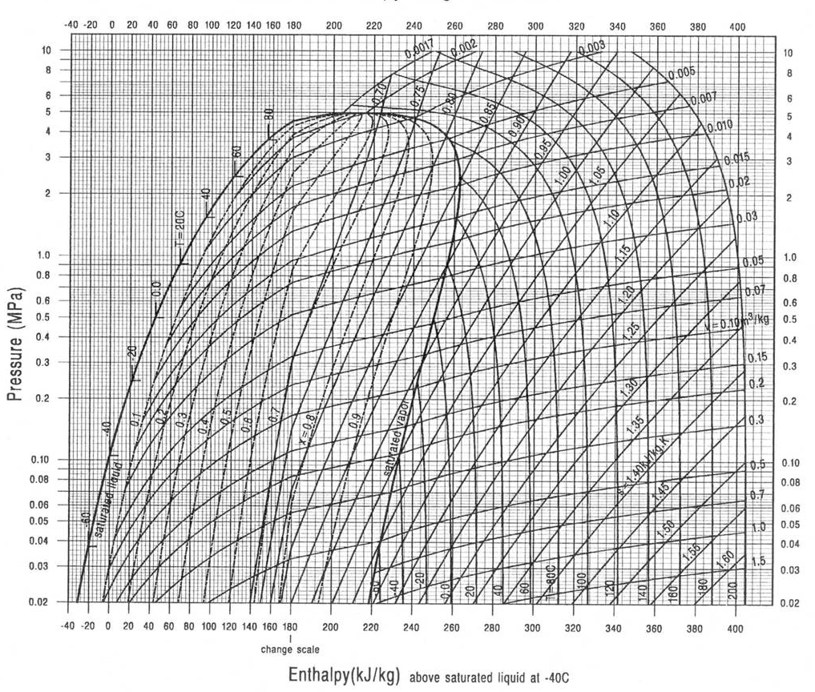
Standard vapor-compression cycle
The actual p-h diagram of R22

Slide 42
Standard vapor-compression cycle
Cycle on the pressure-enthalpy diagram
Pressure, kPa
3
Condensation
2
In refrigeration practice, the enthalpy is one of the most important properties sought, and the pressure can usually be determined most easily.
Expansion
Compression
Evaporation
1
4
Enthalpy, kJ/kg

Slide 43
Standard vapor-compression cycle
COP
The work of compression
= h2 – h1
The refrigerating effect
= h1 – h4
Pressure, kPa
3
Condensation
2
Expansion
Compression
Evaporation
1
4
Enthalpy, kJ/kg

Slide 44
Liquid line – suction line
heat exchange

Slide 45
Liquid line – suction line heat exchange
LLSL-HX
Normal cycle
Liquid line – suction line heat exchange cycle

Slide 46
Liquid line – suction line heat exchange
Schematic and graph
3
2
Pressure, kPa
4
3
2
2
1
6
4
5
4
6
1
5
Enthalpy, kJ/kg

Slide 47
Liquid line – suction line heat exchange
Advantage
Superheating of the vapor leaving the evaporator
Subcooling of the liquid leaving the condenser
Increased the refrigeration effect
( h = refrigeration effect )

Slide 48
Liquid line – suction line heat exchange
Disadvantage
Increase compressor work
Pressure, kPa
4
3
2’
2
5
4’
6
1
Enthalpy, kJ/kg
Additional cost of heat exchanger

Slide 49
Actual vapor-compression cycle

Slide 50
Actual vapor-compression cycle
Subcooling
Pressure drop
Pressure ,kPa
3
2
4
1
Pressure drop
Superheating
Enthalpy, kJ/kg
Pressure drop in the compressor and evaporator
Superheating of the vapor leaving the evaporator
Subcooling of the liquid leaving the condenser
The compression is not isentropic.
( There are inefficiencies due to friction and other losses. )

Slide 51
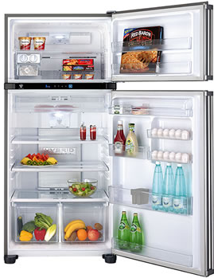

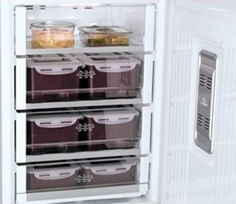
HW #2
When the efficiency of refrigerating systems in household(for example, refrigerator, air conditioner, etc.) operate in an ideal state, let’s consider about how much energy customer could save.

