Slide 1
Environmental Thermal Engineering
Lecture # 6
Min soo Kim
Mechanical & Aerospace Engineering

Slide 2
  The principle and application of absorption refrigerating system

Slide 3
Background
Global environmental pollution problem
Restrict usage of Freon gases ( CFC and HCFC)
R11 – Prohibition of production in 1994
R22 – Expected to abolish all in 2020
Necessity enlargement for air-conditioning using non- Freon gas
Absorption refrigerating system :
- using natural coolant such as water or ammonia
- operates with gases, wasted heat or solar heat

Slide 4
Background
Reduce the amount of use of energy
Develop substitute Energy for Petroleum
An Energy policy of Korea
Stabilization of electricity supplying system in summer
Standardization of gas accommodation
Standardization of demand of electricity in different season
For diversity of importation of energy,
government introduce LNG and
Flame type air conditioners

Slide 5
History of absorption refrigerating machine
1859’ & 1860’ –patent for absorption refrigerating system using NH₃/H₂O F by Fredinand Carr,
1913’ – Theoretical establishment about absorption refrigerating system by 독 by E. Altenkirch, German
1920’ – patent for absorption refrigerating system without circulation pump by introducing hydrogen by G. Munters and B. Conplaten, Switzerland.
Early 1940’ – Develop H₂O/LiBr system by W.H. Carrier.
1955’ – 550 USRT, H₂O/LiBr system
1960’ – 660 USRT, H₂O/LiBr system
1968’ – Develop direct heating type, double effect absorption refrigerating machine, Japan
In Korea, we produce absorption refrigerating system after 1984’.

Slide 6
Absorption refrigerating system
Former vapor compression refrigerant system
Using electricity for compression
Electricity ifs advanced energy
Demand large amount of energy for vapor compression for large change of specific volume
The way to increase pressure of coolant by reducing power consumption
: vapor compression process ⇒ liquid compression process

Slide 7
Vapor compression vs Liquid compression
Ex) Coolant : Ammonia
Condenser - 90℉, 180.73 psi
Evaporator - 0℉, 30.42 psi
P
Vapor compression process
h₃ = 1422 kJ/kg
h_{4,isen} = 1684 kJ/kg
W_{isen} = 262 kJ/kg NH₃
1
4'
4
3
2
Liquid compression process (water is slovent)
Concentration of Ammonia(x) = 0.4,
Specific volume of solution(v) = 0.001149
W = ΔP*v/x = 2.98 kJ/kg NH₃
h

Slide 8
Absorption refrigerating system
Refrigerant
only
Refrigerant plus
absorbant
Condenser
Generator
Refrig.
vapor
Strong
solution
Weak
solution
Exp.
Valve B
Exp.
Valve A
Pump
Evaporator
Absorber

Slide 9
Components
Absorber
It absolves evaporated refrigerant steam in evaporator and sends regenerator.
Regenerator
It absolves coolant and heats solution from absorber, so it separates coolant and absorbent. Evaporated coolant is sanded to condenser and absorbent is sanded to absorber.
Condenser
It condenses refrigerant steam by heat exchanging with cooling water.
Evaporator
It sprays liquid coolant from condenser on upper part of cooling pipe. Depriving the heat, this liquid is evaporated and sanded to absorber.

Slide 10
Flow of energy
Generator
heating
medium
Pump
Absorption
fluids
system
Refrigerated
space
Environment
External energy transfer for absorption refrigerating system

Slide 11
Absorption refrigerating cycle
Single effect absorption refrigerating cycle
Refrigerant steam
Condenser
Condensed solution
Regenerator
Heating
Refrigerant steam
Evaporator
Absorber
Thin solution

Slide 12
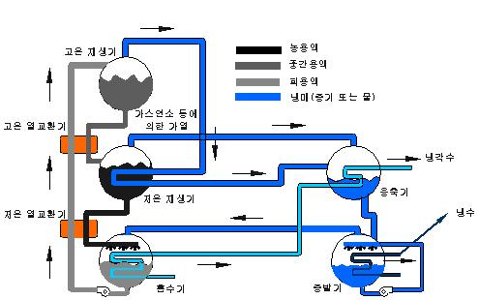
Absorption refrigerating cycle
Double effect absorption refrigerating cycle
A absorption refrigerating cycle having 2 regenerator changing thin solution to condensed solution

Slide 13
Coolant and absorber for absorption refrigerating system
Requirements of coolant and absorber
large latent heat, high critical pressure
Difference of the boiling point between absorber and coolant is large and small heat capacity
The freezing point of coolant and absorber is low and coolant does not coagulation at operation stop.
No corrosiveness to ion and pipe material, and needs stability to heat.
Cheap and easily purchase.

Slide 14
Coolant and absorber for absorption refrigerating system
A system using Water as coolant (H₂O/LiBr)
A binary system based on H₂O/LiBr, and a advanced ternary and quaternary system.
Water has large evaporative latent heat, and high COP and easily acquire.
Due to large boiling point, it is hard to air cooling.
It cannot acquire cold heat source below 0℃.
Due to strong corrosiveness, it is hard to manage solution.
Recently, water receives attention as coolant/absorber of absorption refrigerating system for solar heat.

Slide 15
Coolant and absorber for absorption refrigerating system
A system using Ammonia as coolant (NH₃/H₂O)
Due to high operating pressure, it needs pressure vessel.
Ammonia has adequate characteristic for coolant.
Toxicity, flammable and explosiveness is critical defects.
Applications : large absorption refrigerating system for industry, small absorption refrigerant system for air conditioning.

Slide 16
Coolant and absorber for absorption refrigerating system
A system using Alcohol as coolant
larger latent heat and low freezing point compared to water.
flammable problem.
CF₃CH₂OH receives attention for substitutes of H₂O/LiBr
A system using Halocarbon as coolant
Dimethly formamide solition (DMF) is largely used for absorbent.
R21, R22, R124, R31, R123, R133a are coolants for this system.

Slide 17
Coolant and absorber for absorption refrigerating system
Combination of coolant and absorbent
Coolant | Absorbent
Water type H₂O | LiBr, LiI, LiSCN, LiCl, NaOH, CsBr, CsF, RbF LiBRLiSCN, LiBr-ZnCl₂, LiBr-ZnBr₂, LiBr-C₄H₆O₂, LiBr-C₂H₆O₂, LiBr-LiCl, LiCl-CaCl₂-Zn(NO₃)₂, CH₃OH-LiBr-ZnCl₂
Ammonia type NH₃, CH₃NH₂, C₂H₅NH₂ | H₂O,H₂O, LiSCN, C₂H₆O, LiSCN-NaSCN, H₂O
Alcohol type CH₃OH, C₂H₅OH, CFH₂CH₂OH, CF₂HCH₂OH, CClF₂CH₂OH, CF₃CH₂CH₂OH, CF₃CH₂OH | LiBr, LiI, ZnBr₂, LiBr-ZnCl₂, LiI-ZnBr₂ TEGDME, N-methyle-2-pirolidone
Halocarbon type R22, R21, R124, R23, R31, R123, R133 | TEGDME, TrEGDME, DMF DMA, DEGDME, DMF DMA, DEGDME, ETFE, BTFE

Slide 18
Process of cycle

Slide 19
Basic process of thermodynamics
isotropic 2-fluids mixture
Uniform composition
It does not separated by mechanical ways
It needs pressure, temperature and concentration
Several saturated temperature in each pressure
Condensing
line
Superheat
region
Temperature
Boiling
line
Subcooled liquid
region
x
T-x diagram of isotropic 2-fluids mixture

Slide 20
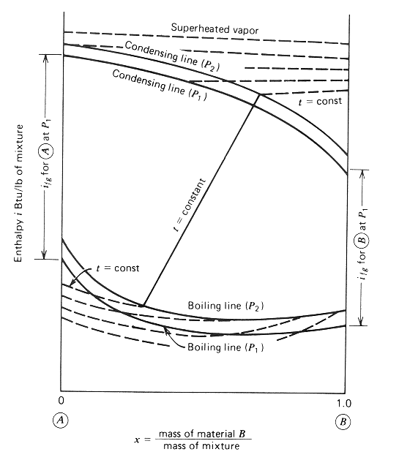
h(i)-x Diagram
h(i)-x diagram of isotropic 2-fluids mixture in liquid-gas region

Slide 21
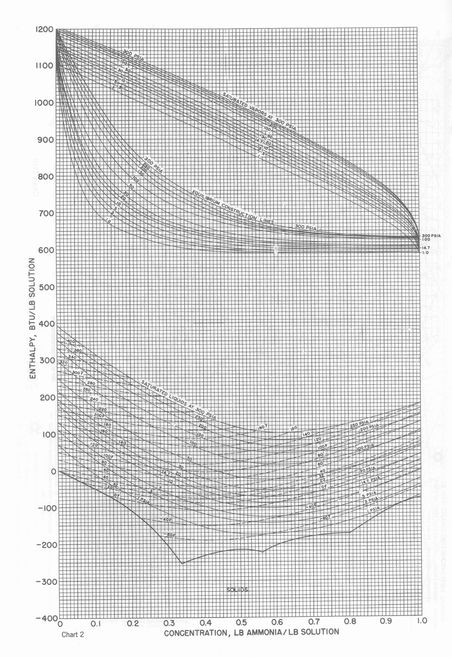
H₂O/NH₃ h(i)-x diagram (1)

Slide 22
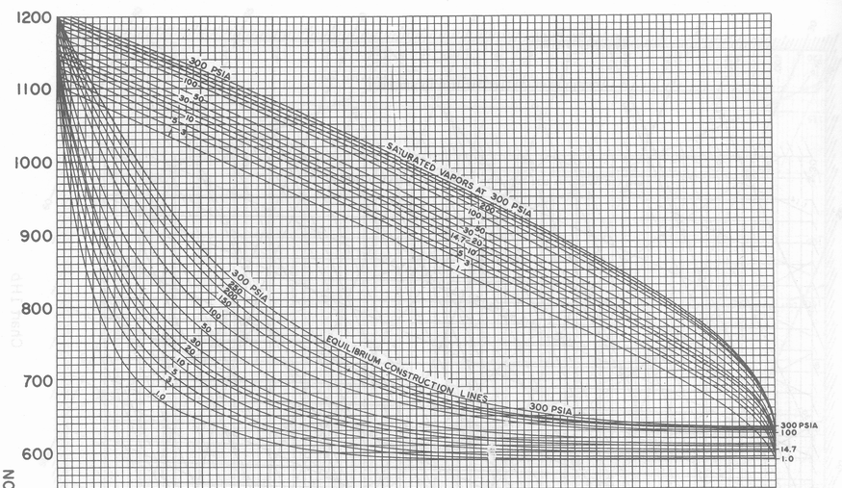
H₂O/NH₃ h(i)-x diagram (2)

Slide 23
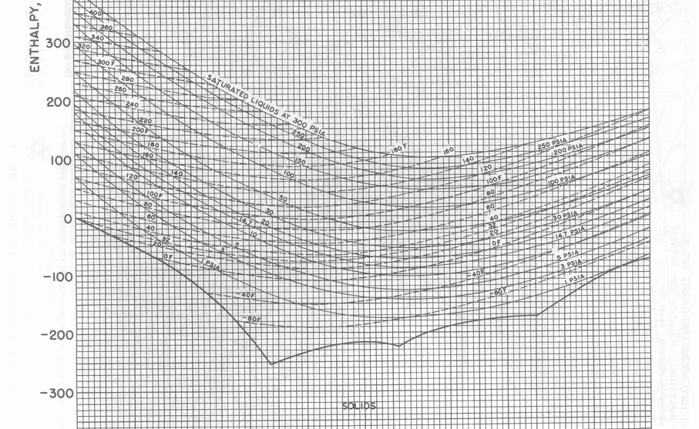
H₂O/NH₃ h(i)-x diagram (3)

Slide 24
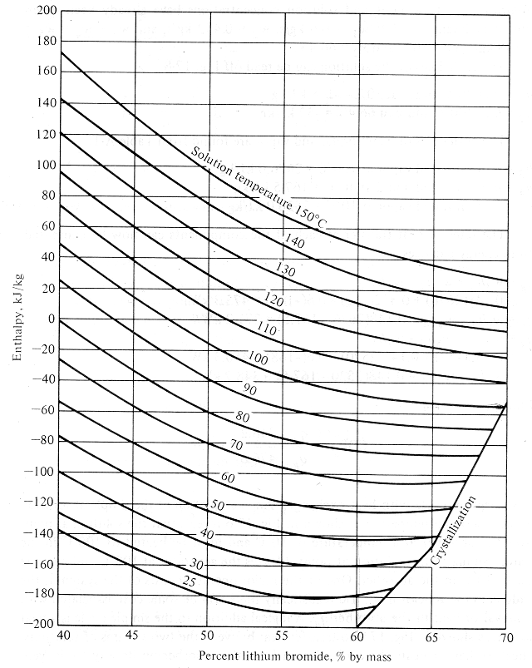
LiBr/H₂O h(i)-x diagram

Slide 25
Adiabatic mixing
i₂
②
i₃
①
③
i₁
x₁
x₃
x₂

Slide 26
Example of adiabatic mixing
150 psi
① P = 150 psi
T = 220F
x = 0.25
m = 20 lbm/min
Equilibrium
construction
line
g
Enthalpy
180F
150 psi
② P = 150 psi
T = 100F
Saturated solution
m = 10 lbm/min
1
3
f
2
0.25
0.41
0.72
③ point 3 is saturation condition. To calculate temperature, apply graphical method using equilibrium line.
Concentration

Slide 27
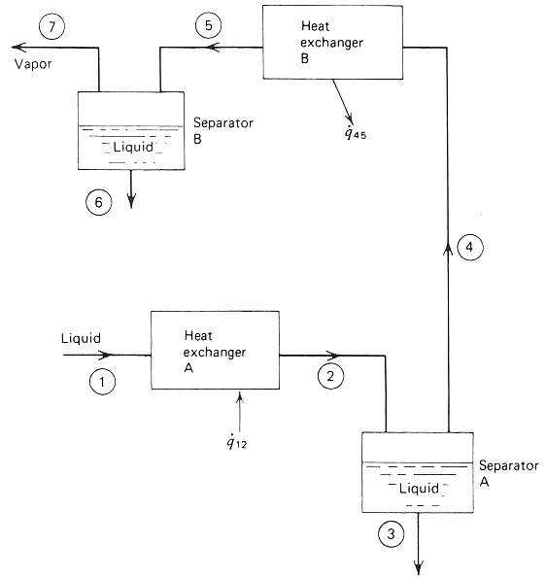
Heating and cooling process
To increase purity
in water-Ammonia system
4
7
Enthalpy
2
5
3
1
6
Concentration

Slide 28
Throttling process
P₂
g
①
②
Enthalpy
① : High pressure, saturated solution
P₁
1
t₁
② : low pressure, saturated condition
Temperature of final state can be calculated applying graphical method.
2
t₂
f
P₂
Concentration

Slide 29
Calculation of heat in absorption refrigerating cycle
Condenser
Generator
Refrig.
vapor
Strong
solution
Weak
solution
Exp.
Valve B
Exp.
Valve A
Pump
Evaporator
Absorber

Slide 30
COP is ideal system

Slide 31
Kind of systems

Slide 32
Absorption refrigerating system (1)
Water-Ammonia Absorption refrigerating system
1800’ - the oldest absorption refrigerating cycle started f fff from middle of 1800s
1960’ – after 1960, it utilized for residential air-conditioning a applications
Coolant – Ammonia, Absorption - water
Water and Ammonia are flammable both, and have similar boiling point
-> It need to separate H₂O from generator
Generator is composed with generator, rectification column and shunt.

Slide 33
Absorption refrigerating system (2)
Water-Ammonia Absorption refrigerating system for industry
Dephlegmtor
Condenser
Generator
Pump
Evaporator
Absorber
Fig. Water-Ammonia Absorption refrigerating system for industry

Slide 34
Absorption refrigerating system (3)
Double effect Water-Ammonia Absorption refrigerating system
Condenser
Rectifier 1
Rectifier 2
Gen 1
Gen 2
Precooler
Sol. HX1
Sol. HX2
Absorber 1
Absorber 2
Fig. 2단 이중효용 Water-Ammonia Absorption refrigerating system

Slide 35
Absorption refrigerating system (4)
LiBr-H₂O Absorption refrigerating system
40℃
80℃
7.38 kPa
Water vapor
p=7.38 kPa
Water vapor
p=7.38 kPa
10℃
30℃
1.23 kPa
Pure water
40℃
LiBr-H₂O
80℃,59%
50
59

Slide 36
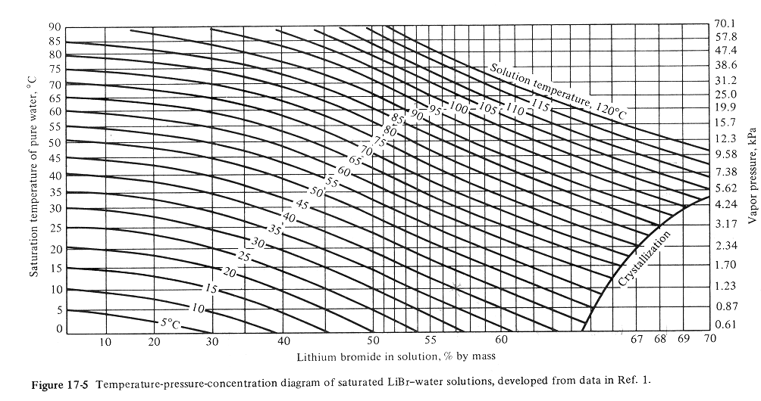
Absorption refrigerating system (4)
LiBr-H₂O Absorption refrigerating system

Slide 37
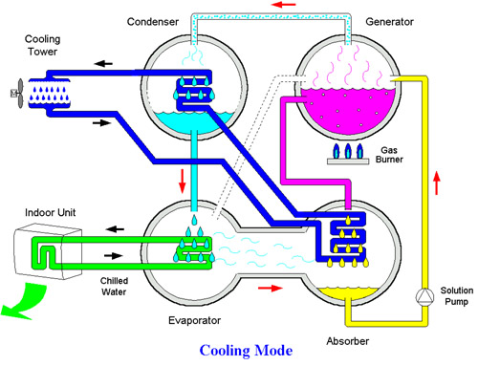
Absorption refrigerating system (4)
LiBr-H₂O Absorption refrigerating system
Fig. Example of LiBr-H₂O Absorption refrigerating system

Slide 38
Classification of systems

Slide 39
Classification of absorption type
Type | Absorption refrigerating system | Absorption chilling system | Absorption heat pump system
Function | Cold water (4~15℃) | Cold water (4~15℃) hot water (40~80℃) | hot water (50~104℃) Steam (140℃~)
Heat sources | Steam , hot water | Exhausted gas Combustion gas | Steam, combustion heat, wasted hot water
Application | cooling, cooling process | Cooling/heating

Slide 40
Characteristics of absorption type
 | Absorption chilling system | Absorption refrigerating system | Turbo refrigerating system
Driving source | Heat from gas combustion | Steam, hot water | Electricity
Components | Evaporator, absorber, condenser, regenerator, heat exchanger, combustion room, circulation pump | Evaporator, absorber, condenser, regenerator, heat exchanger, combustion room, circulation pump | Evaporator, condenser, compressor , oil cooler
operating pressure | Vacuum | Vacuum | Condenser : above atmospheric pressure Evaporator : varies according to coolant
heating method | Hot water | Boiler | Boiler or heat pump
vibration and noise | Low noise | Low noise | High noise

Slide 41
Absorption refrigerating system
Device acquiring cold water about 4~15℃
Cooling only
Generally, temperature at cold water outlet is 7℃, and difference between inlet and outlet is 5℃.
Driving method | Condition of standard heat source |  | Main purpose
 | Single effect | Double effect
Steam type | 1.0 ~ 1.5 kg/cm² steam |  | Hospital, factory
Hot water type | 140℃ hot water | 200℃ hot water | District cooling
Warm water type | 80℃ warm water |  | Solar heat cooling, Cooling through wasted heat

Slide 42
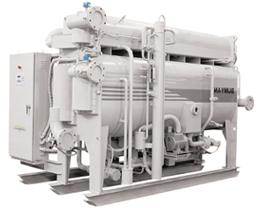
BCD100S ~ BCD1650S...(100R/T ~ 1650R/T)

Slide 43
Absorption chilling system
Driving force is heat energy from combustion of LPG and gas
Heat source equipment producing hot and cold water simultaneously.
Mainly flame and absorption type chillers
Condition for cold water : 12 ~7℃
Condition for warm water : 50 ~ 60℃

Slide 44
Absorption chilling system
Classification of Absorption chilling system by capacity
Size | Small | Medium | Large
Refrigerating capacity | ~ 40RT | 40~100RT | 100RT ~
Combustion heat | ~150,000 kcal/h | 150,000~300,000 kcal/h | 300,000 kcal/h~
Figure | Outdoor with case | Outdoor, indoor | Indoor
Combustion control | On/off or 3-way | 3-way or proportion | proportion
Bleeding device | Non-condensable gas Tank + Paratium | Vacuum pump method | Non-condensable gas Tank Vacuum pump method
Coolant circulation method | Natural circulation Air lift pump | Coolant pump | Coolant pump
Electric facilities | Cooling tower, water pump, coolant, electric facility | electric facility

Slide 45
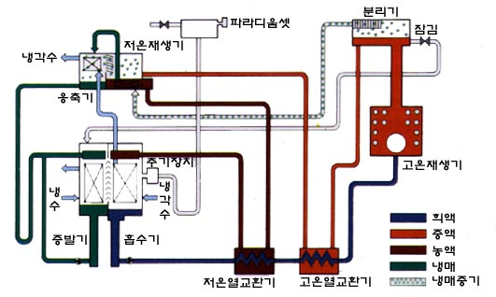
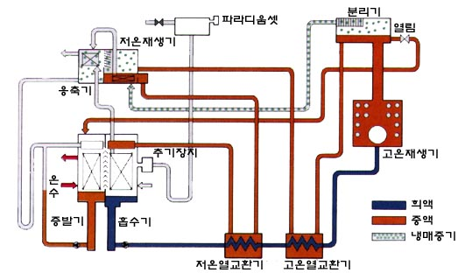
Absorption refrigerating system
Heating and cooling
Cooling cycle
Heating cycle

Slide 46
Problems (1)
Problems
What is the COP of an ideal heat-operated refrigeration system that has a source temperature of heat of 100℃, a refrigerating temperature of 5℃, and an ambient temperature of 30℃?

Slide 47
Problems (2)
Compute the flow rate of refrigerant (water) through the condenser and evaporator in the cycle shown in below figure if the pump delivers 0.6 kg/s and the following temperature prevail: generator, 100℃; condenser, 40℃; evaporator, 10℃; and absorber, 30℃
③
Condenser
water
vapor
Generator
40℃
100℃
②
LiBr-water
solution
④
⑤
①
Evaporator
Absorber
0.6 kg/s
10℃
30℃

Slide 48
Problems (2)
High pressure –
generator, condenser
Low pressure –
absorber, evaporator
40℃
100℃
7.38 kPa
10℃
30℃
1.23 kPa
50
66.4

Slide 49
Problems (2)
Compute heat inputs, outputs and the COP
w₁ = 0.6 kg/s, w₂ = 0.452 kg/s, w₃ = w₄ = w₅ = 0.148 kg/s
x₁ = 50%, x₂ = 66.4 %
h₁ ( h at 30℃ & x = 0.5 )= -168 kJ/kg
h₂ ( h at 100℃ & x = 0.664 )= -52 kJ/kg
-160
h₃ ( h of saturated vapor at 100℃ )= 2676 kJ/kg
25℃
30℃
-180
h₄ ( h of saturated liquid at 40℃ )= 167.5 kJ/kg
h₅ ( h of saturated vapor at 10℃ )= 2520 kJ/kg
45%
50%
55%

Slide 50
Problems (3)
Absorption cycle with heat exchanger
⑤
Condenser
Generator
40℃
water
vapor
100℃
②
52℃
③
⑥
④
LiBr-water
solution
⑦
Evaporator
Absorber
①
10℃
30℃
w₁ = 0.6 kg/s

Slide 51
Problems (3)
w₁ = w₂ =0.6 kg/s, w₃ = w₄ = 0.452 kg/s, w₅ = w₆ = w₇ = 0.148 kg/s
x₁ = 50%, x₂ = 66.4 %
h₁ = -168 kJ/kg
h₃ = -52 kJ/kg
h₅ = 2676 kJ/kg
h₆ = 167.5 kJ/kg
h₇ = 2520 kJ/kg
h₂ = h at 52℃ & x 0.5 = -120 kJ/kg
q_{hx} = w₁(h₂-h₁)=28.8 kW
h₄ = -116 kJ/kg

Slide 52
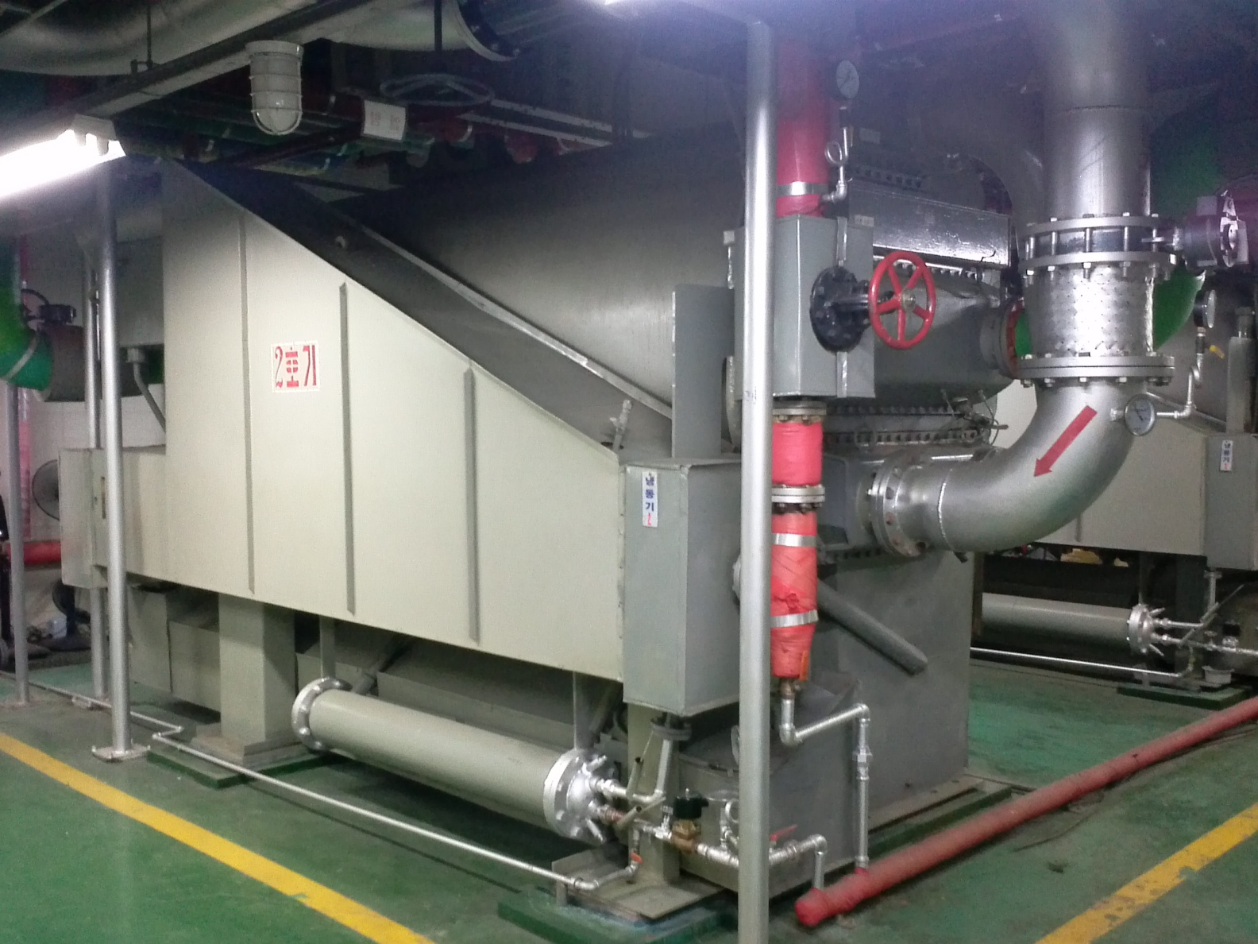
Absorption refrigerating system in # 301
Left-side

Slide 53
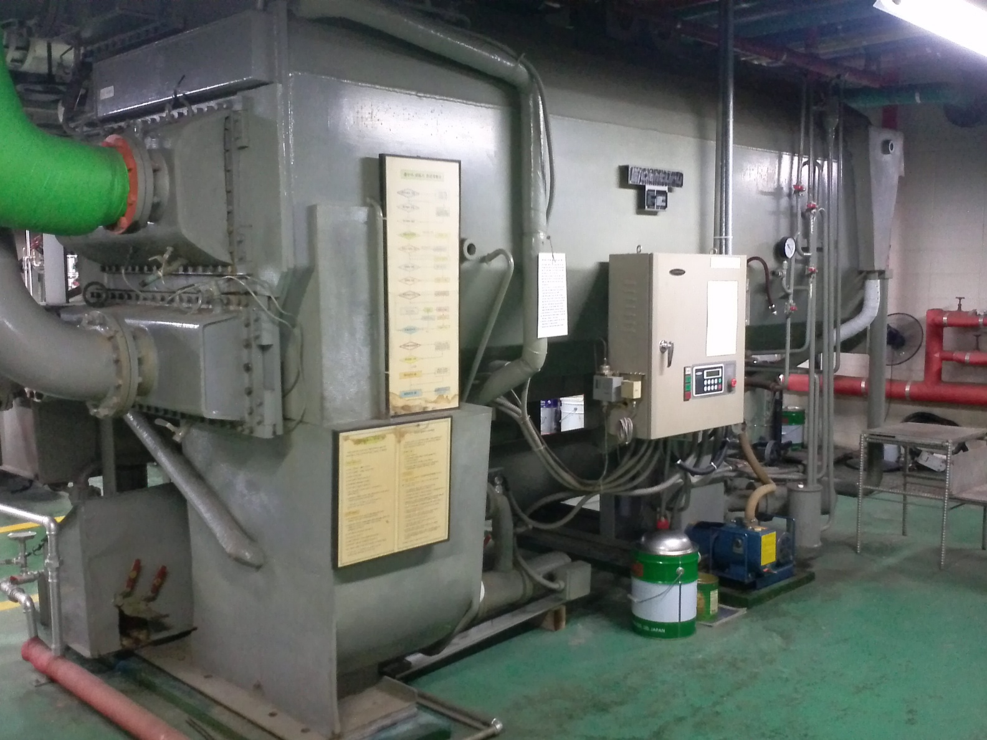
Absorption refrigerating system in # 301
Right-side

Slide 54
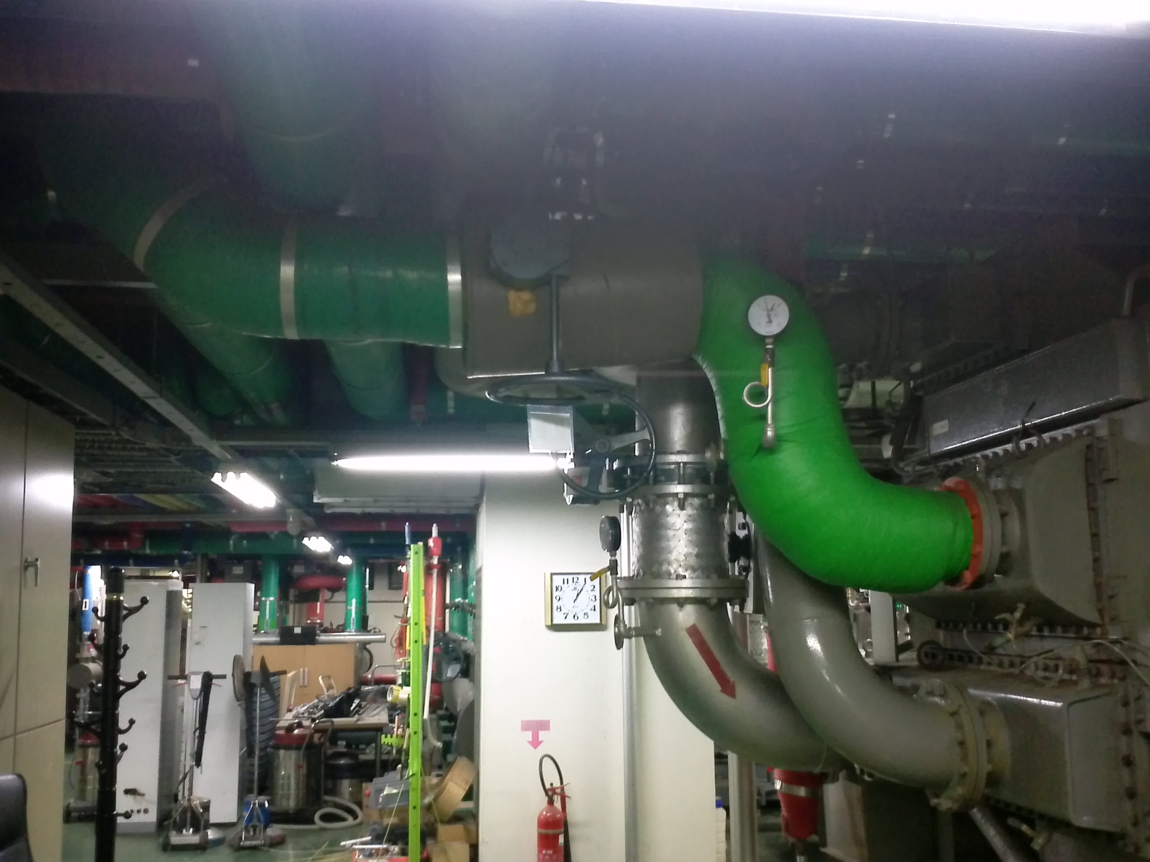
Absorption refrigerating system in # 301
Upper-front

Slide 55
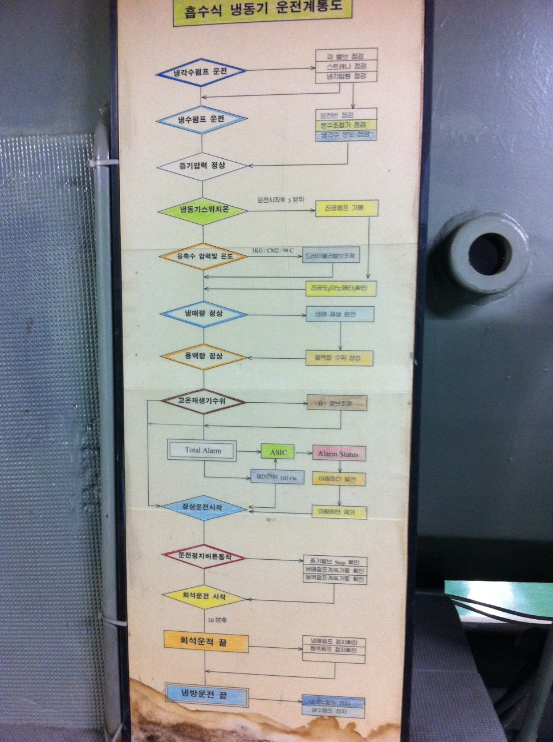
Absorption refrigerating system in # 301
Schematic diagram for driving Absorption refrigerating system

