Slide 1
Environmental Thermal Engineering
Lecture # 10
Min soo Kim
Mechanical & Aerospace Engineering

Slide 2
Heat Pipe

Slide 3
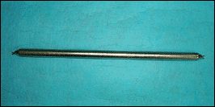
Necessity of heat pipe
Miniaturization, high-powered, high-accumulated products are increased. ⇒ Technology that removing heat generated by products efficiently is needed.
Using energy efficiently and preventing environmental pollution is needed.
To guarantee operation of high-heating product, temperature control is needed.
Fig. Pipe structure
Fig. Plate structure

Slide 4
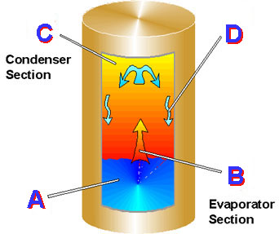
Structure of heat pipe
Airtight container(evaporator, adiabatic & condenser section) + Operating fluid + Wick
A traditional heat pipe is a hollow cylinder
filled with a vaporizable liquid.
A. Heat is absorbed in the evaporating section.
B. Fluid boils to vapor phase.
C. Heat is released from the upper part of
cylinder to the environment; vapor condenses
to liquid phase.
D. Liquid returns by gravity to the lower part
of cylinder (evaporating section).
Fig. Heat Pipe Structure

Slide 5
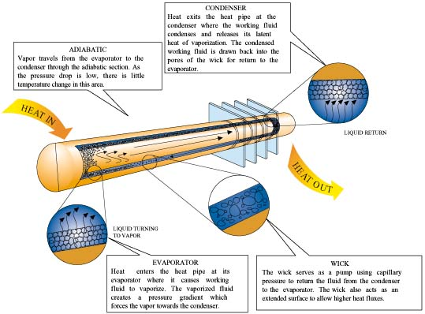
Principle of heat pipe
Heat transfer by the evaporation and condensation of a working fluid.
① The fluid vaporized at the evaporator
creates a pressure gradient in the pipe.
② This pressure gradient forces the vapor
to the cooler section where it condenses.
③ The working fluid is returned to the
evaporator by capillary forces developed
in the porous wick structure or by gravity.
Fig. The Operating Principle of Heat Pipe

Slide 6
Characteristics of heat pipe
(ⅰ) Very high effective thermal conductance (Using the latent heat)
(ⅱ) An isothermal surface of low thermal impedance (Saturation state)
(ⅲ) Simple structure & light weight
(ⅳ) Little expense for maintenance and repairing (No driving part)
(ⅴ) Thermal diodes and switches (Heat flow in one direction only)
(ⅵ) Variable conductance heat pipe

Slide 7
The working fluid of heat pipe
Table. Operating medium and temperature
Medium | Melting point (℃) | Boiling point at 1 atm (℃) | Useful range (℃)
Ammonia | -78 | -33 | -60~100
Freon 11 | -111 | 24 | -40~120
Freon 113 | -35 | 48 | -10~100
Acetone | -95 | 57 | 0~120
Methanol | -98 | 64 | 10~130
Flutec pp² | -50 | 76 | 10~160
Ethanol | -112 | 78 | 0~130
Water | 0 | 100 | 30~200
Flutec pp⁹ | -70 | 160 | 0~225
Thermex | 12 | 257 | 150~395

Slide 8
Design of heat pipe
Design process
(ⅰ) Problem setting
(ⅱ) Select material (working fluid, wall)
(ⅲ) Select wig structure
(ⅳ) Apply design theory
(ⅴ) Choose and evaluate the optimal solution
(ⅰ) Problem setting
＊Decide heat load and operating temperature beyond design parameters
＊Decide size, location and form of heat source and needle
＊Decide boundary condition
＊Decide whether gravity or non-gravity condition

Slide 9
Designing heat pipe
(ⅱ) Select material
① The working fluid
＊Relevant to container’s material (Chemical reaction, Strength)
＊Consider melting point, boiling point and critical point (Working temperature is between melting point and critical point)
＊Generally, bigger density, surface tension and latent heat of vaporization and
smaller liquid’s viscosity is better.
② Select wall material
＊Consider weight, tensile strength and thermal conductivity
＊Attention to compatibility with fluid (Corrosion by chemical reaction, non-condensing gas generation is fatal to heat pipe’s performance

Slide 10
Designing heat pipe
(ⅲ) Select wig structure
＊Choose the form between screen and groove
＊Choose the simplest structure if it meet all of the required characteristics
＊Consider the wig’s property such as pore radius, porosity, permeability
(ⅳ) Apply design theory
＊vapor fluid’s maximum Mach number is 0.2. (Under this condition, vapor is assumed to incompressible and axial temperature gradient is disregarded.)

Slide 11
Application of heat pipe
(ⅰ) Means of thermal control of electronic/electric device
(ⅱ) Aerospace area (Thermal control of spacecraft)
(ⅲ) Collecting waste heat system
(ⅳ) Air-conditioning and cooling system
(ⅴ) Soil stabilization

Slide 12
Means of thermal control of electronic/electric device
Introduction
In modern society, the bigger and faster electronics appears. Increasing density of heat-generated device makes cooling problem. As a result, Heat pipes receive attention because of its efficient cooling.
Specially, recent issue is increasing demand of the Notebook PC’s built-in battery’s cooling for life extension and noise reduction. So heat-sink using heat pipe is favored now.

Slide 13
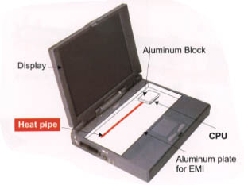
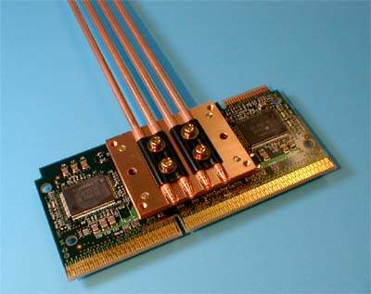
Application in Notebook PC

Slide 14
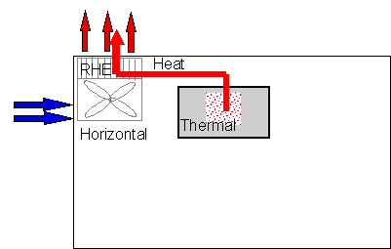
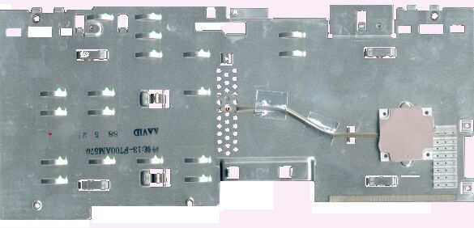
Heat-sink using heat pipe
Heat-sink moves heat generated by semiconductor by heat pipe from heat-sensitive circuit board and device. Heat is moved to heat pipe’s condensation unit which is attaching the fan. Heat is removed by natural or forced convection.
Fig. Remote Heat Exchange
Fig. Sample of heat-sink

Slide 15
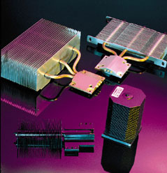
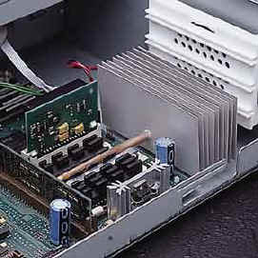
Workstation/Server Cooling
[THERMACORE, USA]
Desktop PC CPU Cooling(Heat Pipe Sink)
[THERMACORE, USA]

Slide 16
Thermal control of spacecraft
1) Introduction
Space Flight’s major problem at the beginning
(A Temperature difference of non-rotating satellite due to sun light on a single side can occur critical problem on satellite electric system.)
『Solution: Heat Pipe』
In the late1960s, heat pipes were began to use in USA and Europe.
In the early 1970s, NASA and EPA began to build up data about designing, manufacturing, and testing Heat Pipes.

Slide 17
Thermal control of spacecraft
2) Requirements of thermal controller for satellite
Should be able to produce proper temperature condition for optimum performance of various equipments of satellite.
Proper method to protect them from thermal transformations should be used.
In case of satellite, thermal controller should operate in zero gravity condition and should be small and light. Also its durability and reliability is important.
Internal modules and components should be able to be manufactured concentrated.

Slide 18
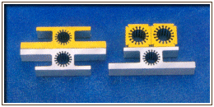
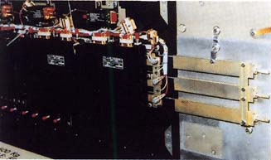
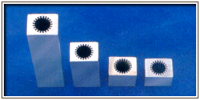
Heat pipes used in satellite
※ Constant Conductance Heat-Pipes (CCHP) fixed on a panel support structure of satellite

Slide 19
Waste heat recovery system
Heat pipe can be used efficiently in heat recovery for following reasons;
Small end-to-end temperature drops
The ability to control and transport high heat rates
at various temperature levels
Heat pipe for waste heat recovery

Slide 20
Heat exchanger vs. Heat pipe
(ⅰ) Using heat exchanger
＊Large surface area due to low heat transfer coefficient
of exhaust gas
＊Duct-connection is required between exhaust gas outlet and waste heat recover
⇒ Device enlargement
(ⅱ) Using separable heat pipe
＊Connect high temperature evaporator and low temperature condenser with adiabatic pipe.
⇒ Duct cost saved.
＊30∼50% of waste heat could be recovered.
＊5∼10% of fuel saving.
＊1∼3 years to recover investment cost.

Slide 21
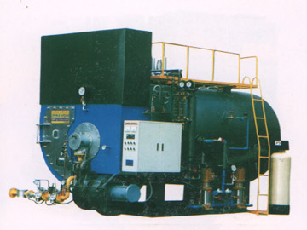
Heat Recovery in Boiler
A boiler with heat pipe
Heat pipe used for air-preheater in boiler
※ Heat pipe can also be used for eliminating the pollutants in burnt gas

Slide 22
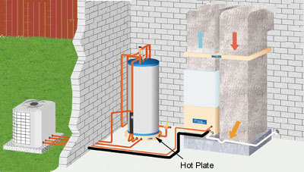
Heat Recovery in House & Building
Capturing the waste heat created by air conditioners or heat pumps
Heating tap water, up to 55~70 deg. C

Slide 23
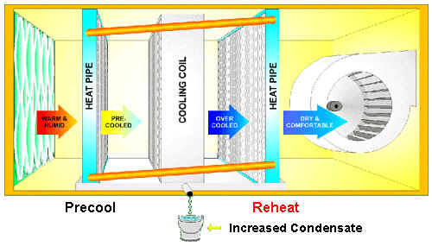
Air-conditioning and cooling system
Heat pipe/cooling system concept, configuration and model parameter
Heat Pipe/Cooling Coil System

Slide 24
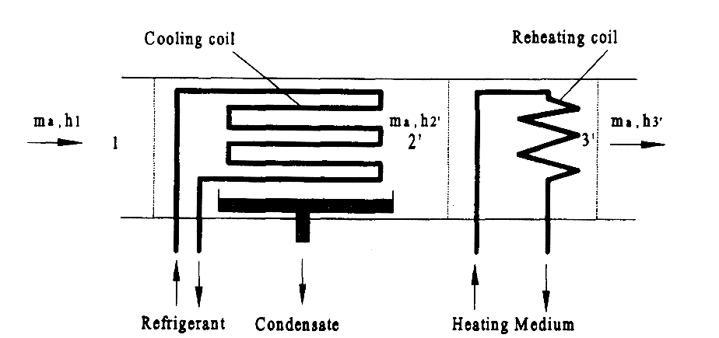
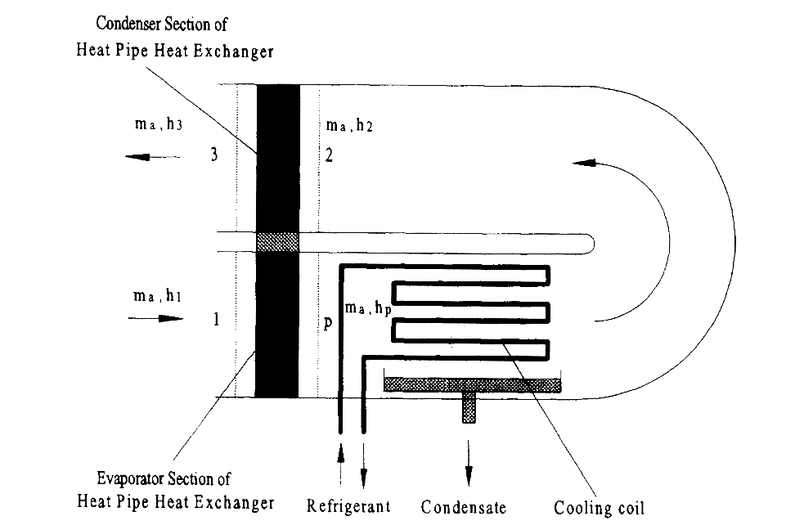
Schematic of an air-conditioner with conventional reheating coil
Schematic of an air-conditioner with heat pipe heat exchangers

Slide 25
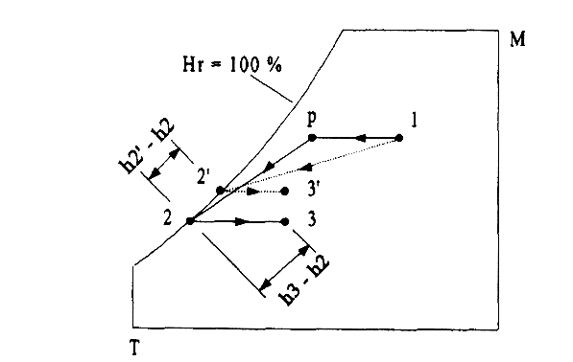
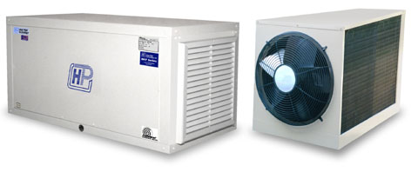
Fig. Psychrometric chart representing the air-conditioning process
Enhanced cooling capability
Humidity control
Low energy consumption
Increased pressure losses, manufacturing cost and overall size of the air-conditioning unit

Slide 26
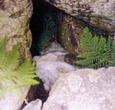
Break time – Ice valley
Altitude 600-700m, Area 2,700 m3
Abnormal climate area where ice forms in midsummer and melts after summer.
Why abnormal phenomenon happens in ice valley?

Slide 27
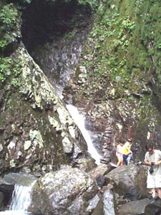
1999. 8. 17. PM. 3
Temperature of Seoul is 32ºC, and highest and lowest temperature of Miryang are 30.2ºC, and 15.3ºC respectively.
3~4cm ice was formed in two rock cracks which are relatively wide.
Did someone bring the ice to valley?
Or the ice formed naturally in midsummer?
The hotter whether is, the more ices formed
and vise versa in ice valley.

Slide 28
Results of observation study done by Prof. ChangHee Jung (SNU)
Temperature of the cracks where the ices formed are remains 2~3ºC during summer.
The temperature begin to sharply increases at mid September and become equal to
external temperature at mid October.
Dry and warm air at outdoor makes lower crack temperature.
Temperature at cradk increases after rain.
The cause is adiabatic cooling due to geological features of the ground.

Slide 29
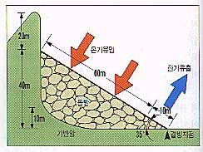
Adiabatic cooling
When saturated air at low temperature mixed with high temperature dry air, a sudden expansion is occurred. The expansion process absorbs heat from surroundings and it causes temperature drop.
Hot air flowed through cracks are cooled in the rocks and move to down side.
When cooled and saturated air exposed to atmosphere, the cooled air suddenly expand and take heat from rocks.

Slide 30
Only adiabatic cooling?
Only the low temperature of rocks is not enough to explain the ice formation and long lasting cold air supply.
For instance, even if there is -10℃ of rocks 30 meters thick, the rocks would be warmed to 3 ℃ in a single day in midsummer if there is no additional cooling factors.
Refrigerant with high specific heat inside the valley?
Might snow or ices formed during winter affect?

Slide 31
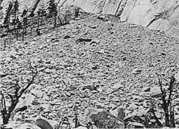
Similarity of Ice Valleys
1.Talus deposit
A collection of rock fragments at the mountain cliffs.
2. Volcanic rock
All the rocks of talus deposit are volcanic rocks which is high effective thermal insulation.
Talus deposit

Slide 32
Thermo-acoustic Refrigeration
Thermo-acoustic Refrigeration
Acoustic Waves
Transverse Pressure Waves
Moving areas of High and Low Pressure
Ideal Gas Law tells us:
Adiabatic Compression at constant volume causes an increase in the temperature of an ideal gas.

Slide 33
Thermo acoustic Refrigeration
Cold Heat Exchanger
Hot Heat
Exchanger
Loud Speaker
Stack
W
L
RESONATOR
Q₊
L = Wavelength / 4
T_{Target}
THERMOACOUSTIC
REFRIGERATOR
F:Co&H
B:Ex&C

Slide 34
Thermo acoustic Refrigeration
Thermo acoustic Theory
Gas is adiabatically compressed and translated
Gas heats up to a temperature greater than the local temperature of the stack.
STACK
GAS
PARCEL

Slide 35
Thermo acoustic Refrigeration
Thermo acoustic Theory
Gas transfers heat to the stack
Gas cools down and its volume slightly decreases
STACK
GAS
PARCEL

Slide 36
Thermo acoustic Refrigeration
Thermo acoustic Theory
Gas moves back to original location returning energy.
Gas undergoes adiabatic expansion cooling down below local stack temperature.
STACK
GAS
PARCEL

Slide 37
Thermo acoustic Refrigeration
Thermo acoustic Theory
Heat is transferred from the stack to the gas.
Gas heats up and its volume increases
STACK
GAS
PARCEL

Slide 38
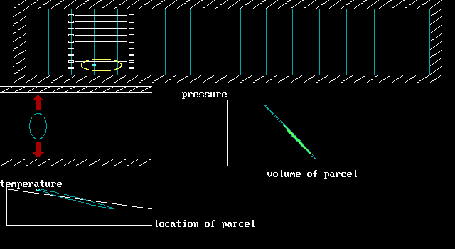
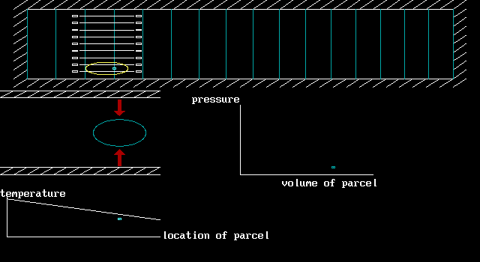
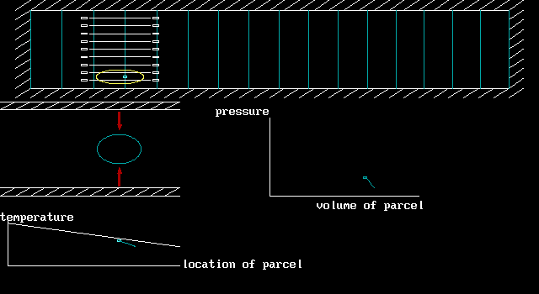
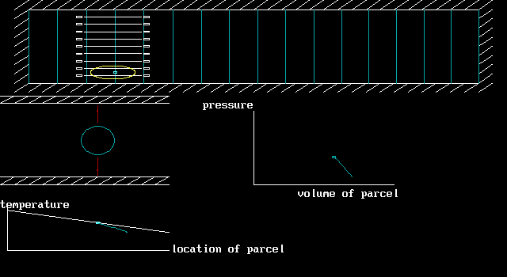
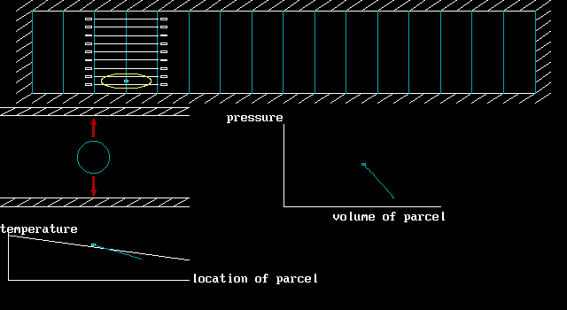
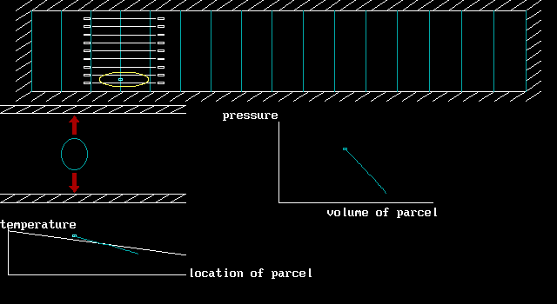
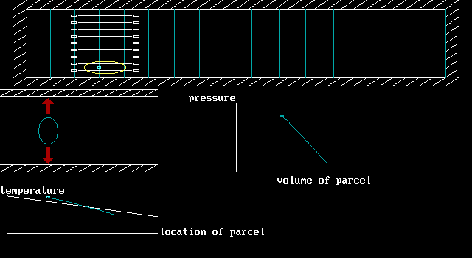
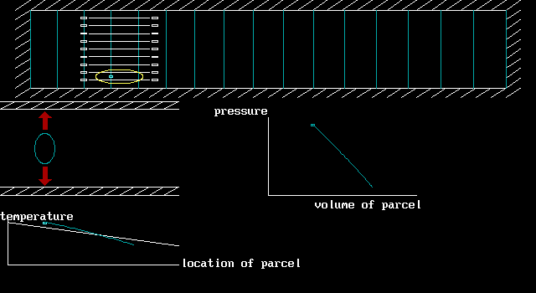
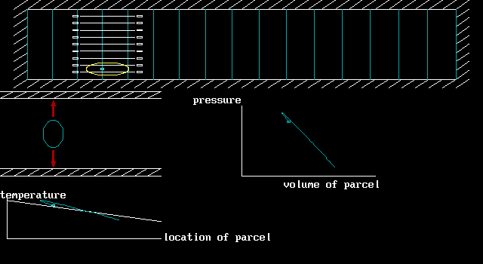
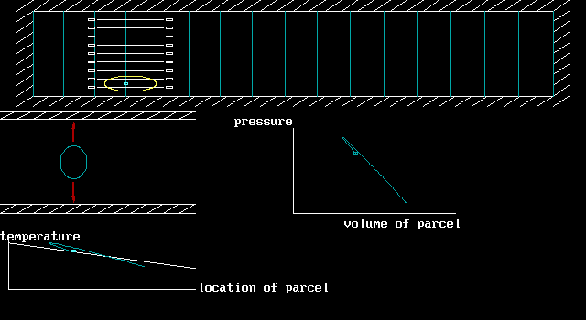
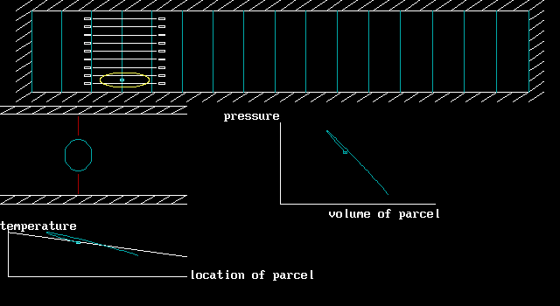
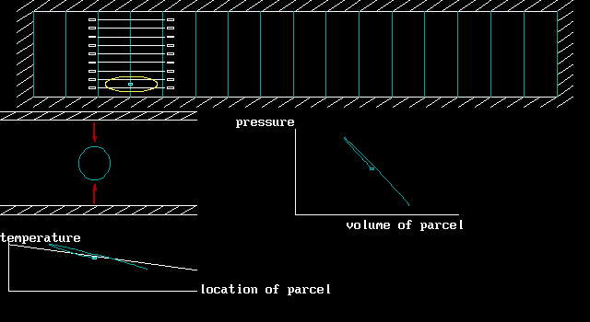
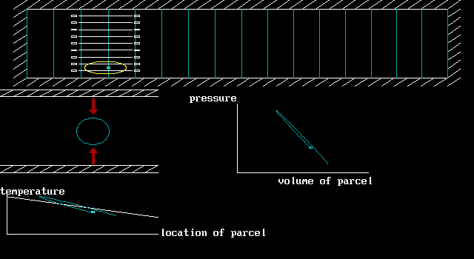
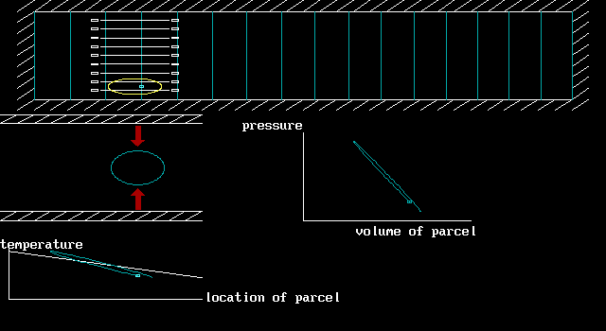
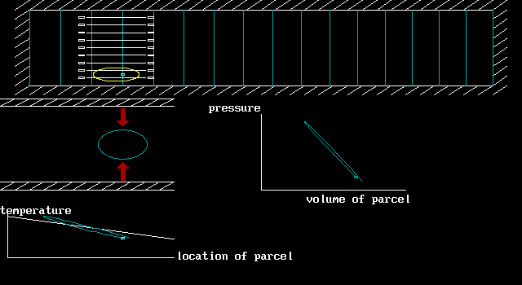
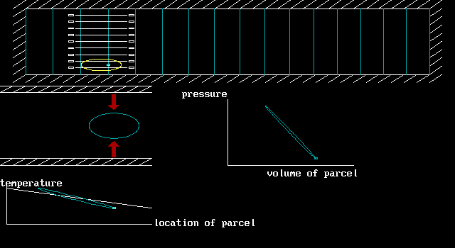
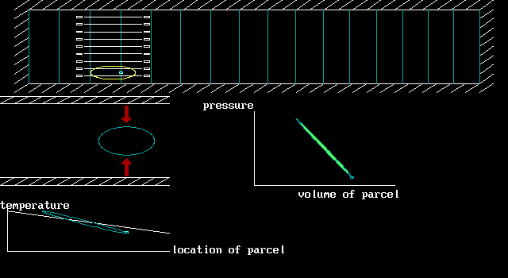
Thermo acoustic Refrigeration
Thermo acoustic Theory

Slide 39
Thermo acoustic Refrigeration
Thermo acoustic Efficiency
Due to technical immaturity
Heat exchangers
Sub-systems
Thermo acoustic refrigerators are well suited to proportional control
EFFICIENCY
Vapor
Thermo-
acoustic
Currently
20-30% Less

