Slide 1
Environmental Thermal Engineering
Lecture # 11
Min soo Kim
Mechanical & Aerospace Engineering

Slide 2
Contents
1. Introduction
2. Equipments of Air Conditioning Systems
3. HVAC Systems
4. HVAC Applications

Slide 3
Introduction

Slide 4
What is air-conditioning?
The process of treating air to control simultaneously
its temperature, humidity, cleanliness and distribution
to meet the comfort requirements of the occupants
of the conditioned space
(“ASHRAE Handbook, Fundamentals, ” American Society of Heating, Refrigerating and Air-Conditioning Engineers)

Slide 5
Air-conditioning
Relationship of the refrigeration and air-conditioning fields
Air Conditioning
Refrigeration
Heating,
Humidifying
and Control
of Air Quality
Industrial
Refrigeration,
Including food
Preservation,
Chemical, and
process industries
Cooling and
Dehumidifying Operations in Air-Conditioning

Slide 6


HVAC & R
Heating
Ventilating
Air Conditioning
Refrigeration

Slide 7
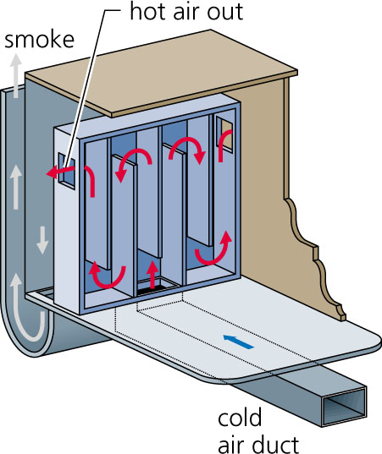
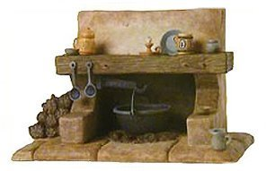
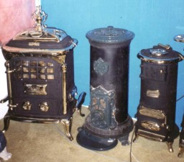
Heating
Traditional Heating Systems
Hearth, Franklin Stove, etc…
Franklin Stove : Burning wood above a cold air duct heats air which then passes through baffles and is released through vents on each side of the stove
Ondol (Korean) : floor radiant heating system

Slide 8
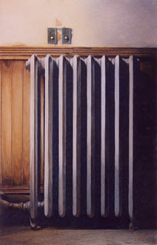
Heating
Heating is the transfer of energy from a source to a space
by following processes;
- direct radiation
- free convection
Rate of sensible heating of air;

Slide 9
Ventilation
Common contaminants
Gases : carbon dioxide(CO₂), carbon monoxide(CO), SO₂, NO₂
Volatile Organic Compounds (VOCs)
Particulate Matter : soot, smoke, clay and bacteria, etc…
Basic Methods to maintain good IAQ(indoor air quality)
Source elimination or modification
Use of outdoor air
Space air distribution
Air cleaning

Slide 10
Ventilation
A typical ventilation system
Exhaust
(relief air)
Return air
Conditioned Space
Recirculated air
Fan
Make-up
outdoor air
Filter
Heating
Coil
Cooling
Coil
Supply air

Slide 11
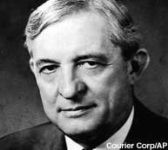
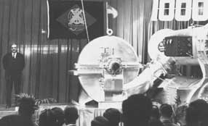
Air Conditioning
W.H. Carrier
Established Psychrometric Formulae (1911)
Centrifugal Chiller (1921)
-first practical method of air conditioning for large spaces
Willis H. Carrier (1876~1950)
「TIME」 “King of Cool”
100 builders & titans of 20th century
Carrier’s Centrifugal Chiller (1921)

Slide 12
Equipments of Air Conditioning System

Slide 13
Primary Equipments of HVAC
Air-Handling Equipment
Heating Equipment
Refrigeration Equipment
Other Energy Saving Equipments
- Thermal storage
- Energy recovery
- Solar energy
- Geothermal

Slide 14
Air Handling Equipment
Duct Construction
Air-Diffusing Equipment
Fans
Evaporative Air Cooling Equipment
Humidifiers
Air-Cooling and Dehumidifying Coils
Desiccant Dehumidification

Slide 15
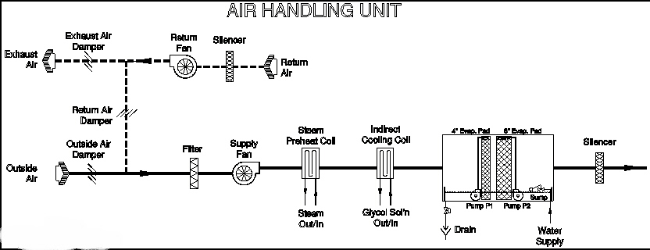
Air Handling Equipment

Slide 16
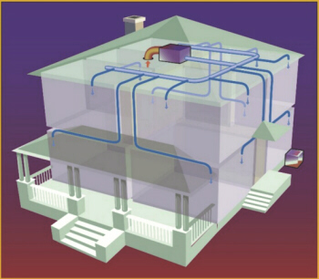
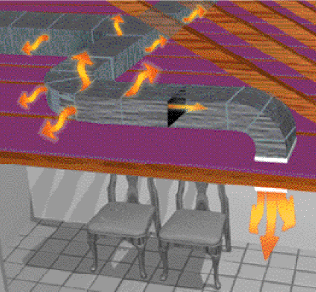
Duct Construction
Duct system delivers a specific amount of air to each diffuser in the conditioned space at a specified total pressure.
Duct construction is classified by application and pressure ;
Residences ±125 Pa, ±250 Pa
Commercial Systems ±125 Pa ~ ±2500 Pa
Industrial Systems Any pressure

Slide 17
Duct Construction
Pressure Drop in Duct
Δp: Pressure drop [Pa]
f: friction factor
L: Length [m]
D: Inner diameter of duct [m]
D_{eq}: Equivalent diameter [m]
V: velocity [m/s]
ρ: density [kg/m³]

Slide 18
Duct Construction
Pressure Drop in Fittings
Sudden Enlargement
1
2
Sudden Contraction
1
1’
2

Slide 19
Duct Construction
Pressure Drop in Fittings
Turns (90°)
Ratio = radius of curvature/diameter | Geometry factor
Mitered | 1.30
0.5 | 0.90
0.73 | 0.45
1.0 | 0.33
1.5 | 0.24
2.0 | 0.19

Slide 20
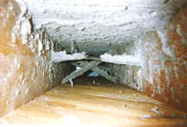
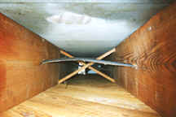
Duct Construction-cleaning
Ducts should be designed, constructed, and maintained to minimize the opportunity for growth and dissemination of microorganisms.
Cleaning…

Slide 21
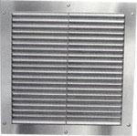
Air Diffusing Equipment
Requirements of air distribution;
The flow rate must compensate for the net heat loss or gain in the space
The velocity must not be higher than 0.25 m/s in the occupied regions of the room
There should be some motion of air to breakup temperature gradients in the room (warm air at the ceiling and cold air at the floors)

Slide 22
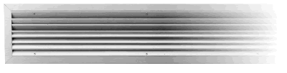
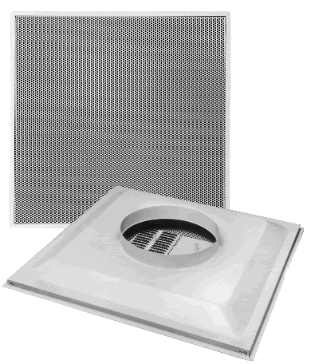
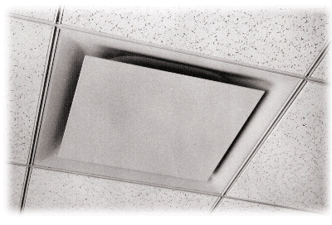

Air Diffusing Equipment
Types of Supply Air Outlets
Grille and Register Outlets
Linear Slot Outlets
Ceiling Diffuser Outlets
Linear Louver diffuser
Linear Slot diffuser
Ceiling Diffuser Outlets
Perforated diffuser

Slide 23
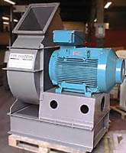
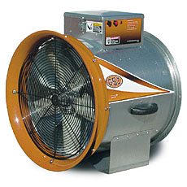
Fans
Fan is an air pump that creates a pressure difference and causes airflow.
Types of Fans
Centrifugal Fan
Axial Fan

Slide 24
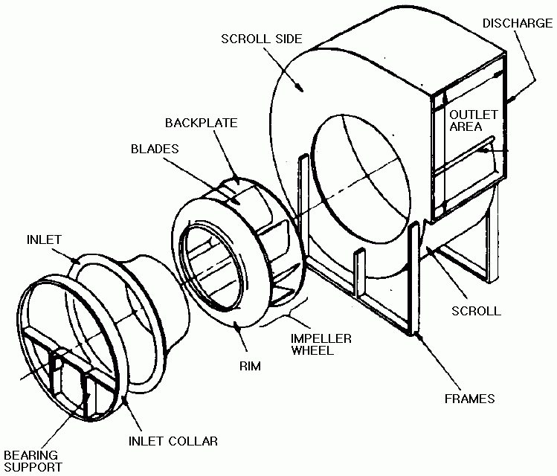
Centrifugal fans
Centrifugal Fans
Air enters the fan
- Turns and moves into the blades
- Enters the scroll
Produce pressure from;
- Centrifugal force created
by rotating the air
- Kinetic energy imparted
to the air

Slide 25
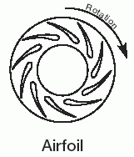
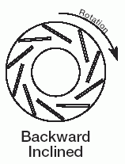
Centrifugal fans
Centrifugal Fans
Type | Figure | Characteristics
Airfoil |  | Highest efficiency of all centrifugal fan designs. 10~16 blades of airfoil contour curved away from direction of rotation. Deep blades allow for efficient expansion within blade passages. Air leaves impeller at velocity less than tip speed. For given duty, has highest speed of centrifugal fan designs
Backward-inclined Backward-curved |  | Efficiency only slightly less than airfoil fan. 10~16 single-thickness blades curved or inclined away from direction of rotation. Efficient for same reasons as airfoil fan.

Slide 26
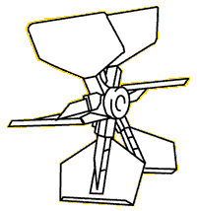
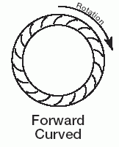
Centrifugal fans
Type | Figure | Characteristics
Radial |  | Higher pressure characteristics than airfoil, backward-curved (inclined) fans. Curve may have a break to left or peak pressure and fan should not be operated in this area. Power rises continually to free delivery.
Forward-curved |  | Flatter pressure curve and lower efficiency than the airfoil, backward-curved (inclined) fans. Do not rate fan in the pressure curve dip to the left of peak pressure. Power rises continually toward free delivery. Motor selection must take this into account

Slide 27
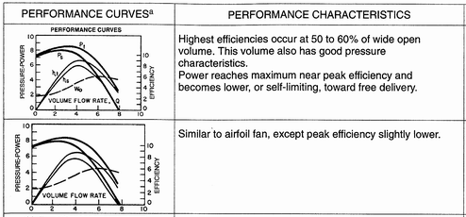
Centrifugal fans
Centrifugal Fans – Performance Curves
Type | Performance curves | Performance characteristics
Airfoil |  | Highest efficiencies occur at 50 to 60% of wide open volume. This volume also has good pressure characteristics. Power reaches maximum near peak efficiency and becomes lower, or self-limiting, toward free delivery.
Backward-inclined Backward-curved |  | Similar to air foil fan, except peak efficiency slightly lower.

Slide 28
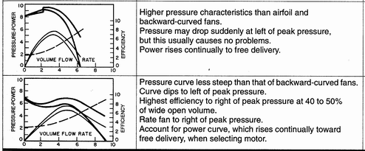
Centrifugal fans
Centrifugal Fans – Performance Curves
Type | Performance curves | Performance characteristics
Radial |  | Higher pressure characteristics than airfoil and backward-curved fans. Pressure may drop suddenly at left of peak pressure, but this usually causes no problems. Power rises continually to free delivery.
Forward-curved |  | Pressure curve less steep than that of backward-curved fans. Curve dips to left of peak pressure. Highest efficiency to right of peak pressure at 40 to 50% of wide open volume. Rate fan to right of peak pressure. Account for power curve, which rises continually toward free delivery, when selecting motor.

Slide 29
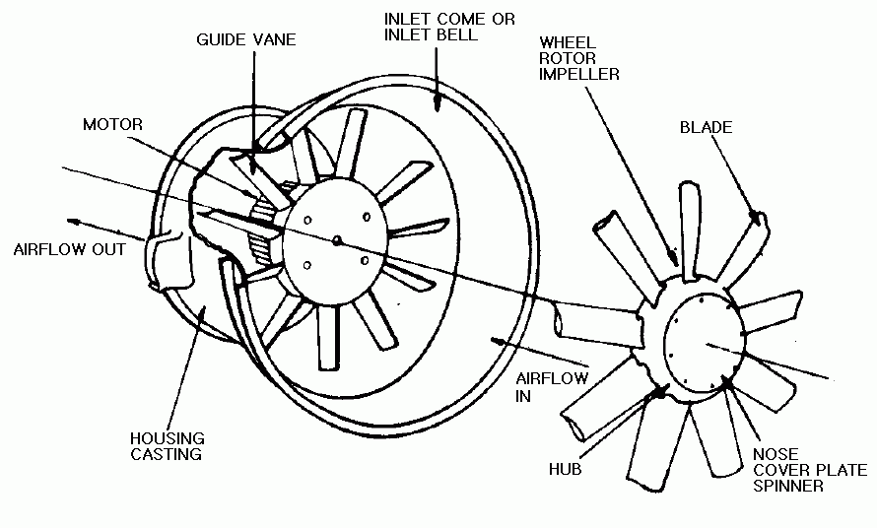
Axial Fans
Produce pressure from the change in velocity passing through the impeller

Slide 30
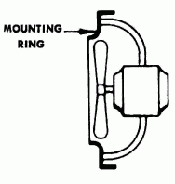
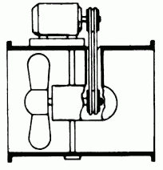
Axial Fans
Axial Fans
Type | Figure | Characteristics
Propeller |  | Low efficiency. Limited to low-pressure applications. Usually low cost impellers have two or more blades of single thickness attached to relatively small hub. Primary energy transfer by velocity pressure.
Tubeaxial |  | Somewhat more efficient and capable of developing more useful static pressure than propeller fan. Usually has 4~8 blades with airfoil or single-thickness cross section. Hub is usually less than half the fan tip diameter.

Slide 31
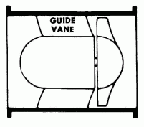
Axial Fans
Vaneaxial |  | Good blade design gives medium-to high- pressure capability at good efficiency. Most efficient of these fans have airfoil blades. Blades may have fixed, adjustable, or controllable pitch. Hub is usually greater than half fan tip diameter.

Slide 32
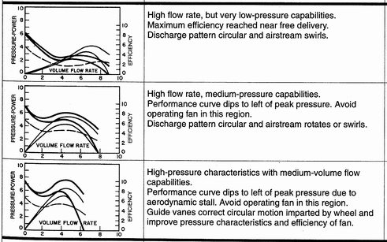
Axial Fans
Axial Fans – Performance Curves
Type | Performance curves | Performance characteristics
Propeller |  | High flow rate, but very low-pressure capabilities. Maximum efficiency reached near free delivery. Discharge pattern circular and airstream swirls.
Tubeaxial |  | High flow rate, medium-pressure capabilities. Performance curve dips to left of peak pressure. Avoid operating fan in this region. Discharge pattern circular and airstream rotates or swirls.
Vaneaxial |  | High-pressure characteristics with medium-volume flow capabilities. Performance curve dips to left of peak pressure due to aerodynamic stall. Avoid operating fan in this region. Guide vanes correct circular motion imparted by wheel and improve pressure characteristics and efficiency of fan.

Slide 33
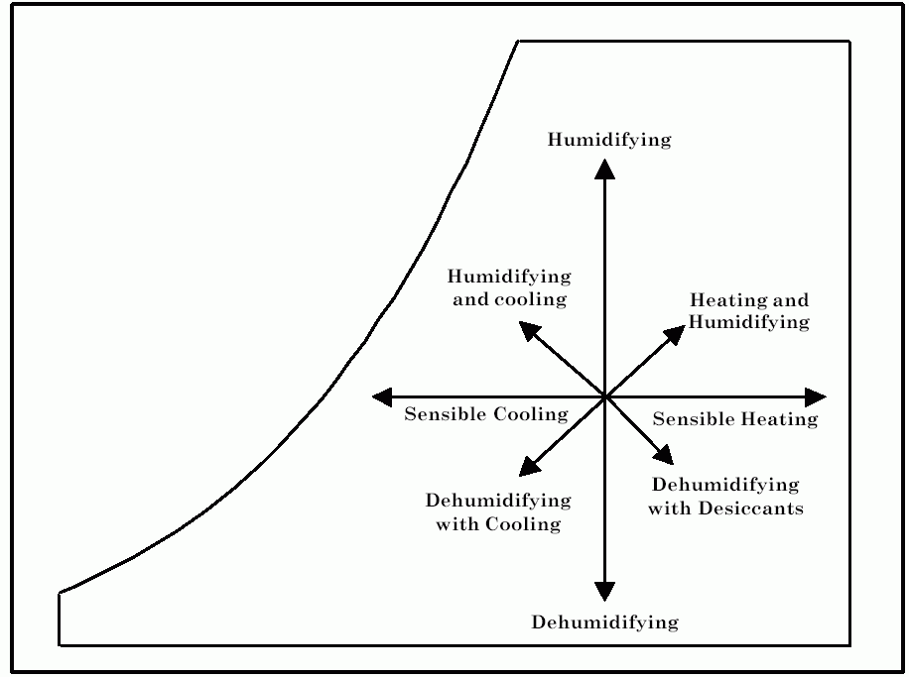
Psychrometric Chart
Cooling, Humidification and Dehumidification

Slide 34
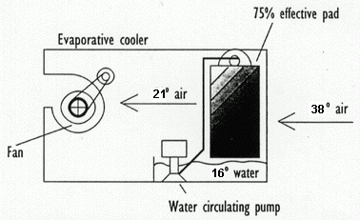
Evaporative Air Cooling Equipment
An evaporative cooler produces effective cooling by combining a natural process - water evaporation - with a simple, reliable air-moving system.
Fresh outside air is filtered through the saturated evaporative media, cooled by evaporation, and circulated by a blower wheel

Slide 35
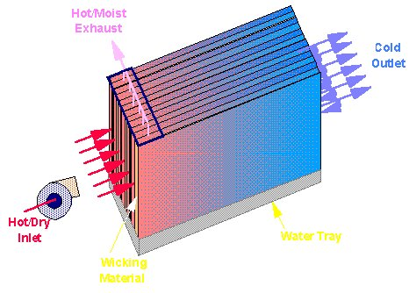
Evaporative Air Cooling Equipment
Advantages
- Substantial energy & cost savings
- Reduced peak power demand
- Improved indoor air quality
- Life cycle cost effectiveness
- Easily integrated into built-up systems
- Environmental benign

Slide 36
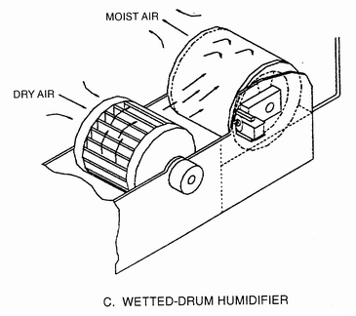
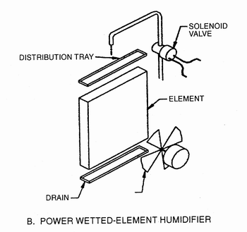
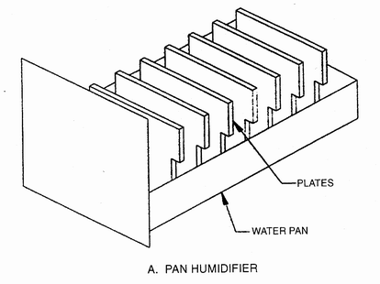
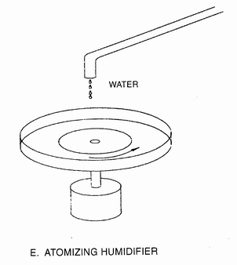
Humidifiers
Residential Humidifiers
Wetted-Drum Humidifier
Power Wetted-Element Humidifier
Pan Humidifier
Atomizing Humidifier

Slide 37
Humidifiers
Humidifiers – Load calculation
For ventilation systems having natural infiltration
For mechanical ventilation systems having a fixed quantity of outside air
H = humidification load, kg/h
V = volume of space to be humidified, m³
R = infiltration rate, air changes per hour
Q_{o} = volumetric flow rate of outside air, kg/h
W_{i} = humidity ratio at indoor design conditions, kg(water)/kg(dry air)
W_{o} = humidity ratio at outdoor design conditions, kg(water)/kg(dry air)
S = contribution of internal moisture sources, kg/h
L = other moisture losses, kg/h
Ρ = density of air at sea level, 1.2kg/ m³

Slide 38
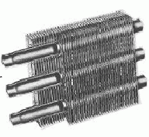
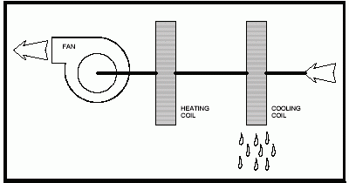
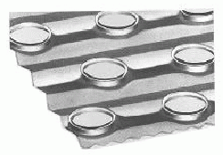
Air-Cooling and Dehumidifying Coils
Fluid inside the coil
- Water and Aqueous Glycol Coils
- Direct-Expansion Coils (refrigerant inside)
Coil design: Extended surface (finned) cooling coil
- most popular and practical

Slide 39
Desiccant Dehumidification
The use of chemical (or physical) absorption of water vapor to dehumidify air and reduce the latent cooling load in a building HVAC system
Advantage
Reduces cost of cooling
Improves product quality for companies with moisture sensitive products
Improves occupant comfort
Increases overall cooling capacity of existing cooling equipment
Reduces the amount of conventional cooling and elective demand
Improves indoor quality by reducing airborne bacteria and fungus

Slide 40
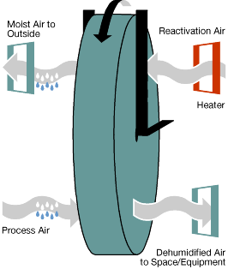
Desiccant Dehumidification
Traditional System
Dehumidification was achieved by lowering the temperature of the air.
Large energy required because air is over-cooled.
Rotary Dehumidification Unit
Desiccant dehumidification flows air from the building over a porous material that attracts moisture.
The porous material attracts moisture until it is saturated and can hold no more. Warm air is then passed over the desiccant and the moisture is released and exhausted to the outside

Slide 41
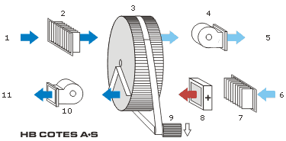
Desiccant Dehumidification
1: Process air "ON"
2: Filter
3: Rotor
4: Process air fan
5: Process air "OFF" (Dry air)
6: Regeneration air "ON"
7: Filter
8: Heating elements
9: Drive motor
10: Regeneration air fan
11: Regeneration air "OFF" (Wet air)

Slide 42
Heating Equipment
Boiler
Furnace
Residential In-Space Heating Equipment

Slide 43
Boilers
Basic Classification of Boilers: working pressure and temperature
Medium & High-
Pressure Boiler
Low-Pressure Boiler
Pressure : 100~200 kPa (Water)
1,100 kPa (Steam)
Temperature : 120°C
Steam Boilers / Water Boilers

Slide 44
Boilers
- Other Classifications:
Fuel Used: coal, fuel oil, gas / electricity
Construction Material:
cast-iron, steel, copper, stainless steel, etc…
Condensing/Non-condensing Boilers:
Condensing fuel gas in the boiler
Etc
Boiler classifications are important to the engineers because they affect performance, first cost and space requirements.

Slide 45
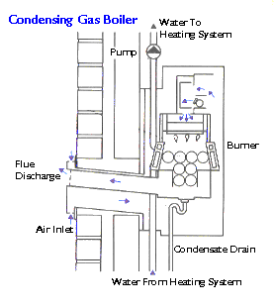
Boilers
Condensing Boilers
Hot exhaust gases condense and lose much of their energy to pre-heat the water in the boiler system

Slide 46
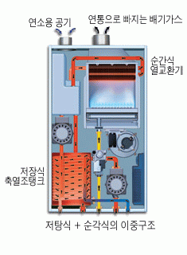
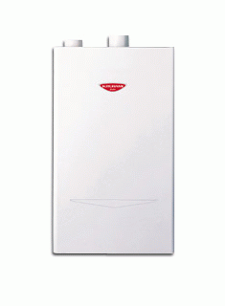
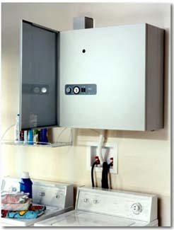
Boilers
Wall-Hung Boilers
Small residential gas fired boiler

Slide 47
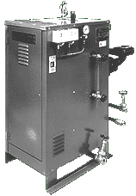
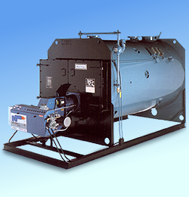
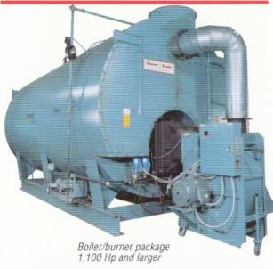
Boilers
Electric Boiler
- No combustion
- Electrode is immersed in the boiler water
Packaged Fire-Tube boiler

Slide 48
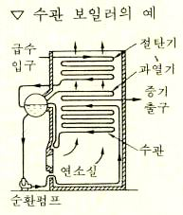
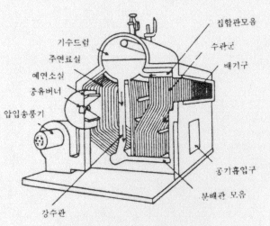
Boilers
Boilers - Terminology in Korean
수관 보일러
flue tube-smoke tube boiler
forced circulation boiler
water tube boiler
once-through boiler
tubular boiler, smoke tube boiler
packaged boiler
convection boiler
double ended boiler
supercharged boiler
monotube boiler
패키지 보일러

Slide 49

In-Space Heating Equipment
Not for the central heating system
Room Heater

Slide 50



Furnace
Wall Furnace
- Part of the structure of building
- Supplying heated air by natural/forced convection
Heating Furnace
- Air is heated directly by the hot gas of combustion

Slide 51




Other Energy Saving Equipments
- Thermal storage
- Energy recovery
- Solar energy
- Geothermal energy

Slide 52
HVAC Systems

Slide 53

Air-Conditioning Systems
Schematic of a typical commercial air
-conditioning system

Slide 54
HVAC System - Selection
On selecting a system, the followings are to be considered;
System constraints
Cooling load, Zoning requirements, Heating and ventilation
Architectural Constraints
Size and appearance of terminal devices, acceptable noise level, Space available to house equipment and its location relative to the conditioned space, acceptability of components into the conditioned space
Financial Constraints
Capital cost, Operating cost, Maintenance cost

Slide 55
HVAC System
Central System
Primary equipments are located in a central plant
Energy efficient
Lower maintenance & operating cost
Decentralized System
Primary equipments are located throughout the building
First cost is very low

Slide 56
All Air Systems
An all-air system provides the conditioned space with;
Sensible heating and humidification
Sensible and latent cooling
All-air systems can be classified into 2 categories;
- Single duct system
Dual duct system
or
Constant air volume system
Variable air volume (VAV) system

Slide 57
All Air Systems
Advantages
Maintenance is performed in unoccupied areas (centrally located).
No drain piping or power wiring or compressors in occupied areas.
Systems can include options such as;
Air-side economizer, heat recovery, winter humidification
Simple seasonal changeover
Simultaneous cooling and heating in various zones.
Disadvantages
Additional duct space is required.
Air-balancing may be difficult in large systems.
Close coordination is needed between designers and installers
to assure good accessibility to terminal units.

Slide 58

All Air Systems
All-Air System (Single duct)

Slide 59
All Air Systems
VAV System
Keep the air temperature constant and vary the air supply volume.
Easy to control, energy efficient and fairly good room control.
Poor ventilation under low load conditions
Difficult humidity control under widely varying latent loads

Slide 60

All Air Systems
VAV System

Slide 61
All Air Systems
Dual duct System
The dual-duct system employs two air ducts to supply cold air and warm air to a mixing terminal unit which proportions the cold and warm air in response to a thermostat located in the conditioned space
Systems with terminal volume regulation are self-balancing.
Zoning of central equipment is not required.
Instant temperature response
No seasonal changeover is needed
Higher initial cost
Does not operate as economically as other systems.

Slide 62

All Air Systems
Dual duct System

Slide 63
All Air Systems
Reheat System
Reheat system heats the supply air whenever the cooling load is below the maximum.
This is applied where spaces have wide load variations, high latent loads, or where close control of both temperature and humidity is required.
High operating cost
Energy inefficient

Slide 64

All Air Systems
Reheat System

Slide 65

All Air Systems
Multizone System (central)
The multi-zone system applies to a relatively small number of zones served by a single, central air-handling unit. Different zone requirements are met by mixing cold and warm air through zone dampers at the central air handler in response to zone thermostats

Slide 66

All Air Systems
Multizone System (central)

Slide 67
Air and Water Central Systems
These systems distribute both air and hot/cold water to terminal units in the conditioned spaces. The air and water is cooled and heated in a central mechanical room.
Advantages
The use of water greatly reduces the size of the air ducts.
The air-handling system is also much smaller.
Provides positive ventilation
All zones can be individually controlled.
Zone cooling and heating needs are satisfied independently.
Disadvantages
High operating cost
Design for the intermediate season operation is critical
Changeover is complicated and requires trained operators
Controls are more complicated than for all-air systems
Terminal units require frequent in-space maintenance
Humidity cannot be tightly controlled.

Slide 68

Air and Water Central Systems

Slide 69

Air and Water Central Systems
The room terminals
Induction unit
Room fan-coil units
: usually used
Radiant panels

Slide 70
All Water Central Systems
The space cooling is performed by chilled water circulated from a central plant to air handling or terminal units. Heating water is supplied through the same or a separate piping system.
Advantages
Water is a more energy and space efficient method.
Recirculation of air is unnecessary.
First cost is often less than for other central systems
Individual zone temperature control
Disadvantages
Some maintenance must be performed in occupied areas.
No humidification is provided.
Seasonal change over is required
No positive ventilation is provided unless wall openings are used

Slide 71

All Water Central Systems

Slide 72


All Water Central Systems
A fan-coil unit consists of a finned tube coil, a filter and a fan section.
The fan recirculates air continuously

Slide 73

Direct Expansion Systems
Direct expansion of refrigerant
- without the chilled water cooling medium
These units are designed for comfort cooling and delivery of conditioned air to a room either without ducts or with very short ducts

Slide 74
HVAC Applications

Slide 75
Comfort Applications
Residences
Retail Facilities
Commercial and public Buildings
Places of Assembly
Domiciliary Facility
Educational Facilities
Health Care Facilities
Surface Transportation
Aircraft
Ships

Slide 76
Industrial Applications
Industrial Air Conditioning
Enclosed Vehicular Facilities
Laboratory Systems
Engine Test Facilities
Clean Spaces
Data Processing System Areas
Printing Plants
Textile Processing
Photographic Materials
Environmental Control for Animals and Plants
Drying and Storing Farm Crops
Air Conditioning of Wood and Paper Products Facilities
Nuclear Facilities
Ventilation of the Industrial Environment
Mine Air Conditioning and Ventilation
Industrial Exhaust Systems

Slide 77
Residences
Single-Family Residences
Multifamily Residences
Heating
Heat Pumps
Furnaces
Hydronic Heating Systems (Boilers)
Air Conditioners
Unitary Air Conditioners
Evaporative Coolers
Humidifiers
Air Filters
Central Forced-air Systems
Hydronic Central Systems
Through-the-wall units
Water-Loop Heat Pump Systems

Slide 78
Residential Heating & Cooling Systems
 | Forced Air | Hydronic | Zonal
Most Common Energy Sources | Gas Oil Electricity Resistance Heat Pump | Gas Oil Electricity Resistance Heat Pump | Gas Electricity Resistance Heat Pump
Heat Distribution Medium | Air | Water Steam | Air Water Refrigerant
Heat Distribution System | Ducting | Piping | Ducting Piping or None
Terminal Devices | Diffusers Registers Grilles | Radiators Radiant panels Fan-coil units | Included with product

Slide 79


Retail Facilities
Even small stores often have large frontal glass areas which could result in high peak solar effects. High heat loss can also occur on cold, cloudy days.
Single-package rooftop units are most commonly used on 1 and 2 story buildings for heating and cooling service.

Slide 80


Retail Facilities
Duct System
Duct velocities should be kept low (800 to 1,200 fpm) to minimize any noise. Lights, displays and other ceiling-suspended obstacles require attention as they can interfere with air distribution
An ample outside air intake duct should also be provided and dampers installed for proper air balance and ventilation

Slide 81


Office Buildings
Weather, occupancy, lighting, and floor loads (computers, printers, copiers, and other office machinery) are the big energy users.
Building shape, design, and orientation can also have a major effect on energy use.

Slide 82


Office Buildings
Systems
Rooftop cooling unit
Heat pumps
Separate VAV unit
Central condenser water loop, etc…

Slide 83

Office Buildings
Ducts
The outdoor air quantities are needed for suitable indoor air quality.
However, a constant minimum volume of ventilation air is needed for VAV units depending upon occupant requirements.

Slide 84


Domiciliary Facility
Systems
Constantly operational, but not necessarily occupied at all times.
→ Individual room control of the HVAC system.
Relatively high domestic hot water use over short periods of time, several times a day.
Load characteristics are well defined at design stages, without need for future expansion.

Slide 85

Libraries and Museums
Systems
HVAC systems run year-round (cooling systems can easily run up to 5,000 hours a year or more)
→ Heavy-duty long-life equipment required
All equipment should be vibration and sound isolated.
→ Mechanical rooms should be located as remotely as possible to minimize the cost of acoustic and vibration isolation

