Slide 1
Environmental Thermal Engineering
lecture # 16-1
Latest issue in energy and efficiency
Min soo Kim
Mechanical & Aerospace Engineering

Slide 2
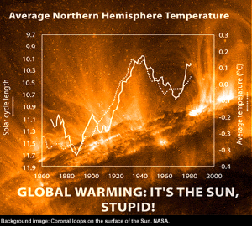
What is truth of energy problem?
Political issue of Global warming
[ Global warming ]
- Trade barrier
- Struggle for world leadership
(High tech with high efficiency= power)
- Issues in academia and political (Symbiotic relationship)
- Inevitable causal relationship between increase of growth and energy usage

Slide 3
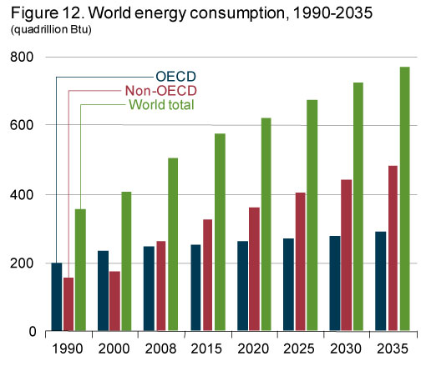
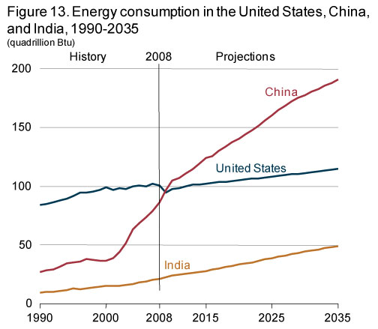
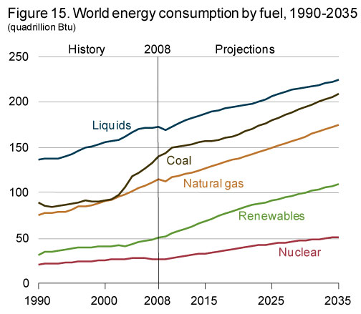

Show me the energy!
energy!
World
Source: U.S. Energy Information Administration, “International energy outlook 2011”

Slide 4
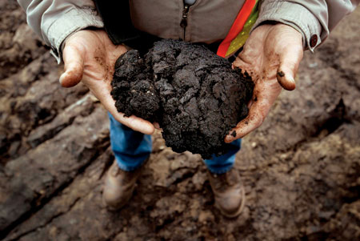
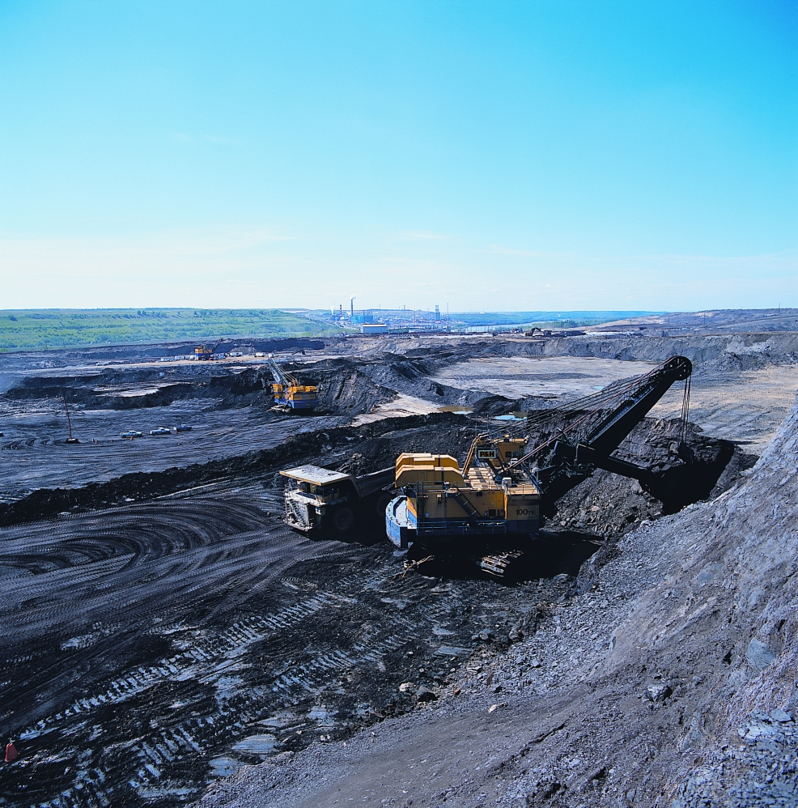
Oil sand / oil shale

Slide 5
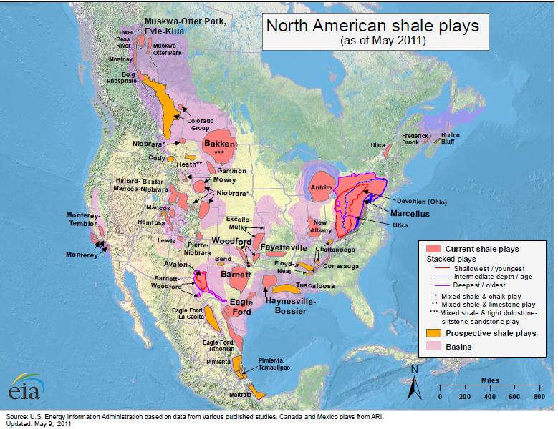
Distribution of Oil shale in North America

Slide 6
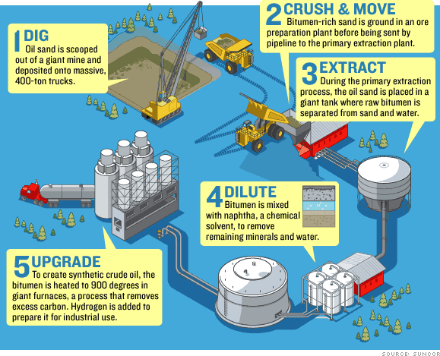
How to dig the oil sand

Slide 7
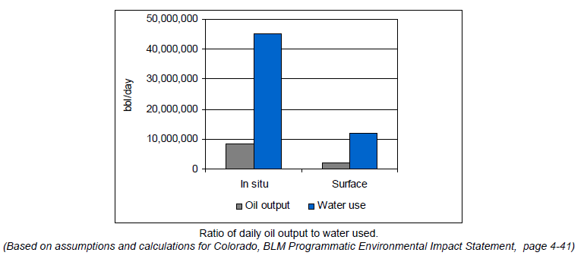
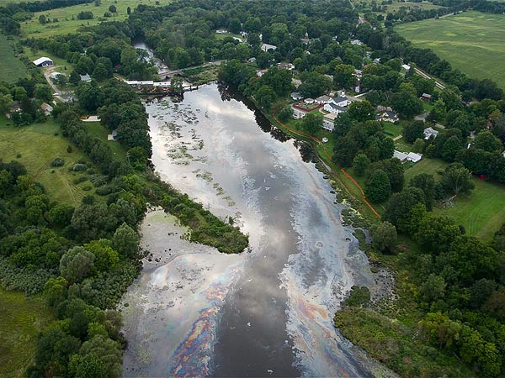
Oil sand and water contamination

Slide 8
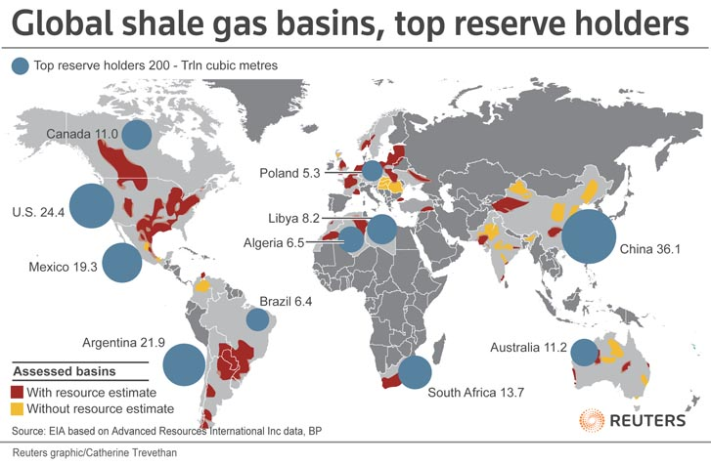
Shale gas

Slide 9
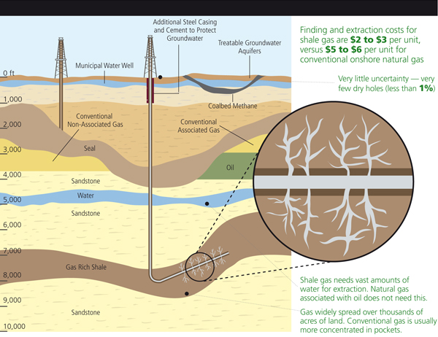
Shale gas digging

Slide 10
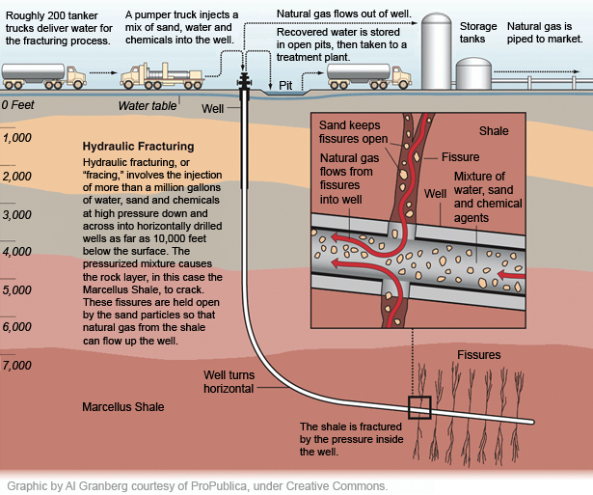
Process of shale gas
Human error
Toxic chemicals
Water contamination
Animal mortality
Earthquake
Well explosion
Government
Regulation in development
Encouragement: national security

Slide 11
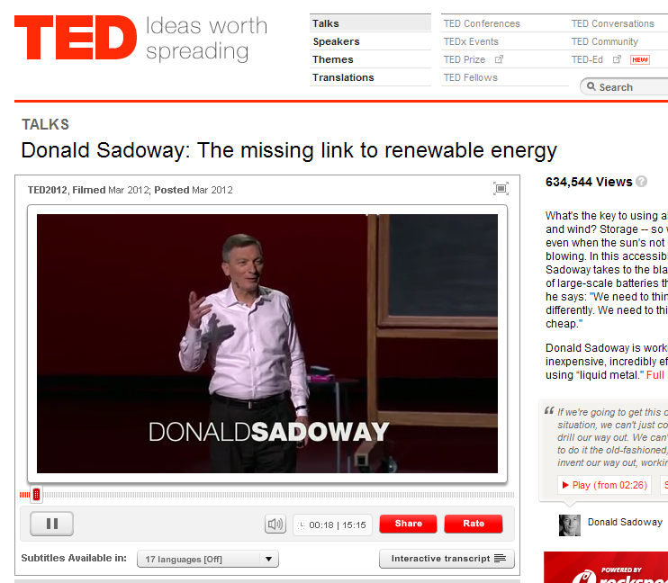
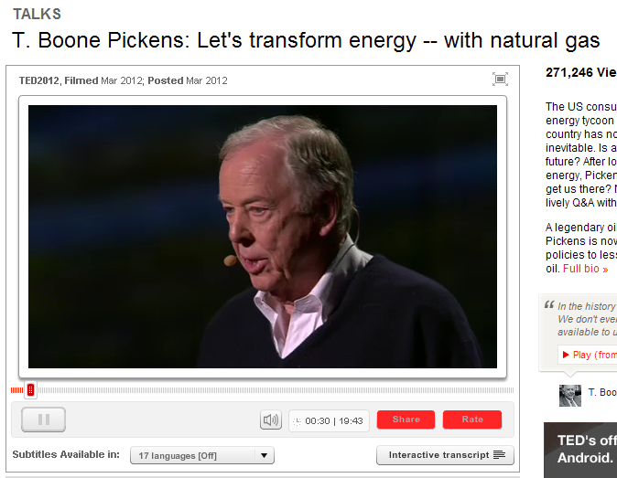
Overcoming efforts in U.S.
“I am a believer of global warming, but, my subject is national security. National security of America is more important than the global warming.”
- T. Boone Pickens
“We can’t bomb our way out. We’re going to do it, the old-fashioned American way. We’re going to invent our way out, working together.”
-Donald Sadoway

Slide 12
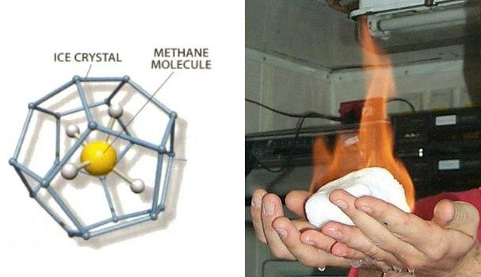
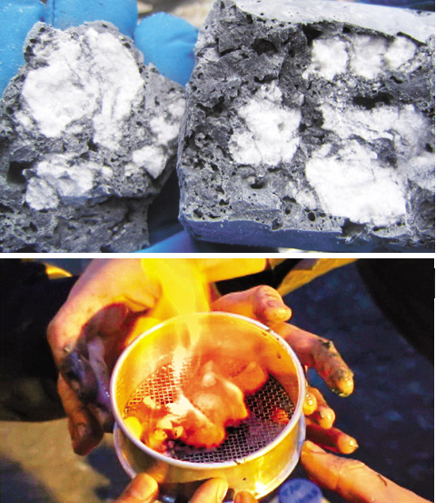

Methane hydrates

Slide 13
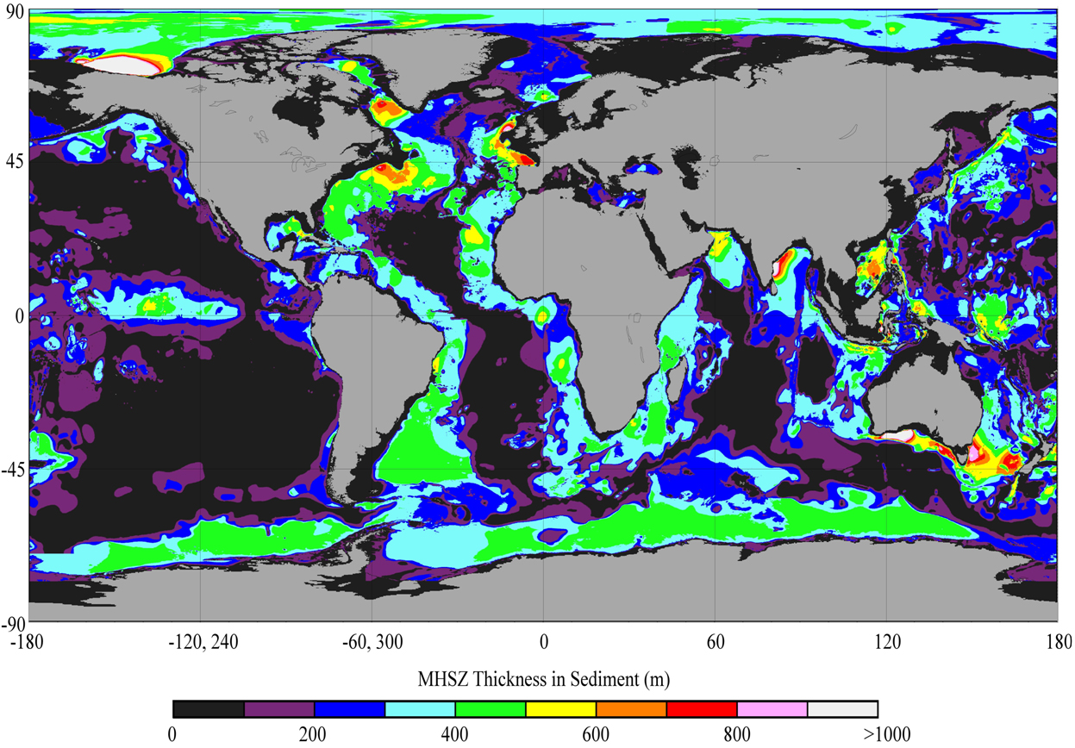
Deposit of methane hydrates
Source: http://globalcarbonprojects.org.

Slide 14

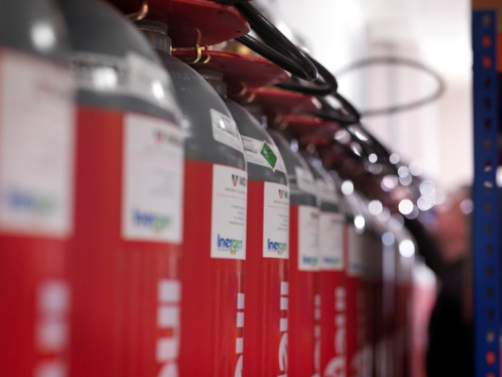

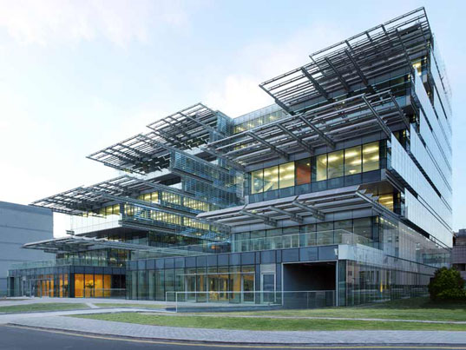


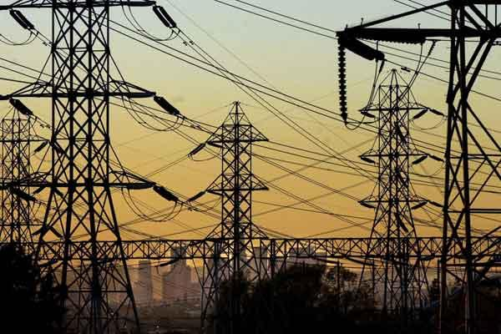

Smart Buildings
identification
Fire security
Space availability and freedom
Energy Efficiency
Heating and cooling
Water and air hygiene
Smart network
with people and facilities

Slide 15
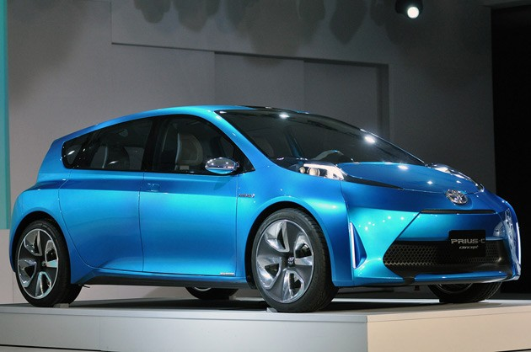
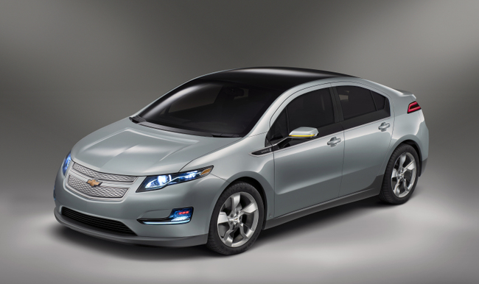
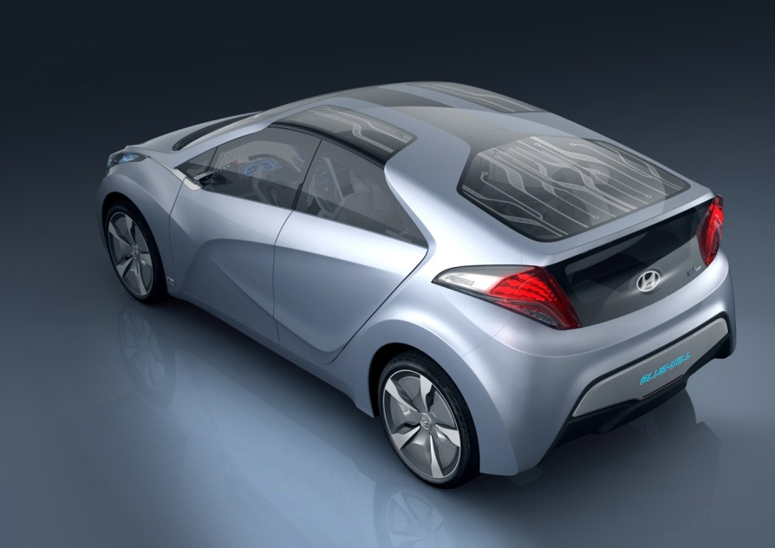
Green car and their penetration
Toyota Prius C
Chevrolet Volts
How to charge..
Where to charge..
How much to pay..
- Regulation and Infrastructure issue
- Oil and gas price issue
- Electricity price issue
Is this dream or vision?
Hyundai Blue series (PHEV)

