Slide 1
Environmental Thermal Engineering
Lecture # 16
Min soo Kim
Mechanical & Aerospace Engineering

Slide 2
Contents
Air Cleaning and
Indoor Air Quality Problem
Basic theory of air cleaning and air washer
(2) Indoor Air Quality Problem and Application (IAQ)

Slide 3
PART I
Indoor Air Quality, IAQ
Sick Building Syndrome, SBS

Slide 4
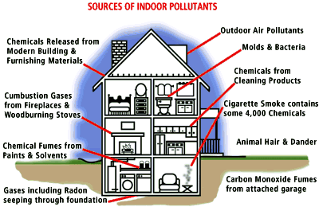
Indoor Air Quality, IAQ
"The #1 Pollution Problem in America is Indoor Pollution"
U.S. Environmental Protection Agency

Slide 5
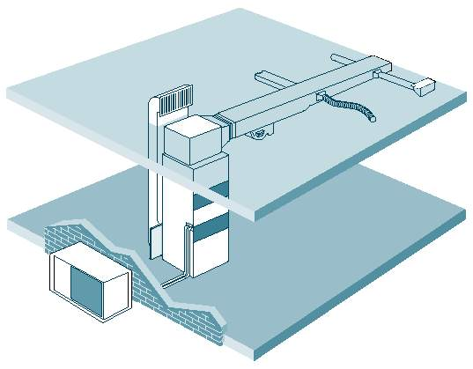
A Typical Residential
Heating and
Cooling System

Slide 6
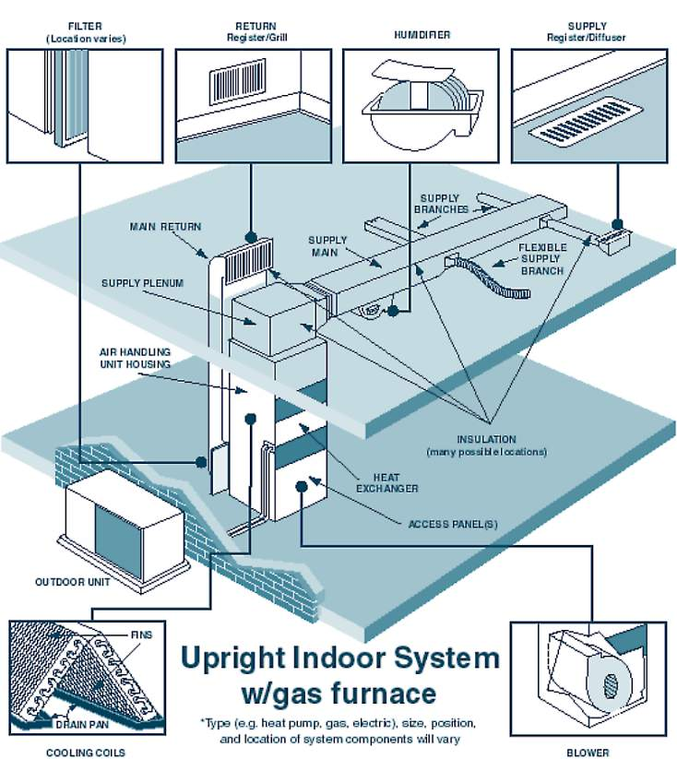
Components of a Typical
Residential Heating and
Cooling System

Slide 7
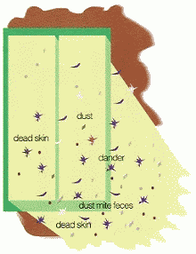
Indoor air problems
Particles
Gases
Electrical
imbalance

Slide 8
Many solutions have been proposed to solve indoor air problems. The solutions range from chemical cover-ups, various methods of filtration, ion generators, and activated oxygen or ozone. Ozone is frequently the best choice: oxidizing the chemical and odor molecules is a superior outcome. Negative ions and filtration can be helpful, but nothing beats elimination of the problem at its source.
And colds are just a small part of the problem. The results of a "surveillance program" reported by the Centers for Disease Control showed that 60.8% of work-related asthma was brought on by "exposures not recognized as known asthma inducers."
Since air is so vital, shouldn't it be clean? According to the EPA, there are three solutions.
#1. Eliminate all sources of pollution. . . . not exactly practical. After all, you and your family still have to live and work there. And who can control what the neighbors do?
#2. Increase ventilation. But what if the air you bring in isn't fresh? If you live near a city, it won't be. What contaminants will the air pick up upon entering your home? And did you know that even with the best ventilation systems, only about one-third of the air is exchanged. And how much is it costing you to heat(or cool) the great outdoors in the meantime?
Air pollution now linked to diabetes - Science Daily Report.
#3. Filter and reuse the air. The Allergy Machine has finally got the stuff to ease night-time allergy symptoms. But filters are way too inefficient for cleaning the air in larger spaces.

Slide 9

A Solution Using Air Filters
As air passes through a filter, small particles that are floating in the air are trapped. This is helpful in reducing particles such as dust, pollen and dander but is only part of the solution. Most gases and odors pass right through even the best Hepa filters.

Slide 10
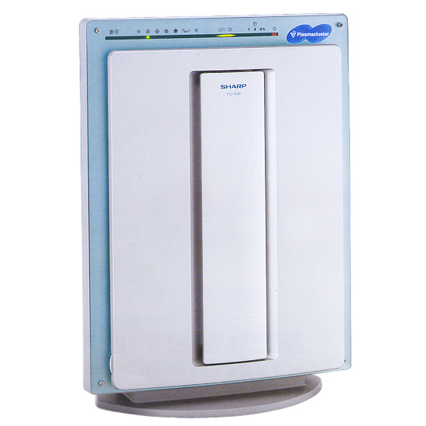
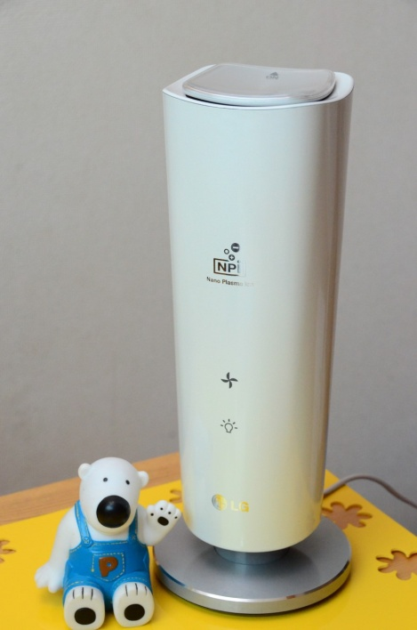
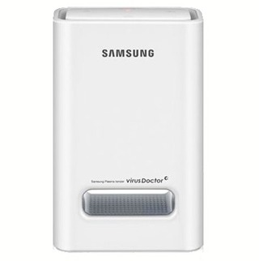
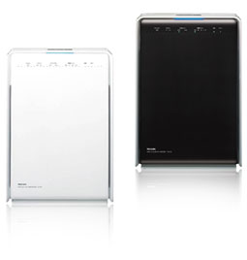
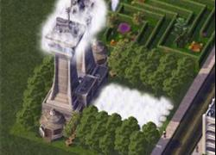
SHARP
samsung
LG
Simcity
Toshiba

Slide 11
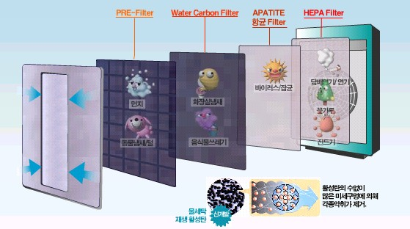
Multi-filter for Air-cleaner
Air Washer??

Slide 12

Negative Ions Cause Dust and Other Particles to Fall Out of the Air
Most indoor particles that are airborne tend to be positively charged. Negative ions will give some of the particles a negative charge. The positive and negative particles then combine with each other, become heavy and fall to the ground.

Slide 13
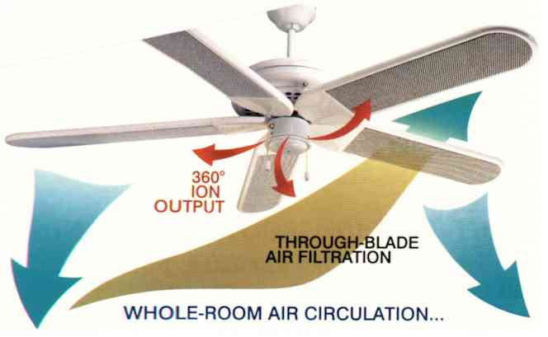
Ceiling Fan "Clean Air System"

Slide 14
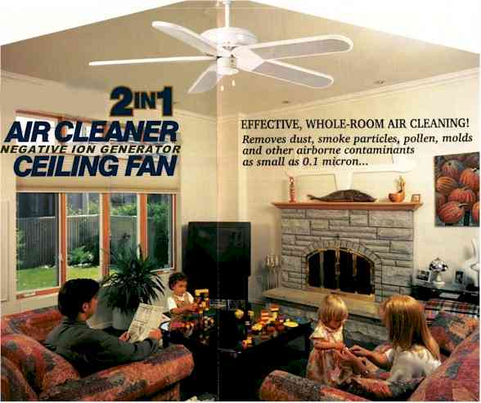
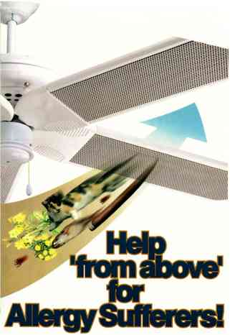

Slide 15
Electret/Carbon filter cartridges mounted in each blade of the fan literally sweep airborne particles and problem odors right out of the air with every revolution.
Dust, smoke particles, pollen and molds as small as 0.1 micron in size are effectively removed..........Quietly!

Slide 16

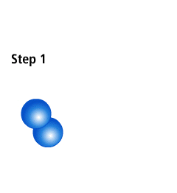



Step 1:
Normal Oxygen (O₂) molecules with two atoms of oxygen each.
Activated Oxygen breaks down odors and other pollutants at their source.
Step 2:
The electrical current of lightning transforms oxygen (O₂) molecules to ozone (O₃), activated oxygen.
Step 3:
Activated oxygen (O₃) breaks back down into oxygen (O₂), as extra atom attaches to pollution molecule.
Nature has many ways to produce activated oxygen, a natural air cleaner. For example, we’ve all taken a walk after a thunderstorm and experienced the clean, fresh smell in the air. That’s ozone, or activated oxygen, at work. Normal oxygen O₂ is converted to O₃, which is commonly called ozone or activated oxygen. O₃ will break down odors and other contaminates. The SpringAir employs a separate O₃ generator to achieve this natural process.
Step 4:
Extra oxygen atom causes breakdown of pollution into benign a substance.

Slide 17
PART II
Air washer in Clean Room

Slide 18

Chinese Dust Storm
April 1998
A major dust storm occurred in April over parts of China and Mongolia.

Slide 19
What is AEROSOL ?
A small particle in air or gas formed in solid or liquid
The 5th material beside solid, liquid, gas, plasma
DUST – Small particle like sand occurred during cutting or grinding
SMOKE – Particle occurred during combustion of coal or firewood
FUME – Particle occurred during combustion of metal meterial
MIST – The case when gas coagulates little fluids
FOG – It occurs when liquids spay
SMOG = SMOKE + FOG
What is HYDROSOL, EMULSION ?
- Particle floats in liquids

Slide 20
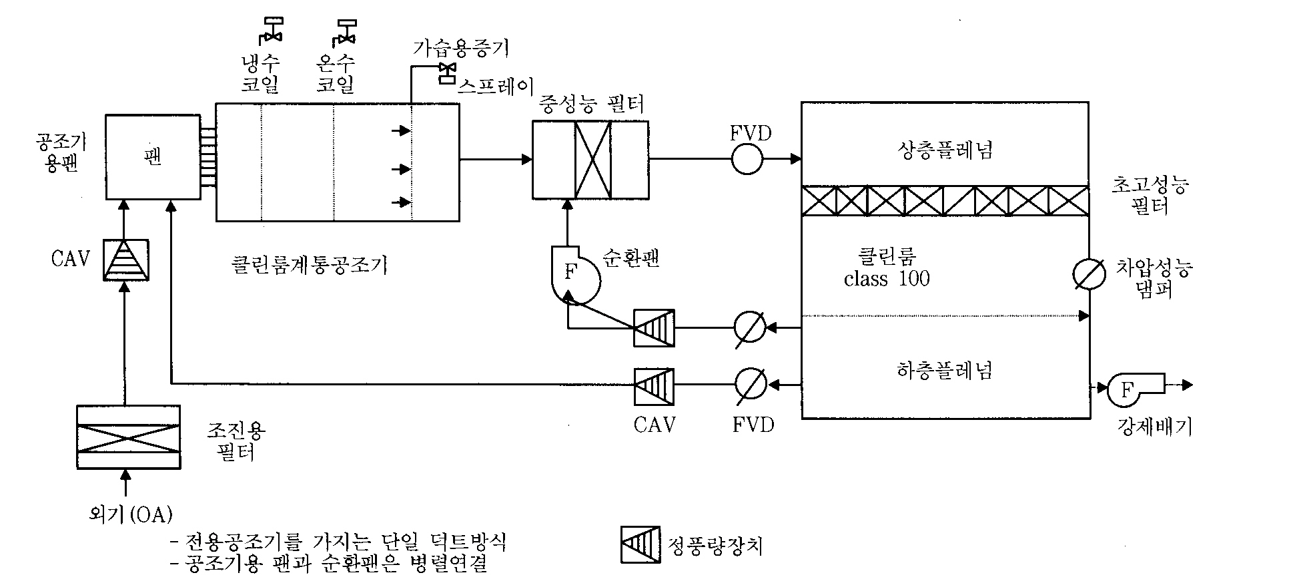
Structure of Air conditioning system in Clean Room

Slide 21
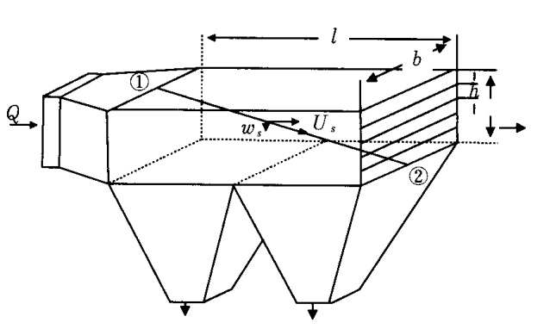
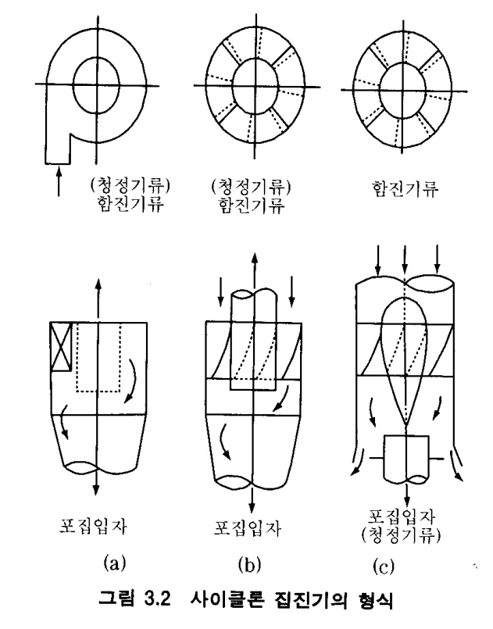
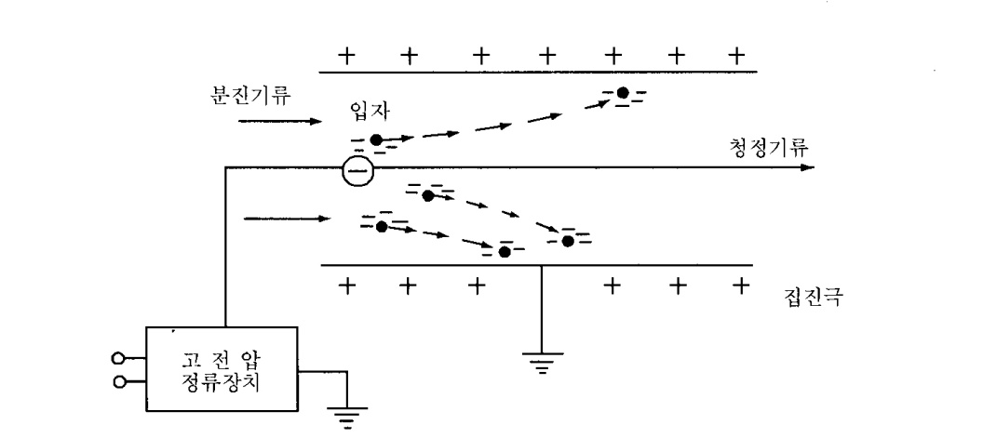
Gravity type dust chamber
Cyclone type dust chamber
The principle of electricity type dust chamber

Slide 22
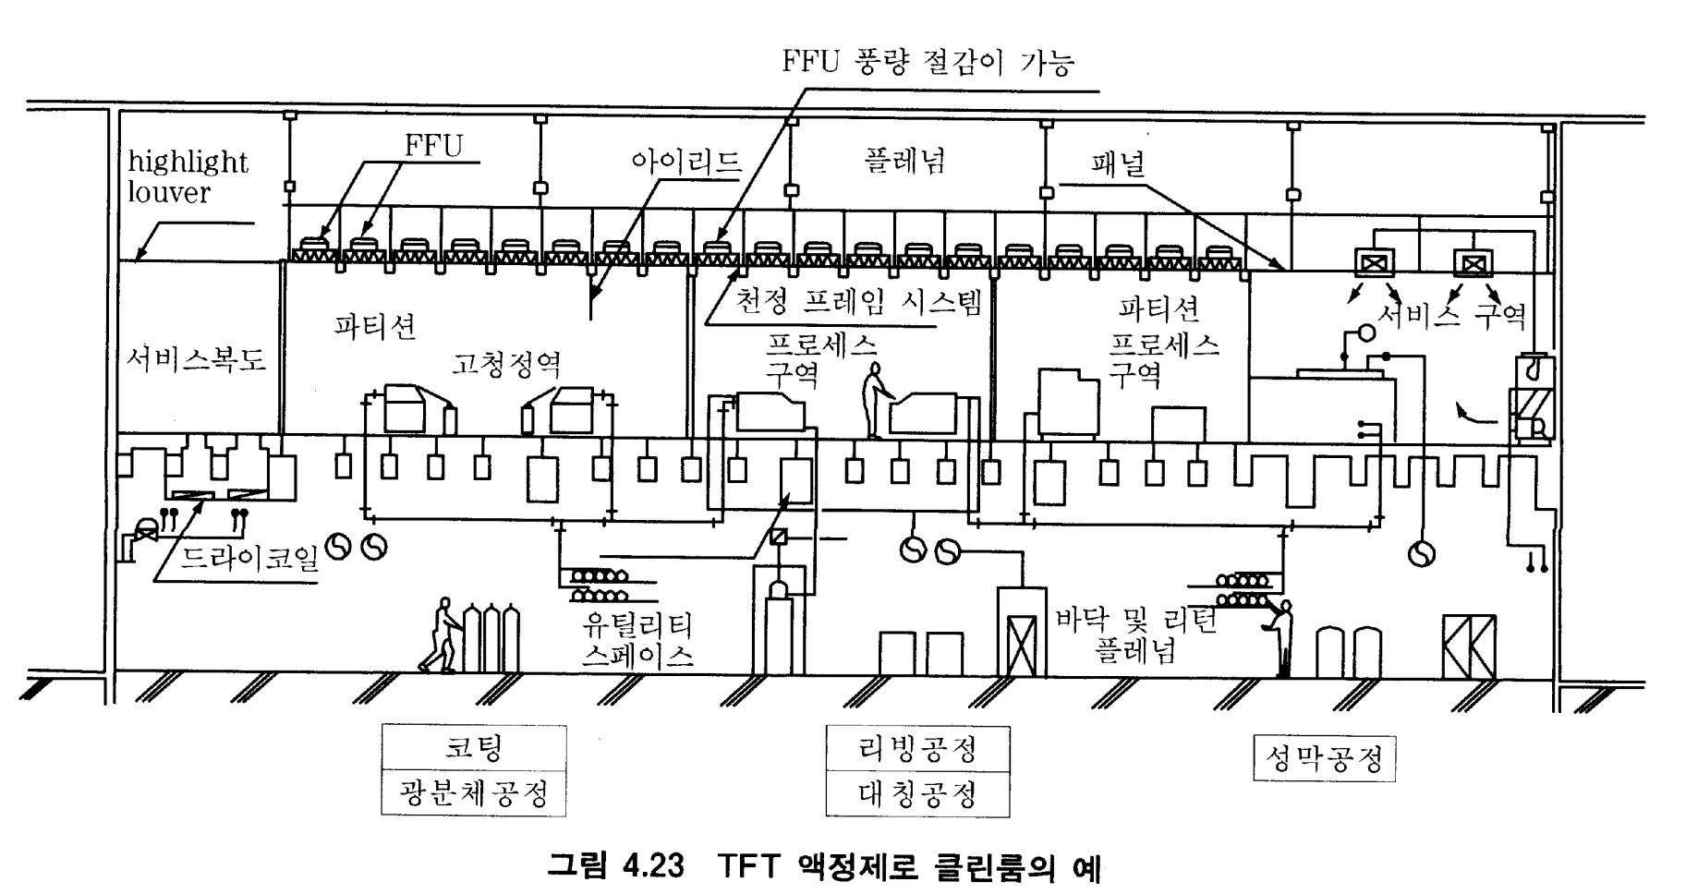
TFT-LCD Clean Room

Slide 23
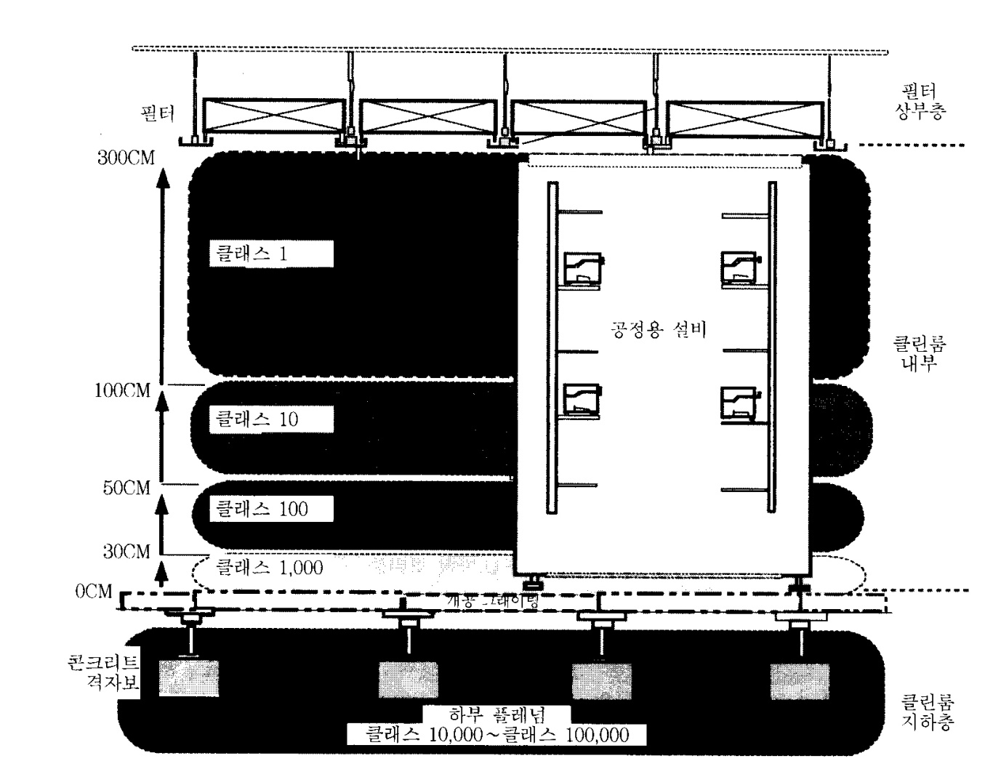
The vertical characteristic of Clean Room

