Slide 1
Chapter 1. Properties of Gases
Equation of State
The physical state of a substance is defined by its physical properties. The state of a pure gas, for example, is specified by giving its value, V, n, p, and T. Equation of state is an equation which interrelate these four variables:
Extensive Properties: properties proportional to the amount of material.
e.g., mass, volume, number of moles, heat capacity.
Intensive Properties: the nature of material not depending upon the amount.
e.g., temperature, pressure, diffusivity, viscosity,
thermal conductivity, electrical conductivity, dielectric constant.

Slide 2
For a homogeneous material, only two intensive variables can be independent; the remaining variables must then be a function of these two.
e.g., f (P,T) or f (σ,T)
Equation of state Functional dependence of any other properties on these two variables.
1.2 The Ideal Gas Law
Ideal Gas: 1. The size of molecule is negligibly small.
2. The interactions between molecules do not exist.
p V = n R T p V = N kB T

Slide 3
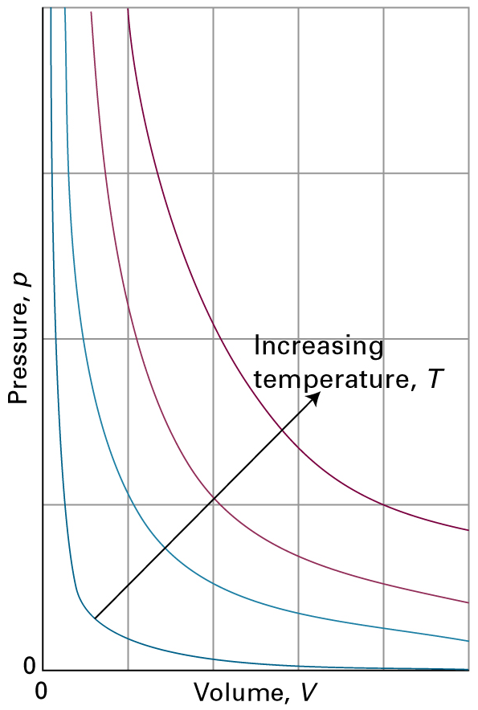
Figure 1.4 The pressure-volume dependence of a fixed amount of perfect gas at different temperatures. Each curve is a hyperbola (pV = constant) and is called an isotherm.

Slide 4
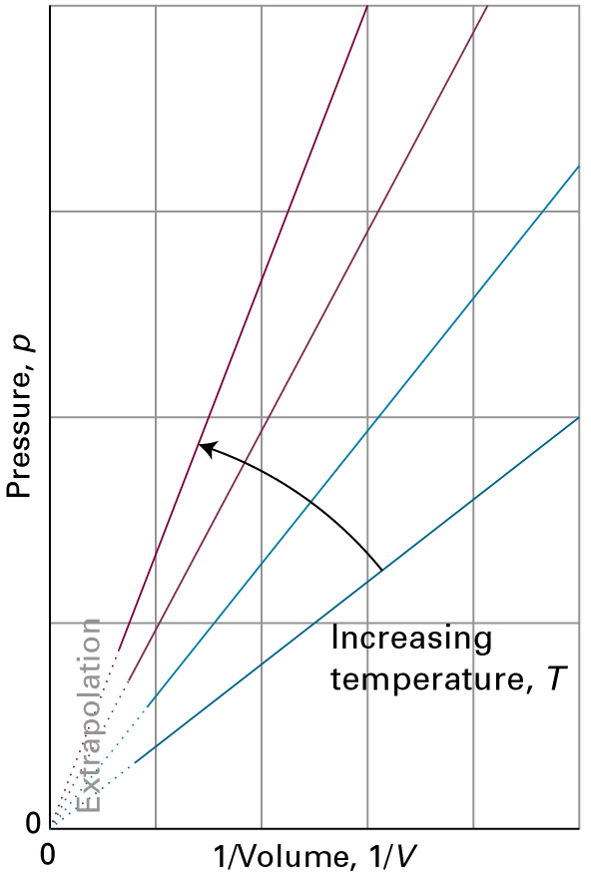
Figure 1.5 Straight lines are obtained when the pressure is plotted against 1/V.

Slide 5
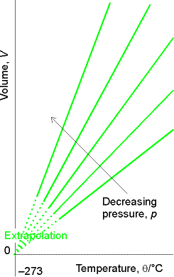
Volume, V
Figure 1.6 The variation of volume of a fixed amount of gas with the temperature at constant pressure (isobar). Note that in each case they extrapolate to zero volume at -273.15 °C.
Decreasing pressure, p
0
–273
Temperature, T/°C

Slide 6
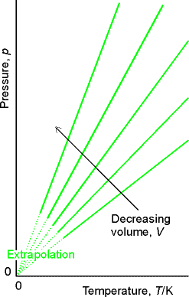
Pressure, p
Decreasing volume, V
Figure 1.7 The pressure also varies linearly with the temperature at constant volume, and extrapolates to zero at T= 0 K (= -273.15°C).
0
0
Temperature, T/K

Slide 7
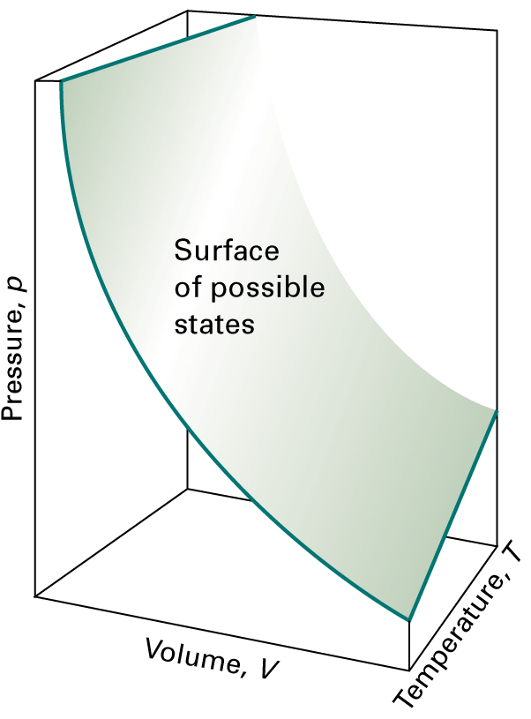
Figure 1.8 A region of the p, V, T surface of a fixed amount of perfect gas. The points forming the surface represent the only states of the gas that can exist.

Slide 8
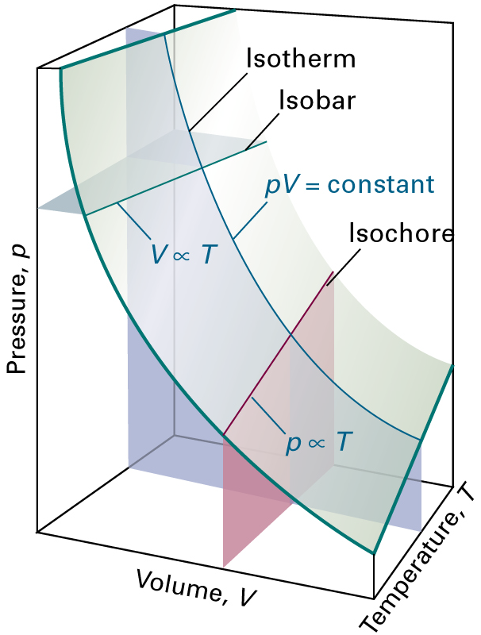
Figure 1.9
Sections through the surface shown at a constant variable.

Slide 9
~
1.4 The van der Waals Equation = Real Gases
Ideal gas: 1. The size of molecule is negligible.
2. The interactions are negligible.
Vm = molar volume
a, b : empirical constants that are characteristic of the particular force.
a At finite concentrations, molecules will have attractive forces which will reduce the pressure.
b The volume in the ideal gas law should not be the volume of the container, but the volume available to a molecule for kinetic movement.
The excluded volume per pair of spheres: The excluded volume is
[Justific. 1.1]
for NA molecules

Slide 10
2r
Excluded volume. A sphere of diameter 2r creates an excluded volume, which is a sphere of radius r, into which the center of a another sphere of the same size may not penetrate.

Slide 11
1.3(b) The Virial Series
Define the compression factor:
p Vm = R T Z
(1.18)
For ideal gas,
_________
For real gas,
 We might represent Z as a power series in the mole concentration:
(1.19b)
B=B(T) : the second virial coefficient
C=C(T) : the third virial coefficient

Slide 12
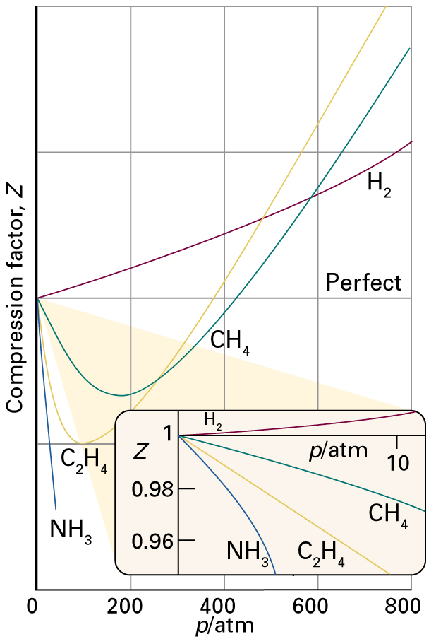
Repulsive Forces
Z = p Vm / R T
1
1
Attractive Forces
Figure 1.14 The variation of the compression factor Z = pVm/RT with pressure for several gases at 0°C. A perfect gas has Z = 1 at all pressures. Notice that, although the curves approach 1 as p  0, they do so with different slopes.

Slide 13
Estimation of Virial Coefficients
The virial coefficients can be related to the van der Waals constants.

Slide 14
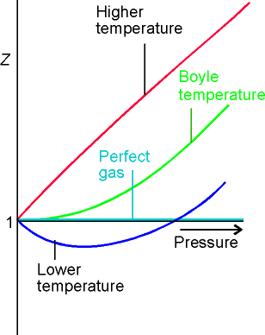
Z (p,T) = p Vm / R T
= Vm / Vm^{ideal}
Figure 1.16 The compression factor approaches 1 at low pressures, but does so with different slopes. Real gases may have either positive or negative slopes, and the slope may vary with temperature. At the Boyle temperature, the slope is zero and the gas behaves perfectly over a wider range of conditions than at other temperatures.
Repulsive Forces
Attractive Forces

Slide 15
The Boyle Temperature
For all gases, there is some temperature at which B(T) = 0.
Boyle temperature  the repulsive and attractive forces cancel each other, giving nearly ideal behavior.
Example: Estimate the Boyle Temperature of N2: the actual value is 324 K.
From van der Waals constants,

Slide 16
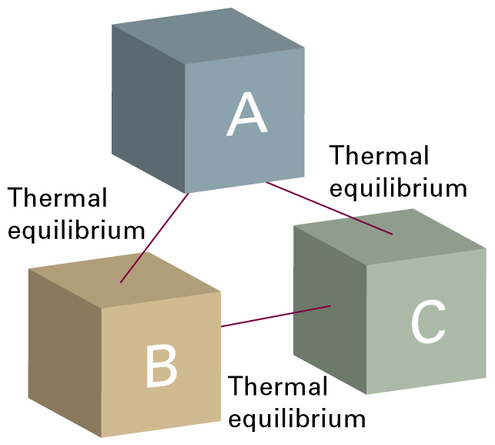
Thermal Equilibrium
Figure 1.3 The experience summarized by the Zeroth Law of Thermodynamics: If an object A is in thermal equilibrium with B, and if B is in thermal equilibrium with C, then C is in thermal equilibrium with A.

Slide 17
Critical Behavior of Fluids
*
p vs. V (or p vs. Vm ) for a gas at constant temperature (isotherms)
Isotherms for various temperature
T
L or G
Pressure
L + G
L
G
-2014-3-11
-2014-3-13 휴강
~Fig. 1.15
At high temperatures, these are similar to the hyperbolae predicted by the ideal gas law.
At the critical temperature, the isotherm has a horizontal inflection at the critical point (C).
Below the critical temperature, the isotherms have a horizontal segment (shown by the dotted lines) in the two-phase region, where both liquid and vapor are present.
Volume

Slide 18
Near the critical temperature, the isotherms have a nearly horizontal section.
At the critical temperature, this becomes an inflection point for which the slope is zero at some point − namely, the critical point (Pc, Vc, Tc).
The value of the pressure at which, for a given temperature, liquid and vapor phases are in equilibrium (i.e., the horizontal lines) is called the vapor pressure.
The meaning of the horizontal part of the isotherms below Tc:
The total volume of the fluid (liquid plus vapor) can be decreased without a change in pressure.
If there are two phases in the container, compression will cause more vapor to condense into the higher-density liquid, but the pressure will not be altered.

Slide 19
P
Liquefaction of a gas. The isothermal compression of a gas that is below its critical temperature will, at the pV point (a), cause the condensation of a liquid.
Further reduction of volume will cause more liquid to condense, but the pressure will not change; this is the vapor pressure of the liquid at this temperature.
At the point (c) on the diagram), all the gas will have condensed to a liquid, and further reduction of volume requires the compression of the liquid.
P
T
T
T
P
at T < Tc
L
L + G
G

Slide 20
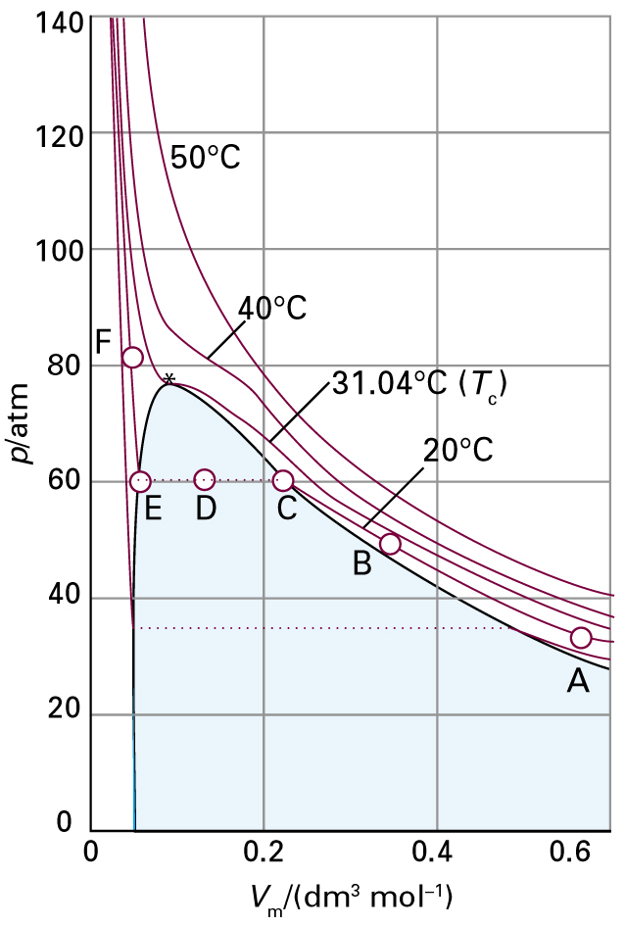
Figure 1.15 Experimental isotherms of carbon dioxide (CO2) at several temperatures.
The critical isotherm *, the isotherm at the critical temperature, is at 31.04 °C. The critical point is marked with a star.
______
dry ice = solid of CO2

Slide 21
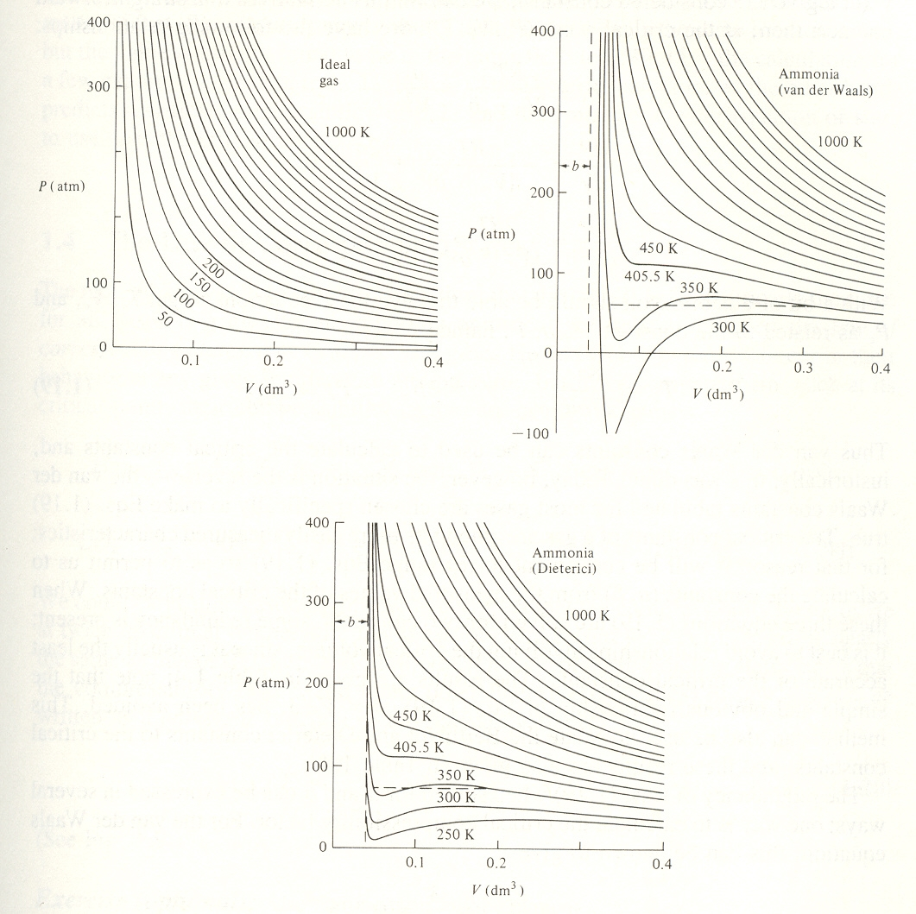
P – V Dependence at Different Temperatures
Gas isotherms:
Comparison of the isotherms of an ideal gas to that predicted by the van der Waals equation for ammonia.
An ideal gas will not condense at any temperature.
The other law (model) predicts the location of the critical point, but their behavior in the two-phase region is unrealistic.
Ammonia (van der Waals)
Ideal gas
Ammonia (Dieterici)

Slide 22
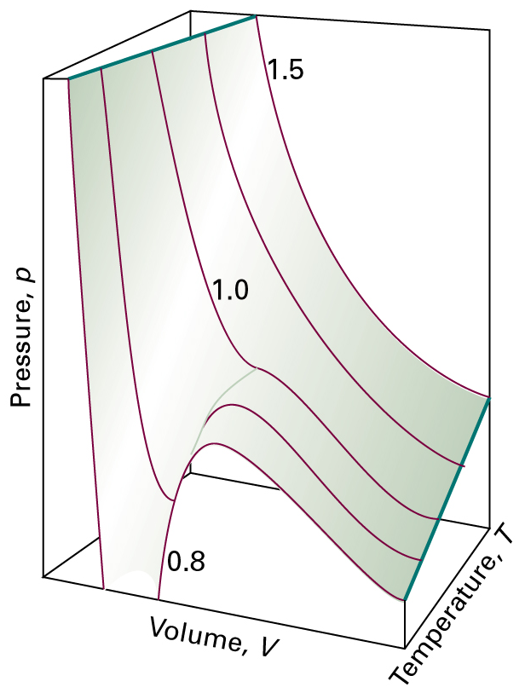
Figure 1.19 The surface of possible states allowed by the van der Waals equation. Compare this surface with that shown in Fig.1.8.
.
P = 0
V = 0

Slide 23
For van der Waals equation,
T > Tc, somewhat realistic
T < Tc, the isotherms show an undulation which is not at all like the observed behavior
Reason:
Van der Waals equation  cube in volume
For any choice of T and p, there will be three values of the volume which will, mathematically, satisfy the van der Waals equation.

Slide 24
A cubic equation  three roots
T > Tc  one real, two complex
T = Tc  all three roots: real and equal
T < Tc  all three roots: real and unequal
Horizontal line is drawn through the undulation with equal areas above & below:
Interpreted as the vapor pressure of the liquid. (Maxwell construction)
Why? (derivation on white board)

Slide 25
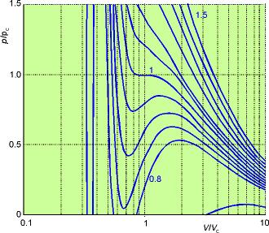
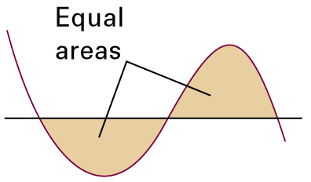
Figure 1.20
Van der Waals isotherms at several values of T/Tc.
The van der Waals loops are replaced by horizontal straight lines.
The critical isotherm is the isotherm for T/Tc = 1.

Slide 26
1.4(b) Evaluation of Gas Constants from Critical Data
At critical temperature, the curve has an inflection at which the gradient and curvature are zero.
at T = Tc, p = pc, Vm = Vm,c
(1.22)

Slide 27
1.4(c) The Law of Corresponding States
The gases He and CO2 are very different in their behavior at any given temperature and pressures. However, if we compare them, each at its critical point, their compression factors are nearly the same.
He: Tc=5.3 K, pc=2.26 atm, Vc=57.7 cm³/mol  Zc=0.300 CO2: Tc=304.2 K, pc=73.0 atm, Vc=95.6 cm³/mol  Zc=0.280
The law of corresponding states demonstrates that the compression factor (and many other intensive properties) of any gas can be written as a universal function of the reduced variables:

Slide 28
The compression factor Z is plotted as a function of reduced pressure. It is strikingly clear that the values of Z are approximately the same for a wide variety of gases under a wide range of conditions.
Write the p, Vm and T of van der Waals equation in terms of the reduced variables, and then express the latter in terms of the relations in eqs:
의미
(1.25)
These have the same form as the original equation. However,
the constants a and b, which differ from gas to gas, have disappeared.

Slide 29
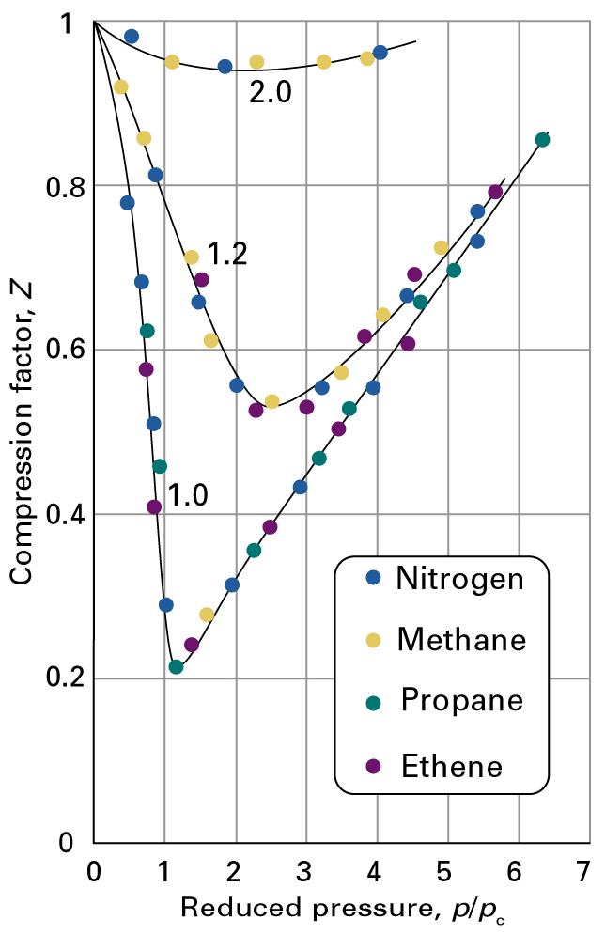
Tr = T / Tc
Z (p,T) = p Vm / R T
= Vm / Vm^{ideal}
Figure 1.21
The compression factors of four gases plotted using reduced variables. The curves are labelled with the reduced temperature Tr=T/Tc. The use of reduced variables organizes the data on to single curves.
pr = p / pc

Slide 30
1.3 Intermolecular Forces
Pairwise potential function, U(r), which gives the potential energy of the pair as a function of the distance (r) between their centers.
At long range, a weak attractive force between the molecules
→ F 
At short range, the force becomes very strongly repulsive. A number of semi-empirical potentials have been proposed and used. The ability of a proposed potential to fit a variety of data over a range of temperatures with the set of parameters is an indicator of generality.

Slide 31
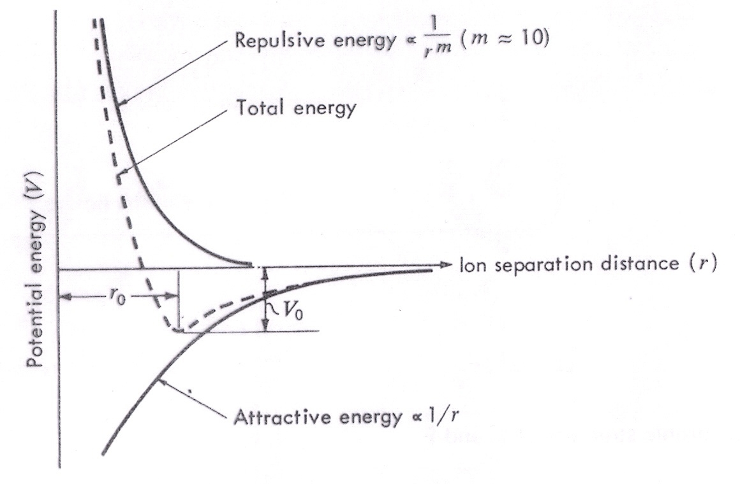
Repulsive energy  (m  12)
Total energy
Potential energy (V)
Ion separation distance (r)
r0
V0
Attractive energy  1/r ⁶
Fig. 1.13 Energy vs. separation distance for two oppositely charged ions.

Slide 32
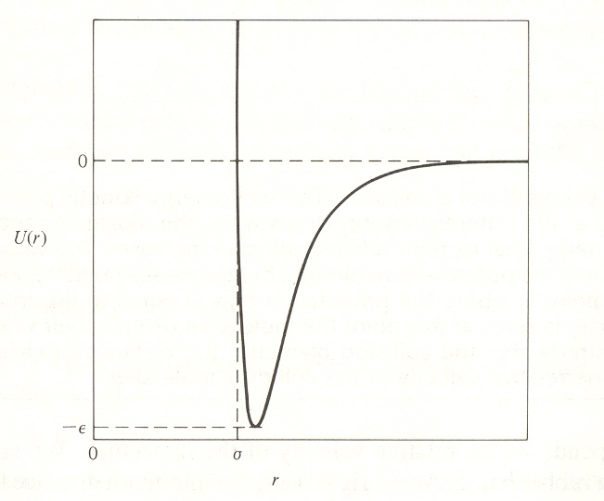
0
U(r)

–
0
2r
distance
Figure 1.13 The intermolecular potential U(r). The potential is a function of the distance between the centers of the molecule. This figure illustrates two parameters (2r), which is the distance between the centers of the molecules where the potential curve crosses zero, and the well-depth parameters (), which is the depth of the potential well at its minimum.

Slide 33
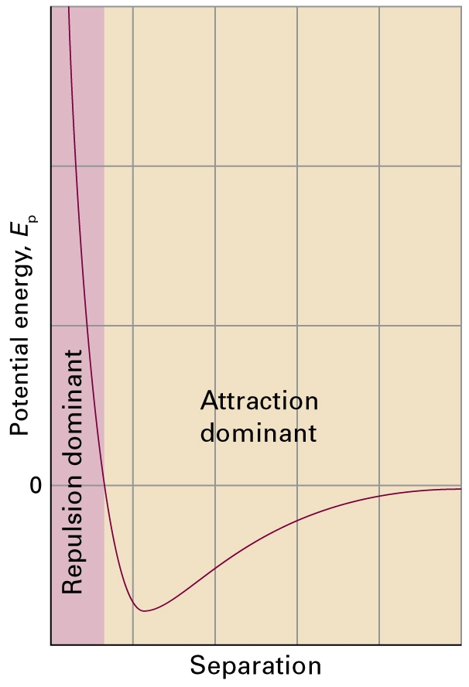
Figure 1.13
The variation of the potential energy of two molecules on their separation.
High positive potential energy (at very small separations) indicates that the interactions between them are strongly repulsive at these distances.
At intermediate separations, where the potential energy is negative, the attractive interactions dominate.
At large separations (on the right), the potential energy is zero and there is negligible interaction between the molecules.

Slide 34
(skip)
The Lennard-Jones Potential
(See page 13)
Second virial coefficient
The integral part of the equation for the second virial coefficient can be done analytically, but the solution is complicated and in the form of an infinite series.
Define a unitless distance as
Define a parameter:

Slide 35
(skip)
For the Lennard-Jones (L−J) potential, the exponent in the integral is:
Note that /k has unit of temperature, i.e., Kelvin. This suggests the use of two reduced parameters.
Define a parameter
Note that the reduced virial coefficient is a universal function of the reduced temperature. The integral must be evaluated numerically for each of .
-2014-3-18

Slide 36
1.2(c) Mixed Gases
The simplest assumption is that of an ideal mixture.
The ideal-mixing approximation assumes that the properties of a mixture are either the sum or the mean of the properties that the pure gases would have under the same conditions.
Daltons’s law
where pi is the partial pressure, the pressure exerted by the individual gases.
Assume that the pressure of a gas is in proportion to the numbers of molecules present, then:
where Xi is the mole fraction.

Slide 37
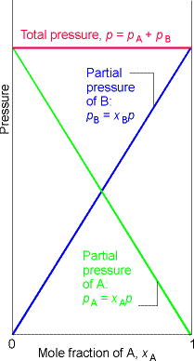
Ideal Mixture
The partial pressures pA and pB of a binary mixture of (real or perfect) gases of total pressure p as the composition changes from pure A to pure B.
The sum of the partial pressures is equal to the total pressure.
If the gases are perfect (ideal), then the partial pressure is also the pressure that each gas would exert if it were present alone in the container.

Slide 38
Problems from Chap. 1
D1.3
E1.3(a) E1.5(a) E1.13(a) E1.19(a)
P1.11 P1.15 P1.17 P1.21

