Slide 1
In-Class Scheduling Exercise
Activity | Description | Duration | Predecessor | Code
10 | Mobilization | 1 |  | GC
20 | Excavation | 2 | 10 | GC
30 | Place gravel | 2 | 20 | GC
40 | Place slab forms | 3 | 20 | GC
50 | Place rebar | 2 | 30 | GC
60 | Rough in plumbing | 2 | 50 | PC
70 | Pour & cure concrete | 9 | 40, 60 | GC
80 | Remove forms | 2 | 70 | GC
90 | Erect frame & sheath walls | 4 | 70 | GC
100 | Sheath roof | 3 | 80, 90 | RC
110 | Electrical | 3 | 100 | EC
120 | Install siding | 4 | 100 | GC
130 | Finish carpentry | 3 | 100 | GC
140 | Finish roof & flashing | 3 | 100 | RC
150 | Paint | 5 | 110, 120, 130 | GC
160 | Clean-up | 2 | 140, 150 | GC
Project Start Date: 5/1/2016
Code Value | Code Title
GC | General Contractor
PC | Plumbing Contractor
EC | Electrical Contractor
RC | Roofing Contractor

Slide 2
In-Class Scheduling Exercise
Draw the precedence diagram network
Use CPM calculations to determine the project duration
Develop a Gantt chart

Slide 3
In-Class Scheduling Exercise
1. Draw the precedence diagram network
3
5
5
7
7
9
30
50
60
2
0
2
0
2
0
3
5
5
7
7
9
0
1
1
3
9
18
10
20
70
1
0
2
0
9
0
0
1
1
3
9
18
3
6
40
3
3
6
9
ES
EF
Activity
Dur.
Float
LS
LF

Slide 4
In-Class Scheduling Exercise
1. Draw the precedence diagram network
18
20
25
28
80
110
2
2
3
1
20
22
26
29
9
18
22
25
25
29
29
34
34
36
70
100
120
150
160
9
0
3
0
4
0
5
0
2
0
9
18
22
25
25
29
29
34
34
36
18
22
25
28
90
130
4
0
3
1
18
22
26
29
25
28
ES
EF
140
Activity
3
6
Dur.
Float
31
34
LS
LF

Slide 5
In-Class Scheduling Exercise
2. Determine the project duration
3
5
5
7
7
9
30
50
60
2
0
2
0
2
0
3
5
5
7
7
9
0
1
1
3
9
18
10
20
70
1
0
2
0
9
0
0
1
1
3
9
18
3
6
40
3
3
6
9
ES
EF
Activity
Dur.
Float
LS
LF

Slide 6
In-Class Scheduling Exercise
2. Determine the project duration
Duration: 36 days
C.I. = # of Critical Act /
# of Total Act
= 11/16 = 0.69
18
20
25
28
80
110
2
2
3
1
20
22
26
29
9
18
22
25
25
29
29
34
34
36
70
100
120
150
160
9
0
3
0
4
0
5
0
2
0
9
18
22
25
25
29
29
34
34
36
18
22
25
28
90
130
4
0
3
1
18
22
26
29
25
28
ES
EF
140
Activity
3
6
Dur.
Float
31
34
LS
LF

Slide 7
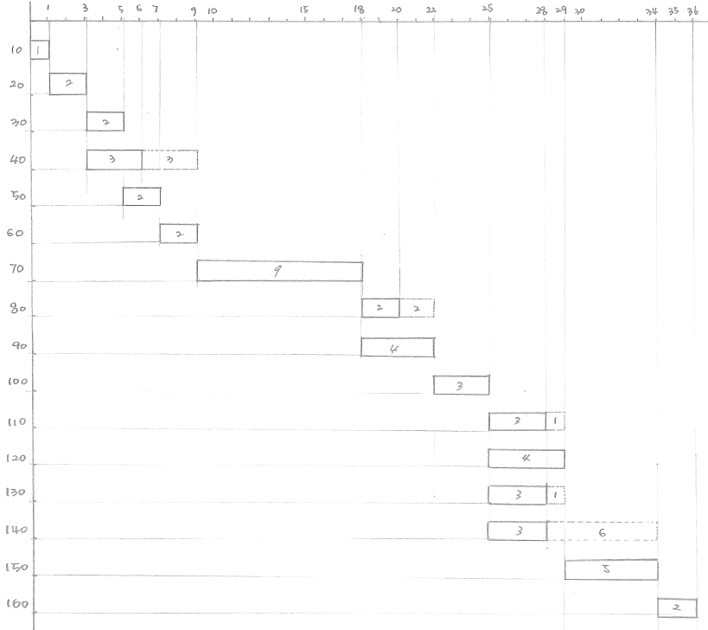
In-Class Scheduling Exercise
3. Develop a Gantt chart

